Slide 1
Predicting Total Enrollment at U.S. Higher Education Institutions
A Multiple Linear Regression Approach Using the 2013 IPEDS Dataset
Will Sanderfer • Taylor Dunkle
DS160-01 • Final Project

Slide 2
Project Overview
Predict total enrollment at U.S. higher education institutions from publicly available 2013 data.
Model type: Multiple Linear Regression (continuous target).
Dataset: IPEDS 2013, 1,534 institutions, 145 variables.
Why it matters: enrollment drives revenue, staffing, and capacity, so understanding its drivers is useful for administrators and prospective students alike.

Slide 3
The Dataset: IPEDS 2013
IPEDS = Integrated Postsecondary Education Data System (NCES).
Mandatory reporting for every institution in federal student aid programs.
Variable naming pattern:
IC2013 → admissions & academic data
HD2013 → institutional information (control, location)
SFA1213 → financial aid
EF2013 → enrollment figures
Target: Total enrollment. Range 66 to 77,338 students, median 3,127.

Slide 4
The Problem & Data Leakage
Avoiding data leakage
Target: Total enrollment.
Variables like Undergraduate, Graduate, Full-time enrollment are components of the target. Using them yields a fake-perfect model.
These variables are excluded from every feature set.
Honest predictors used
Numeric: Applicants, % Admitted, Tuition, SAT/ACT scores, Pell %, Graduation rate.
Categorical: Control of institution, Highest degree offered.

Slide 5
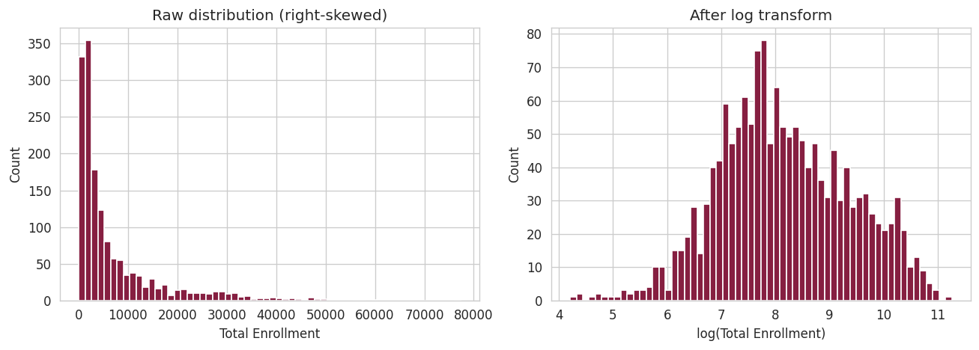
EDA: Target is Right-Skewed
Raw skewness = 2.49
Most schools are small; a long tail of mega-universities (77K+ students) pulls the mean far above the median.
log(1 + enrollment) → skew of 0.07
Nearly normal. Errors now interpretable multiplicatively.
All models use log target
R² reported on log scale; RMSE reported back-transformed to students.
Figure 1: Target distribution before and after log transform

Slide 6
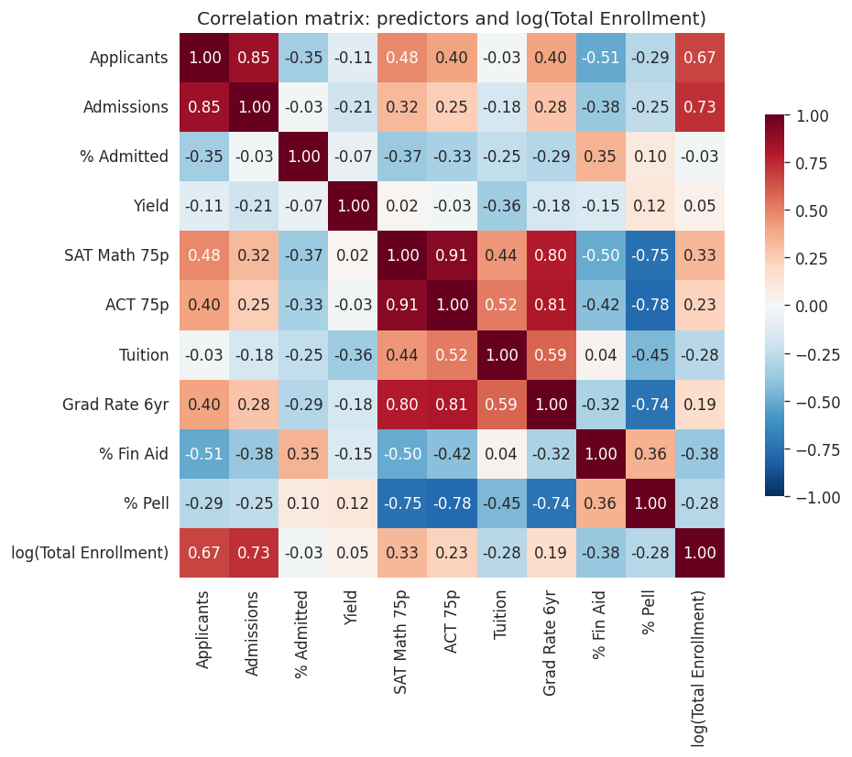
EDA: What Correlates with Enrollment?
Strong positive
Admissions (0.73), Applicants (0.67)
Moderate positive
SAT Math 75p (0.33), Graduation rate (0.19)
Negative
% Financial aid (-0.38), Tuition (-0.28), % Pell (-0.28)
Multicollinearity flags
SAT ↔ ACT: r = 0.91 | SAT ↔ Pell: r = -0.75
Kept one predictor from each correlated pair in Feature Set B.
Figure 2: Correlation matrix of predictors and log(Total Enrollment)

Slide 7
Data Preparation
Dropped 2 rows with missing target.
Applied log1p transform to the target.
Complete-case analysis per experiment (no imputation, since SAT is "missing for a reason").
One-hot encoded categoricals with drop_first=True.
StandardScaler fit on training set only, applied to both train and test.
Excluded enrollment-component variables to avoid data leakage.
Excluded Admissions total (redundant with Applicants × % Admitted).

Slide 8
Experimental Design
Two feature sets × two train/test splits = 4 experiments
Feature Set A (4 numeric): Applicants, % Admitted, Tuition, 6-yr Graduation Rate.
Feature Set B (A + 4): SAT Math 75p, % Pell, Control of institution, Highest degree offered.
Splits
Exp 1: Feature Set A, 80 / 20
Exp 2: Feature Set A, 70 / 30
Exp 3: Feature Set B, 80 / 20
Exp 4: Feature Set B, 70 / 30
All runs: scikit-learn LinearRegression, random_state=42, standardized features.

Slide 9
Results: Feature Set B Wins
Experiment | Features | Split | R² test | RMSE (log)
Exp 1 | Set A (4 numeric) | 80 / 20 | 0.588 | 0.698
Exp 2 | Set A (4 numeric) | 70 / 30 | 0.613 | 0.693
Exp 3 | Set B (6 num + 2 cat) | 80 / 20 | 0.776 | 0.538
Exp 4 | Set B (6 num + 2 cat) ← best | 70 / 30 | 0.780 | 0.538
Key takeaways
• Adding 2 categorical variables jumps test R² from ~0.59 to ~0.78. • 80/20 vs 70/30 split barely matters (< 0.01 R² difference), so the result holds up. • Best model MAE ≈ 3,700 students on the raw student scale.

Slide 10
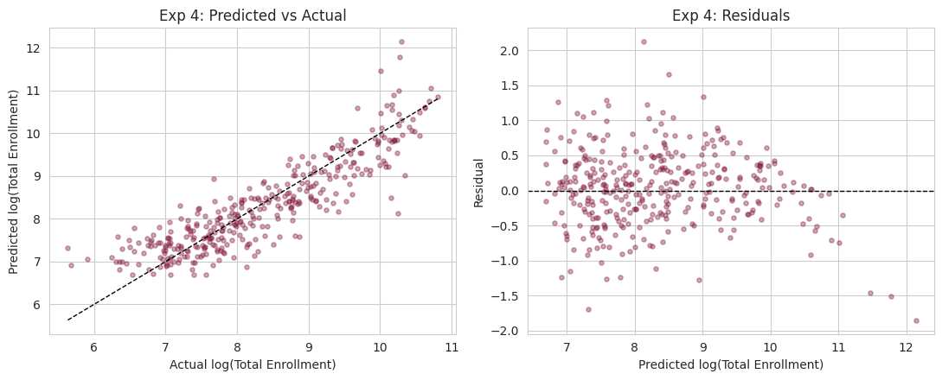
Best Model: Predicted vs. Actual
Top standardized coefficients (Exp 4)
Doctoral (research + practice): +0.59
Applicants total: +0.44
Control = Public: +0.38
Doctoral (research/scholarship): +0.35
Master's degree: +0.24
SAT Math 75p: +0.15
Institutional type matters most
Residuals show a mild fan. The model under-predicts the largest universities.
Figure 3: Predicted vs. Actual and Residuals (best model)

Slide 11
Conclusion & Future Work
What we learned
Simple OLS explains ~78% of variance in log(enrollment) on held-out data.
Institutional type (degree + control) matters more than any single numeric metric.
Log transform + avoiding data leakage were the two biggest wins.
Limitations
Under-predicts the largest universities; mild heteroscedasticity.
Complete-case analysis means results generalize only to SAT-reporting institutions.
Future work
Fit a Random Forest / Gradient Boosting regressor and compare.
Use multi-year IPEDS data to model enrollment growth rather than level.

