Slide 1
Docker Primer fundamentals
Part 1

Slide 2
What will we talk about?
Short Docker introduction
What is Docker?
Understanding Docker
How it compares to virtual machines
Practical class/tutorial
Docker Installation
Docker Hub
Creating/downloading an image
Creating a container
Updating application in container
Some useful commands for containers
Dockerfile – Custom Image
Docker advantages
More information

Slide 3
What is Docker?
Docker is a platform for developers and sysadmins to develop, ship, and run applications. Docker lets you quickly assemble applications from components and eliminates the friction that can come when shipping code. Docker lets you get your code tested and deployed into production as fast as possible.
Docker provides a way to run almost any application securely isolated in a container. The isolation and security allow you to run many containers simultaneously on your host.

Slide 4
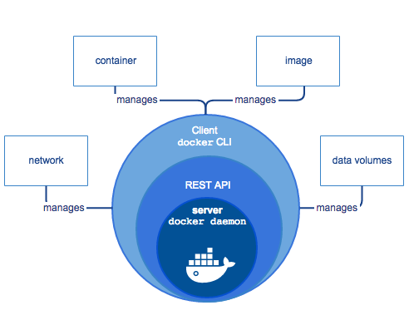
What is Docker Engine?
Docker Engine is a client-server application with these major components:
A server (daemon process).
A REST API which specifies interfaces that programs can use to talk to the daemon
A command line interface (CLI) client.
The CLI makes use of the REST API to control or interact with the daemon through scripting or direct CLI commands.
The daemon creates and manages Docker objects, such as images, containers, networks, data volumes, and so forth.
The user does not directly interact with the daemon, but instead through the Docker client.
The client, in the form of the docker binary, is the primary user interface to Docker. It accepts commands from the user and communicates back and forth with a Docker daemon.

Slide 5
Inside Docker
To understand Docker’s internals, you need to know about three resources:
Docker images
A Docker image is a read-only template. For example, an image could contain an CentOS operating system with Apache and your web application installed. Images are used to create Docker containers. Docker images are the build component of Docker.
Docker registries
Docker registries hold images. These are public or private stores from which you upload or download images. The public Docker registry is provided with the Docker Hub.
Docker containers
Docker containers are similar to a directory. A Docker container holds everything that is needed for an application to run. Each container is created from a Docker image. Docker containers can be run, started, stopped, moved, and deleted. Each container is an isolated and secure application platform. Docker containers are the run component of Docker.

Slide 6
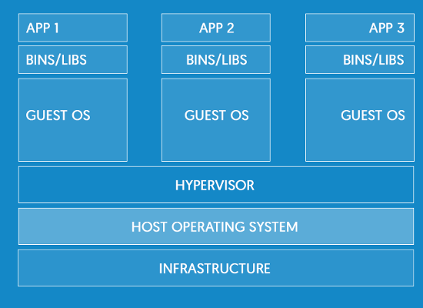
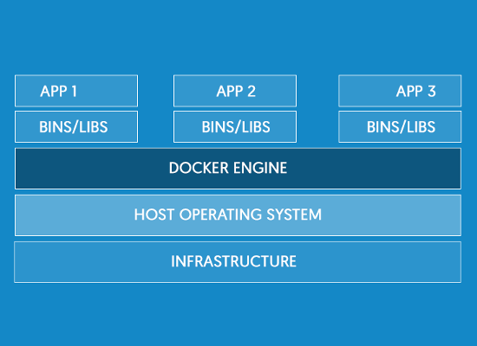
Containers vs Virtual Machines
Virtual Machine Architecture
Virtual Machine Architecture

Slide 7
Docker Installation
Notes for Barclays installation

Slide 8
Creating/downloading an image
Downloading an image
# docker image pull <image_name_like_ind_docker_registry>
# docker image ls
Multiple images
# docker image pull <other_image_name>
# docker image ls
Multiple versions of the same image
# docker image pull <image_name>:<version>
# docker image ls

Slide 9
Creating a container
Running a container
# docker image ls
# docker container run <image_name> (it will be in the foreground)
# docker container ls (-a)
Running a container in background
# docker container run -ti -d --name my_webserver httpd
# docker container ls (-a)
- try to open http://container_ip
Expose ports for access
# docker container run -ti -d -p 80:80 --name my_webserver httpd
Mount an external mount point inside container
docker container run -ti --name servidorweb -v /opt/external_mount/code/:/var/www/html:ro -d httpd
Access container’s Command Line
# docker container exec -ti my_webserver bash

Slide 10
Updating a container
Saving changed container to a new image
(Change website content)
# docker container commit findmore_apache findmore_apache:v2
# docker image ls
Export image to a file
# docker image save -o image_save.tar <image_name>
Export container to a file
# docker container export -o /home/container_save.tar <container_name>
(loses history, flattens image)
Run container with new version
# docker container stop <container>
# docker container rm <container>
# docker container run -ti -d -p 80:80 --name my_webserver findmore_apache:v2
Load a saved image
# docker image load -i <container_file>

Slide 11
Other Docker Commands
Events
# docker events
Inspect Container
# docker container inspect my_webserver
Logs - Container
# docker container logs my_webserver
History - Image
# docker image history findmore_web:v2

Slide 12
Dockerfile
Add docker file notes

Slide 13
Docker Advantages
Technical advantages
Lightweight
Containers running on a single machine share the same operating system kernel; they start instantly and use less RAM.
Images are constructed from layered filesystems and share common files, making disk usage and image downloads much more efficient.
Open
Docker containers are based on open standards, enabling containers to run on all major Linux distributions, Microsoft Windows, Apple macOS -- and on top of any infrastructure.
Secure
Containers isolate applications from one another and the underlying infrastructure, while providing an added layer of protection for the application.

Slide 14
Docker Advantages
Advantages for developers
No more “It works on my machine”
Accelerated Development
Stop wasting hours setting up developer environments, spinning up new instances, and making copies of production code to run locally.
With Docker, you simply take copies of your live environment and run them on any new endpoint running a Docker engine.
Eliminate environment inconsistencies
Packaging an application in a container with its configs and dependencies guarantees that the application will always work as designed in any environment: locally, on another machine, in test or production.
No more worries about having to install the same configurations into different environments.

Slide 15
Docker Advantages
Advantages for Operations Team
Less effort for maintaining environments
The creation of an environment is automated. Hence, less manual actions are necessary. This reduces the risks and increases the reliability.
Manually maintaining a consistent environment on multiple servers is error-prone and can be a nightmare. With Docker it’s easy to create several instances of an environment, because we just have to execute the image on the servers. This way it is easy to add further nodes to a cluster and to scale horizontally.
Easy updating
Using traditional approaches for setting up an environment (like install scripts) run into trouble when there is already an existing environment. Considering the update path in the script can be a very complex task (e.g. checking the existence of files and cleanup unused files). With Docker we don’t have to take an existing environment into account (except for the database). We just stop the running container and start the new updated one. This simplifies the setup because we always start with an empty environment.

Slide 16
Where can I get more information?
Docker Documentation: https://docs.docker.com
Understanding Docker: https://docs.docker.com/engine/understanding-docker/
Dockerfile
Dockerfile reference: https://docs.docker.com/engine/reference/builder/
CentOS Dockerfile examples: https://docs.docker.com/engine/reference/builder/
ENTRYPOINT vs ADD:
https://www.ctl.io/developers/blog/post/dockerfile-entrypoint-vs-cmd/
ADD vs COPY: https://www.ctl.io/developers/blog/post/dockerfile-add-vs-copy/

Slide 17
Thank you

Slide 18
Docker Primer fundamentals
Part 2

Slide 19
What will we talk about?
Microservices
Images & Dockerfiles
Docker Registry (Hub/Store, custom registry)
Networking
Volumes
Logging
Healthcheck
Interact with Containers
Docker Compose

Slide 20
IMPORTANT
Instead of a personal VM or Local Docker installation, you can (and should!) use Play With Docker: https://labs.play-with-docker.com (requires a free Docker Account)

Slide 21
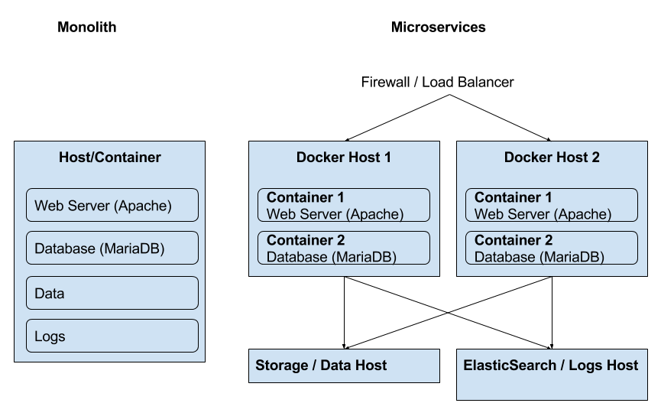
Monoliths vs Microservices

Slide 22
Monoliths vs Microservices
 | Monoliths | Microservices
Pros | Faster initial development Easier integration Easier local deployment | Easier to develop, understand, upgrade and maintain Starts faster Scales individually Easier fault isolation (ex: cpu/memory leaks) Not stuck with any stack
Cons | Stuck with same technology stack Difficult to share with other developers Difficult to scale Difficult to deploy to other environments | Slower initial development

Slide 23
Docker Images & Dockerfile
FROM debian:stretch
RUN apt update && \
apt -y install nginx && \
apt clean
#ADD index.html /var/www/html/
EXPOSE 80
VOLUME /var/html/www
CMD ["nginx", "-g", "daemon off;"]
A Docker Image is a template, whether of a basic operating system, of a microservice, or even of a full service (monolith).
Containers are always created from Docker Images.
Docker Images can be downloaded from a Docker Registry, such as Docker Hub, with pre-built microservices.
Docker allows us to create customized Docker Images, using a definition file, called Dockerfile.
Every Docker Image starts with a Dockerfile. So we can say that a Dockerfile is where everything begins, in Docker.
To create an image with any of these Dockerfiles, run this command on the same folder as the Dockerfile:
$ docker build -t my-nginx-image .
And then, to run the container:
$ docker run -tdi --name my-nginx -p 80:80 my-nginx-image
FROM nginx:1.15.8
RUN apt update && \
apt -y install iputils-ping && \
apt clean

Slide 24
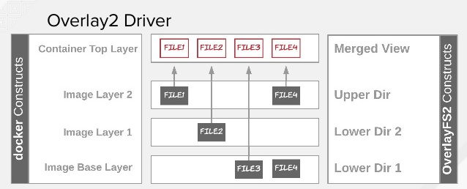
Docker Images & Layers
FROM debian:stretch
RUN apt update && \
apt -y install nginx && \
apt clean
#ADD index.html /var/www/html/
EXPOSE 80
VOLUME /var/html/www
CMD ["nginx", "-g", "daemon off;"]
A Docker image consists of read-only layers each of which represents a Dockerfile instruction. The layers are stacked and each one is a delta of the changes from the previous layer.
$ docker image history my-nginx-image
When we create a new container, we add a new and thin writable layer on top of the underlying stack of layers present in the base docker image. All changes made to the running container, such as creating new files, modifying existing files or deleting files, are written to this thin writable container layer.

Slide 25
Docker Images & Layers
FROM debian:stretch
LABEL maintainer="Luis Nabais <luis.nabais@findmore.pt>"
RUN apt update && \
apt -y install nginx && \
apt clean
#ADD index.html /var/www/html/
EXPOSE 80
VOLUME /var/html/www
CMD ["nginx", "-g", "daemon off;"]
OverlayFS Filesystem
To allow layers on the filesystem, Docker uses a storage driver, called OverlayFS (also known as overlay or overlay2), which is integrated into Linux Kernel. Older driver was AUFS.
OverlayFS is a modern union filesystem, which allow one, usually read-write, directory tree to be overlaid onto another, read-only directory tree. All modifications go to the upper, writable layer. All of them are them read as one.
You can check the default storage driver, with the command:
$ docker info

Slide 26
Docker Images - Dockerfile examples
FROM node:carbon
WORKDIR /usr/src/app
COPY package*.json ./
RUN npm install
COPY . .
EXPOSE 8080
CMD [ "npm", "start" ]
Multi-Stage Builds
Docker also supports multi-stage builds, where the first stage creates a temporary image, which is used to build/compile and the second to integrate what was built, onto a final Docker Image.
FROM maven:3.5.2-jdk-9 AS build
COPY src /usr/src/app/src
COPY pom.xml /usr/src/app
RUN mvn -f /usr/src/app/pom.xml clean package
FROM openjdk:9
COPY --from=build /usr/src/app/target/flighttracker-1.0.0-SNAPSHOT.jar /usr/app/flighttracker-1.0.0-SNAPSHOT.jar
EXPOSE 8080
ENTRYPOINT ["java","-jar","/usr/app/flighttracker-1.0.0-SNAPSHOT.jar"]
FROM openjdk:8-jdk
VOLUME /tmp
COPY build/libs /app
ENTRYPOINT ["java", "-jar", "/app/java-example.jar"]

Slide 27
Docker Registry
What is a Docker Registry? A Docker registry is a centralized storage and distribution system for named Docker images.
Is organized into Docker repositories, where a repository holds all the versions of a specific image. The same image might have multiple different versions, identified by their tags.
Docker Hub
By default, the Docker engine interacts with Docker Hub (https://hub.docker.com), Docker's public registry.
However, it is possible to run on-premise the open-source Docker registry/distribution, as well as a commercially supported version called Docker Trusted Registry. There are other public registries available online.
Docker Hub allows 1 free private image per user, but doesn’t have any limit on pulled (downloaded) images.
There are other pricing plans, as usual.
Pull Image from Docker Hub
$ docker image pull mariadb:10.3.13
Push image to Docker Hub *
$ docker image push repository-name/image-name:tag
Login user to Docker Hub *
$ docker login

Slide 28
Docker Registry
Custom Docker Registry
A custom Docker Registry allows unlimited private Docker Images, usually on a custom managed infrastructure.
The easiest way to create a Registry is to use the official Docker Registry container, like this:
$ docker image pull registry:2.7.1
$ docker container run -d --name registry -p 5000:5000 registry:2.7.1
There are more external applications which can be downloaded, integrated into existing infrastructures and used as Custom Registries.
List repositories on custom registry
$ curl localhost:5000/v2/_catalog
Pull image from custom registry
$ docker image pull localhost:5000/mariadb:10.3.13
Push image to custom registry *
$ docker image tag mariadb:10.1.13 localhost:5000/mariadb:10.3.13
$ docker image push localhost:5000/mariadb:10.3.13
Login user to custom registry *
$ docker login server-host:server-port
* After making sure user is registered on the Docker Hub website, if it is a private Docker Registry with user registration.

Slide 29
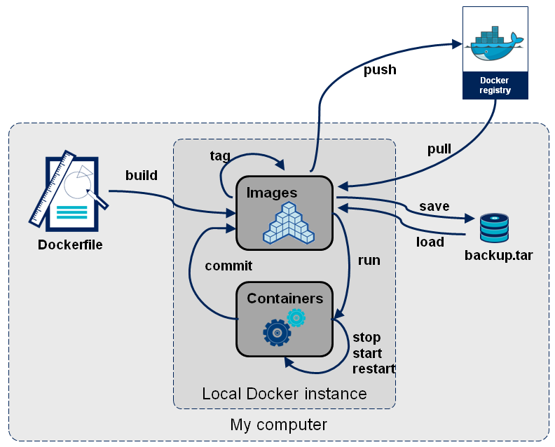
Docker Images Workflow

Slide 30
Docker Networks
Containers need networking to:
communicate with the outside
communicate among themselves
Be isolated from other containers
Be completely isolated
Port exposure
Port Binding
Docker takes care of networks out of the box, as it creates three networks automatically:
$ docker network ls
NETWORK ID NAME DRIVER SCOPE
e22d0e10deb3 bridge bridge local
276b6fb8ee09 host host local
55946e2e5ced one null local
bridge: the default network for all containers
host: this network exactly matches the host network
none: containers connected to this network will only have a loopback interface

Slide 31
Docker Networks - Drivers
Bridge
The default network driver. If no driver is specified, this is the type of network created.
The default bridge network also called “system bridge network” is also the default network for every container if you don’t specify a network.
IMPORTANT: This is not a bridged connection!
The bridge network is a standalone network with its own router (the Docker Engine).
Each container attached to this type of network is assigned its own private IP address which is not reachable from the outside by default. When the container needs to request outer resources it sends packets through the default gateway (the Docker Engine).
Communication from outside to container
To access a container from the outside of the Docker Engine, we need to expose a port on the Docker Host:
$ docker run -tdi --name my-nginx -p 80:80 nginx
Communication between containers on the same default bridge connection
Containers attached to the default bridge connection can communicate by default using IP addresses, but they can’t communicate using DNS.
This handy behavior can be obtained using user-defined bridge networks, which have a feature called automatic service discovery. This feature allows containers to resolve names into IPs of other containers connected to the same network, much like a local DNS server.

Slide 32
Docker Networks - Drivers
Host
This is basically a bridged network, as we usually know it.
It removes network isolation between the container and the Docker host, and use the host’s networking directly, sharing the networking stack with the host.
This means a container exposing port 80 will automatically bind to hostIP:80 (without the need of -p). If the container has no port exposed using the host network is meaningless.
The host network does not connect the container directly to the physical network of the host. The container doesn’t appear as a physical device in the network. The host network is still a classical bridge, it bridges the container to the host rather than the host physical interface.
Macvlan
Macvlan networks are also bridged networks, which allow us to assign a MAC address to a container, making it appear as a physical device on your network.
The Docker daemon routes traffic to containers by their MAC addresses. Using the macvlan driver is sometimes the best choice when dealing with legacy applications that expect to be directly connected to the physical network, rather than routed through the Docker host’s network stack.
None
Disable all networking, except loopback (127.0.0.1).
Usually used in conjunction with a custom network driver, or for some background tasks, like generate a report, or to integrate in CI/CD workflows.

Slide 33
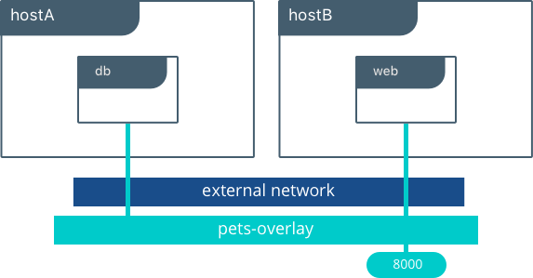
Docker Networks - Drivers
Overlay
Overlay networks connect multiple Docker daemons together and enable swarm services to communicate with each other.
We can also use overlay networks to facilitate communication between a swarm service and a standalone container, or between two standalone containers on different Docker daemons. This strategy removes the need to do OS-level routing between these containers.
Network plugins: You can install and use third-party network plugins with Docker. These plugins are available from Docker Hub or from third-party vendors. See the vendor’s documentation for installing and using a given network plugin.

Slide 34
Docker Networks - User-defined Networks
Creating a User-defined Network
$ docker network create --driver bridge --subnet 172.49.0.0/16 frontend
As bridge is the default driver, the option is not needed in the command.
The subnet is automatically configured, so it’s not mandatory as well.
So the command could just be only:
$ docker network create frontend
Starting a container on a specific network
When containers are created, can be associated with the networks, using the --network flag in the run command.
$ docker run -tdi --name my-nginx --network frontend nginx bash
Assign a network to a running container
$ docker network connect frontend my-nginx
Removing a User-defined Network
$ docker network rm frontend
Inspect a Network
$ docker network inspect frontend
Notes:
TASKS:
Create 2 containers with ping and try to ping between them by name
Talk about conflicts with (mainly automatically generated) subnets - relembrar problema na Indra

Slide 35
Persistent Data
By default, Docker containers do not store persistent data.
Any data written to a container's writable layer will no longer be available once the container stops running. Also, getting data written to a container back out of it for another process can be difficult. To solve the issue of persisting data from a container, Docker has two options.
Bind mounts
A bind mount is a file or folder stored anywhere on the Docker Host filesystem, mounted into a running container.
As the file or folder can exist anywhere on the host filesystem, processes outside of Docker can also modify it. A disadvantage is that it prevents an easy way of integrate with other processes, like backups, as it can be very disorganized, spread among the Host filesystem.
Volumes
Volumes are the preferred way to store persistent data Docker containers create or use. The Docker Host filesystem also stores volumes, similar to bind mounts. However, Docker completely manages them and stores them under a Docker internal directory (/var/lib/docker/volumes, in case of Linux).

Slide 36
Persistent Data
Both provide several useful features for persistent or shared data:
Can be shared and reused among containers.
Changes will not be included when and image is updated.
Persist even if the container itself is deleted.
Allows for troubleshooting (ex: view logs or edit configuration files which prevent service from starting)
Docker never automatically deletes volumes when you remove a container, nor will it “garbage collect” volumes that are no longer referenced by a container.

Slide 37
Persistent Data
Listing volumes
$ docker volume ls
Creating volumes
$ docker volume create nginx-conf
Assign to containers
This option is only available during container creation, using -v or --mount flags: $ docker run -tdi --name my-nginx -v nginx-conf:/etc/nginx/conf.d -p 80:80 nginx
$ docker run -tdi --name my-nginx --mount type=volume,source=nginx-conf,target=/etc/nginx/conf.d -p 80:80 nginx
Bind mounts can also be assigned to containers during creation, using the same -v or --mount flags:
$ docker run -tdi --name my-nginx -v /home/user/docker-data/nginx-conf:/etc/nginx/conf.d -p 80:80 nginx
$ docker run -tdi --name my-nginx --mount type=bind,source=/home/user/docker-data/nginx-conf:,target=/etc/nginx/conf.d -p 80:80 nginx
-v or --mount?
Using -v or --mount is a personal choice option, none is deprecated. The --mount flag is more explicit and easier to read and required for specific volume drivers, but using -v for local volumes is easier to manage.
Third Party Drivers
There are many external drivers which can be integrated with Binds/Volumes, such as AWS S3, GlusterFS, DigitalOcean Block Storage, among many others. Research Volume Plugins.
Notes:
TASK: Example troubleshooting with bad nginx Conf

Slide 38
Docker Logs
Docker incorporates a basic logging system.
If app is running as a true microservice, in foreground, logs will be available in a JSON file, on Docker file structure, in:
/var/lib/docker/containers/<container id>/<container id>-json.log
which can be seen using the command, which shows all logs for the container, since it was created:
$ docker logs nginx
or can be seen only the last 100 lines using the command:
$ docker logs nginx --tail=100
or even can be seen live using the command:
$ docker logs nginx -f
All options can combined, as this example shows:
$ docker logs nginx --tail=100 -f

Slide 39
Docker Logs
Logging Drivers
As usual, Docker allows third-party drivers to redirect logs to external logging management systems.
Logging drivers can be configured for all containers, using the Docker Host configuration:
{ "log-driver": "syslog" } - (in /etc/docker/daemon.json)
or for a specific container:
$ docker run -it --log-driver none alpine ash
Common third-party logging drivers:
none No logs are available for the container and docker logs does not return any output.
json-file The logs are formatted as JSON. The default logging driver for Docker. All logs are lost when container is removed.
local Writes logs messages to local filesystem in binary files using Protobuf.
syslog Writes logging messages to the syslog facility.
journald Writes log messages to journald.
gelf Writes log messages to a Graylog Extended Log Format (GELF) endpoint such as Graylog or Logstash.
fluentd Writes log messages to fluentd (forward input).
awslogs Writes log messages to Amazon CloudWatch Logs.
splunk Writes log messages to splunk using the HTTP Event Collector.
etwlogs Writes log messages as Event Tracing for Windows (ETW) events. (Windows only)
gcplogs Writes log messages to Google Cloud Platform (GCP) Logging.
Notes:
Fazer uma demonstração dum log com journald

Slide 40
Docker Healthcheck
Healthcheck is an instruction configured on Dockerfile, which reports the service status on the containers to Docker Engine.
The command’s exit status indicates the health status of the container. The possible values are:
0: success - the container is healthy and ready for use
1: unhealthy - the container is not working correctly
2: reserved - do not use this exit code
When a container has a health check specified, it has a health status in addition to its normal status. This status is initially starting. Whenever a health check passes, it becomes healthy (whatever state it was previously in). After a certain number of consecutive failures, it becomes unhealthy.
We can check the container health status by using the simple command
$ docker ps
And notice the extra column with the health status.
This can be integrated with monitoring systems to automatically restart or rebuild containers in case of failure.
HEALTHCHECK --interval=5m --timeout=3s --retries=3 CMD curl -f http://localhost/ || exit 1

Slide 41
Interact with Docker Containers
Copy
$ docker cp index.html nginx:/var/www/html/
$ docker cp nginx:/var/www/html/index.html .
If we copy the files to a folder which is associated to a volume, the files will be added to the volume, therefore, will be persistent.
We can also copy the files manually to the volume folder, and they will automatically show up on the container.
Exec
$ docker exec -ti nginx bash (use sh instead of bash if container doesn’t contain bash)
Attach
$ docker attach nginx
Use CTRL+c to stop container (SIGKILL)
Use CTRL+p & CTRL+q to detach and leave container running
Update
$ docker container update --restart always my-nginx
$ docker container update --cpus 1 my-nginx
$ docker container update -m 512m my-nginx
Stats
$ docker stats
$ docker container stats container_name
Notes:
Falar sobre attach?

Slide 42
Docker Compose
In the words of Docker Inc.:
“Compose is a tool for defining and running multi-container Docker applications. With Compose, you use a YAML file to configure your application’s services. Then, with a single command, you create and start all the services from your configuration.”
Docker Compose uses a Compose File, which allows the automation of the most common operations:
Container creation
Network creation
Port exposing/binding
Container linking
Volume/bind linking
Microservice scaling
But also some more advanced operations:
Add environment variables
Customize DNS Servers
Add entries to hosts
Add labels
Add service dependencies (on the same file)
version: '3'
services:
web:
build: .
ports:
- "80:80"
volumes:
- "nginx-conf:/etc/nginx/conf.d"
postgres:
image: "postgres:10.7"
Notes:
https://docs.docker.com/compose/wordpress/
https://docs.microsoft.com/en-us/dotnet/standard/microservices-architecture/multi-container-microservice-net-applications/multi-container-applications-docker-compose
https://devhints.io/docker-compose

Slide 43
Docker Compose
Some Docker Compose common commands
$ docker-compose build
$ docker-compose pull
$ docker-compose push
$ docker-compose up
$ docker-compose ps
$ docker-compose exec
$ docker-compose logs
$ docker-compose start
$ docker-compose stop
$ docker-compose restart
Some specific commands
$ docker-compose up -d
$ docker-compose logs -t
$ docker-compose logs --tail=10
$ docker-compose logs -f
$ docker-compose logs -t --tail=100 -f
$ docker-compose scale web=2 worker=3
$ docker-compose kill
$ docker-compose events
$ docker-compose down --volumes
version: '3'
services:
web:
build: .
image: my-nginx:1.0
ports:
- "80:80"
volumes:
- "nginx-conf:/etc/nginx/conf.d"
postgres:
image: "postgres:10.7"

Slide 44
Docker Compose
Some Notes & Best Practices
Docker Compose can interact with Dockerfiles for the services, if contains the build parameter
Automatically uses the image parameter for the build for naming and tagging the image
We can (and should) use a file with variables, called .env, for better organization
IMAGE_NAME=my-nginx
IMAGE_VERSION=1.0
CONTAINER_NAME=my-nginx
version: '3'
services:
web:
build: .
image: ${IMAGE_NAME}:${IMAGE_VERSION}
restart: always
container_name: ${CONTAINER_NAME}
hostname: ${CONTAINER_NAME}
ports:
- "80:80"
volumes:
- "nginx-conf:/etc/nginx/conf.d"
postgres:
image: "postgres:10.7"

Slide 45
Where can I get more information?
Docker Documentation: https://docs.docker.com
Docker Overview: https://docs.docker.com/engine/docker-overview/
Networks: https://docs.docker.com/network/ Storage (Binds/Mounts): https://docs.docker.com/storage/
Dockerfile: https://docs.docker.com/engine/reference/builder/
Docker Compose: https://docs.docker.com/compose/
Notes:
Demonstrar como abrir as organizations no GitHub

