Slide 1


Core Principles of Programming with python
Week 3

Slide 2
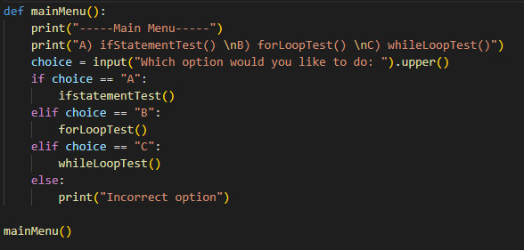
Main Menu
An example of a main menu using last weeks code is:
Remembering to use .upper() for validation.
A main menu is what is displayed at the start of any program.
It should be kept in a function and mainly includes an IF statement.

Slide 3
Activity
Help
Remember to use IF and ELIF statements for each option as the ELSE statement should be used if the user enters anything that isn’t an option.
Also remember to use .upper() as a basic form of validation.
Using what you have just learnt,
Create a main menu for your code from last week.

Slide 4
First Project Layout
To achieve this, we will be using the import command to import into our project, our first Python library.
The layout of the project will be:
Main Menu
Rock Paper Scissors against AI
Tic Tac Toe against either AI or another player

Slide 5
Setup Activity
Further activity
Try and place the main menu in a while loop for validation, that is only exited if the user inputs the exit choice of the menu.
Before we get ahead of ourselves:
Create a new folder called “Python Game Project”.
Create a new file called “main.py”
Create a function for the main menu with three options:
Rock Paper Scissors
Tic Tac Toe
Exit
Create two functions:
rockpaperscissors()
tictactoe()
The main menu should call these functions respectively

Slide 6
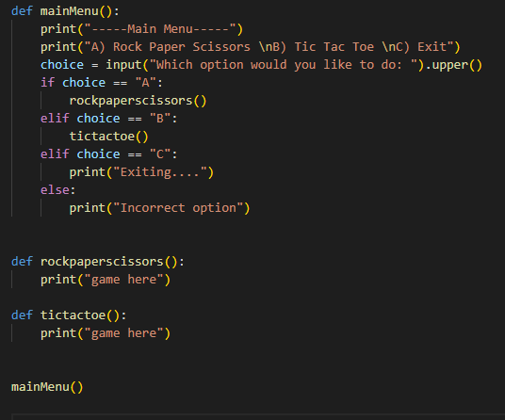
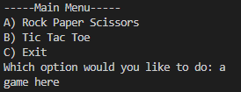
The main menu should look like this
Console output:

Slide 7
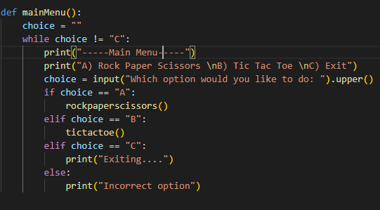
The Further activity main menu should look like this
Console output:

Slide 8
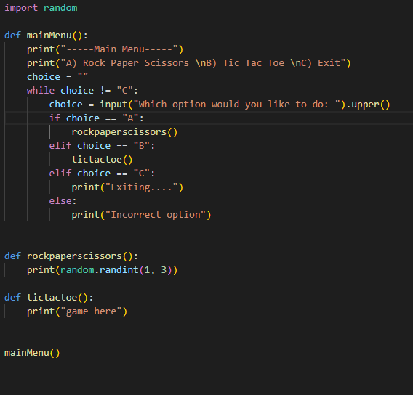
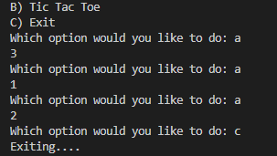
Random Library
An example of the random and random.randint() code is:
This code will print a random number of either 1, 2, or 3.
A library is a collection of prewritten python functions that we can use.
The one we will be using today is the “random” library.
Standard practice is to place all your imports at the top of the code.
Random.randint() is the command to pick a number between the first integer and the second integer (including both of them).

Slide 9
Rock Paper Scissors
Help
Compare the users input with numbers to make your life easier
Remember “AND” for comparing values in the IF statement.
There will be a lot of IF statements in this program so do not worry if you have a lot.
Also remember to use .upper() as a basic form of validation.
Now is the time to flex your skills.
I will let you guys crack on but here is how I would lay out the program:
Import random
Ask the user what they would like to pick
Print what the computer decided on (1 = Rock, 2 = Paper, 3 = Scissors)
Compare the two values
Print if it is a win, lose or draw
Ask the user to play again (optional)
Return to main menu

Slide 10
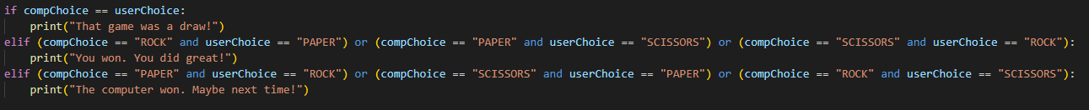
Rock Paper Scissors
Help
Import random
Ask the user what they would like to pick
compChoice = Randint(1,3)
Convert that to a words
Print what the computer decided on (1 = Rock, 2 = Paper, 3 = Scissors)
Compare the two values
Print if it is a win, lose or draw
Ask the user to play again (optional)
Return to main menu
For more help here is the comparison code:

Slide 11
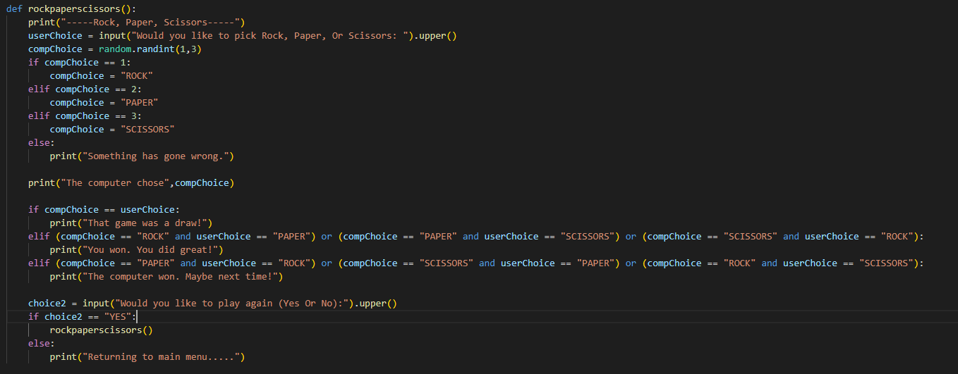
Rock Paper Scissors
Here is the full code:

Slide 12

Arrays
An example of an array is:
An array is a special variable that can be used to store multiple values in one single variable.
To access a value in the array you would write the arrays name and then the index of the value you want in square brackets.
0 1 2 3
This would print the word “Is” as the first value of the array is called 0.

Slide 13
Tic Tac Toe
Help
Print the table with “–” and “|”
Use board[x] to pick a certain value in the list.
Having the win conditions in a test function will help you repeatedly check if anyone has won.
Also remember to use numbers for the nine slots.
Now this is the ultimate challenge.
How I would go about it:
Create a Board Array to store what spots are empty.
PrintTable() Function
Pick which player one, will be (X or O)
Compare the win conditions of the slots
When the board is filled, print it was a draw.
Ask the user to play again (optional)
Return to main menu

Slide 14
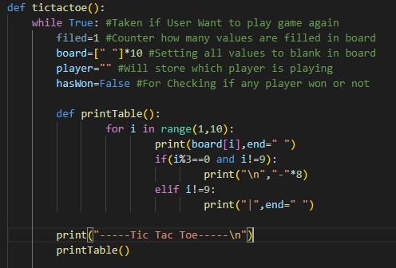
Tic Tac Toe
Help
Here is some code for printing the board:
How I would go about it:
Create a Board Array to store what spots are empty.
PrintTable() Function
Pick what player one will be (X or O)
Compare the win conditions of the slots
When the board is filled, print it was a draw.
Ask the user to play again (optional)
Return to main menu

Slide 15
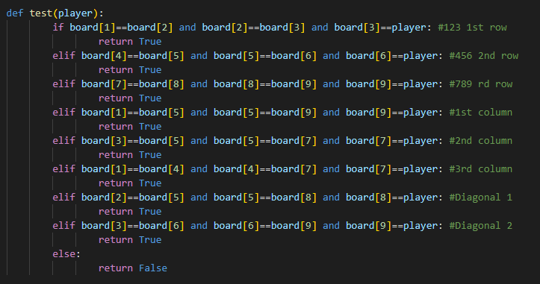
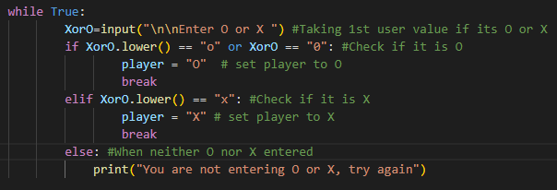
Tic Tac Toe
Help
The win conditions for Tic-Tac-Toe:
Here is some code for validation:

Slide 16
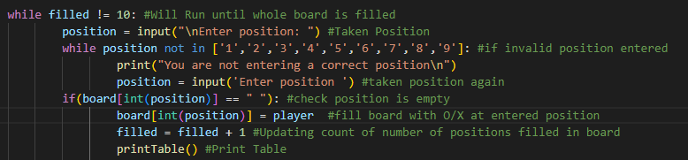
Tic Tac Toe
Here is the code for entering a position:

Slide 17
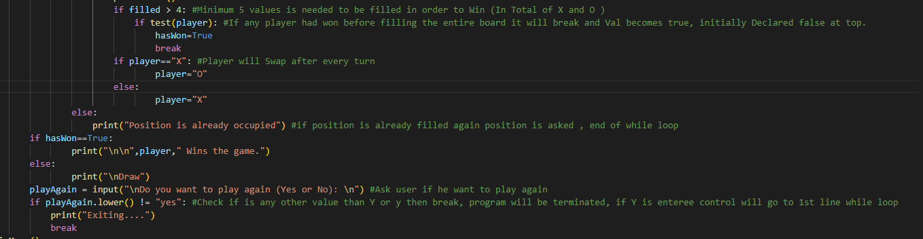
Tic Tac Toe
Here is the code for:
Checking if anyone has won
Swapping between players
And asking the user if they want to play again.

Slide 18
Home Activity
Combining what you have learnt today,
Try and make a computer opponent version of Tic-Tac-Toe using randint() to pick their turns.

Slide 19

End of week Three
And have a good Christmas

