Slide 1
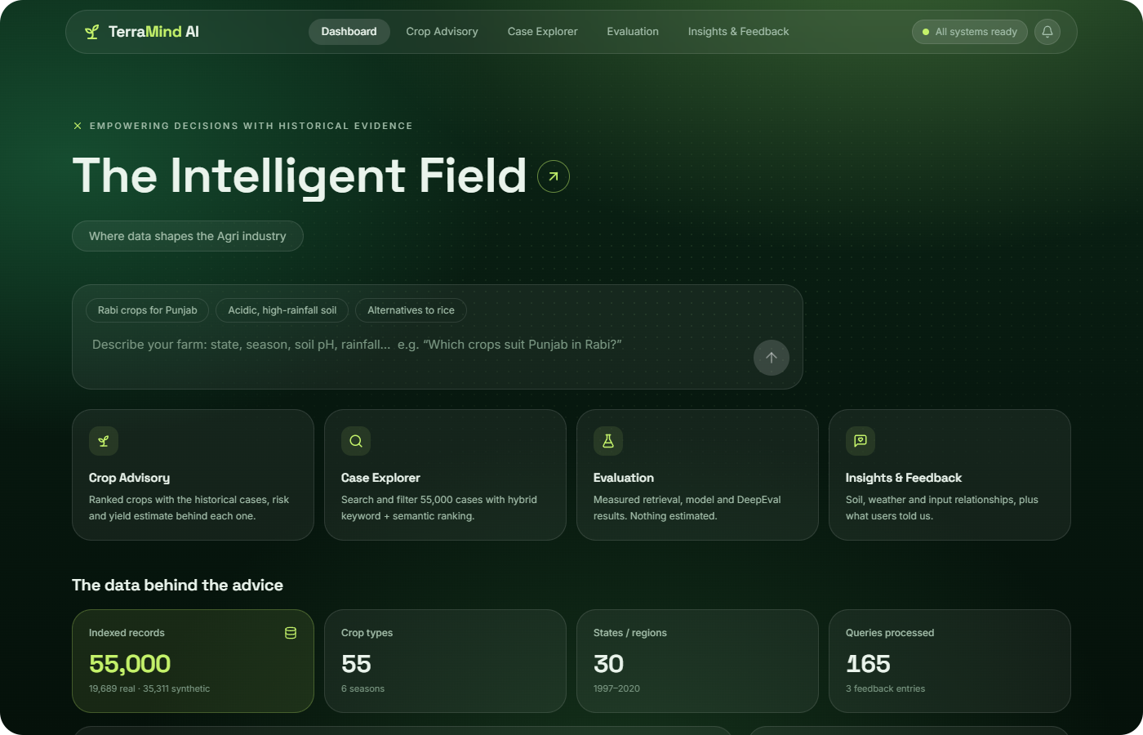
TerraMind AI
CAPSTONE PROJECT
AI-powered crop advisory assistant
Smarter crop decisions. Evidence-driven farming.
Hybrid RAG
7 AI agents
Yield model
LLM-as-judge
Notes:
Introduce TerraMind AI: a crop advisory assistant that answers natural-language farming questions with evidence drawn from real historical cases. One line on the motivation: advisers need fast, traceable answers.

Slide 2








Plain-language questions in, evidence-backed crop advice out
AT A GLANCE
55,000
7
0.968
31 / 31
cases indexed
cooperating agents
yield model R²
test cases passed
19,689 real + 35,311 labelled synthetic
coordinated by one orchestrator
held-out 2018–2020 · baseline 0.836
MRR 1.000 · Hit rate@10 1.000
HOW IT WORKS
Ask
Retrieve
Advise
Describe the farm in plain language: state, season, soil, rainfall.
Find comparable historical cases with hybrid keyword + semantic search.
Get ranked crops with supporting cases, risk and a labelled yield estimate.
Notes:
Executive summary. Four numbers to remember: 55,000 indexed cases (with the real/synthetic split stated up front), 7 agents, R² 0.968 on a held-out future period, and 31/31 evaluation test cases passed.

Slide 3





Crop decisions rely on records nobody can search quickly
01 · PROBLEM
Rich data, hard to use
Thousands of historical records: crop, season, state, soil, weather, inputs and yield.
QUESTIONS ADVISERS ASK
Which crops did well under conditions like mine?
Slow, inconsistent lookup
Finding comparable farming cases by hand takes time and varies by person.
Why do yields differ between similar farms?
Advice without evidence
What alternative crop fits my season and region?
Recommendations rarely point back to the cases that justify them.
Goal: natural-language questions in, evidence-backed crop advice out, with every claim traceable to real cases.
Notes:
Frame the pain: manual search through records. Emphasise traceability: the goal is not just an answer, but an answer you can check against real cases.

Slide 4




What advisers and farmers need from the tool
02 · BUSINESS NEED
Speed and consistency
Transparent evidence
Faster crop-selection discussions that give the same quality of answer every time, for advisers and farmers alike.
Every recommendation shows the historical cases behind it, so users can check the reasoning themselves.
Honest uncertainty
Safe by design
Observed yield is kept separate from model estimates. The tool never promises an outcome.
Guardrails, input validation and an LLM judge check every answer before advice is shown.
Notes:
Four requirements shaped every design decision: speed, transparency, honesty about uncertainty, and safety.

Slide 5





Hybrid RAG and multi-agent reasoning over real cases
03 · SOLUTION OVERVIEW
Hybrid retrieval
Seven agents
Analytics models
BM25 + semantic search fused by RRF, with metadata filters over historical cases.
Specialised agents behind one orchestrator, with failure isolation.
Trained yield model, rule-based suitability risk, soil/weather/input impact.
Claude
Full-stack app
Built-in evaluation
Query understanding, grounded explanations and LLM-as-judge validation.
FastAPI backend and React dashboard with a persistent feedback loop.
Retrieval metrics, model metrics and DeepEval in one reproducible pipeline.
Notes:
Six building blocks. Retrieval and the agent layer are the core (highlighted); models, Claude, the app and the evaluation pipeline support them.

Slide 6




55,000 cases: real Kaggle records plus labelled synthetic rows
04 · DATASET AND PREPROCESSING
55
DATA-HANDLING RULES
crops
Synthetic rows are flagged, badged in the UI and excluded from model testing and statistics.
55,000
Soil N/P/K/pH are state-level constants; weather is state-year. Both are joined and labelled as such.
30
total rows
states
Stable case IDs and quality flags; outliers inspected, not deleted.
1997–2020
years covered
Yield ≈ production / area; units are crop-specific.
Source: Kaggle, “Crop Yield Data with Soil and Weather Dataset” (CC0). All 19,689 source rows passed validation.
Notes:
Be upfront: only about 36% of rows are real. Synthetic rows are there to exercise retrieval at scale, are always labelled, and never touch model testing or reported statistics.

Slide 7

Five layers from raw data to the advisory dashboard
05 · ARCHITECTURE
1
Data
2
Prep + index
3
Multi-agent advisory
4
API (FastAPI)
5
React UI
Kaggle crop_yield.csv
19,689 rows
Validate, clean, dedupe,
merge → 55,000 cases
Orchestrator
stage status, isolation
/advisory
jobs + stage polling
Dashboard
Crop Advisory
State soil (30 states)
+ state-year weather
MiniLM embeddings
+ BM25 → FAISS index
A1–A3 classify,
retrieve, recommend
/cases /predictions
/analysis
Case Explorer
Evaluation
SQLite: queries,
feedback, eval runs
Yield model training
HGB vs RF vs baseline
A4–A6 risk, yield, impact
A7 validation + judge
/evaluations /feedback
/system
Insights &
Feedback
Feedback loop: user feedback → SQLite → review candidates → human verification → new evaluation cases → re-run evaluation (no automatic retraining)
Notes:
Walk left to right: data, preparation and indexing, the multi-agent core, the FastAPI layer and the React UI. Security: retrieved records are passed to Claude as untrusted data blocks and the API key never leaves the backend.

Slide 8
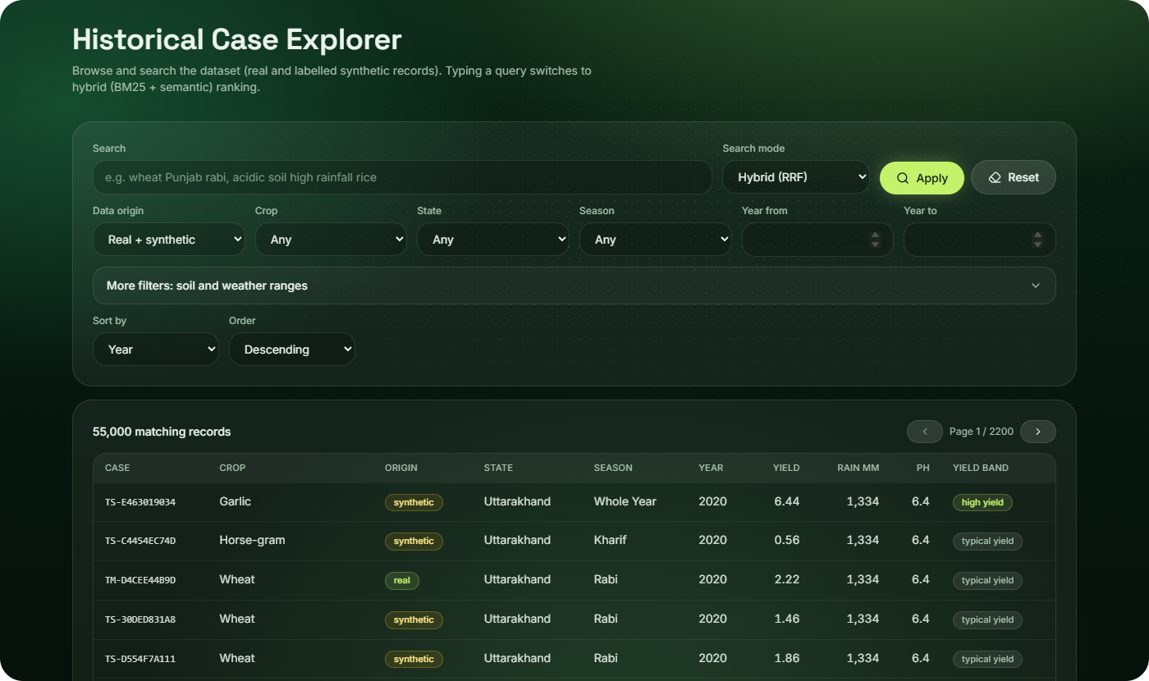

Finding comparable cases, not just similar text
06 · HYBRID RETRIEVAL
1
Chunk
One CSV row = one case = one chunk. Short structured rows are never split.
2
Filter
Metadata filters first: crop, season, state, year and numeric ranges.
3
Search + fuse
BM25 keywords and MiniLM embeddings (persistent FAISS index), fused by RRF.
4
Prioritise
Relevance + crop/season/region match + soil/weather similarity + completeness.
RRF score = Σ 1 / (60 + rank)
Resilient: if one search backend is down, the other answers and the UI shows a visible notice.
A ranking score, not a probability. Yield is never a ranking input.
Notes:
Explain why hybrid: keywords catch exact crop/state names, embeddings catch paraphrases. Filters run before ranking so results always respect hard constraints. RRF with k = 60 merges the two ranked lists.

Slide 9

Seven specialised agents behind one orchestrator
07 · AGENT COLLABORATION
Orchestrator tracks stage status and isolates failures
RUN IN PARALLEL
4
Suitability
Rule-based historical-envelope risk
1
Classifier
2
Retrieval
3
Recommender
7
Validation
5
Yield
Regex + Claude extract conditions, with provenance for every value
Hybrid search, filters and prioritisation
Groups evidence by crop and explains it
Deterministic checks + Claude LLM-as-judge before advice is shown
Trained regressor + 10–90% interval
6
Impact
Correlations, groups, permutation importance
A failing optional agent (4–6) never discards the results of the others.
Notes:
Agents 1 to 3 run in sequence. Agents 4 to 6 run in parallel; a failing optional agent does not discard the others. Agent 7 validates everything before advice reaches the user.

Slide 10
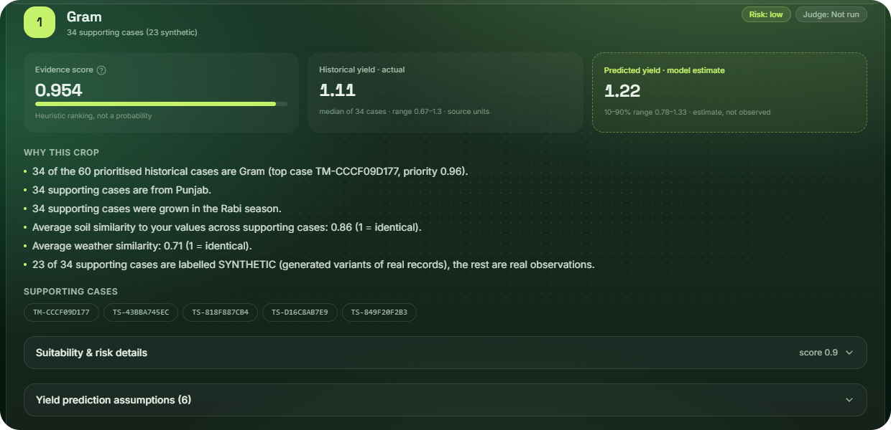

Each recommendation shows its evidence and an honest estimate
08 · RECOMMENDATION AND YIELD PREDICTION
Yield model
HistGradientBoosting on log1p(yield) · temporal split: train ≤ 2014, test 2018–2020
0.968
0.956
R² on held-out test · baseline 0.836
R² on log scale
10.05
151.2
EVERY RECOMMENDATION INCLUDES
MAE · source units
RMSE · source units
Reasons
Supporting case IDs
Actual historical yield
Predicted yield (estimate)
Risk level
Judge verdict
10–90% interval covers 70% on test (nominal 80%). Slight under-coverage, reported as is.
Notes:
Stress that predicted yield is always labelled as a model estimate, separate from observed historical yield. The temporal split tests on future years the model never saw. Interval coverage is honestly reported below nominal.

Slide 11


Measured, not estimated: strong retrieval, every test passed
09 · EVALUATION RESULTS
31 / 31
test cases passed · labels verified against the dataset
DeepEval (4 metrics) and LLM judge: Not evaluated. They need Claude credit, which was unavailable in the recorded run, so they are reported as missing rather than estimated.
Pass rule: R-precision, because Precision@10 is capped when only 3–4 relevant cases exist. Disclosed in the report.
Notes:
All numbers come from run eval-20261009-161607. Precision@10 looks lower only because many queries have just 3 or 4 relevant cases; MRR and hit rate are perfect. DeepEval was not run, and we say so instead of estimating.

Slide 12
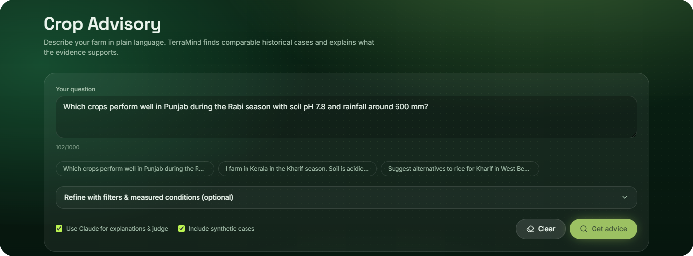

From a farmer’s question to verified advice
10 · DEMONSTRATION
“Which crops perform well in Punjab during Rabi with pH 7.8, rainfall ~600 mm, N 150?”
THEN
Open a supporting case and inspect its record
Compare actual vs predicted yield; read the risk factors
Submit feedback and review it on the Insights page
Re-run the evaluation pipeline
LIVE STAGE PROGRESS
Validate
Classify
Retrieve
Prioritise
Recommend
Analyse
Judge
Notes:
Live demo script. Ask the Punjab Rabi question, watch the real stage progress across all seven stages, open a supporting case, compare actual and predicted yield, read the risk factors, then submit feedback and show it on Insights.

Slide 13





What we learned building it
11 · CHALLENGES AND LEARNINGS
CHALLENGE
HOW WE HANDLED IT
Less real data than planned
Filled the gap with clearly labelled synthetic rows, kept out of model evaluation.
19,689 rows vs a 55,000 target
Next steps
Embeddings are weak on numbers
Added structured numeric candidates alongside semantic retrieval.
1
More granular soil data (below state level)
pH, rainfall and NPK matched poorly
A misleading pass rule
Switched to R-precision and disclosed the change.
2
Farm-level labels to train a real suitability classifier
Precision@10 failed perfect retrievals
3
Calibrated prediction intervals that hit nominal coverage
LLM availability failures
Graceful degradation; metrics stay honest and show “Not evaluated”.
Billing and outages
Notes:
Each challenge was met with a fix that keeps the system honest. Close with the three next steps that would most improve the advice quality.

Slide 14


Thank you
Evidence first
Every recommendation traces back to real historical cases.
Questions and discussion
Honest by design
Estimates are labelled; gaps are reported, never hidden.
Built end to end
FastAPI + React, evaluation pipeline and a feedback loop.
TerraMind AI · Smarter crop decisions. Evidence-driven farming.
Notes:
Recap the three takeaways and open the floor for questions.

