Slide 1
Cryptocurrency Value Prediction Project
By Will Stenzel, Max Hopley, and Shivam Kollur

Slide 2
Project Motivation & Who Cares
Is is possible to predict the price of Bitcoin based on sentiment data? Can this be generalized to other investments?
Individuals interested in investing, particularly in cryptocurrencies
Traditional equity investors looking to utilize similar models for stock analysis

Slide 3
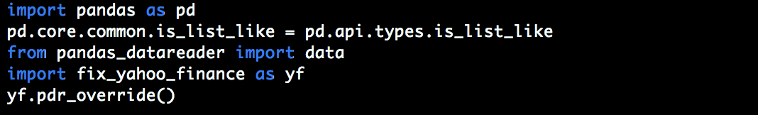
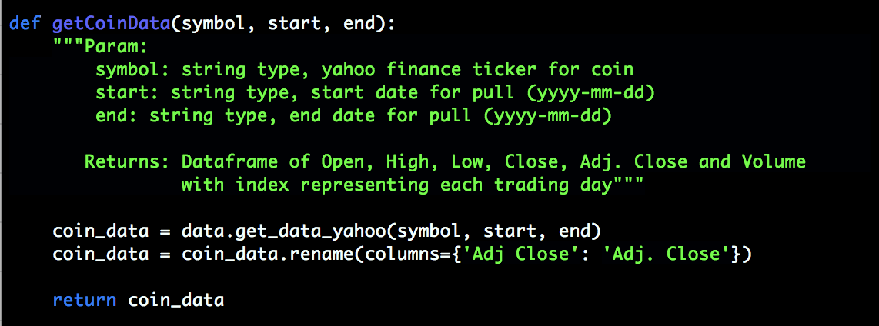
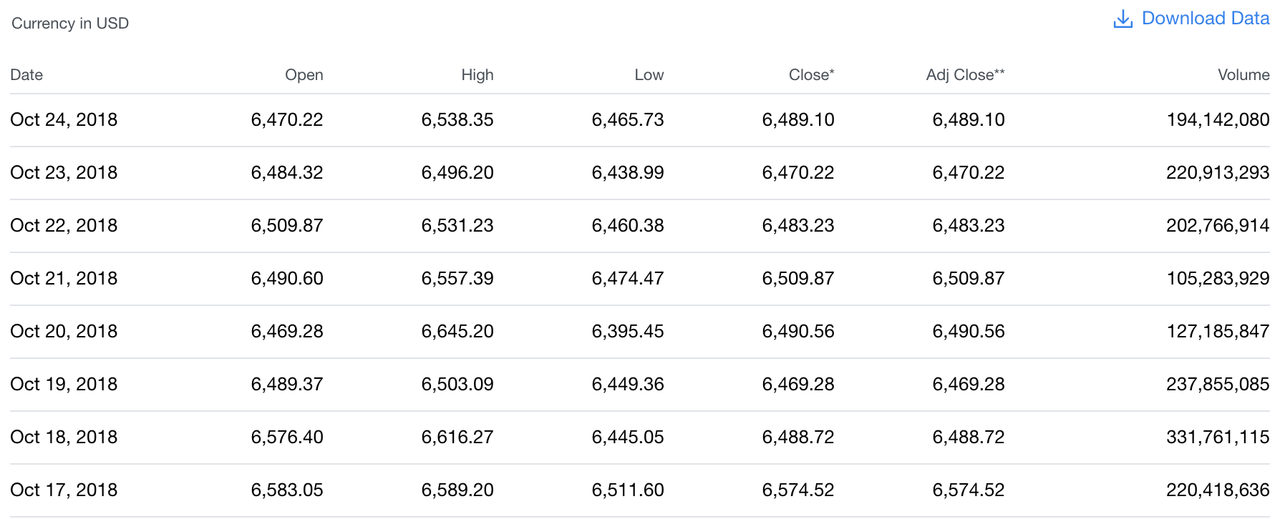
Technical Data Collection - Historical Prices

Slide 4
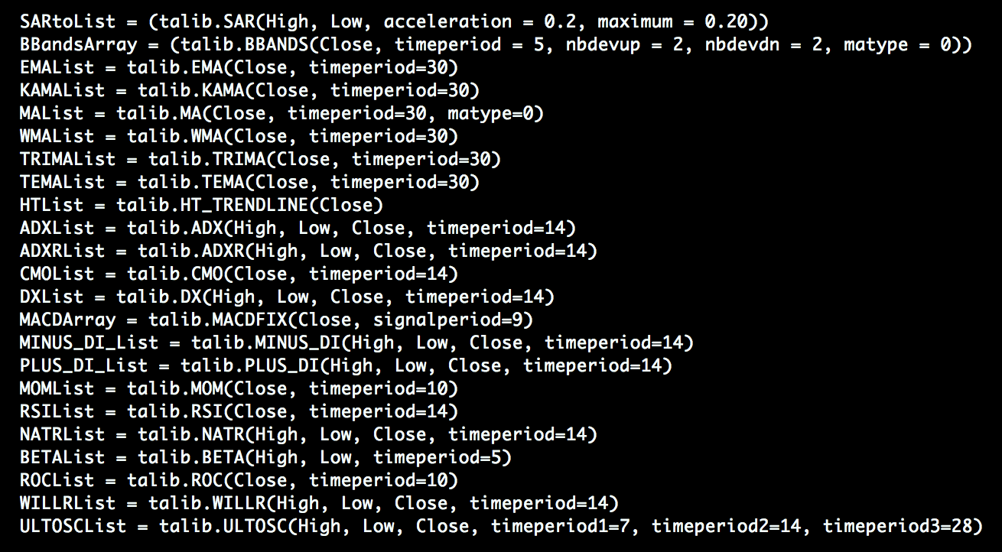
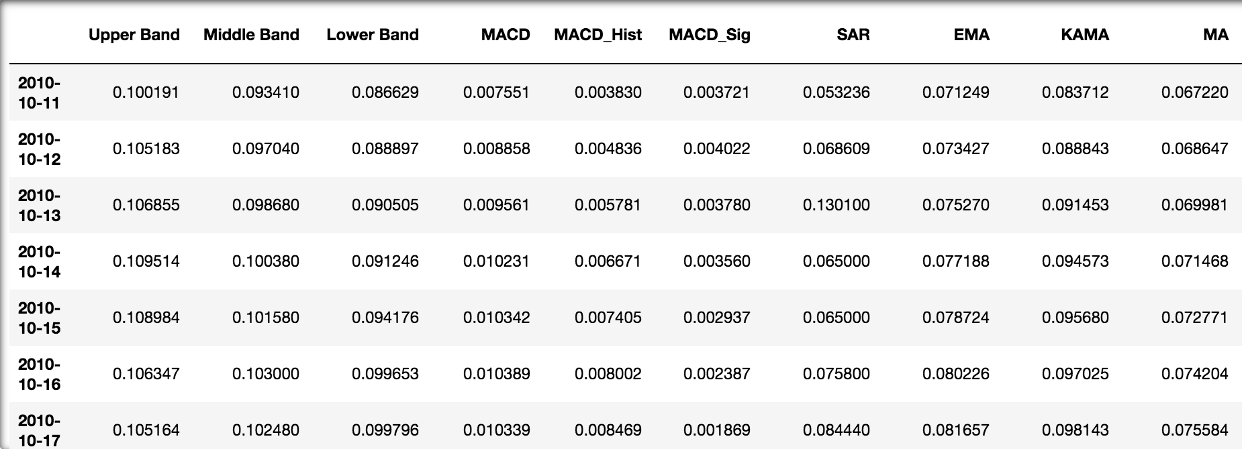
Technical Data Collection - Technical Indicators

Slide 5
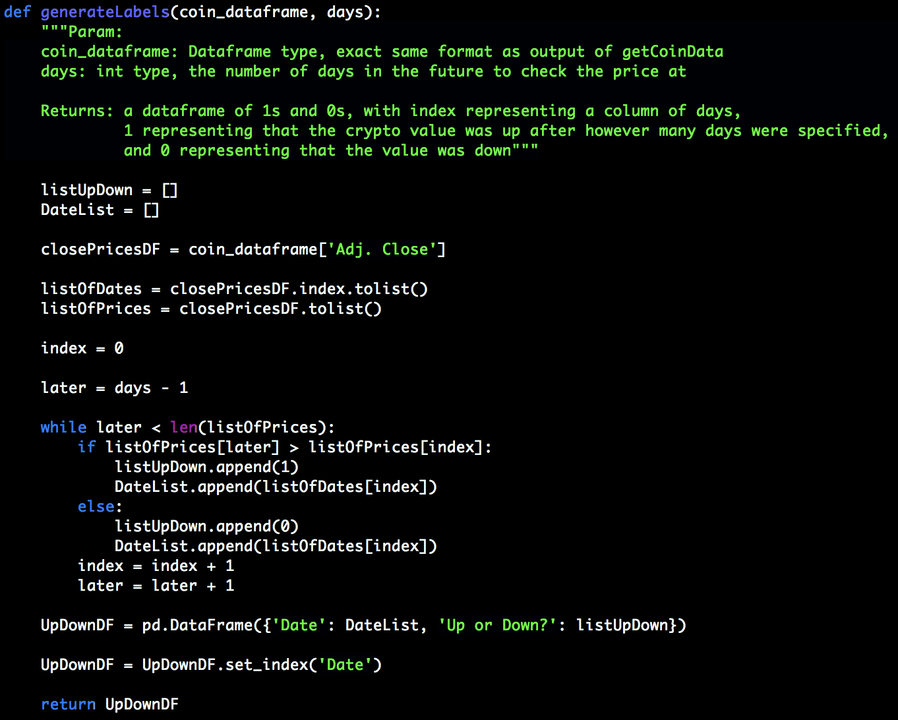
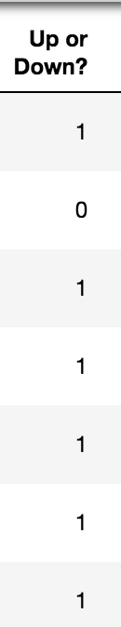
Technical Data Collection - Labels

Slide 6
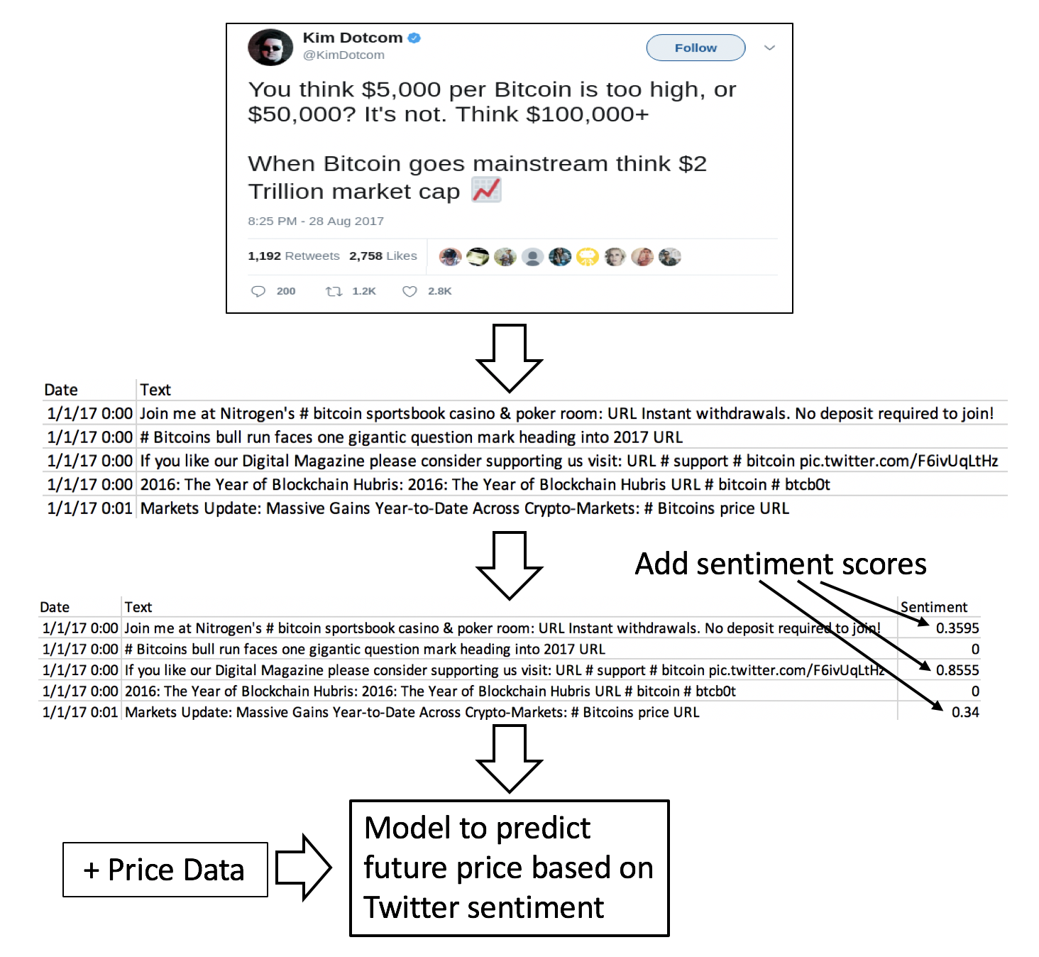
Sentiment Data Collection
Raw Tweets and Scoring

Slide 7
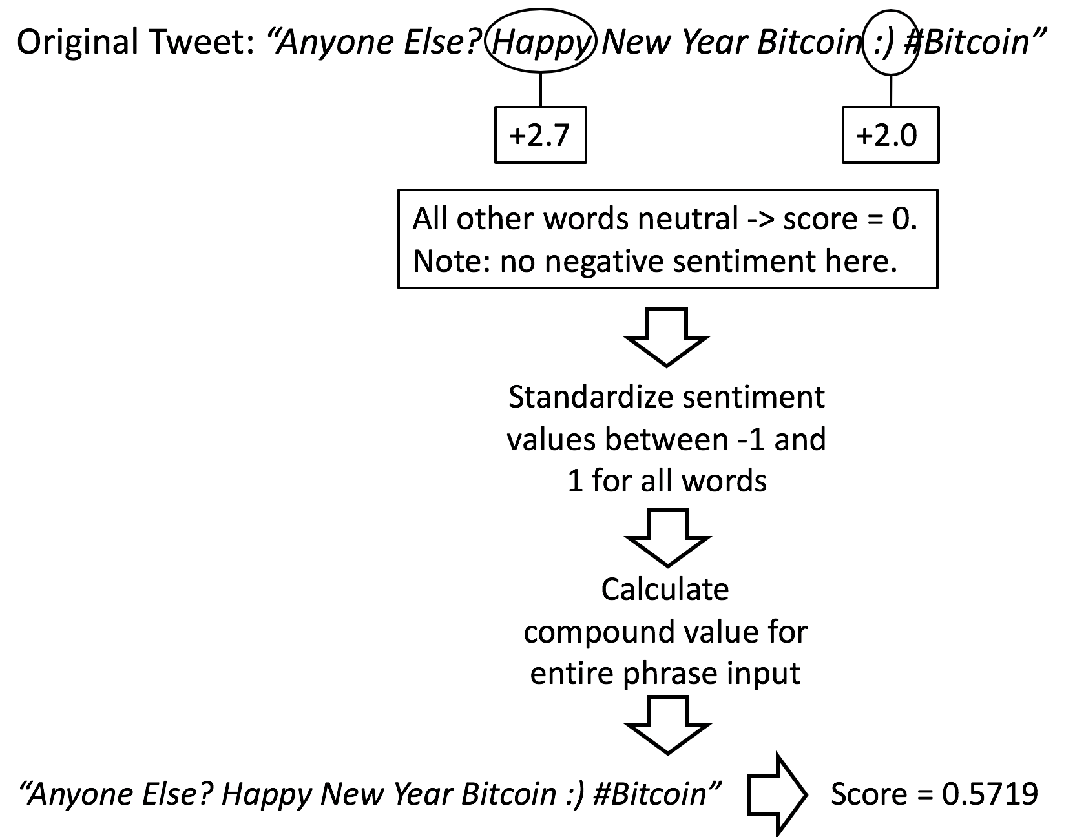
Sentiment Data Collection
In depth look at sentiment analysis

Slide 8
Explanation of Technical Data
Five indicator types tested:
Moving Averages
Momentum Indicators
Cycle Indicators
Volatility Indicators
Ichimoku Bull/Bear Signals

Slide 9
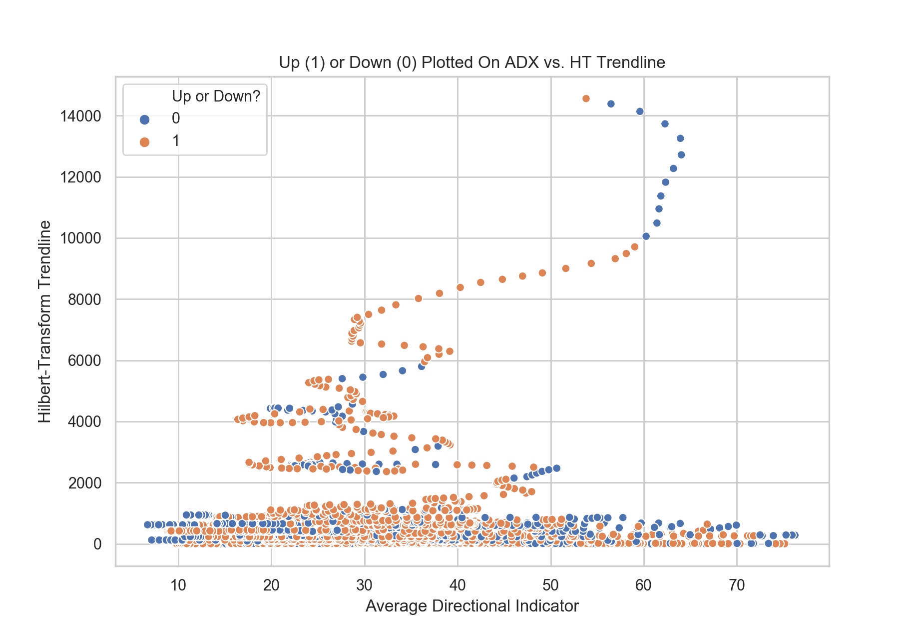
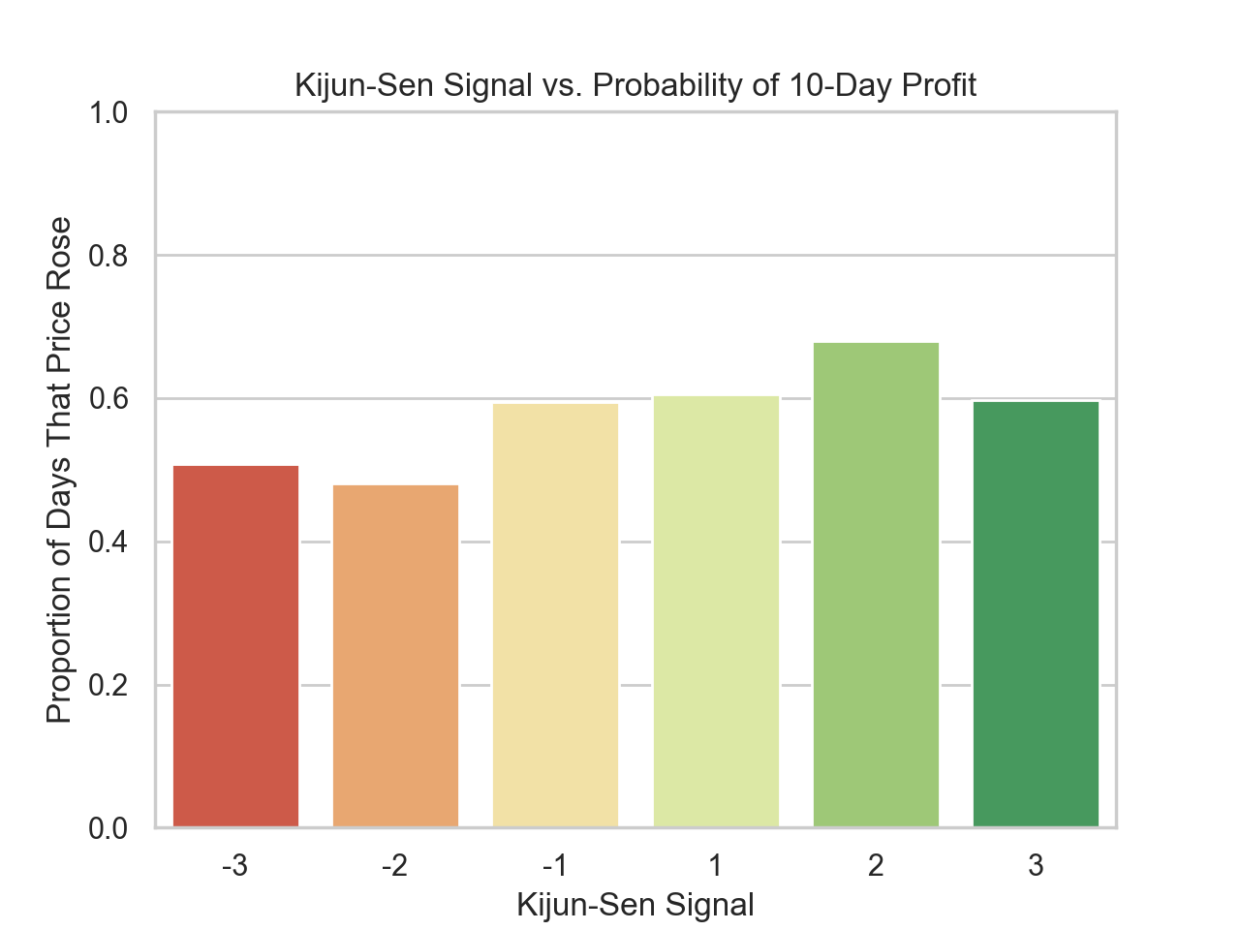
Explanation of Technical Data

Slide 10
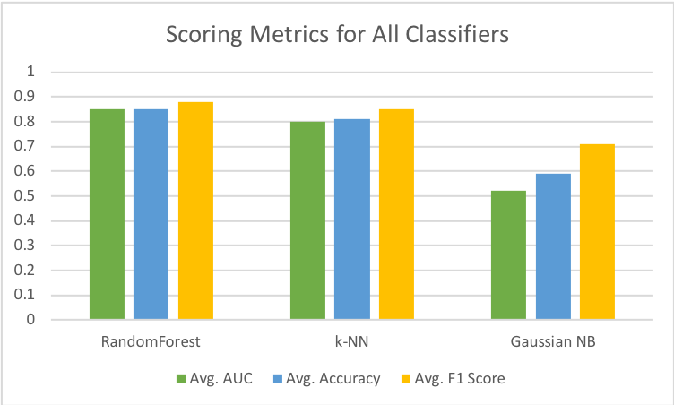
Technical Analysis Results
Three classifiers tested:
RandomForest
k-Nearest Neighbors
Gaussian Naive Bayes
Three metrics calculated:
Area Under Curve
Accuracy
F1-Score (Average of Precision and Recall)

Slide 11
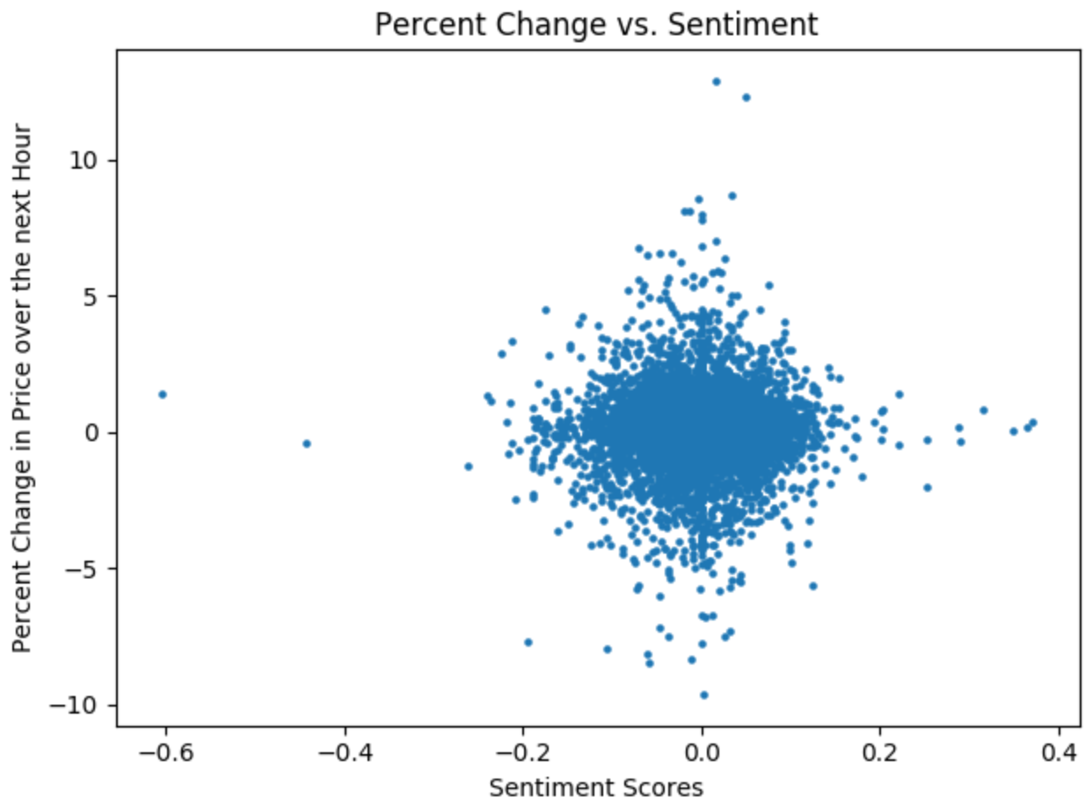
Sentiment Analysis Results
No correlation (.007)
Sentiment analysis program
Tweet selection

Slide 12
If we had more time …
Use words as features
Create our own sentiment analysis algorithm
Gather real time tweet data and price data
Test gains of coin relative to market performance
Develop buy and sell triggers (based on predict_proba method)
Plug our model into a bot that automatically buys and sells

Slide 13
Conclusion
Found it is harder than expected to make predictions on price bases twitter sentiment
Learned a lot about the process of collecting and analyzing data
Creating a predictive model for buying and selling Bitcoin is certainly feasible

Slide 14
Thank You!
Questions?

Slide 15
Works Cited
Bitcoin Dataset: https://www.cryptodatadownload.com/index.html
Twitter Dataset: https://www.kaggle.com/augiedoebling/bitcoin-tweets
vaderSentiment: https://github.com/cjhutto/vaderSentiment
Ichimoku Sentiment: https://www.ichimokutrader.com/signals.html
TA-lib: https://mrjbq7.github.io/ta-lib/funcs.html
Bitcoin Historical: https://finance.yahoo.com/quote/BTC-USD/

