Slide 1
The Fresh Components of the Web
An Introduction to Web Components, Polyfills, and Polymer.
Notes:
Good Evening. How many people here have heard of web components?.
Web components are going to change everything.
I’m pretty skeptical when I hear that something new is going to “change everything”, but regardless it’s a really exciting time to be a web developer.

Slide 2
What exactly are web components?
“A collection of standards which are working their way through the W3C. They enable truly encapsulated and reusable components for the web.”
Web components is a set of browser level API’s.
Notes:
Web components are components of the web. LOL
Web components when they work together they really create something that is pretty awesome.
So now that we vaguely now what they are, why do we need them?

Slide 3

What’s wrong with the way we do things now?

Slide 4
UI’s depend heavily on the framework they are created with.
Front end solutions aren’t really reusable.
No encapsulation, elements and styles are global.

Slide 5


Slide 6
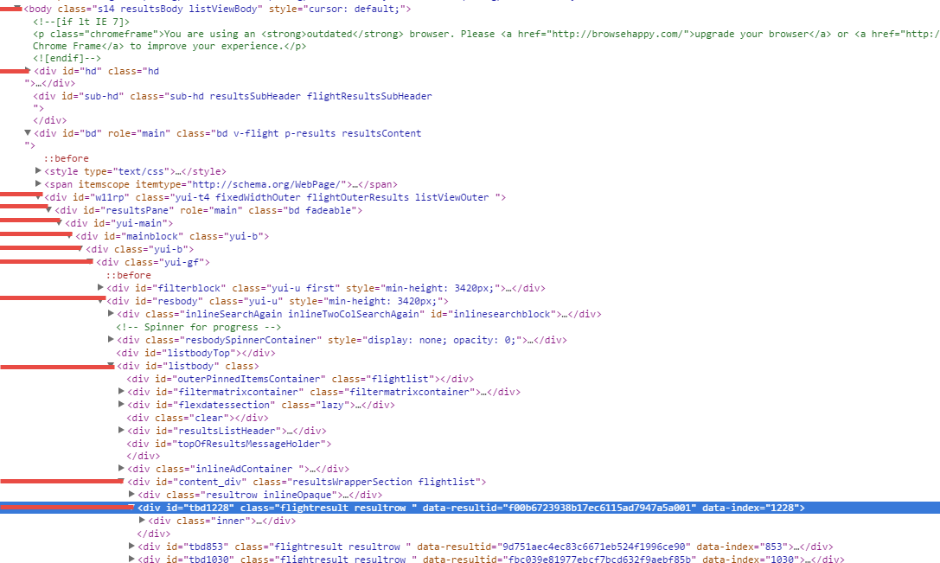

Slide 7
HTML Imports
Custom Elements
Templates
Shadow DOM
<link rel=“import” href=“customElement.html"></link>
<custom-element></custom-element>
<template id=“customElement”>
<div>
<p>I’m a reusable piece of DOM</p>
<content></content>
</div>
</template>
var element = document.createElement(‘div’);
var shadowDom = element.createShadowRoot();
shadowDom.innerHTML = “<p>I’m hidden!</p>”
var container = document.querySelector(‘body’);
container.appendChild(element);

Slide 8
HTML Imports
Allows importing entire HTML documents.
Single requests for resources defined with HTML imports.
Scripts are not limited to the DOM of the file in which they are declared.
Enables reuse of custom elements.

Slide 9
Custom Elements
Create your own HTML Elements!
Extend existing HTML elements!
Custom Elements must have hyphenated names (e.g.) <awesome-select></awesome-select>
Feature detect with document.registerElement();
Notes:
Lifecycle callback functions
createdCallback
attachedCallback
detachedCallback
attributeChangedCallback(attrName, oldVal, newVal)

Slide 10
Templates
Introducing the <template></template> element.
Allows you to define reusable snippets of markup.
Templates are totally inert until copied and added to the DOM (e.g.)
var t = document.importNode(templateRef.content, true);
someElement.appendChild(t);
Templates also make specifying shadow DOM easy!.

Slide 11
Shadow DOM
Allows composability.
Allows developers to create a declarative API for users of their custom elements.
Encapsulates implementation details, DOM, styles and script alike.
Notes:
Terminology
ShadowHost
ShadowRoot
ShadowElements
ShadowTree
Light DOM
ShadowDOM
ComposedDOM

Slide 12
What is a polyfill?
“A piece of code (or plugin) that provides the technology that you, the developer, expect the browser to provide natively. -Remy Sharp”
Feature Detection
Feature Implementation

Slide 13
A simple polyfill example.
if(typeof Array.prototype.filter !== “function”) { // feature detection part Array.prototype.filter = function(fn, thisp) { // feature implementation part
var result = [];
for(var i = 0; i < this.length; i++) {
if(i in this) {
var val = this[i];
if(fn.call(thisp, val, i, this)) {
result.push(val);
}
}
}
return result;
}; // end feature implementation part
} // end feature detection part
Code Example from: Peter_Olsen’s article on codeproject.com http://www.codeproject.com/Articles/369858/Writing-polyfills-in-Javascript

Slide 14

What polyfills are there for web components?
Polymer
Notes:
Mozilla has X-Tags.
It is important to know that Polymer is not just polyfills. Polymer is a layer on top of web components that allows for things like data binding.
The polyfill layer is in platform.js

Slide 16
References
http://www.html5rocks.com/en/tutorials/webcomponents/customelements/
http://www.html5rocks.com/en/tutorials/webcomponents/imports/
http://www.html5rocks.com/en/tutorials/webcomponents/shadowdom/
http://www.html5rocks.com/en/tutorials/webcomponents/template/
http://www.w3.org/standards/techs/components#w3c_all
https://www.polymer-project.org/
http://www.codeproject.com/Articles/369858/Writing-polyfills-in-Javascript

