Slide 1
VIRTUAL LIBRARY MCP
A library that arrives inside the client
Fresh-session discovery · GCP-hosted · secure by default
Notes:
Open with the promise: no tunnel, no patron number, no special demo client.
[Sources]
- Project deployment evidence: https://github.com/willtech3/mcp-learning/actions/runs/31299253938

Slide 2
The protocol supports a clean handoff — not ambient server hunting
What works
A fresh coding-agent session reads checked-in project configuration, connects to the declared HTTPS MCP endpoint, negotiates capabilities, and asks for authorization when required.
What does not
MCP does not scan a cloud account or local network for arbitrary ephemeral servers. The discoverable unit is the configured server; its tools, resources, prompts, skills, and Apps are then self-describing.
2
Notes:
Frame this as a useful security boundary, not a missing feature.
[Sources]
- MCP 2025-11-25: https://modelcontextprotocol.io/specification/2025-11-25
- MCP 2026-07-28: https://modelcontextprotocol.io/specification/2026-07-28

Slide 3
A fresh agent reaches the GCP library in three steps
1 · OPEN
2 · AUTHORIZE
3 · USE
Fresh repo session
The project config exposes the Virtual Library MCP without changing the developer’s personal agent settings.
Secure connector
The client connects directly to the HTTPS Cloud Run endpoint and performs the supported OAuth flow.
Self-described library
The agent discovers read-only Apps, catalog tools, patron-safe lookup, and explicit mutation tools.
3
Notes:
Start from a visibly clean Codex or Claude Code session and show the server list before any tool call.
[Sources]
- Project client checks in repository justfile
- Production deployment: https://github.com/willtech3/mcp-learning/actions/runs/31299253938

Slide 4
Exploration becomes action only after explicit consent
Explore the collection
Ask for Murderbot, Dune, or a genre. Open a title, check copies, and inspect its shelf record inside the MCP App.
Find the patron
Use a name, email, or phone digits. Contact hints stay masked; a card number is never required.
Preflight first
Run checkout readiness read-only. Only then request a checkout, where the client’s permission gate makes the mutation explicit.
BROWSE
IDENTIFY
ACT
4
Notes:
Keep the first two beats read-only. Pause at the permission gate so the audience sees the security model.
[Sources]
- MCP Apps extension: https://modelcontextprotocol.io/extensions/apps
- App implementation: https://github.com/willtech3/mcp-learning/pull/65

Slide 5
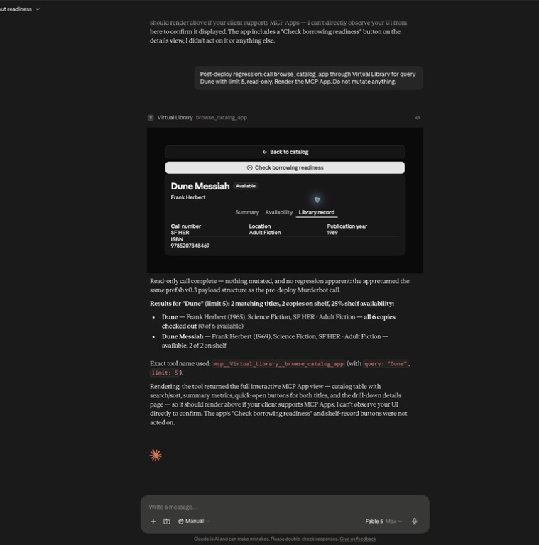
Claude renders the live library
One tool call, multiple screens
The hosted catalog opens inside Claude Desktop. Explicit title controls work across clients; Summary, Availability, and Library record tabs expose a realistic shelf experience without leaving the conversation.
5
Notes:
Show the title button, then click Availability and Library record. Do not invoke checkout from this slide.
[Sources]
- Local test evidence: /Users/will/.codex/visualizations/2026/08/08/019fe3ba-77ec-7c10-b677-53059db72ce9/virtual-library-e2e-audit/claude-postdeploy-detail.png
- Cross-client navigation fix: https://github.com/willtech3/mcp-learning/pull/68

Slide 6
The demo is backed by gates, not hope
Production confidence
The same merge SHA passed local and hosted validation before Cloud Run moved all traffic to the new revision.
662
100%
0
tests passed · 85% coverage
traffic on revision 00008
known dependency vulnerabilities
6
Notes:
Use the numbers to establish reliability, then move quickly back to the live product.
[Sources]
- CI and deployment: https://github.com/willtech3/mcp-learning/actions/runs/31299253938
- Local just prod-check run, 2026-08-09

Slide 7
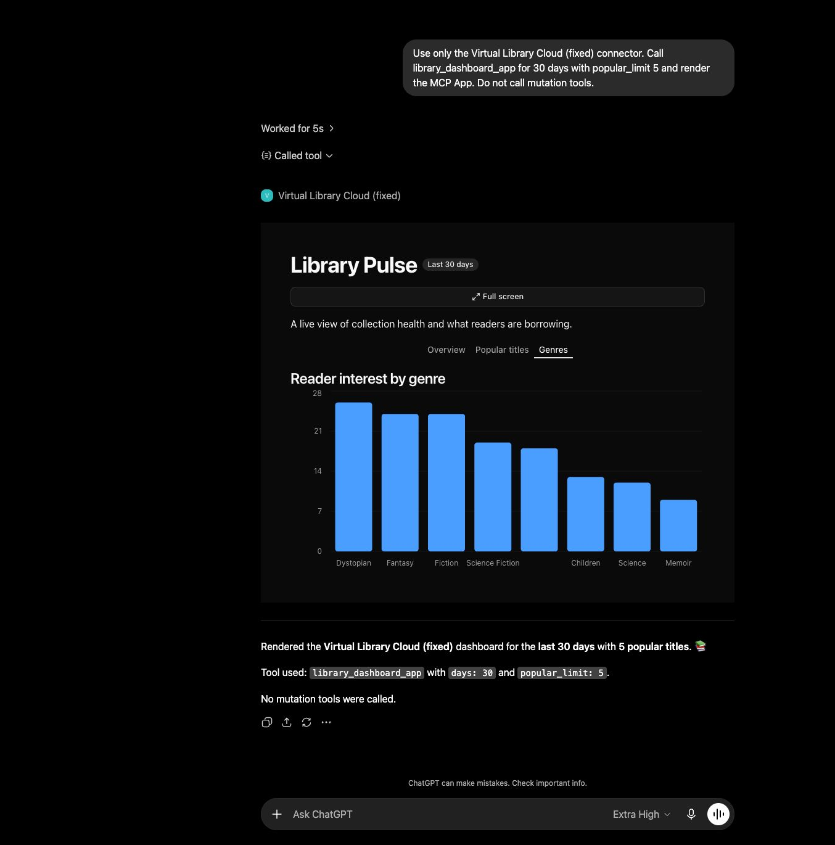
ChatGPT renders Library Pulse
Five Apps, one library
Browse catalog, checkout readiness, patron account, reading recommendations, and the circulation dashboard all render from the same GCP MCP server. The client changes; the library contract does not.
7
Notes:
Open the dashboard last: it is a strong visual payoff after the patron journey.
[Sources]
- Local test evidence: /Users/will/.codex/visualizations/2026/08/08/019fe3ba-77ec-7c10-b677-53059db72ce9/virtual-library-e2e-audit/chatgpt-hosted-dashboard.png
- Modern renderer compatibility fix: https://github.com/willtech3/mcp-learning/pull/67

Slide 8
Run the demo as one secure patron journey
SET THE STAKES
SHOW THE MAGIC
PROVE THE GUARDRAILS
Fresh session
Show project-scoped discovery and the owned GCP endpoint before the model knows the library.
Patron journey
Browse a title, find Aaron Gomez without a card number, then render checkout readiness.
Stop at consent
Call out masked identity, read-only hints, the permission prompt, idempotent retries, and the green production gate.
8
Notes:
Suggested prompts: 'Find Murderbot books'; 'Show Aaron Gomez’s account'; 'Can Aaron borrow The Hobbit?'.
[Sources]
- Demo sequence derived from verified ChatGPT and Claude Desktop sessions, 2026-08-09

Slide 9
DEMO READY
Own tenant. Secure by default.
Fresh-session discovery
Two protocol eras
Five native MCP Apps
Notes:
Close on the architecture promise, then return to the live client for questions.
[Sources]
- Production revision: virtual-library-mcp-00008-tms
- Release PR: https://github.com/willtech3/mcp-learning/pull/68

