Slide 1
Solution by Gazua

Slide 2
Data Analysis
사고유형_중분류
%
기타
23.3
횡단중
21.1
측면직각충돌
12.1

Slide 3
Data Preprocess
count
count
측면직각충돌
측면충돌
2012
2013
2014
2015
2016
2017 (~6)

Slide 4
Determine sequence to fill in columns
100 %
Classification
도로형태_대분류
도로형태
others
사고유형_대분류
Regression
당사자종별_1당_대분류
당사자종별_2당_대분류

Slide 5


Machine Learning
Deep Learning
structured dataset
can choose own features

Slide 6
Data Set
Training Set #1
Training Set #1
Training Set #n
Learning Model #1
Learning Model #2
Learning Model #n
Combiner
Ensemble
Ensemble Prediction

Slide 7
Decision Tree
Random Forest
XGBoost
Bagging
Models, independent
to lower variance
Low bias, High variance
Short time
Boosting
Models, related
to lower bias
High bias, Low variance
Long time

Slide 8
Hyperparameter Optimization
Coarse to Fine Search
Coarse
all range
epoch number = 100
n_estimators
max_depth
learning_rate
subsample
colsample_bylevel
colsample_bytree
Fine
specific range

Slide 9
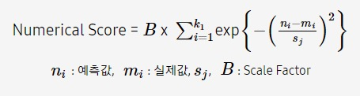
Validation
numpy, sklearn
Define Error
score
Cross Validation

Slide 10
Cross Validation
Train dataSet, #10000
A
A
A
A
A
CV = 5
#
2000
2000
2000
2000
2000
Prediction
Real Value
A + B + C + D
A + B + C + E
A + B + D + E
A + C + D + E
B + C + D + E
E’
D’
C’
B’
A’
E
D
C
B
A
compare

Slide 11
Data
Analysis
Validation
Design Model
Data Preprocess
Optimization

Slide 12
Thank you

