Slide 1



Slide 2

Welcome to wonderland!

Slide 3

“Wonderland” =

Slide 4
?

Slide 5


Slide 6




ON
OFF
Click!

Slide 7

SOUND
STRANGE 1

Slide 8
QUIZ LOCK
STRANGE 2

Slide 9
BACKGROUND
STRANGE 3

Slide 10

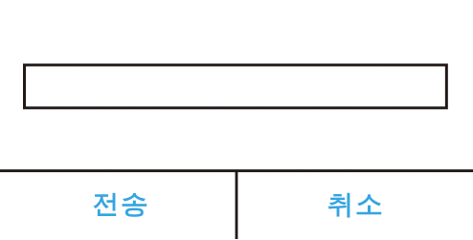
Call number
“welcome to wonderland”

Slide 11
Q & A

Slide 12
THANKS

