Slide 1
Midterm Project

Slide 2
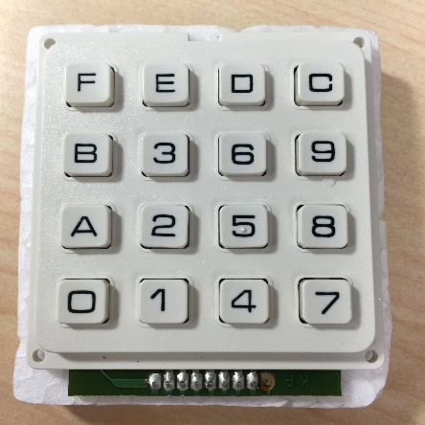
Outline
題目
設計一個簡易計算機 (in1 op in2)
支援加(A)、減(B)、乘(C)運算 (減法不會有負數)
System I/O
Input: 1個4x4 keypad (00~99 for in1 and in2)
Output: 4個七段顯示器
Bonus: 除法(D) (運算到整數為即可)
Due day: 5/4(三) PM10，一個人只能demo 2次
繳交檔案：
MidPrj_dcsXX.tar
Top module name: MidPrj_dcsXX
Note~1 module in a file (file name = module name)
MidPrj_dcsXX.bit

Slide 3
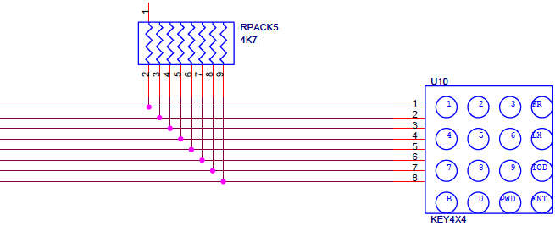
Architecture
Suggestion system and Verilog architecture

Slide 4
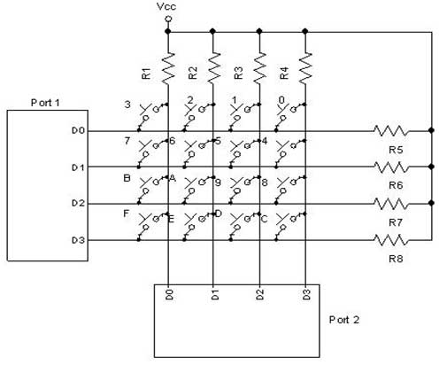
4x4 Keypad Scanning
Periodically scan 4x4 keypad to read input value
D0-D3 @port1 are output signals (FPGA -> keypad)
D0-D3 @port2 are input signals (FPGA <- keypad)
4k7 resistance for R1-R8
precharge port2 signals to logic 1

Slide 5
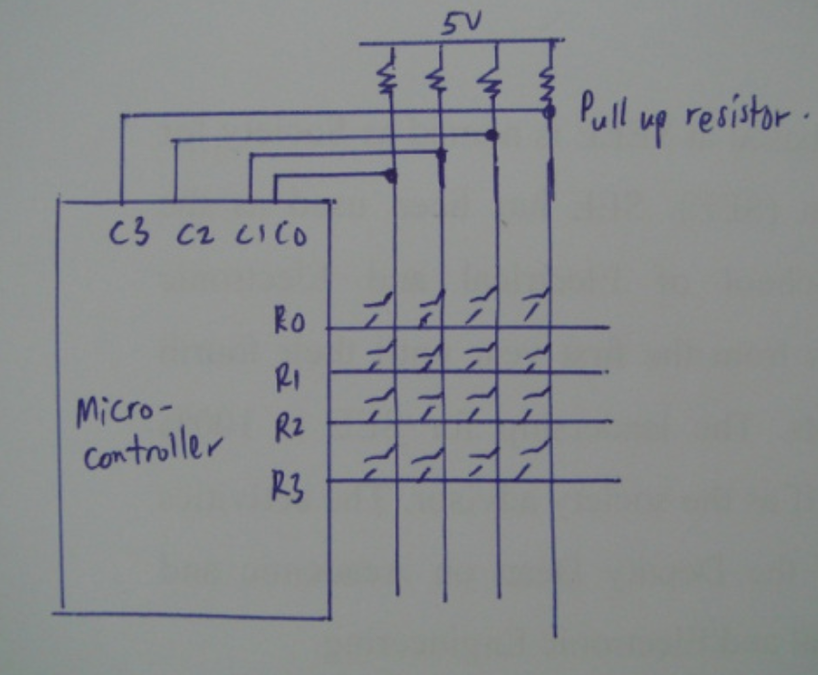
4x4 Keypad Scanning
t=0
t=1
t=2
t=3
0
1
1
1
1
0
1
1
1
1
0
1
1
1
1
0
0
5V→0V
得知 (row1, col1)被按

Slide 6
助教會抓抄襲，被抓到的暑假就開始囉^_^

