Slide 1
7 Series Dedicated Hardware
Part 1

Slide 2
Objectives
After completing this module, you will be able to:
Describe the dedicated hardware IP that is included with the 7 series FPGAs

Slide 3
Lessons
Serial Gigabit Transceivers
PCI Express Technology Interface
XADC
Summary

Slide 4
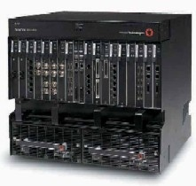

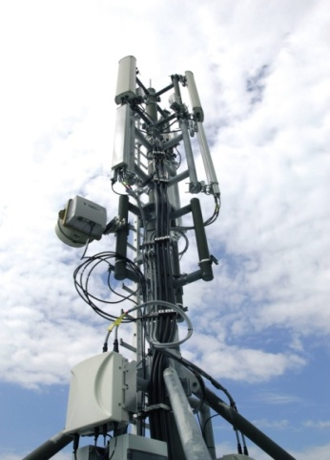
Need for Higher Bandwidth
Modern systems require more bandwidth
Chip-to chip on the pc-board
Card-to-card
Wiring between boxes
Long distance transmission over fiber optics
Parallel I/O reaches a speed limit
< 1.5 GHz for single-ended pins
< 2.0 GHz for LVDS differential pin-pairs
Standards are getting faster
Wide parallel connections pose problems
Use too much space and power
Unavoidable skew between data lanes
Unavoidable skew between clock and data
Crosstalk and other signal integrity issues
Notes:
Refer to the application note, High Speed Serial I/O Made Simple, which discusses the technology and its applications.

Slide 5





Next-Generation Serial Connectivity
HT
XT
28 Gbps
GTZ
GTH
GTH
13.1+ Gbps
12.5 Gbps
11.18 Gbps
GTX
GTX
GTX
GTH
GTX
6.6 Gbps
3.75 Gbps
3.125 Gbps
GTP
GTP

Slide 6
Multi-Gigabit Transceiver
Different families have different MGT devices
Artix™-7 family: GTP
Kintex™-7/Virtex®-7 family: GTX
Virtex-7 XT family: Mixture of GTX and GTH
Virtex-7 HT family: Mixture of GTH and GTZ
Speed Grade | Artix GTP |  | Kintex GTX |  |  | Virtex GTX |  | Virtex GTH |  | Virtex GTZ
 | min | max | min | max | max (FF) | min | max | min | max | min | max
1LC/I | 0.612 | 3.125 | 0.612 | 5.0 | 6.6 | 0.612 | 6.6 | 0.612 | 10.3125 | N/A | N/A
1C/I | 0.612 | 3.125 | 0.612 | 5.0 | 6.6 | 0.612 | 6.6 | 0.612 | 10.3125 | TBD | TBD
2C/I | 0.612 | 3.75 | 0.612 | 6.6 | 10.3125 | 0.612 | 10.3125 | 0.612 | 13.1 | 28.05 | 28.05
3C | N/A | N/A | 0.612 | 6.6 | 12.5 | 0.612 | 12.5 | 0.612 | 13.1 | 28.05 | 28.05

Slide 7
Transceiver Quad Clocking
Transceivers in Quads (4 per block)
1 or 2 columns of transceivers
Two types of PLLs
LC Tank PLL (QPLL)
Highest performance
LC can operate at 1/2, 1/4 and 1/8 rate
One per transceiver Quad
Ring Oscillator PLL (CPLL)
Wider range of frequencies
One per transceiver
Flexibility
Each TX and RX can choose from its local ring or the common LC Tank
Selection can be done independently for RX and TX

Slide 8
Gigabit Transceivers Overview
FPGA
Fabric
Interface
2
Tx
PMA
PCS
2
Rx
PMA
PCS
Dedicated parallel-to-serial transmitter and serial-to-parallel receiver
Unidirectional, differential bit-serial data I/O
Integrated PLL-based Clock and Data Recovery (CDR)
Parallel interface to the FPGA internal fabric
Width varies by family, protocol, and line rate from 8 to 40 bits
Serial interface to the printed circuit board (differential signaling)
Differential Current Mode Logic (CML)
Two traces for the transmitter and two traces for the receiver; removes common-mode noise

Slide 9
Transmitter Overview – PCS
FPGA
TX
Interface
2
TX
OOB
&
PCI
TX
Pre-
emp
PISO
Polarity
Control
Tx
CML
Driver
Phase
Adjust
FIFO
8B/10B
Decoder
TX Clock
TX
Gearbox
PRBS
Generator
TX PIPE Control
Tx- PMA
Tx- PCS
Physical Coding Sub-layer (PCS)
Wide data widths for connection to FPGA fabric
Built-in 8b/10b encoding
Gearbox for 64b/66b and 64b/67b encoding
Pattern generator for testing link integrity
Notes:
Each transceiver includes an independent transmitter, made up of a PCS and a PMA.
The PCS is responsible for accepting parallel data from the FPGA fabric, providing encoding options, and preparing the data for serialization.

Slide 10
Transmitter Overview – PMA
FPGA
TX
Interface
2
TX
OOB
&
PCI
TX
Pre-
emp
PISO
Polarity
Control
Tx
CML
Driver
Phase
Adjust
FIFO
8B/10B
Decoder
TX Clock
TX
Gearbox
PRBS
Generator
TX PIPE Control
Tx- PMA
Tx- PCS
Physical Media Attachment (PMA)
Parallel to serial converter
Current Mode Logic (CML) differential drivers
Programmable output level
To compensate for external signal attenuation
Programmable pre-emphasis
To compensate for unavoidable external low-pass attenuation
Special signaling required for PCIe® and SATA technologies
Notes:
The PMA side is responsible for serializing the data from the PCS, and the analog transmission of the data on the physical medium.
Data is sent on a differential CML link. To overcome the shortcomings of the copper interconnect, the CML levels and pre-emphasis can be adjusted.
The PMA also has special features to allow for PCIe beaconing and SATA OOB signaling; these are required in order to support these protocols.

Slide 11
Receiver Overview – PMA
EQ
FPGA
RX
Interface
2
DFE
SIPO
CDR
Over-
sampling
RX
Polarity
Comma
Detect
And
Align
OOB
10B/8B
Decoder
Elastic
Buffer
RX
Gear- box
Rx
RX
Clock
Loss of Sync
PRBS
Check
RX Status Control
RX- PMA
RX- PCS
PMA
Differential receiver inputs
Decision Feedback Equalization (DFE) or Linear Equalization (LPM) to compensate for board effects
Clock Data Recovery (CDR)
Detection of OOB signaling and beaconing
Serial-to-Parallel conversion
Notes:
The receiver is also split into a PMA and PCS section. The PMA is responsible for the processing in the analog domain, which recovers the serial data from the physical medium.
It also detects the special signaling required for PCIe and SATA.
Finally, it does the serial to parallel conversion. The parallel data is unframed at this point.

Slide 12
Receiver Overview – PCS
EQ
FPGA
RX
Interface
2
DFE
SIPO
CDR
Over-
sampling
RX
Polarity
Comma
Detect
And
Align
OOB
10B/8B
Decoder
Elastic
Buffer
RX
Gear- box
Rx
RX
Clock
Loss of Sync
PRBS
Check
RX Status Control
RX- PMA
RX- PCS
PCS
Performs comma detection and alignment for framing
Performs 8b/10b decoding
Elastic buffer for matching the rate to the local clock and channel bonding
Gearbox for supporting 64b/66b and 64b/67b decoding
Pattern checker for testing link integrity
Notes:
The PCS takes the parallel data from the PMA. This data is unframed and running on the recovered clock.
The PCS offers a variety of optional processing steps:
Comma detection for framing and packet delineation
8b/10b decoding
Elastic buffer for rate matching to the local clock source, and also for channel bonding (data can be fed to the fabric on a local clock, or on the recovered clock)
Gearbox for aiding in 64b/66b and 64b/67b decoding

Slide 13
7 Series Transceiver Architecture Major Supported Protocols
Market | Protocol | GTP | GTX | GTX | GTH
General | PCI Express | Gen1 | Gen 1, 2, 3 | Gen 1, 2, 3 | Gen 1, 2, 3
Wired | Ethernet | 1GE, 2.5GE, XAUI | 1GE, 2.5GE, XAUI, RXAUI, 10GBase-R, 10G-KR, 40GE, 100GE | 1GE, 2.5GE, XAUI, RXAUI, 10GBase-R, 10G-KR, 40GE, 100GE | 1GE, 2.5GE, XAUI, RXAUI, 10GBase-R, 10G-KR, 40GE, 100GE
 | SONET/OTU | OC-3/12 | OC-3/12/48/192, OTU1 | OC-3/12/48/192, OTU1 | OC-3/12/48/192, OTU1/2/3/4
 | Interlaken | <= 3.75G | <=6.5G, 12.5G | <=6.5G, 12.5G | <=6.5G, 10.3125G, 12.5G
 | Custom CEI Backplane | <= 3.75G | <=6.5G, EQ support for faster | <=6.5G, EQ support for faster | <= 6.5G, CEI-11LR
 | PON | TBD | BPON, GPON, GEPON, 10GEPON, 10GGPON (TX) | BPON, GPON, GEPON, 10GEPON, 10GGPON (TX) | BPON, GPON, GEPON, 10GEPON, 10GGPON*
Wireless | CPRI/OBSAI | 0.614, 1.2, 2.4, 3.0 | 0.614, 1.2, 2.4, 3.0, 4.9, 6.14, 9.8 | 0.614, 1.2, 2.4, 3.0, 4.9, 6.14, 9.8 | 0.614, 1.2, 2.4, 3.0, 4.9, 6.14, 9.8, 12
 | Serial Rapid IO | Gen1 | Gen1, 2 | Gen1, 2 | Gen1, 2
Audio Video | SDI | SD/HD/3G-SDI | SD/HD/3G-SDI | SD/HD/3G-SDI | SD/HD/3G/10G-SDI
 | Display Port | Yes | Yes | Yes | Yes
Other | QPI | x | 4.8, 6.4, 8.0*, 9.6* | 4.8, 6.4, 8.0*, 9.6* | 4.8, 6.4, 8.0*, 9.6*
 | Fiber Chan. | 1G, 2G | 1G, 2G, 4G, 8G | 1G, 2G, 4G, 8G | 1G, 2G, 4G, 8G, 10G
 | SATA/SAS | 1.5G, 3G | 1.5G, 3G (pending 6G) | 1.5G, 3G (pending 6G) | 1.5G, 3G, (pending 6G)
 | Aurora | Up to 3.75G | Up to 12.5G | Up to 12.5G | Up to 13.1G

Slide 14
Power Reduction Options
Flexible clocking options
Use only the QPLL for the lowest power consumption
Use only the CPLLs for more flexibility
Use both for maximum flexibility
Low Power Mode (LPM) receive mode
Uses lower power linear equalization rather than high power DFE
Ideal for short chip-to-chip links
Adjust TX CML swing for lower power
PISO
TX
Driver
Hard
PCS
Logic
Serial
Channel
RX
CDR
X
X
FPGA Fabric
SIPO
RX
DFE
RX
Linear EQ
RX
DiffAmp
RX
Low Power
Linear EQ
Notes:
The transceiver has several configurable options for finding the right performance to power trade-offs.
Having both the QPLL and CPLLs powered offers the most flexibility in terms of mixing receive and transmit frequencies. If this flexibility is not used, the unused PLLs can be powered down to reduce system power.
The Decision Feedback Equalization provides a powerful mechanism for restoring a data eye over larger lengths of lossy medium. For shorter lengths, a simpler linear equalization mechanism may suffice, which consumes significantly less power.
Similarly, the CML output levels of the transmitter are programmable. For large link lengths, higher voltage levels help maintain signal integrity. For shorter lengths, though, lower levels can be sufficient, and consume less power.

Slide 15
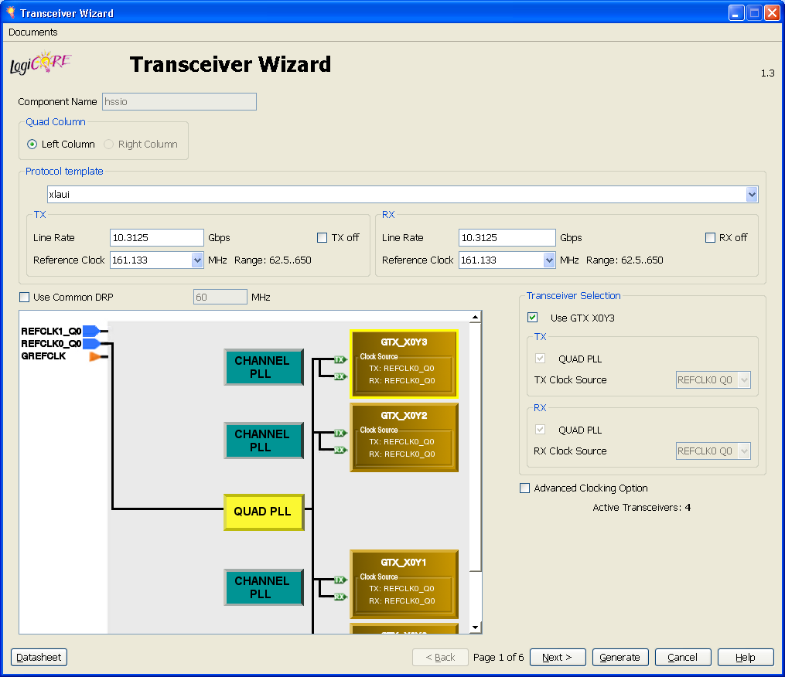
Transceiver Wizard Overview
The Transceiver Wizard simplifies transceiver configuration for common protocols
Ease of use, shorter design time
Getting Started Guide available
Designing with Multi-Gigabit Serial I/O course available

Slide 16
Transceiver Wizard
Instantiates transceivers (including HDL wrapper)
Steps through the configuration parameters
Protocol-specific templates are provided for common protocols
Notes:
The Transceiver Wizard walks you through the setting of all parameters and options for all the transceivers in your design.
It allows you to set many parameters at once by selecting one of the known protocols or to individually set each parameter.
The wizard builds the core for implementation and also generates an example design for simulating and downloading the resulting system.

Slide 17
ChipScope Pro Tool + IBERT
Can move sampling point within the eye opening horizontally
Can measure jitter margin vs. bit error rate for a particular channel and equalization setting
Can sweep equalization settings to find optimal setting
Allows easy channel margin analysis
Eye Sweep (ps)
Bit
Error
Rate
Ideal Sampler Position
Notes:
More details are available in the Debugging Techniques Using the ChipScope Tools course.

Slide 18
Lessons
Serial Gigabit Transceivers
PCI Express Technology Interface
XADC
Summary

Slide 19
Summary
By fully utilizing your dedicated hardware, you can save substantial FPGA resources and improve system speed
Almost all 7 series FPGAs provide high-speed serial transceivers
Type and number vary by family; only the smallest Artix-7 devices have none
All versions support a variety of protocols

Slide 20
Where Can I Learn More?
User Guides
7 Series FPGAs GTX Transceivers User Guide, UG596
Describes the GTX transceivers in the Kintex-7 FPGAs
Xilinx Education Services courses
www.xilinx.com/training
Designing with the 7 Series Families course
Xilinx tools and architecture courses
Hardware description language courses
Basic FPGA architecture, Basic HDL Coding Techniques, and other Free videos!

Slide 21
Trademark Information
Xilinx is disclosing this Document and Intellectual Property (hereinafter “the Design”) to you for use in the development of designs to operate on, or interface with Xilinx FPGAs. Except as stated herein, none of the Design may be copied, reproduced, distributed, republished, downloaded, displayed, posted, or transmitted in any form or by any means including, but not limited to, electronic, mechanical, photocopying, recording, or otherwise, without the prior written consent of Xilinx. Any unauthorized use of the Design may violate copyright laws, trademark laws, the laws of privacy and publicity, and communications regulations and statutes.
Xilinx does not assume any liability arising out of the application or use of the Design; nor does Xilinx convey any license under its patents, copyrights, or any rights of others. You are responsible for obtaining any rights you may require for your use or implementation of the Design. Xilinx reserves the right to make changes, at any time, to the Design as deemed desirable in the sole discretion of Xilinx. Xilinx assumes no obligation to correct any errors contained herein or to advise you of any correction if such be made. Xilinx will not assume any liability for the accuracy or correctness of any engineering or technical support or assistance provided to you in connection with the Design.
THE DESIGN IS PROVIDED “AS IS" WITH ALL FAULTS, AND THE ENTIRE RISK AS TO ITS FUNCTION AND IMPLEMENTATION IS WITH YOU. YOU ACKNOWLEDGE AND AGREE THAT YOU HAVE NOT RELIED ON ANY ORAL OR WRITTEN INFORMATION OR ADVICE, WHETHER GIVEN BY XILINX, OR ITS AGENTS OR EMPLOYEES. XILINX MAKES NO OTHER WARRANTIES, WHETHER EXPRESS, IMPLIED, OR STATUTORY, REGARDING THE DESIGN, INCLUDING ANY WARRANTIES OF MERCHANTABILITY, FITNESS FOR A PARTICULAR PURPOSE, TITLE, AND NONINFRINGEMENT OF THIRD-PARTY RIGHTS.
IN NO EVENT WILL XILINX BE LIABLE FOR ANY CONSEQUENTIAL, INDIRECT, EXEMPLARY, SPECIAL, OR INCIDENTAL DAMAGES, INCLUDING ANY LOST DATA AND LOST PROFITS, ARISING FROM OR RELATING TO YOUR USE OF THE DESIGN, EVEN IF YOU HAVE BEEN ADVISED OF THE POSSIBILITY OF SUCH DAMAGES. THE TOTAL CUMULATIVE LIABILITY OF XILINX IN CONNECTION WITH YOUR USE OF THE DESIGN, WHETHER IN CONTRACT OR TORT OR OTHERWISE, WILL IN NO EVENT EXCEED THE AMOUNT OF FEES PAID BY YOU TO XILINX HEREUNDER FOR USE OF THE DESIGN. YOU ACKNOWLEDGE THAT THE FEES, IF ANY, REFLECT THE ALLOCATION OF RISK SET FORTH IN THIS AGREEMENT AND THAT XILINX WOULD NOT MAKE AVAILABLE THE DESIGN TO YOU WITHOUT THESE LIMITATIONS OF LIABILITY.
The Design is not designed or intended for use in the development of on-line control equipment in hazardous environments requiring fail-safe controls, such as in the operation of nuclear facilities, aircraft navigation or communications systems, air traffic control, life support, or weapons systems (“High-Risk Applications”). Xilinx specifically disclaims any express or implied warranties of fitness for such High-Risk Applications. You represent that use of the Design in such High-Risk Applications is fully at your risk.
© 2012 Xilinx, Inc. All rights reserved. XILINX, the Xilinx logo, and other designated brands included herein are trademarks of Xilinx, Inc. All other trademarks are the property of their respective owners.

Slide 22
7 Series Dedicated Hardware
Part 2

Slide 23
Objectives
After completing this module, you will be able to:
Describe the dedicated hardware IP that is included with the 7 series FPGAs

Slide 24
Lessons
Serial Gigabit Transceivers
PCI Express Technology Interface
XADC
Summary

Slide 25
PCI Express Technology Success
PCI Express® technology is now the dominant serial I/O
Broad market adoption, not just personal computers
Plug-and-play capability removes technical hurdles
Full PHY/protocol compliance
Seamless interoperability between ASSPs/ASICs/FPGAs
Scalable bandwidth
Gen1 (2.5Gbps), Gen2, (5.0Gbps), Gen3 (8Gbps)
Multiple lane configurations (x1, x2, x4, x8, x16)
Systems (Million)
2004
2005
2006
2007
2008
2009
PCI Express System Shipments

Slide 26



7 Series FPGA PCI Express Solutions
Aggregate
Data Rate
Soft IP
Integrated Block
T / XT Devices
16 GB/s
X8 Gen3
Root &
Endpoint
Soft-IP
X8 Gen3
Root &
Endpoint
Soft-IP (T devices)
X8 Gen3
Root &
Endpoint
Hard-IP
(XT devices)
T Devices
8 GB/s
X8 Gen2
Root &
Endpoint
Hard-IP
X8 Gen2
Root &
Endpoint
Hard-IP
X4 Gen1 Root & Endpoint
Hard-IP
2 GB/s
Hard PCI Express block in Every 7 Series Family – Unified Architecture for Scalable Bandwidth

Slide 27

7 Series Gen2 Integrated Block
Features
Compliant to PCIe revision 2.1
Endpoint & Root Port
AXI user interface
<100ms FPGA configuration over PCI Express
Easy migration from previous generation
End-to-end CRC
Advanced Error Reporting
Wrappers
Multi-Function
Single-Root I/O Virtualization
Configurations
Lane Widths: x1-8
Data Rates: Gen1 & Gen2 (2.5/5.0 Gbps)
Scales with device, GT and fabric speed
GTX Transceivers
PCI Express Block
Transaction Layer
Data Link Layer
Physical Layer
Configuration module
Block RAM
7 Series FPGAs
Improved Feature Set

Slide 28
7 Series Gen3 Solutions
Soft
Soft IP
Kintex-7 and Virtex-7 families
Supported in -2 & -3 speed grades
Xilinx supplied Gen3 PCS/PMA
GTX transceivers
PIPE 3.0
Alliance partner soft IP for Gen3
Data Link layer
Transaction layer
Hard IP
Virtex-7 XT family
Integrated block for PCIe Gen3
Up to 8 lanes Gen3
Hard
Transaction Layer
Data Link Layer
PCS
PMA
AXI
Alliance Partner IP
PIPE 3.0
Kintex-7 and Virtex-7 FPGAs
Transaction Layer
Data Link Layer
PCS
PCS
PMA
AXI
Integrated IP
Virtex-7 XT FPGAs

Slide 29
7 Series PCIe AXI4 Interfaces Designed for Different Personas
AXI4 – Streaming Basic
Easy migration from Local Link
Maximum control
Maximum performance
AXI4 – Streaming Enhanced
New designs
Minimizes design work by including common functions
Enables high-performance
AXI4 – Memory Mapped (MM)
Memory Mapped Users
Processor/EDK Users
Migration from PLB46
_{PCIe Wrapper AXI-ST Basic}
AXI-ST TX
AXI-ST RX
_{PCIe Block}
_{PCIe}
_{AXI-ST Enhanced for PCIe}
_{Requestor I/F}
Requestor Write
_{IW AXI-S Data}
Requestor Read
_{IR AXI-S Data}
Requestor Completion
_{IC AXI-S Data}
_{Stream}
_{Combiner}
_{Splitter}
_{PCIe}
_{Block}
_{PCIe}
Completer Write
_{Completer I/F}
Completer Read
_{TW AXI-S Data}
Completer Completion
_{TR AXI-S Data}
_{DeMUXing}
_{AXI-MM for PCIe}
Write
_{RequestorI/F}
Address Write
_{IW AXI-S Data}
B
_{Requestor I/F}
_{Memory Map}
_{IR AXI-S Data}
Read
_{IC AXI-S Data}
Address Read
_{MUXing}
_{Stream}
_{Combiner}
_{Splitter}
Write
_{PCIe}
_{Block}
_{PCIe}
Address Write
_{Completer I/F}
Extensive PCI Express Coverage for Different User Needs
B
_{Completer I/F}
_{Memory Map}
Read
_{TW AXI-S Data}
_{TR AXI-S Data}
Address Read
_{DeMUXing}

Slide 30
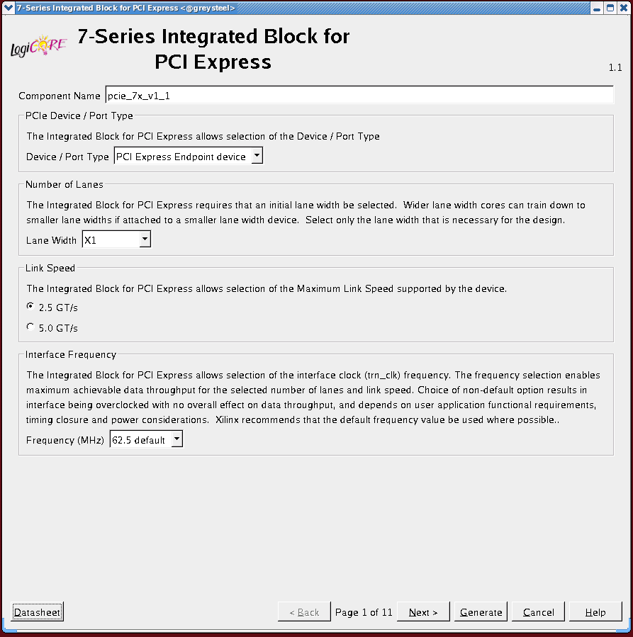
CORE Generator Interface Simplifies Design Tasks
Configures the PCIe Integrated Block
Lane width*, link speed*, BAR settings, buffer configurations, interrupts
Configures the GTX transceivers for specific PCIe requirements
Electrical Idle, OOB signaling, signal swing, de-emphasis, channel bonding*, data rate selection*
Connects PCIe, block RAM, GTX/GTP
Automatically inserts pipeline registers between the PCIe block and block RAM if necessary
CORE Generator eliminates the complexity

Slide 31
Lessons
Serial Gigabit Transceivers
PCI Express Technology Interface
XADC
Summary

Slide 32
XADC Block Diagram
17 External
Analog Inputs
Analog
Digital
ADC Results
Status
Registers
ADC
Define XADC Operation
Initialise with Attributes
Mux
Control
Registers
On-Chip
Sensors
ADC 2
DRP
JTAG
Arbitrator
On-Chip Sensors Supplies ±1%
Temperature ±4°C
12 Bits
1 MSPS
2 x 12 Bits
1 MS/s
Interconnect
Dynamic Reconfiguration Port Interface

Slide 33
High Quality ADCs
High resolution Analog to Digital Converters (ADCs)
Factory tested and specified 12-bit accuracy with 1V input range
16-bit resolution conversion
Built in digital gain and offset correction / calibration
Fast sampling
Conversion time of 1 us with support for simultaneous sampling
Flexible timing modes (self and externally triggered sampling modes)
Separate track/hold amplifier for each ADC ensures maximum throughput using multiplexed analog input channels
Flexible analog inputs
Differential analog inputs with high common mode noise rejection
Support for unipolar, bipolar, and true differential input signal types
Available in all 7 series devices
Notes:
The ADCs in the XADC block are fast and precise. These can replace external ADCs in many applications, reducing overall system cost.
This can be especially true in systems built using smaller Artix-7 devices.

Slide 34
Other Features
Internal and external multiplexing and sampling
Can sample internal power supplies and temperature
Multiplexes internal sources and 17 external analog inputs
Can control an external analog multiplexer to reduce pin count
Flexible triggering
Conversion data is stored in internal status registers
Internal control registers control source selection, sampling, and alarms
Registers can be accessed internally via Dynamic Reconfiguration Port (DRP)
Register can be accessed via JTAG
Available on power up, before configuration
Accessible through ChipScope™ Pro tool GUI
Operates over a wide temperature range (–40°C to +125°C)
Notes:
The XADC can generate alarm outputs whenever one of the internal measurements goes outside bounds set in the control registers.

Slide 35
Lessons
Serial Gigabit Transceivers
PCI Express Technology Interface
XADC
Summary

Slide 36
Summary
By fully utilizing your dedicated hardware, you can save substantial FPGA resources and improve system speed
Almost all 7 series FPGAs provide high-speed serial transceivers
Type and number vary by family; only the smallest Artix-7 devices have none
All versions support a variety of protocols

Slide 37
Where Can I Learn More?
User Guides
7 Series FPGAs GTX Transceivers User Guide, UG596
Describes the GTX transceivers in the Kintex-7 FPGAs
Xilinx Education Services courses
www.xilinx.com/training
Designing with the 7 Series Families course
Xilinx tools and architecture courses
Hardware description language courses
Basic FPGA architecture, Basic HDL Coding Techniques, and other Free videos!

Slide 38
Trademark Information
Xilinx is disclosing this Document and Intellectual Property (hereinafter “the Design”) to you for use in the development of designs to operate on, or interface with Xilinx FPGAs. Except as stated herein, none of the Design may be copied, reproduced, distributed, republished, downloaded, displayed, posted, or transmitted in any form or by any means including, but not limited to, electronic, mechanical, photocopying, recording, or otherwise, without the prior written consent of Xilinx. Any unauthorized use of the Design may violate copyright laws, trademark laws, the laws of privacy and publicity, and communications regulations and statutes.
Xilinx does not assume any liability arising out of the application or use of the Design; nor does Xilinx convey any license under its patents, copyrights, or any rights of others. You are responsible for obtaining any rights you may require for your use or implementation of the Design. Xilinx reserves the right to make changes, at any time, to the Design as deemed desirable in the sole discretion of Xilinx. Xilinx assumes no obligation to correct any errors contained herein or to advise you of any correction if such be made. Xilinx will not assume any liability for the accuracy or correctness of any engineering or technical support or assistance provided to you in connection with the Design.
THE DESIGN IS PROVIDED “AS IS" WITH ALL FAULTS, AND THE ENTIRE RISK AS TO ITS FUNCTION AND IMPLEMENTATION IS WITH YOU. YOU ACKNOWLEDGE AND AGREE THAT YOU HAVE NOT RELIED ON ANY ORAL OR WRITTEN INFORMATION OR ADVICE, WHETHER GIVEN BY XILINX, OR ITS AGENTS OR EMPLOYEES. XILINX MAKES NO OTHER WARRANTIES, WHETHER EXPRESS, IMPLIED, OR STATUTORY, REGARDING THE DESIGN, INCLUDING ANY WARRANTIES OF MERCHANTABILITY, FITNESS FOR A PARTICULAR PURPOSE, TITLE, AND NONINFRINGEMENT OF THIRD-PARTY RIGHTS.
IN NO EVENT WILL XILINX BE LIABLE FOR ANY CONSEQUENTIAL, INDIRECT, EXEMPLARY, SPECIAL, OR INCIDENTAL DAMAGES, INCLUDING ANY LOST DATA AND LOST PROFITS, ARISING FROM OR RELATING TO YOUR USE OF THE DESIGN, EVEN IF YOU HAVE BEEN ADVISED OF THE POSSIBILITY OF SUCH DAMAGES. THE TOTAL CUMULATIVE LIABILITY OF XILINX IN CONNECTION WITH YOUR USE OF THE DESIGN, WHETHER IN CONTRACT OR TORT OR OTHERWISE, WILL IN NO EVENT EXCEED THE AMOUNT OF FEES PAID BY YOU TO XILINX HEREUNDER FOR USE OF THE DESIGN. YOU ACKNOWLEDGE THAT THE FEES, IF ANY, REFLECT THE ALLOCATION OF RISK SET FORTH IN THIS AGREEMENT AND THAT XILINX WOULD NOT MAKE AVAILABLE THE DESIGN TO YOU WITHOUT THESE LIMITATIONS OF LIABILITY.
The Design is not designed or intended for use in the development of on-line control equipment in hazardous environments requiring fail-safe controls, such as in the operation of nuclear facilities, aircraft navigation or communications systems, air traffic control, life support, or weapons systems (“High-Risk Applications”). Xilinx specifically disclaims any express or implied warranties of fitness for such High-Risk Applications. You represent that use of the Design in such High-Risk Applications is fully at your risk.
© 2012 Xilinx, Inc. All rights reserved. XILINX, the Xilinx logo, and other designated brands included herein are trademarks of Xilinx, Inc. All other trademarks are the property of their respective owners.

