Slide 1
7 Series Memory Resources
Part 1

Slide 2
Objectives
After completing this module, you will be able to:
Describe the dedicated block memory resources in the 7 series FPGAs
Describe the different block memory modes available
Describe the capabilities of the built in FIFO

Slide 3
Lessons
Overview
Block RAM Capabilities
FIFO Capabilities
Using Block RAM Resources
Summary

Slide 4
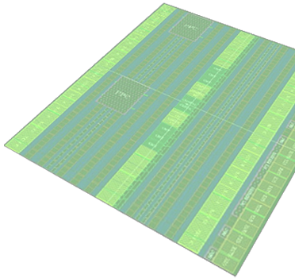
7 Series Block RAM and FIFO
All members of the 7 series families have the same Block RAM/FIFO
Fully synchronous operation
All operations are synchronous; all outputs are latched
Optional internal pipeline register for higher frequency operation
Two independent ports access common data
Individual address, clock, write enable, clock enable
Independent data widths for each port
Multiple configuration options
True dual-port, simple dual-port, single-port
Integrated cascade logic
Byte-write enable in wider configurations
Integrated control for fast and efficient FIFOs
Integrated 64 / 72-bit Hamming error correction
Separate Vbram supply to ensure block memory functionality in -1L
36K Memory
or
FIFO
Dual-Port
BRAM
Notes:
The 7 series FPGAs have a separate Vccbram power supply. This allows the voltage of the core to be lowered in the -1L part without also lowering the voltage of the block RAMs.
Unused block RAMs are automatically powered down by the configuration bitstream. This reduces overall power of the FPGA.
The block memory contents is initialized during configuration with the FPGA bitstream. If you reset the memory while it is running, you only clear the register contents in the FPGA, not the contents of the Block RAM memory unless you overwrite the memory contents.

Slide 5
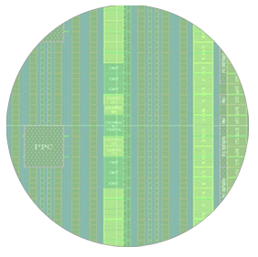
7 Series Block RAM and FIFO Block
Each block RAM block can be used as
36 Kb
BRAM /
FIFO
18 Kb
BRAM
or
18 Kb
BRAM /
FIFO
(1) 36 Kb BRAM
OR
(1) 36 Kb or FIFO
(2) independent 18 Kb block RAMs
OR
(1) 18 Kb FIFO + (1) 18 Kb block RAM

Slide 6
Lessons
Overview
Block RAM Capabilities
FIFO Capabilities
Using Block RAM Resources
Summary

Slide 7
Single-Port Block RAM
ADDRA
Port A
36
36
DIA
DOA
4
WEA
CLKA
36 Kb Memory Array
Single read/write port
Clock: CLKA
Address: ADDRA
Write enable: WEA
Write data: DIA
Read data: DOA
36-kbit configurations
32k x 1, 16k x 2, 8k x 4, 4k x 9, 2k x 18, 1k x 36
18-kbit configurations
16k x 1, 8k x 2, 4k x 4, 2k x 9, 1k x 18, 512 x 36
Configurable write mode
WRITE_FIRST: Data written on DIA is available on DOA
READ_FIRST: Old contents of RAM at ADDRA is presented on DOA
NO_CHANGE: The DOA holds its previous value (saves power)
Notes:
In addition to the signals shown above, the RAM port also has:
RAM enable: ENA
Output latch reset: RSTRAMA
Output register reset: RSTREGA
Output register chip enable: REGCEA
For simplicity, the DIA and DOA busses are shown as including the parity bits, which are actually on separate buses, DIPA and DOPA.
The polarity of the RST, CE, and CLK signals are programmable. The RST signals are synchronous.
The priority of REGCEA over RSTREGA is programmable via the RSTREG_PRIORITY attribute.
It is important to ensure that no timing violations occur on the address pins of the RAM, even if the write enable is not asserted. Violating address timing (even during a read operation) can corrupt the RAM contents.

Slide 8
True Dual-Port Block RAM
Two separate read/write ports
Each port has separate clock, address, data in, data out, write enable…
Clocks can be asynchronous to each other
The two ports can have different widths
Same configurations as when single ported
The two ports can have different write modes
No contention avoidance when both ports access the same address, except
If clocked by the same clock, and the write port is READ_FIRST, the read port gets the old data
ADDRA
Port A
36
36
DIA
DOA
4
WEA
CLKA
36 Kb Memory Array
36
ADDRB
36
4
DIB
DOB
WEB
CLKB
Port B
Notes:
Because the two ports can operate on independent clocks, it is up to the user to avoid contention.
If both ports attempt to write to the same location “too close together”, the contents of that RAM location can be corrupted.
If one port attempts to read from an address that is being written from the other port, the read result will be unpredictable.
In the special case where both ports are clocked by the same clock signal (that is, the two ports are synchronous), and the write port is in READ_FIRST mode, then the other port can read the old contents of a RAM location while the new value is being written.

Slide 9
Simple Dual-Port Block RAM
One read port and one write port
Each port has separate clock and address
In 36-kbit configuration, one of the two ports must be 72 bits wide
The other port can be x1, x2, x4, x9, x18, x36, or x72
In 18-kbit configuration, one of the two ports must be 36 bits wide
The other port can be x1, x2, x4, x9, x18, or x36
WRADDR
Port A
72
DI
8
WE
WRCLK
36 Kb Memory Array
RDADDR
72
DO
RDCLK
Port B
Notes:
At least one of the two ports in a simple dual-port block RAM must either be x64 or x72 wide. If a wide port is not necessary, use a true dual-port RAM instead, even if the functionality of a simple dual-port RAM would suffice.

Slide 10
Summary of Block RAM Configurations
 | 18kbit | 36kbit
Single Port | 16Kx1, 8Kx2, 4Kx4, 2Kx9, 1Kx18 | 32k x 1, 16Kx2, 8Kx4, 4Kx9, 2Kx18, 1Kx36 | 1 read/write port Read OR write in 1 cycle
True Dual Port | 16Kx1, 8Kx2, 4Kx4, 2Kx9, 1Kx18 | 32Kx1, 16Kx2, 8Kx4, 4Kx9, 2Kx18, 1Kx36 | Two fully independent read/write ports Any two operations in 1 cycle
Simple Dual Port | 16Kx1, 8Kx2, 4Kx4, 2Kx9, 1Kx18, 512x36 | 32K x 1, 16Kx2, 8Kx4, 4Kx9, 2Kx18, 1Kx36, 512x72 | 1 read port and 1 write port Read AND write in 1 cycle

Slide 11
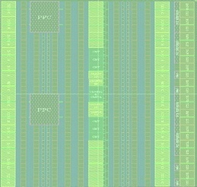
Block RAM Cascading
Built-in cascade logic for 64Kx1
Cascade two vertically adjacent 32Kx1 block RAMs without using external CLB logic or compromising performance
Saves resources and improves speed of larger memories
Cascade option for larger arrays
128Kb, 256Kb, 512Kb, 1 Mb, …
Using external CLB logic for depth expansion
Not quite as fast as cascaded block RAMs
Width expansion uses parallel block RAMs
DQ
DI
A[13:0]
A14
WE _ Control)
1
0
DO
DQ
DQ
DI
Ram_ Extension
1
A[13:0]
1
0
DQ
DQ
DI
A[13:0]
A14
WE _ Control)
Not Used
1
0
DQ
DQ
Ram_ Extension
1
1
0
DQ
Example: Cascade 8 block RAMs to build 256-Kb memory

Slide 12
Integrated Error Correction
Built-in optional error correction / detection
64-bit ECC (Hamming code, uses all 72 bits)
Corrects all single-bit errors
On outputs but not in the memory array
Detects, but does not correct, all double-bit errors
Identifies the address of the error
Error insertion for testing purposes
Can also be used with external memory interfaces
18 kbit
64-bits
+
Code
FIFO Logic
ECC and Interconnect
18 kbit

Slide 13
Byte-Wide Write Enable
clk
Byte write during write-first mode
Bytes not being written will show existing memory value on the output
Output thus truly reflects the new memory content
Writing always implies a read
address
a0
data
ABCD
we[3:0]
1001
memory@a0
FFFF
AFFD
output
AFFD
Controls which byte is being written
One write enable for each byte of data and its parity bit
Useful when interfacing with processors

Slide 14
Lessons
Overview
Block RAM Capabilities
FIFO Capabilities
Using Block RAM Resources
Summary

Slide 15
Summary
The 7 series block RAM provides the on-chip bulk memory required by many applications
Complements the distributed SelectRAM resources and off-chip memories
Provides huge aggregate bandwidth
Each block RAM has up to two 72-bit ports
Supports byte write capability
Has integrated FIFO logic
Has integrated error correcting logic
36K Memory
FIFO
Dual-Port
BRAM

Slide 16
Where Can I Learn More?
User Guides
7 Series FPGAs Memory Resources User Guide
Describes the complete block memory and FIFO resources
White Papers
Xilinx 7 Series FPGAs Embedded Memory Advantages, WP377
Discusses the features at a high level that is good for new users
Xilinx Education Services courses
www.xilinx.com/training
Designing with the 7 Series Families course
Xilinx tools and architecture courses
Hardware description language courses
Basic FPGA architecture, Basic HDL Coding Techniques, and other Free Videos!

Slide 17
Trademark Information
Xilinx is disclosing this Document and Intellectual Property (hereinafter “the Design”) to you for use in the development of designs to operate on, or interface with Xilinx FPGAs. Except as stated herein, none of the Design may be copied, reproduced, distributed, republished, downloaded, displayed, posted, or transmitted in any form or by any means including, but not limited to, electronic, mechanical, photocopying, recording, or otherwise, without the prior written consent of Xilinx. Any unauthorized use of the Design may violate copyright laws, trademark laws, the laws of privacy and publicity, and communications regulations and statutes.
Xilinx does not assume any liability arising out of the application or use of the Design; nor does Xilinx convey any license under its patents, copyrights, or any rights of others. You are responsible for obtaining any rights you may require for your use or implementation of the Design. Xilinx reserves the right to make changes, at any time, to the Design as deemed desirable in the sole discretion of Xilinx. Xilinx assumes no obligation to correct any errors contained herein or to advise you of any correction if such be made. Xilinx will not assume any liability for the accuracy or correctness of any engineering or technical support or assistance provided to you in connection with the Design.
THE DESIGN IS PROVIDED “AS IS" WITH ALL FAULTS, AND THE ENTIRE RISK AS TO ITS FUNCTION AND IMPLEMENTATION IS WITH YOU. YOU ACKNOWLEDGE AND AGREE THAT YOU HAVE NOT RELIED ON ANY ORAL OR WRITTEN INFORMATION OR ADVICE, WHETHER GIVEN BY XILINX, OR ITS AGENTS OR EMPLOYEES. XILINX MAKES NO OTHER WARRANTIES, WHETHER EXPRESS, IMPLIED, OR STATUTORY, REGARDING THE DESIGN, INCLUDING ANY WARRANTIES OF MERCHANTABILITY, FITNESS FOR A PARTICULAR PURPOSE, TITLE, AND NONINFRINGEMENT OF THIRD-PARTY RIGHTS.
IN NO EVENT WILL XILINX BE LIABLE FOR ANY CONSEQUENTIAL, INDIRECT, EXEMPLARY, SPECIAL, OR INCIDENTAL DAMAGES, INCLUDING ANY LOST DATA AND LOST PROFITS, ARISING FROM OR RELATING TO YOUR USE OF THE DESIGN, EVEN IF YOU HAVE BEEN ADVISED OF THE POSSIBILITY OF SUCH DAMAGES. THE TOTAL CUMULATIVE LIABILITY OF XILINX IN CONNECTION WITH YOUR USE OF THE DESIGN, WHETHER IN CONTRACT OR TORT OR OTHERWISE, WILL IN NO EVENT EXCEED THE AMOUNT OF FEES PAID BY YOU TO XILINX HEREUNDER FOR USE OF THE DESIGN. YOU ACKNOWLEDGE THAT THE FEES, IF ANY, REFLECT THE ALLOCATION OF RISK SET FORTH IN THIS AGREEMENT AND THAT XILINX WOULD NOT MAKE AVAILABLE THE DESIGN TO YOU WITHOUT THESE LIMITATIONS OF LIABILITY.
The Design is not designed or intended for use in the development of on-line control equipment in hazardous environments requiring fail-safe controls, such as in the operation of nuclear facilities, aircraft navigation or communications systems, air traffic control, life support, or weapons systems (“High-Risk Applications”). Xilinx specifically disclaims any express or implied warranties of fitness for such High-Risk Applications. You represent that use of the Design in such High-Risk Applications is fully at your risk.
© 2012 Xilinx, Inc. All rights reserved. XILINX, the Xilinx logo, and other designated brands included herein are trademarks of Xilinx, Inc. All other trademarks are the property of their respective owners.

Slide 18
7 Series Memory Resources
Part 2

Slide 19
Objectives
After completing this module, you will be able to:
Describe the capabilities of the built in FIFO
Describe how to add a memory component to your design

Slide 20
Lessons
Overview
Block RAM Capabilities
FIFO Capabilities
Using Block RAM Resources
Summary

Slide 21
FIFO Mode Top-Level View
Full featured
Synchronous or asynchronous read and write clocks
Four flags
Full, empty, programmable almost-full/empty
Optional first-word-fall-through
FIFO configurations
Any 36-Kb block RAM: 8Kx4, 4Kx9, 2Kx18, 1Kx36, 512x72
Any 18-Kb block RAM: 4Kx4, 2Kx9, 1Kx18, 512x36
Write and read width must be equal
Can use the integrated error correction when used in the x72 width
DIN Bus
WREN
WRCLK
RDEN
RDCLK
RESET
DOUT Bus
FULL
AFULL
EMPTY
AEMPTY
RDERR
WRERR
RDCONT<11:0>
WRDCONT<11:>
>
>
Notes:
The depth of the FIFO is determined by the size of the block RAM. When using First Word Fall Through mode, the FIFO depth is one element larger than the block RAM size. This is slightly different from previous implementations.

Slide 22
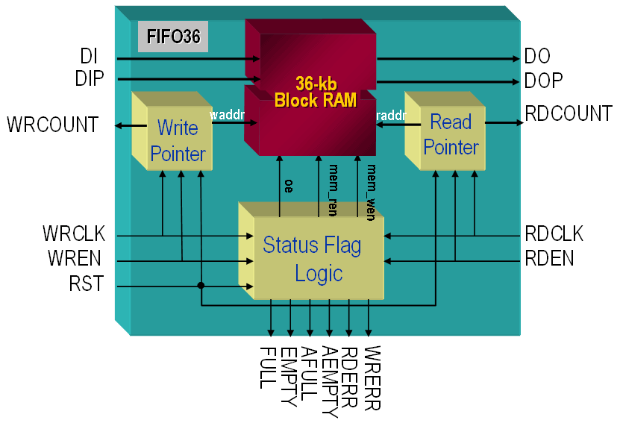
FIFO Modes
Asynchronous clocks
Can be used in Standard or FWFT
EN_SYN = FALSE (default)
Synchronous clocks
Can be used in Standard mode only
EN_SYN = TRUE
Deassertion of flags has lower latency
Notes:
Reading data from the FIFO is synchronous to the rising edge of RDCLK.
Writing data to the FIFO is synchronous to the rising edge of WRCLK.

Slide 23
Flags
Generates flags for FIFO status
FULL: No more room exists for write data in the FIFO
ALMOST_FULL: Less than a programmable amount of space exists for write data
EMPTY: There is no data currently in the FIFO
ALMOST_EMPTY: Less than a programmable number of words of data exist in the FIFO
FULL and ALMOST_FULL are synchronous to the write clock
FULL is asserted with 0 clocks of latency after write, ALMOST_FULL with 1 clock of latency
Deassertion latency is up to 4 clocks in asynchronous mode, or the same as assertion in synchronous mode
EMPTY and ALMOST_EMPTY are synchronous to the read clock
EMPTY is asserted with 0 clocks of latency after read, ALMOST_EMPTY with 1 clock of latency
Deassertion latency is up to 4 clocks in asynchronous mode, or the same as assertion in synchronous mode
Notes:
FIFO also provides WRERR, which is asserted when a write is attempted to a full FIFO, and RDERR, when reading from an empty FIFO.
RDCOUNT and WRCOUNT are the current address pointers into the underlying RAM (on RDCLK and WRCLK, respectively).
In synchronous mode, the ALMOST_EMPTY level can be programmed to be between 1 and DEPTH-2. In Asynchronous mode, the range is 5 to DEPTH-6, or 6 to DEPTH-6 in FWFT mode.
The ALMOST_FULL level can also be 1 to DEPTH-2 in synchronous mode, 4 to DEPTH-7 in asynchronous mode, and 4 to DEPTH-8 in FWFT mode.
These limits are slightly different than in previous technologies.

Slide 24
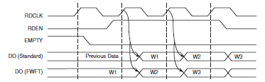
First Word Fall Through (FWFT) Mode
In normal mode the first word of data must be actively read from the FIFO
When EMPTY is deasserted, RDEN must be asserted to access the first word
In First Word Fall Through mode, data appears on the read port as soon as it is pushed into the FIFO
The RDEN signal signals acceptance of the data on DO
Mode is controlled by the FIRST_WORD_FALL_THROUGH attribute

Slide 25
Lessons
Overview
Block RAM Capabilities
FIFO Capabilities
Using Block RAM Resources
Summary

Slide 26
Inference
Single-port, true dual-port, and simple dual-port block RAMs can be inferred
RTL code that describes the functionality of the desired RAM will infer the RAM
RTL description must match capability
Synchronous write and read
One or two addresses being accessed each clock
Synchronous reset for output stages only (not array)
Synthesis directives can be used to help the synthesis tool choose the right resource
For example when a RAM could be implemented in either distributed SelectRAM™ memory or block RAM
FIFOs cannot be inferred
Notes:
For more information on inferring RAMs, refer to the user guide for your synthesis tool.

Slide 27
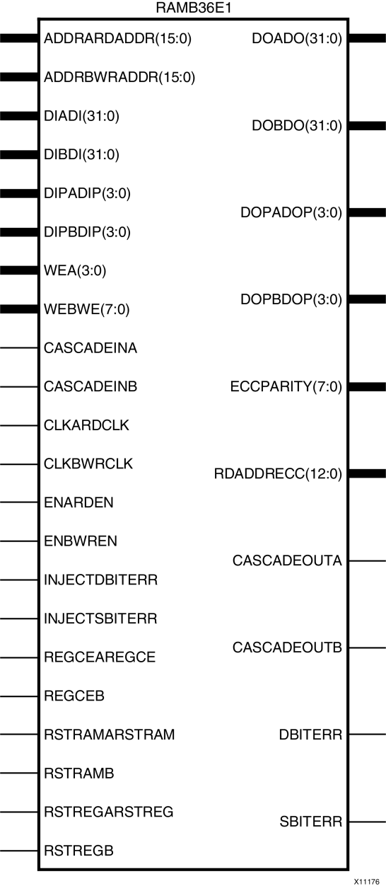
Instantiation
Block RAMs and FIFOs can be directly instantiated
The 7 series Library Guide contains the complete description of the primitive’s ports and attributes
The language template also gives the ports and attributes
Click in the Project Navigator
There are many ports and attributes to the block RAM, which makes direct instantiation difficult

Slide 28
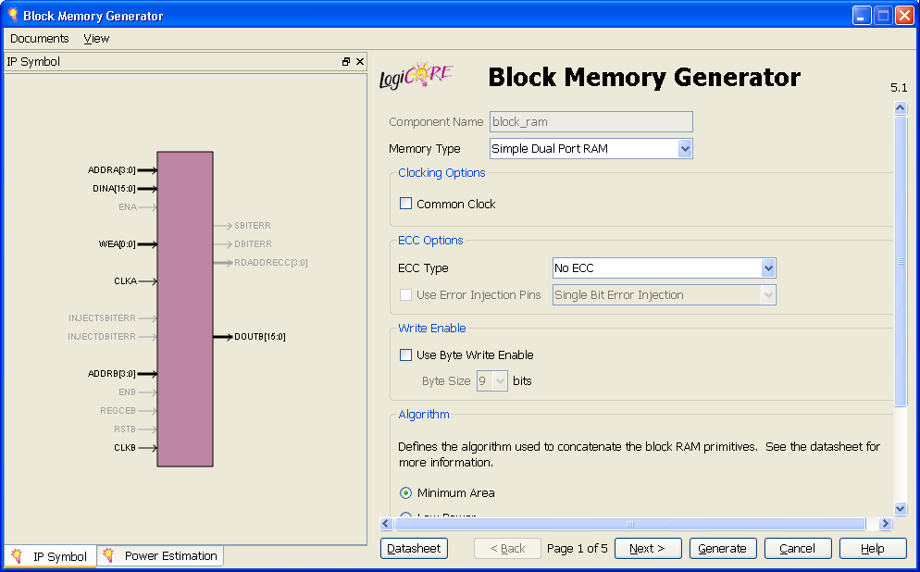
Block Memory Generator and FIFO Generator
The CORE Generator interface offers a simple graphical user interface for generating customized block RAM and FIFO components
Provides instantiation templates and all files required for implementation and simulation

Slide 29
Lessons
Overview
Block RAM Capabilities
FIFO Capabilities
Using Block RAM Resources
Summary

Slide 30
Summary
The 7 series block RAM provides the on-chip bulk memory required by many applications
Complements the distributed SelectRAM resources and off-chip memories
Provides huge aggregate bandwidth
Each block RAM has up to two 72-bit ports
Supports byte write capability
Has integrated FIFO logic
Has integrated error correcting logic
36K Memory
FIFO
Dual-Port
BRAM

Slide 31
Where Can I Learn More?
User Guides
7 Series FPGAs Memory Resources User Guide
Describes the complete block memory and FIFO resources
Xilinx Education Services courses
www.xilinx.com/training
Designing with the 7 Series Families course
Xilinx tools and architecture courses
Hardware description language courses
Basic FPGA architecture, Basic HDL Coding Techniques, and other Free Videos!

Slide 32
Trademark Information
Xilinx is disclosing this Document and Intellectual Property (hereinafter “the Design”) to you for use in the development of designs to operate on, or interface with Xilinx FPGAs. Except as stated herein, none of the Design may be copied, reproduced, distributed, republished, downloaded, displayed, posted, or transmitted in any form or by any means including, but not limited to, electronic, mechanical, photocopying, recording, or otherwise, without the prior written consent of Xilinx. Any unauthorized use of the Design may violate copyright laws, trademark laws, the laws of privacy and publicity, and communications regulations and statutes.
Xilinx does not assume any liability arising out of the application or use of the Design; nor does Xilinx convey any license under its patents, copyrights, or any rights of others. You are responsible for obtaining any rights you may require for your use or implementation of the Design. Xilinx reserves the right to make changes, at any time, to the Design as deemed desirable in the sole discretion of Xilinx. Xilinx assumes no obligation to correct any errors contained herein or to advise you of any correction if such be made. Xilinx will not assume any liability for the accuracy or correctness of any engineering or technical support or assistance provided to you in connection with the Design.
THE DESIGN IS PROVIDED “AS IS" WITH ALL FAULTS, AND THE ENTIRE RISK AS TO ITS FUNCTION AND IMPLEMENTATION IS WITH YOU. YOU ACKNOWLEDGE AND AGREE THAT YOU HAVE NOT RELIED ON ANY ORAL OR WRITTEN INFORMATION OR ADVICE, WHETHER GIVEN BY XILINX, OR ITS AGENTS OR EMPLOYEES. XILINX MAKES NO OTHER WARRANTIES, WHETHER EXPRESS, IMPLIED, OR STATUTORY, REGARDING THE DESIGN, INCLUDING ANY WARRANTIES OF MERCHANTABILITY, FITNESS FOR A PARTICULAR PURPOSE, TITLE, AND NONINFRINGEMENT OF THIRD-PARTY RIGHTS.
IN NO EVENT WILL XILINX BE LIABLE FOR ANY CONSEQUENTIAL, INDIRECT, EXEMPLARY, SPECIAL, OR INCIDENTAL DAMAGES, INCLUDING ANY LOST DATA AND LOST PROFITS, ARISING FROM OR RELATING TO YOUR USE OF THE DESIGN, EVEN IF YOU HAVE BEEN ADVISED OF THE POSSIBILITY OF SUCH DAMAGES. THE TOTAL CUMULATIVE LIABILITY OF XILINX IN CONNECTION WITH YOUR USE OF THE DESIGN, WHETHER IN CONTRACT OR TORT OR OTHERWISE, WILL IN NO EVENT EXCEED THE AMOUNT OF FEES PAID BY YOU TO XILINX HEREUNDER FOR USE OF THE DESIGN. YOU ACKNOWLEDGE THAT THE FEES, IF ANY, REFLECT THE ALLOCATION OF RISK SET FORTH IN THIS AGREEMENT AND THAT XILINX WOULD NOT MAKE AVAILABLE THE DESIGN TO YOU WITHOUT THESE LIMITATIONS OF LIABILITY.
The Design is not designed or intended for use in the development of on-line control equipment in hazardous environments requiring fail-safe controls, such as in the operation of nuclear facilities, aircraft navigation or communications systems, air traffic control, life support, or weapons systems (“High-Risk Applications”). Xilinx specifically disclaims any express or implied warranties of fitness for such High-Risk Applications. You represent that use of the Design in such High-Risk Applications is fully at your risk.
© 2012 Xilinx, Inc. All rights reserved. XILINX, the Xilinx logo, and other designated brands included herein are trademarks of Xilinx, Inc. All other trademarks are the property of their respective owners.

