Slide 1
7 Series Slice Flip-Flops
Part 1

Slide 2
Objectives
After completing this module, you will be able to:
Describe the control sets of the slice flip-flops
Identify the implications of the control sets on packing

Slide 3
Lessons
Control Sets
Designing Resets
Other Reset Considerations
Summary

Slide 4
Slice Flip-Flop Capabilities
All flip-flops are D type
All flip-flops have a single clock input (CLK)
Clock can be inverted at the slice boundary
All flip-flops have an active high chip enable (CE)
All flip-flops have an active high SR input
SR can be synchronous or asynchronous, as determined by the configuration bit stream
Sets the flip-flop value to a pre-determined state, as determined by the configuration bit stream
All flip-flops are initialized during configuration
D
D
Q
CE
CE
CK
CK
SR
SR

Slide 5
Chip Enable
All flip-flops in the 7 series FPGAs have a chip enable (CE) pin
Active high, synchronous to CLK
When asserted, the flip-flop clocks in the D input
When not asserted, the flip-flop holds the current value
Inferred naturally from RTL code
always @ (posedge CLK )
begin if (CE)
Q <= D;
end
FF: process (CLK)
begin
if (rising_edge CLK) then if (CE = ‘1’) then
Q <= D;
end if;
end if;
end
Notes:
The chip enable of the flip-flop is active high. If you code for an active-low chip enable, the synthesis tool will infer a LUT to invert the signal.

Slide 6
Reset and Initialization
The flip-flop has a single active high SR port
The SR port can be configured as either a synchronous set/reset or asynchronous preset/clear port
When asserted, the flip-flop output will be forced to the SRVAL attribute of the flip-flop
This attribute is extracted automatically from your RTL code based on your reset structure
The flip-flop also has an initialization value, INIT
This is the value loaded into the flip-flop during configuration, and when the global set reset (GSR) signal is asserted
This attribute can also be extracted from your RTL code by some synthesis tools
Notes:
The GSR signal will be described in more detail later in this module.

Slide 7
Asynchronous Reset
To infer asynchronous resets, the reset signal must be in the sensitivity list of the process
Output takes reset value immediately
Even if clock is not present
SRVAL attribute is determined by reset value in RTL code
always @ (posedge CLK or posedge RST )
begin if (RST)
Q <= 1’b0;
else
Q <= D;
end
FF: process (CLK, RST)
begin
if (RST = ‘1’) then
Q <= ‘0’;
elsif (rising_edge CLK) then
Q <= D;
end if;
end
SRVAL
SRVAL

Slide 8
Using Asynchronous Resets
Deassertion of reset should be synchronous to the clock
Not synchronizing the deassertion of reset can create problems
Flip-flops can go metastable
Not all flip-flops are guaranteed to come out of reset on the same clock
Use a reset bridge to synchronize reset to each domain
rst_pin
SR
SR
D
D
0
D
Q
D
Q
rst_clkA
CE
CE
CK
CK
CK
CK
SR configured as asynchronous, SRVAL=1
SR
SR
clkA
Notes:
Using an un-synchronized asynchronous reset can cause your system to fail to come out of reset properly.
Any flip-flop that can change state on the clock after reset is deasserted may go metastable.
The metastability can cause circuit failure.
In addition, flip-flops may come out of reset on different clocks. If different bits of the same state machine come out of reset on different clocks, the state machine may transition into an illegal state.
By default, the reset recovery timing check (reg_sr_r) is enabled for Virtex®-6, Spartan®-6, and 7 series FPGAs.

Slide 9
Synchronous Reset
A synchronous reset will not take effect until the first active clock edge after the assertion of the RST signal
The RST pin of the flip-flop is a regular timing path endpoint
The timing path ending at the RST pin will be covered by a PERIOD constraint on the clock
always @ (posedge CLK)
begin if (RST)
Q <= 1’b0;
else
Q <= D;
end
FF: process (CLK)
begin
if (rising_edge CLK) then
if (RST = ‘1’) then
Q <= ‘0’;
else
Q <= D;
end if;
end
SRVAL
SRVAL
Notes:
For a synchronous reset, the source of the RST signal should also be synchronous to each clock domain.

Slide 10
Initialization
When the FPGA is configured, flip-flops are loaded with an initialization value
The value is determined by the INIT attribute
The INIT value can be restored by asserting the GSR net
The initial value of the reg/signal that is used for the flip-flop is extracted by the synthesis tool
reg Q =1’b1;
always @ (posedge CLK or posedge RST )
begin if (RST)
Q <= 1’b0;
else
Q <= D;
end
signal Q: std_logic:=‘1’;
FF: process (CLK, RST)
begin
if (RST = ‘1’) then
Q <= ‘0’;
elsif (rising_edge CLK) then
Q <= D;
end if;
end
INIT
INIT
SRVAL
SRVAL
Notes:
The ability to extract the INIT value from the RTL code is relatively new, and may not be supported by all synthesis tools.
The SRVAL and INIT need not be the same value.

Slide 11
Control Sets
All flip-flops and flip-flop/latches share the same CLK, SR, and CE signals
This is referred to as the “control set” of the flip-flops
CE and SR are active high
CLK can be inverted at the slice boundary
If any one flip-flop uses a CE, all others must use the same CE
CE gates the clock at the slice boundary
Saves power
If any one flip-flop uses the SR, all others must use the same SR
The reset value used for each flip-flop is individually set by the SRVAL attribute
AFF
AFF/LATCH
D
Q
D
CE
D
Q
CE
CK
CE
CK
CK
SR
SR
SR
● ● ●
● ● ●
DFF
DFF/LATCH
D
Q
CE
D
Q
CK
CE
CK
SR
SR
Notes:
All flip-flops within the slice will enter and leave the reset state at the same time because they share the same SR signal. However, each flip-flop has its own SRVAL attribute, so the value forced on to the Q output when in the reset state is individually set.

Slide 12
Managing Control Sets
Eight registers per slice; all use the same control set
If the number of registers in a control set do not divide cleanly by eight, some registers will go unused
This is of concern for designs that have lots of low fanout control sets
A design with a large number of control sets potentially can show lower device utilization (but not always)
Designs with a small number of control sets are preferable
The key is to evaluate slices that have unused registers
Try to build designs with common control sets (plan)

Slide 13
Control Port Usage Rules
Control signals are the signals that are connected to the actual control ports on the register
Clocks and asynchronous set/resets always become control signals
They cannot be moved to the datapath
Clock enables and synchronous set/resets sometimes become control signals (this is decided by the synthesis tool)
These control signals can be moved to the datapath (to a LUT input)
Asynchronous sets/resets have priority access to the control ports over synchronous sets/resets
Example: If an asynchronous reset and a synchronous reset are inferred on a single register
The asynchronous reset gets the port on the register
The synchronous reset gets a LUT input
There is no coding style or synthesis option that allows users to control when a LUT will be used for this purpose

Slide 14
Control Set Reduction – SR
Flip-flops with different control sets cannot be packed into the same slice
Synchronous SR port can be converted to a flip-flop without SR using a LUT
This results in higher LUT utilization, but may result in lower overall slice utilization
Design
FPGA
D
Q
D
Q
CK
CK
D
Q
3 Slices
CK
D
D
Q
1 Slice
set
SR
SRVAL=1
set
CK
D
Q
CK
D
D
Q
rst
SR
SRVAL=0
rst
CK
Notes:
This feature can be controlled using the “Reduce Control Sets” property of the synthesis process.
In this example, the three flip-flops in the original design must be placed in separate slices because they each use a different control set. All three flip-flops share the same clock, but one has no set/reset, a second uses a signal named ‘set’ to synchronously set it to a 1, and the other uses a signal named rst to reset it to 0.
If the synchronous set and reset functions are implemented using LUT logic, then all three flip-flops can be placed into the same slice. This implementation is shown on the right.
In some instances, the increased combinatorial logic can be combined with existing logic or placed in an unused LUT connected to the flip-flop. So the overall increase in LUT utilization may be small.

Slide 15
Control Set Reduction – CE
CE port can be converted to a flip-flop without CE using a LUT and routing
This results in higher LUT utilization, but may result in lower overall slice utilization
Design
FPGA
D
Q
D
Q
CK
CK
2 Slices
D
Q
1 Slice
ce
CE
CLK
D
Q
D
CK
ce
Notes:
In this example, the two flip-flops in the original design must be placed in separate slices because they each use a different control set. Both flip-flops share the same clock, but one has no CE, a second does.
If the CE function is implemented using LUT logic, then both flip-flops can be placed into the same slice. This implementation is shown on the right.

Slide 16
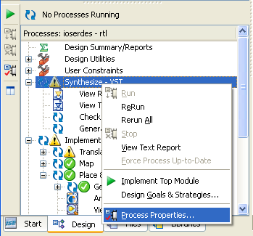
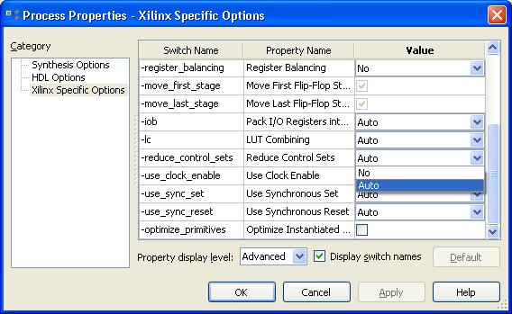
Setting Control Set Reduction in Synthesis
The synthesis tool can be instructed to reduce the number of control sets in the design
Setting the value to “Auto” instructs the synthesis tool to reduce control sets by converting synchronous SR and CE to LUT implementations where appropriate

Slide 17
Control Signal Problems
Instantiation of primitives and cores
Gate-level connection of UNISIM and core primitives dictates control signal usage
Be aware that some IP does not necessarily follow the guidelines presented later
Synthesis optimization
Synthesis may choose to build a control signal for logic optimization
Physical synthesis, design hierarchy, and incremental design practices
Can change control sets from the original specifications (be careful)
Global or logic optimization may choose to build a control signal for logic optimization
Notes:
Remember that when you instantiate a primitive, you are going to get what you build.
So if you instantiate a register (or a core that uses a register) and connect that port up, it will use that control signal.

Slide 18
Active-Low Control Signals
Problem: Active-low control signals can produce sub-optimal results
Control ports on registers are active high
Hierarchical design and design reuse can exacerbate this problem
This results in
Poor device utilization
More LUTs
Less dense slice packing
More routing resources necessary
Longer run times
Worse timing and power
Notes:
Active-low signals use more LUTs because they require inversion before they can directly drive the control port of a register. This inversion must be done with a LUT and thus takes up a LUT input.
If you use hierarchical design techniques (meaning you are using partitions, using keep hierarchy equals true, using cores, using multiple netlists, or using bottom-up synthesis), many inverters may be inferred.

Slide 19
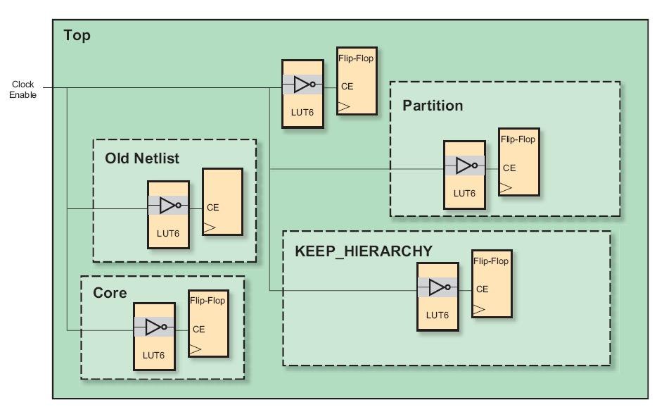
Use Active-High Control Signals
The inverters cannot be combined into the same slice
This consumes more power and makes timing difficult
Flip-Flop
Hierarchical design methods can proliferate LUT usage on active-low control signals
Notes:
Remember that the synthesis tools and the implementation tools cannot merge this logic into the same slice because the designer is not allowing optimization across a hierarchical boundary.
Instructor Note:
This slide is animated. Click once to show all animations.

Slide 20
Apply Your Knowledge
Can these flip-flops be placed into the same slice? Note: All control signals drive the control port of the flip-flop
Case 1
FF1: Clock, CE, Set
FF2: CLK, CE, Set
Case 2
FF1: CLK, CE, Reset
FF2: CLK, Reset
Case 3
FF1: CLK, CE, Reset
FF2: CLK, CE, not Reset
Case 4
FF1: CLK, CE, Reset
FF2: CLK, CE, Reset
Notes:
Active-low signals use more LUTs because they require inversion before they can directly drive the control port of a register. This inversion must be done with a LUT and thus takes up a LUT input.
If you use hierarchical design techniques (meaning you are using partitions, using keep hierarchy equals true, using cores, using multiple netlists, or using bottom-up synthesis), many inverters may be inferred.

Slide 21
Lessons
Control Sets
Designing Resets
Other Reset Considerations
Summary

Slide 22
Summary
Control set restrictions can reduce design utilization
Your reset methodology can have a significant impact on your design efficiency
For designs that are not pushing the limits of your technology, it is recommended that synchronous resets be used for all storage elements
For more sophisticated designs, a mixed approach where only critical logic is explicitly synchronously reset, and all other logic relies on the GSR is recommended
Use asynchronous resets only when required

Slide 23
Where Can I Learn More?
Software Manuals
Start → Xilinx ISE Design Suite 13.1 → ISE Design Tools → Documentation → Software Manuals
This includes the Synthesis & Simulation Design Guide
This guide has example inferences of many architectural resources
Xilinx Libraries Guide
FF functionality
Xilinx Education Services courses
www.xilinx.com/training
Xilinx tools and architecture courses
Hardware description language courses
Basic FPGA architecture, Basic HDL Coding Techniques, and other Free Videos!

Slide 24
Trademark Information
Xilinx is disclosing this Document and Intellectual Property (hereinafter “the Design”) to you for use in the development of designs to operate on, or interface with Xilinx FPGAs. Except as stated herein, none of the Design may be copied, reproduced, distributed, republished, downloaded, displayed, posted, or transmitted in any form or by any means including, but not limited to, electronic, mechanical, photocopying, recording, or otherwise, without the prior written consent of Xilinx. Any unauthorized use of the Design may violate copyright laws, trademark laws, the laws of privacy and publicity, and communications regulations and statutes.
Xilinx does not assume any liability arising out of the application or use of the Design; nor does Xilinx convey any license under its patents, copyrights, or any rights of others. You are responsible for obtaining any rights you may require for your use or implementation of the Design. Xilinx reserves the right to make changes, at any time, to the Design as deemed desirable in the sole discretion of Xilinx. Xilinx assumes no obligation to correct any errors contained herein or to advise you of any correction if such be made. Xilinx will not assume any liability for the accuracy or correctness of any engineering or technical support or assistance provided to you in connection with the Design.
THE DESIGN IS PROVIDED “AS IS" WITH ALL FAULTS, AND THE ENTIRE RISK AS TO ITS FUNCTION AND IMPLEMENTATION IS WITH YOU. YOU ACKNOWLEDGE AND AGREE THAT YOU HAVE NOT RELIED ON ANY ORAL OR WRITTEN INFORMATION OR ADVICE, WHETHER GIVEN BY XILINX, OR ITS AGENTS OR EMPLOYEES. XILINX MAKES NO OTHER WARRANTIES, WHETHER EXPRESS, IMPLIED, OR STATUTORY, REGARDING THE DESIGN, INCLUDING ANY WARRANTIES OF MERCHANTABILITY, FITNESS FOR A PARTICULAR PURPOSE, TITLE, AND NONINFRINGEMENT OF THIRD-PARTY RIGHTS.
IN NO EVENT WILL XILINX BE LIABLE FOR ANY CONSEQUENTIAL, INDIRECT, EXEMPLARY, SPECIAL, OR INCIDENTAL DAMAGES, INCLUDING ANY LOST DATA AND LOST PROFITS, ARISING FROM OR RELATING TO YOUR USE OF THE DESIGN, EVEN IF YOU HAVE BEEN ADVISED OF THE POSSIBILITY OF SUCH DAMAGES. THE TOTAL CUMULATIVE LIABILITY OF XILINX IN CONNECTION WITH YOUR USE OF THE DESIGN, WHETHER IN CONTRACT OR TORT OR OTHERWISE, WILL IN NO EVENT EXCEED THE AMOUNT OF FEES PAID BY YOU TO XILINX HEREUNDER FOR USE OF THE DESIGN. YOU ACKNOWLEDGE THAT THE FEES, IF ANY, REFLECT THE ALLOCATION OF RISK SET FORTH IN THIS AGREEMENT AND THAT XILINX WOULD NOT MAKE AVAILABLE THE DESIGN TO YOU WITHOUT THESE LIMITATIONS OF LIABILITY.
The Design is not designed or intended for use in the development of on-line control equipment in hazardous environments requiring fail-safe controls, such as in the operation of nuclear facilities, aircraft navigation or communications systems, air traffic control, life support, or weapons systems (“High-Risk Applications”). Xilinx specifically disclaims any express or implied warranties of fitness for such High-Risk Applications. You represent that use of the Design in such High-Risk Applications is fully at your risk.
© 2012 Xilinx, Inc. All rights reserved. XILINX, the Xilinx logo, and other designated brands included herein are trademarks of Xilinx, Inc. All other trademarks are the property of their respective owners.

Slide 25
7 Series Slice Flip-Flops
Part 2

Slide 26
Objectives
After completing this module, you will be able to:
Analyze different reset methodologies
Control the synthesis tool in these areas

Slide 27
Lessons
Control Sets
Designing Resets
Other Reset Considerations
Summary

Slide 28
Types of Reset
Global resets
Sets all storage elements to a known state based on global criteria
Assertion of an external reset pin
Waiting for a PLL/MMCM to lock
Local resets
Internally generated signal that causes some storage elements to be forced to a known state
Example: The terminal count on a counter clearing existing conditions

Slide 29
Local Resets
Synchronous resets
A synchronous local reset is simply a part of regular logic
Any generated condition that causes one or more flip-flops to be returned to a fixed state can be viewed as a local synchronous reset
Synthesis tools are free to use the synchronous SR port as part of the implementation of normal functionality
Asynchronous resets
Using locally generated asynchronous resets is not recommended
Any glitch on the generated reset signal can cause unwanted clearing
A runt pulse on the generated reset signal can cause metastability

Slide 30
Complete Global Synchronous Reset
Based on a global criteria, all storage elements are set to a known state, using a synchronous SR port
Each clock domain in the device uses a synchronized version of the global reset
Advantages
Simple to implement
“Foolproof”
Allows synthesis tools to perform control set reduction if necessary
Disadvantages
Will not work in situations where the clock is not guaranteed to be running
Uses substantial routing resources

Slide 31
Global Asynchronous Reset
Based on a global criteria, all storage elements are set to a known state, using an asynchronous SR port
Each clock domain in the device uses a synchronized version of the global reset
Advantages
Will work even if the clock is not present
Required for systems that need to generate valid outputs even when clock is not present
Input interfaces from “hot pluggable” devices
Interfaces using recovered clocks
Disadvantages
Cannot be control set reduced
Uses substantial routing resources
Notes:
There are some circumstances where a portion of a design may not have a valid clock.
Clocks may come from off-board resources that are hot-pluggable; when the source board is not inserted, a portion of the design has no clock. In these cases, it is still generally required that the outputs of the un-clocked portion of the design still be sane – at very least signaling “Idle”.
In the case of 3-state I/O, it may be important to disable 3-state outputs. In these situations, using an asynchronous reset may be required.

Slide 32
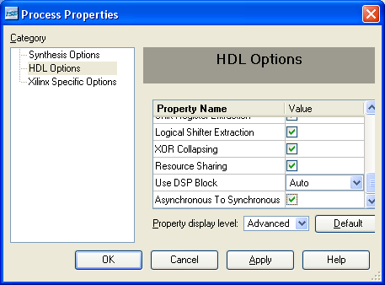
Changing to Synchronous Resets
All new code should use synchronous resets when a reset is necessary
For existing code, you have three choices
Leave alone
Acknowledge the possible drawbacks of asynchronous resets
Use synthesis switch (dangerous!)
Not the same as changing to synchronous reset
This can make the synthesis result different from the behavioral simulation
Recommended: Manually change (or use a script) the asynchronous reset to synchronous
Removing the top-level reset port does not get the same result as removing the reset from your code
Synplify: syn_clean_reset
XST: -async_to_sync YES
Notes:
If you have the existing code and are not having any trouble meeting timing, are fitting your device, and are happy with the operation of your device, then you may choose to do nothing.
Synthesis tools do not like to give you logic that is not reflective of the code. So be careful with this option. Using these switches is not the same as manually changing code.
Also note that some believe that if the global set/reset comes from a top-level port that is removed from the code, then the optimization algorithms will rip out the reset. It does not work this way. The synthesis algorithms that perform that optimization run after the low-level device resources are chosen. So, you still end up with a flip-flop that has an asynchronous reset.
Likewise, connecting a reset port high or low in your HDL would not remove the reset from a design that uses the reset as part of a core because the core would not be regenerated.

Slide 33
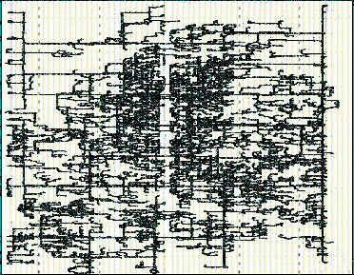
Reset Routing Costs
Routing can be considered one of the most valuable resources
Resets compete for the same resources as the rest of the active signals of the design
Including timing-critical paths
More available routing gives the tools a better chance to meet your timing objectives
Notes:
You can see how much fanout a typical reset can have. This is probably the biggest reason to remove resets from your design.

Slide 34
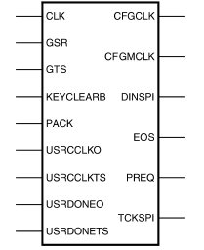
Global Set Reset (GSR)
GSR is a special reset signal that is used to hold the design in a reset state while the FPGA is being configured
After the configuration is complete, the GSR is released and all of the flip-flops and other resources now possess the INIT value
The deassertion of GSR can take several clocks to affect all flip-flops in your design
The deassertion of GSR is asynchronous to all system clocks
The GSR can be asserted again from fabric logic by instantiating the STARTUPE2 module
Allows connection to the GSR net inside the FPGA
STARTUPE2
Notes:
Relying on the GSR may be sufficient for a substantial portion of your design. Any signal that is known to keep its state immediately after reset (until some future triggering event occurs), can be implemented without a reset.
However, since the GSR is slow and asynchronous to your system clocks, special care must be taken when relying on this mechanism for control logic.
If logic can change state immediately after the deassertion of GSR, you can encounter the same problems as when using a non-synchronized reset; flip-flops can go metastable and state machines can go to illegal states.

Slide 35
Getting By Without Resets
Resets are generally used to
Initialize the design to a known state at power up
Control the starting up of the design after power up
The GSR ensures that all storage elements are at a known value after initialization
However, GSR deassertion is asynchronous and slow
Can cause metastability or illegal states in logic that starts autonomously
A mixed approach whereby the GSR is used to set the initial state and an explicit reset is used to manage the start up can be very efficient
Notes:
Any state machine, counter, or other logic that can change state “autonomously” cannot be solely reset by the GSR. Due to its asynchronous nature with respect to the design’s clock, it may result in flip-flops going metastable or state machines going into illegal states. Thus, these flip-flops will require an explicit reset that deasserts synchronously to the user clock.
However, other logic that can be guaranteed to remain in its INIT state after the GSR is deasserted (until some event occurs in the future), will function properly with only the GSR.
This mixed approach can result in reliable designs that are the most efficient in terms of reset routing. However, great care must be used to determine which portions of the design can rely solely on the GSR, and which need explicit resets.
Leaving a portion of the design to rely on the GSR inappropriately can result in an unreliable system.

Slide 36
Lessons
Control Sets
Designing Resets
Other Reset Considerations
Summary

Slide 37
DSP Slice Uses a Synchronous Reset
The DSP slice is more versatile than most realize
It can be used for multipliers, add/sub, MACC, counters (with programmable terminal count), comparators, shifters, multiplexer, pattern match, and many other logic functions
Each DSP slice effectively has more than 250 registers
None have an asynchronous reset
Using synchronous global resets allows the synthesis tool to use DSP slices more easily
Asynchronous reset methodologies will prevent the tools from using the storage resources in the DSP slices

Slide 38
Block RAM Uses a Synchronous Reset
Block RAMs obtain minimum clock-to-output time by using the output register
Output registers only have synchronous resets
Unused block RAMs can be used for many alternative purposes
ROMs, large LUTs, complex logic, state machines, and deep-shift registers, for example
Using block RAMs for other purposes can free up hundreds of flip-flops
Using the block RAM in dual-port mode allows for greater utilization of this resource
Using synchronous global resets allows the synthesis tool to use block RAMs more easily
Asynchronous resets will prevent the tools from using the output registers on block RAMs
Notes:
Inferring a block RAM requires a synchronous reset in your HDL.

Slide 39
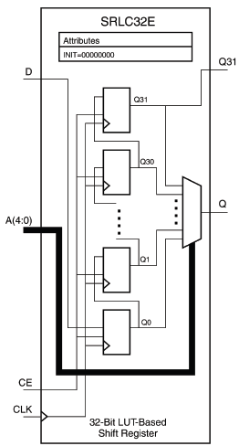
SRL Has No Reset Capabilities
Synthesis can infer SRL-based shift registers
But only if no resets are used (otherwise flip-flops are wasted)
Or, the synthesis tool can emulate the reset
This uses extra resources and negatively impacts timing
Notes:
There is no reset functionality built into the Shift-Register LUT. If you have a reset on the shift register that you code, the synthesis tools are left with one or two choices. They either do not implement the SRL, meaning they will use a bunch of registers (not what you want), or they try to emulate the reset.
Emulating the reset means that they add more logic and it becomes even slower than it should be.

Slide 40
Lessons
Control Sets
Designing Resets
Other Reset Considerations
Summary

Slide 41
Summary
Control set restrictions can reduce design utilization
Your reset methodology can have a significant impact on your design efficiency
For designs that are not pushing the limits of your technology, it is recommended that synchronous resets be used for all storage elements
For more sophisticated designs, a mixed approach where only critical logic is explicitly synchronously reset, and all other logic relies on the GSR is recommended
Use asynchronous resets only when required
That is, when the clock may not be present

Slide 42
Where Can I Learn More?
Software Manuals
Start → Xilinx ISE Design Suite 13.1 → ISE Design Tools → Documentation → Software Manuals
This includes the Synthesis & Simulation Design Guide
This guide has example inferences of many architectural resources
Xilinx Libraries Guide
FF functionality
Xilinx Education Services courses
www.xilinx.com/training
Xilinx tools and architecture courses
Hardware description language courses
Basic FPGA architecture, Basic HDL Coding Techniques, and other Free Videos!

Slide 43
Trademark Information
Xilinx is disclosing this Document and Intellectual Property (hereinafter “the Design”) to you for use in the development of designs to operate on, or interface with Xilinx FPGAs. Except as stated herein, none of the Design may be copied, reproduced, distributed, republished, downloaded, displayed, posted, or transmitted in any form or by any means including, but not limited to, electronic, mechanical, photocopying, recording, or otherwise, without the prior written consent of Xilinx. Any unauthorized use of the Design may violate copyright laws, trademark laws, the laws of privacy and publicity, and communications regulations and statutes.
Xilinx does not assume any liability arising out of the application or use of the Design; nor does Xilinx convey any license under its patents, copyrights, or any rights of others. You are responsible for obtaining any rights you may require for your use or implementation of the Design. Xilinx reserves the right to make changes, at any time, to the Design as deemed desirable in the sole discretion of Xilinx. Xilinx assumes no obligation to correct any errors contained herein or to advise you of any correction if such be made. Xilinx will not assume any liability for the accuracy or correctness of any engineering or technical support or assistance provided to you in connection with the Design.
THE DESIGN IS PROVIDED “AS IS" WITH ALL FAULTS, AND THE ENTIRE RISK AS TO ITS FUNCTION AND IMPLEMENTATION IS WITH YOU. YOU ACKNOWLEDGE AND AGREE THAT YOU HAVE NOT RELIED ON ANY ORAL OR WRITTEN INFORMATION OR ADVICE, WHETHER GIVEN BY XILINX, OR ITS AGENTS OR EMPLOYEES. XILINX MAKES NO OTHER WARRANTIES, WHETHER EXPRESS, IMPLIED, OR STATUTORY, REGARDING THE DESIGN, INCLUDING ANY WARRANTIES OF MERCHANTABILITY, FITNESS FOR A PARTICULAR PURPOSE, TITLE, AND NONINFRINGEMENT OF THIRD-PARTY RIGHTS.
IN NO EVENT WILL XILINX BE LIABLE FOR ANY CONSEQUENTIAL, INDIRECT, EXEMPLARY, SPECIAL, OR INCIDENTAL DAMAGES, INCLUDING ANY LOST DATA AND LOST PROFITS, ARISING FROM OR RELATING TO YOUR USE OF THE DESIGN, EVEN IF YOU HAVE BEEN ADVISED OF THE POSSIBILITY OF SUCH DAMAGES. THE TOTAL CUMULATIVE LIABILITY OF XILINX IN CONNECTION WITH YOUR USE OF THE DESIGN, WHETHER IN CONTRACT OR TORT OR OTHERWISE, WILL IN NO EVENT EXCEED THE AMOUNT OF FEES PAID BY YOU TO XILINX HEREUNDER FOR USE OF THE DESIGN. YOU ACKNOWLEDGE THAT THE FEES, IF ANY, REFLECT THE ALLOCATION OF RISK SET FORTH IN THIS AGREEMENT AND THAT XILINX WOULD NOT MAKE AVAILABLE THE DESIGN TO YOU WITHOUT THESE LIMITATIONS OF LIABILITY.
The Design is not designed or intended for use in the development of on-line control equipment in hazardous environments requiring fail-safe controls, such as in the operation of nuclear facilities, aircraft navigation or communications systems, air traffic control, life support, or weapons systems (“High-Risk Applications”). Xilinx specifically disclaims any express or implied warranties of fitness for such High-Risk Applications. You represent that use of the Design in such High-Risk Applications is fully at your risk.
© 2012 Xilinx, Inc. All rights reserved. XILINX, the Xilinx logo, and other designated brands included herein are trademarks of Xilinx, Inc. All other trademarks are the property of their respective owners.

