Slide 1
7 Series CLB Architecture
Part 1

Slide 2
Objectives
After completing this module, you will be able to:
Describe the fabric routing and CLB arrangement
Describe the CLB and slice resources available in 7 series FPGAs

Slide 3
Lessons
CLB Structure and Routing
Slice Resources
Distributed RAM/SRL
Using Slice Resources
Summary

Slide 4
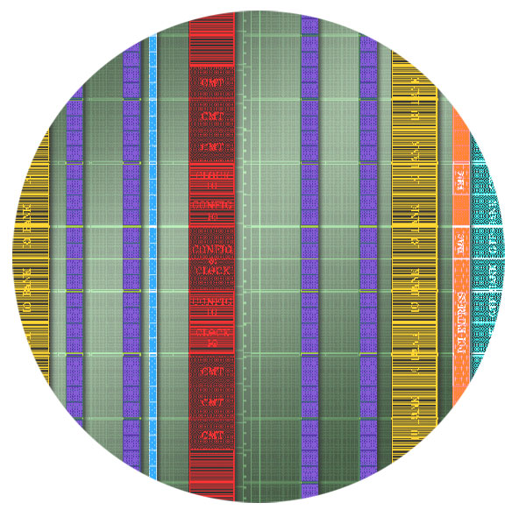

CLB in the 7 Series FPGAs
COUT
COUT
Primary resource for design
  Combinatorial functions
  Flip-flops
CLB contains two slices
Connected to switch
matrix for routing to other
FPGA resources
Carry chain runs
vertically in a column from
one slice to the one
above
Switch
Matrix
CIN
CIN

Slide 5
Symmetrical Layout
Pairs of CLBs are arranged symmetrically
  Improves density
  Saves metal by sharing clock lines
Improves routability
Slice
Clocks
Slice
Switch Matrix
Switch Matrix
Slice
Slice
Data
Data
Notes:
The symmetrical layout of CLB columns is a new feature of the 7 series FPGAs.
This arrangement utilizes silicon area more efficiently, which allows for higher logic cell counts.
This arrangement also reduces the clock routing; one set of clock lines can drive both the CLB on the left and the right. Previous generations had separate clock routing for each CLB, despite the fact that the same set of clocks was routed to all CLBs in a clock region.
Data routing to the CLBs is not shared; each CLB has its own data routing connections.

Slide 6
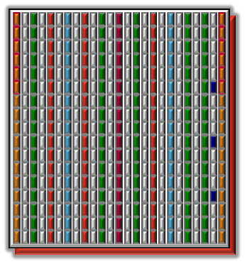
Fabric Routing
Connections between CLBs and other resources use the fabric routing resources
  Routing lines connect to the switch
  matrixes adjacent to the resources
Routes connect resources vertically,
horizontally, and diagonally
Routes have different spans
  Horizontal: Single, Dual, Quad, Long (12)
  Vertical: Single, Dual, Hex, Long (18)
  Diagonal: Single, Dual, Hex
Notes:
Routing decisions are made by the implementation tools, based upon the timing constraints that have been applied to the design.
The lengths of the vertical and diagonal routing resources has increased from the Virtex-6 family to improve vertical routing capabilities:
Quad lines have become Hex lines.
Long lines have increased from 16 to 18.
The changes in the routing lengths also contribute to substantially improved routability.

Slide 7
Lessons
CLB Structure and Routing
Slice Resources
Distributed RAM/SRL
Using Slice Resources
Summary

Slide 8
FPGA Slice Resources
Four six-input Look Up Tables (LUT)
Wide multiplexers
Carry chain
Four flip-flop/latches
Four additional flip-flops
The implementation tools (MAP)
are responsible for packing slice
resources into the slice
LUT/RAM/SRL
LUT/RAM/SRL
LUT/RAM/SRL
LUT/RAM/SRL
0 1
Notes:
Here is a simplified view of the full slice. The SRL cascade paths are not shown.

Slide 9
6-Input LUT with Dual Output
6-input LUT can be two 5-input LUTs with common inputs
  Minimal speed impact to
  a 6-input LUT
  One or two outputs
  Any function of six variables or
  two independent functions of
  five variables
6-LUT
A6
A5
A4
A3
A2
A1
A5
A4
A3
A2
A1
5-LUT
D
O6
A5
A4
A3
A2
A1
5-LUT
D
O5
Notes:
LUTs can perform any combinatorial function limited only by the number of inputs. It is your primary combinatorial logic resource and it is the industry standard.
The look-up table functionality is essentially a small memory containing the desired output value for each combination of input values.
The truth table for the desired function is stored in the memory.
The inputs of the function act as the address to be read from the memory (essentially a multiplexer controlled by the inputs).
The values for the storage elements are generated by the ISE® software tools, and downloaded to all LUTs at configuration time.
Each 6-input LUT can be configured as two 5-input LUTs. This gives the device a great deal of flexibility to build an efficient design.
Thus, the LUT can be used to build any function of six variables or two independent functions of five variables.
The synthesis and implementation tools use these resources to build combinatorial functions automatically.

Slide 10
Wide Multiplexers
Each F7MUX combines the outputs of two LUTs together
  Can implement an arbitrary 7-input function
  Can implement an 8-1 multiplexer
The F8MUX combines the outputs of the two F7MUXes
  Can implement an arbitrary 8-input function
  Can implement a 16-1 multiplexer
MUX is controlled by the BX/CX/DX slice input
MUX output can drive out combinatorially or to the flip-flop/latch
LUT/RAM/SRL
LUT/RAM/SRL
LUT/RAM/SRL
LUT/RAM/SRL
0 1
Notes:
The synthesis and implementation tools will automatically map logic to the F7MUX and F8MUX when appropriate.

Slide 11
Carry Chain
Carry chain can implement fast arithmetic addition and subtraction
  Carry out is propagated vertically through the four LUTs in a slice
  The carry chain propagates from one slice to the slice in the same column in the CLB above
Carry look-ahead
  Combinatorial carry look-ahead over the four LUTs in a slice
  Implements faster carry cascading from slice to slice
LUT/RAM/SRL
LUT/RAM/SRL
LUT/RAM/SRL
LUT/RAM/SRL
0 1

Slide 12
Slice Flip-Flops and Flip-Flop/Latches
FF
FF/L
Each slice has four flip-flop/latches (FF/L)
  Can be configured as either flip-flops or latches
  The D input can come from the O6 LUT output, the carry chain, the wide multiplexer, or the AX/BX/CX/DX slice input
Each slice also has four flip-flops (FF)
  D input can come from O5 output or the AX/BX/CX/DX input
    These don’t have access to the carry chain, wide multiplexers, or the slice inputs
If any of the FF/L are configured as latches, the four FFs are not available
LUT/RAM/SRL
LUT/RAM/SRL
LUT/RAM/SRL
LUT/RAM/SRL
0 1
Notes:
The four primary storage elements are referred to as “flip-flop/latch” elements.
These correspond to the storage elements that existed in previous generations.
They are named AFF/LATCH, BFF/LATCH, CFF/LATCH, and DFF/LATCH.
The four secondary storage elements are referred to simply as “flip-flop” elements.
They are named AFF, BFF, CFF, and DFF.

Slide 13
Slice Flip-Flop Capabilities
All flip-flops are D type
All flip-flops have a single clock input (CLK)
  Clock can be inverted at the slice boundary
All flip-flops have an active high chip enable (CE)
All flip-flops have an active high SR input
  Input can be synchronous or asynchronous, as determined by the configuration bit stream
  Sets the flip-flop value to a pre-determined state, as determined by the configuration bit stream
D
D
Q
CE
CE
CK
CK
SR
SR
Notes:
The management of the control signals (CLK, CE, and SR) are discussed in the “Slice Flip-Flops” module.

Slide 14
Lessons
CLB Structure and Routing
Slice Resources
Distributed RAM/SRL
Using Slice Resources
Summary

Slide 15
Summary
All slices contain four 6-input LUTs and eight registers
  LUTs can perform any combinatorial function of up to six inputs or two functions of five inputs
  Four of the eight registers can be used as flip-flops or latches; the remaining four can only be used as flip-flops
Slices also contain carry logic and the MUXF7 and MUXF8 multiplexers
  The MUXF7 multiplexers combine LUT outputs to create 7-input functions or 8-input multiplexers
  The MUXF8 multiplexers combine the MUXF7 outputs to create 8-input functions or 16-input multiplexers
  The carry logic can be used to implement fast addition, subtraction, and comparison operations

Slide 16
Where Can I Learn More?
Software Manuals
  Start → Xilinx ISE Design Suite 13.1 → ISE Design Tools → Documentation → Software Manuals
  Synthesis & Simulation Design Guide
    This guide has example inferences of many architectural resources
  XST User Guide
    HDL language constructs and coding recommendations
  Targeting and Retargeting Guide for 7 Series FPGAs
  7 Series FPGA User Guides

Slide 17
Where Can I Learn More?
Xilinx Education Services courses www.xilinx.com/training
  Designing with 7-Series Families course
    How to get the most out of both device families
    How to build the best HDL code for your FPGA design
    How to optimize your design for Spartan-6 and/or Virtex-6
    How to take advantage of the newest device features
Free Video Based Training
  Part 1,2, and 3 of the 7 Series FPGA Overview
  How Do I Plan to Power My FPGA?
  What are the Virtex-6 Power Management Features?
  Virtex-6 and Spartan-6 HDL Coding Techniques, parts 1 and 2

Slide 18
Trademark Information
Xilinx is disclosing this Document and Intellectual Propery (hereinafter “the Design”) to you for use in the development of designs to operate on, or interface with Xilinx FPGAs. Except as stated herein, none of the Design may be copied, reproduced, distributed, republished, downloaded, displayed, posted, or transmitted in any form or by any means including, but not limited to, electronic, mechanical, photocopying, recording, or otherwise, without the prior written consent of Xilinx. Any unauthorized use of the Design may violate copyright laws, trademark laws, the laws of privacy and publicity, and communications regulations and statutes.
Xilinx does not assume any liability arising out of the application or use of the Design; nor does Xilinx convey any license under its patents, copyrights, or any rights of others. You are responsible for obtaining any rights you may require for your use or implementation of the Design. Xilinx reserves the right to make changes, at any time, to the Design as deemed desirable in the sole discretion of Xilinx. Xilinx assumes no obligation to correct any errors contained herein or to advise you of any correction if such be made. Xilinx will not assume any liability for the accuracy or correctness of any engineering or technical support or assistance provided to you in connection with the Design.
THE DESIGN IS PROVIDED “AS IS" WITH ALL FAULTS, AND THE ENTIRE RISK AS TO ITS FUNCTION AND IMPLEMENTATION IS WITH YOU. YOU ACKNOWLEDGE AND AGREE THAT YOU HAVE NOT RELIED ON ANY ORAL OR WRITTEN INFORMATION OR ADVICE, WHETHER GIVEN BY XILINX, OR ITS AGENTS OR EMPLOYEES. XILINX MAKES NO OTHER WARRANTIES, WHETHER EXPRESS, IMPLIED, OR STATUTORY, REGARDING THE DESIGN, INCLUDING ANY WARRANTIES OF MERCHANTABILITY, FITNESS FOR A PARTICULAR PURPOSE, TITLE, AND NONINFRINGEMENT OF THIRD-PARTY RIGHTS.
IN NO EVENT WILL XILINX BE LIABLE FOR ANY CONSEQUENTIAL, INDIRECT, EXEMPLARY, SPECIAL, OR INCIDENTAL DAMAGES, INCLUDING ANY LOST DATA AND LOST PROFITS, ARISING FROM OR RELATING TO YOUR USE OF THE DESIGN, EVEN IF YOU HAVE BEEN ADVISED OF THE POSSIBILITY OF SUCH DAMAGES. THE TOTAL CUMULATIVE LIABILITY OF XILINX IN CONNECTION WITH YOUR USE OF THE DESIGN, WHETHER IN CONTRACT OR TORT OR OTHERWISE, WILL IN NO EVENT EXCEED THE AMOUNT OF FEES PAID BY YOU TO XILINX HEREUNDER FOR USE OF THE DESIGN. YOU ACKNOWLEDGE THAT THE FEES, IF ANY, REFLECT THE ALLOCATION OF RISK SET FORTH IN THIS AGREEMENT AND THAT XILINX WOULD NOT MAKE AVAILABLE THE DESIGN TO YOU WITHOUT THESE LIMITATIONS OF LIABILITY.
The Design is not designed or intended for use in the development of on-line control equipment in hazardous environments requiring fail-safe controls, such as in the operation of nuclear facilities, aircraft navigation or communications systems, air traffic control, life support, or weapons systems (“High-Risk Applications”). Xilinx specifically disclaims any express or implied warranties of fitness for such High-Risk Applications. You represent that use of the Design in such High-Risk Applications is fully at your risk.
© 2009 Xilinx, Inc. All rights reserved. XILINX, the Xilinx logo, and other designated brands included herein are trademarks of Xilinx, Inc. All other trademarks are the property of their respective owners.

Slide 19
7 Series CLB Architecture
Part 2

Slide 20
Objectives
After completing this module, you will be able to:
Describe the CLB and slice resources available in 7 series FPGAs
Describe distributed RAM and Shift Register LUT capability

Slide 21
Lessons
CLB Structure and Routing
Slice Resources
Distributed RAM/SRL
Using Slice Resources
Summary

Slide 22
Two Types of Slices
Two types of slices
  SLICEM: Full slice
    LUT can be used for logic and
    memory/SRL
    Has wide multiplexers and carry chain
  SLICEL: Logic and arithmetic only
    LUT can only be used for logic
    (not memory)
    Has wide multiplexers and carry chain
Slice_L
Slice_L
CLB_LL
Slice_L
Slice_M
CLB_LM
Notes:
In the 7 series FPGAs, approximately ¼ of slices are SLICEM, the remainder are SLICEL.
CLB columns on both sides of the block RAM columns have SLICEM/SLICEL CLBs, resulting in slightly more than ¼ of SLICEM.

Slide 23
SLICEM Used as Distributed SelectRAM Memory
Uses the same storage that is used for the look-up table function
Synchronous write, asynchronous read
  Can be converted to synchronous read using the flip-flops available in the slice
Various configurations
  Single port
    One LUT6 = 64x1 or 32x2 RAM
    Cascadable up to 256x1 RAM
  Dual port (D)
    1 read / write port + 1 read-only port
  Simple dual port (SDP)
    1 write-only port + 1 read-only port
  Quad-port (Q)
    1 read / write port + 3 read-only ports
Single Port | Dual Port | Simple Dual Port | Quad Port
32x2 32x4 32x6 32x8 64x1 64x2 64x3 64x4 128x1 128x2 256x1 | 32x2D 32x4D 64x1D 64x2D 128x1D | 32x6SDP 64x3SDP | 32x2Q 64x1Q
Each port has independent address inputs
Notes:
The look-up table functionality is essentially a small memory containing the desired output value for each combination of input values. These storage cells are programmed at configuration time, and the look-up itself is done by using the inputs as the control for a wide multiplexer.
By allowing these storage elements to be modified using FPGA fabric resources, the LUT can be used for the implementation of a small distributed memory.
Each LUT can be a single ported 64-bit RAM with synchronous write and asynchronous read.
LUTs in slices can be combined to create small dual-port and multi-port RAMs.
Approximately one quarter of the slices in each 7 series device is a SLICEM, which has LUTs that can be used as distributed SelectRAM™ memory.
Simple dual-port configurations can be used to implement LUT FIFOs and MicroBlaze™ processor register files.

Slide 24
SLICEM Used as 32-bit Shift Register
Versatile SRL-type shift registers
  Variable-length shift register
  Synchronous FIFOs
  Content-Addressable Memory (CAM)
  Pattern generator
  Compensate for delay / latency
Shift register length is determined by the address
  Constant value giving fixed delay line
  Dynamic addressing for elastic buffer
Cascadable up to 128x1 shift register in one slice
LUT
D
32-bit Shift register
Q ₃₁
CLK
32
MUX
A
5
Q_{n}
SRL Configurations in one Slice (4 LUTs)
16x1, 16x2, 16x4, 16x6, 16x8
32x1, 32x2, 32x3, 32x4
64x1, 64x2
96x1
128x1
Notes:
In the SLICEM slices, the LUT can also be configured as a dynamically addressable shift register. This component basically acts as a programmable pipeline delay element.
There are no set or reset capabilities, it is not loadable, and data can only be read serially
To ensure that software can map pipeline delays to the SRL, be sure to code them with these restrictions in mind.
Each LUT6 can implement a maximum delay of 32 clock cycles. The SRLs within a slice can be cascaded for longer shift registers (up to 128).
The shift register length can be changed asynchronously by changing the value applied to the address pins (A)
This means that you can dynamically change the pipeline delay associated with an SRL.

Slide 25
Shift Register LUT Example
20 Cycles
Operation D - NOP must add 17 pipeline stages of 64 bits each
  1,088 flip-flops (hence 136 slices) or
  64 SRLs (hence 16 slices)
Operation A
Operation B
64
8 Cycles
12 Cycles
64
Operation C
Operation D - NOP
3 Cycles
17 Cycles
Paths are Statically
Balanced
20 Cycles
Notes:
Because there are so many registers in FPGAs, pipelining is an effective method of designing to increase design performance. Because pipelines can sometimes become unbalanced, it may be necessary to delay branches of the pipeline. SRLs are ideal for this purpose.
In this example, you see a 64-bit bus processed through operations A, B, and C. A has a delay of eight cycles, B has a delay of twelve cycles, and C has a delay of three cycles. Because the data processed is also grouped at its output with a multiplexer, these datapaths must be synchronized so that appropriate data is compared at the multiplexer. To do this, the SRL can be used to delay the C operation by seventeen clock cycles; essentially, 17 “No Operation (NOP)” operations.
If you were to do this with registers, it would require 1,088 registers. If you use the SRL functionality instead, you only need 64 LUTs, each programmed for seventeen clock cycles of delay.

Slide 26
Lessons
CLB Structure and Routing
Slice Resources
Distributed RAM/SRL
Using Slice Resources
Summary

Slide 27
Mechanisms for Using Slice Resources
Three primary mechanisms for using FPGA resources
  Inference
    Describe the behavior of the desired circuit using Register Transfer Language (RTL)
    The synthesis tool will analyze the described behavior and use the required FPGA resources to implement the equivalent circuit
  Instantiation
    Create an instance of the FPGA resource using the name of the primitive and manually connecting the ports and setting the attributes
  CORE Generator™ interface and Architecture Wizard
    The CORE Generator interface and Architecture Wizard are graphical tools that allow you to build and customize modules with specific functionality
    The resulting modules range from simple modules containing few FPGA resources or highly complex Intellectual Property (IP) cores
Notes:
The above three mechanisms are used for all FPGA resources, including those that exist within the slice.

Slide 28
Inference
All primary slice resources can be inferred by XST and Synplify
  LUTs
    Most combinatorial functions will map to LUTs
  Flip-flops
    Coding style defines the behavior
  Distributed SelectRAM memory
    Synchronous write, asynchronous read
  SRL
    Non-loadable, serial functionality
  Multiplexers
    Use a CASE statement or other conditional operators
  Carry logic
    Use arithmetic operators (addition, subtraction, comparison)
Inference should be used wherever possible
  HDL code is portable, compact, and easily understood and maintained

Slide 29
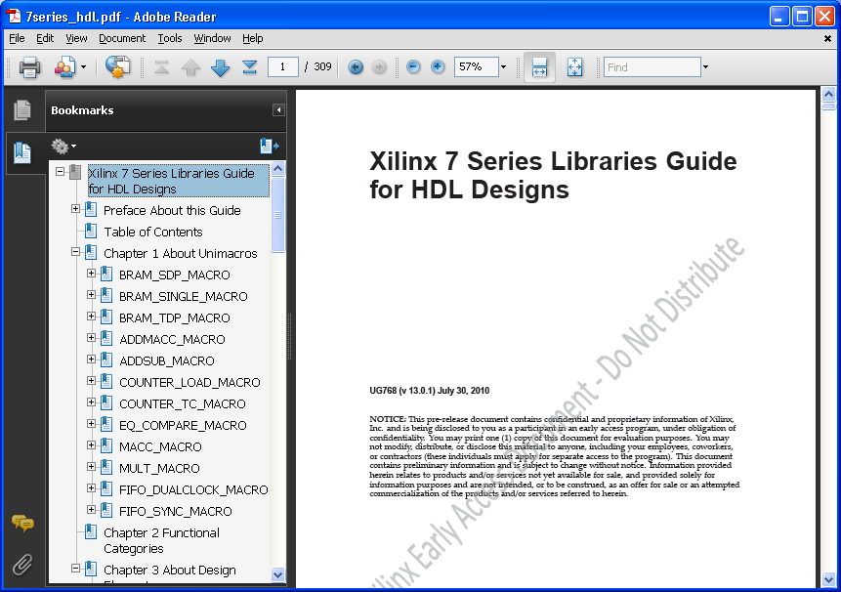
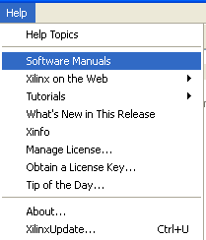
Instantiation
For a list of primitives that can be instantiated, see the HDL library guide
  Provides a list of primitives, their functionality, ports, and attributes
Use instantiation when it is difficult to infer the exact resource you want
Help > Software Manuals > Libraries Guides
Notes:
For a list of possible configurations for the sequential elements, refer to the Libraries Guide on www.xilinx.com.
The Libraries Guide contains a list of all of the possible primitives and macros that Xilinx has to offer. All primitives and macros are listed and include a schematic drawing, port names (for HDL instantiation), attribute names, a functional description, and a truth table on the behavior of the component.
One of the benefits of using the Libraries Guide is that while inference of a resource can sometimes be challenging, you can always instantiate the primitive you want into your design.

Slide 30
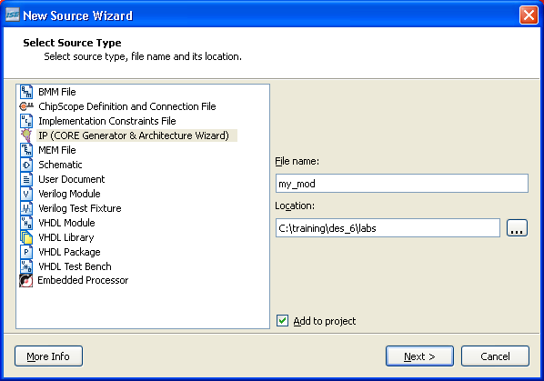
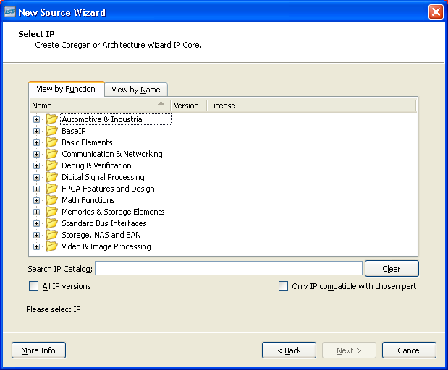
CORE Generator Interface and Architecture Wizard
The CORE Generator interface and Architecture Wizard can help you create modules with the required functionality
  Typically used for FPGA-specific resources (like clocking, memory, or I/O), or for more complex functions (like memory controllers or DSP functions)
Notes:
Another option available to you is to use the Architecture Wizard and CORE Generator interface to instantiate particular primitives.
These utilities allow you to customize components with GUIs and then copy the generated instantiation template into your design.

Slide 31
Lessons
CLB Structure and Routing
Slice Resources
Distributed RAM/SRL
Using Slice Resources
Summary

Slide 32
Summary
The LUTs in SLICEM slices can also be used as 32-bit shift registers or 64-bit memories
Slice resources are most commonly inferred by synthesis tools, but can be instantiated or accessed via the CORE Generator interface

Slide 33
Where Can I Learn More?
Software Manuals
  Start → Xilinx ISE Design Suite 13.1 → ISE Design Tools → Documentation → Software Manuals
  Synthesis & Simulation Design Guide
    This guide has example inferences of many architectural resources
  XST User Guide
    HDL language constructs and coding recommendations
  Targeting and Retargeting Guide for 7 Series FPGAs
  7 Series FPGA User Guides

Slide 34
Where Can I Learn More?
Xilinx Education Services courses www.xilinx.com/training
  Designing with 7-Series Families course
    How to get the most out of both device families
    How to build the best HDL code for your FPGA design
    How to optimize your design for Spartan-6 and/or Virtex-6
    How to take advantage of the newest device features
Free Video Based Training
  Part 1,2, and 3 of the 7 Series FPGA Overview
  How Do I Plan to Power My FPGA?
  What are the Virtex-6 Power Management Features?
  Virtex-6 and Spartan-6 HDL Coding Techniques, parts 1 and 2

Slide 35
Trademark Information
Xilinx is disclosing this Document and Intellectual Propery (hereinafter “the Design”) to you for use in the development of designs to operate on, or interface with Xilinx FPGAs. Except as stated herein, none of the Design may be copied, reproduced, distributed, republished, downloaded, displayed, posted, or transmitted in any form or by any means including, but not limited to, electronic, mechanical, photocopying, recording, or otherwise, without the prior written consent of Xilinx. Any unauthorized use of the Design may violate copyright laws, trademark laws, the laws of privacy and publicity, and communications regulations and statutes.
Xilinx does not assume any liability arising out of the application or use of the Design; nor does Xilinx convey any license under its patents, copyrights, or any rights of others. You are responsible for obtaining any rights you may require for your use or implementation of the Design. Xilinx reserves the right to make changes, at any time, to the Design as deemed desirable in the sole discretion of Xilinx. Xilinx assumes no obligation to correct any errors contained herein or to advise you of any correction if such be made. Xilinx will not assume any liability for the accuracy or correctness of any engineering or technical support or assistance provided to you in connection with the Design.
THE DESIGN IS PROVIDED “AS IS" WITH ALL FAULTS, AND THE ENTIRE RISK AS TO ITS FUNCTION AND IMPLEMENTATION IS WITH YOU. YOU ACKNOWLEDGE AND AGREE THAT YOU HAVE NOT RELIED ON ANY ORAL OR WRITTEN INFORMATION OR ADVICE, WHETHER GIVEN BY XILINX, OR ITS AGENTS OR EMPLOYEES. XILINX MAKES NO OTHER WARRANTIES, WHETHER EXPRESS, IMPLIED, OR STATUTORY, REGARDING THE DESIGN, INCLUDING ANY WARRANTIES OF MERCHANTABILITY, FITNESS FOR A PARTICULAR PURPOSE, TITLE, AND NONINFRINGEMENT OF THIRD-PARTY RIGHTS.
IN NO EVENT WILL XILINX BE LIABLE FOR ANY CONSEQUENTIAL, INDIRECT, EXEMPLARY, SPECIAL, OR INCIDENTAL DAMAGES, INCLUDING ANY LOST DATA AND LOST PROFITS, ARISING FROM OR RELATING TO YOUR USE OF THE DESIGN, EVEN IF YOU HAVE BEEN ADVISED OF THE POSSIBILITY OF SUCH DAMAGES. THE TOTAL CUMULATIVE LIABILITY OF XILINX IN CONNECTION WITH YOUR USE OF THE DESIGN, WHETHER IN CONTRACT OR TORT OR OTHERWISE, WILL IN NO EVENT EXCEED THE AMOUNT OF FEES PAID BY YOU TO XILINX HEREUNDER FOR USE OF THE DESIGN. YOU ACKNOWLEDGE THAT THE FEES, IF ANY, REFLECT THE ALLOCATION OF RISK SET FORTH IN THIS AGREEMENT AND THAT XILINX WOULD NOT MAKE AVAILABLE THE DESIGN TO YOU WITHOUT THESE LIMITATIONS OF LIABILITY.
The Design is not designed or intended for use in the development of on-line control equipment in hazardous environments requiring fail-safe controls, such as in the operation of nuclear facilities, aircraft navigation or communications systems, air traffic control, life support, or weapons systems (“High-Risk Applications”). Xilinx specifically disclaims any express or implied warranties of fitness for such High-Risk Applications. You represent that use of the Design in such High-Risk Applications is fully at your risk.
© 2009 Xilinx, Inc. All rights reserved. XILINX, the Xilinx logo, and other designated brands included herein are trademarks of Xilinx, Inc. All other trademarks are the property of their respective owners.

