Slide 1
7 Series Memory Controllers
Part 1

Slide 2
Objectives
After completing this module, you will be able to:
Describe the new I/O features for supporting high speed memory controllers

Slide 3
Lessons
Overview
Phaser and I/O FIFOs
Memory Controller
Memory Interface Generator (MIG)
Summary

Slide 4
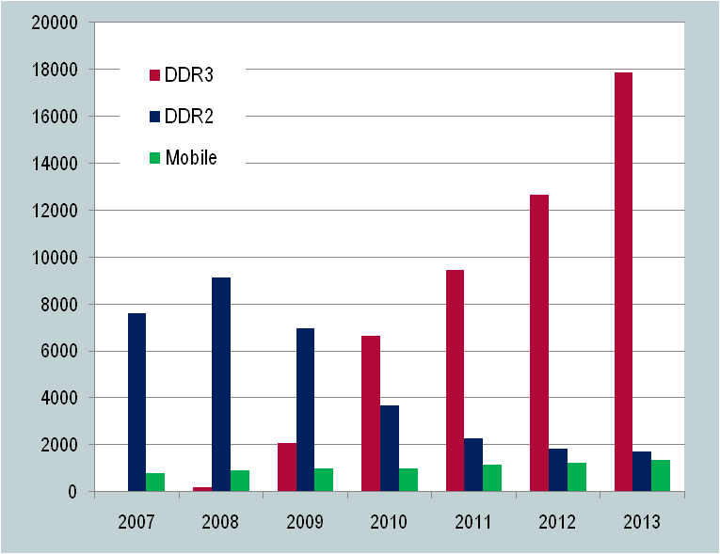
DRAM Technologies
Shipments by Technology Type
1 Gb equivalent Units (Millions)
DDR3 (1.5V and 1.35V)
  Volume leader 2010
  1866 Mbps for high-performance applications
  DDR4 expected introduction ~2014
DDR2 (1.8V)
  Legacy designs
  Volumes declining
Mobile DRAMs
  LPDDR (1.8V) mobile products
  LPDDR2 (1.2V) emerging in handsets
Data Source: iSuppli
DDR3 is the Majority DRAM Usage for 2011-2013
Notes:
It is clear form market data that DDR3 is the highest volume DRAM technology and will be so for the coming years.
DDR2 is the legacy technology and there may be some interest for new FPGA designs in the low end for compatibility with legacy products. But this interest will quickly fade away as prices for DDR2 will start to increase in the near future.
Mobile DRAM or LPDDR with the latest LPDDR2 at 1.2V will become more popular especially in handsets and with volumes increasing will be more attractive in other applications where FPGA s are used.

Slide 5
Networking Applications: SRAM and Specialty DRAM
QDRII+ SRAM
  Table and index storage
  Roadmap driven by QDR Consortium
  QDR-II+ is data rate extension (up to 550 MHz) of QDRII
  QDR-III/IV roadmap planned for higher rates
RLDRAM II → RLDRAM 3
  Packet buffers
  Lower latency and better random access than DDR3
  RLDRAM 3 planned for higher data rate (up to 1866 Mbps)
QDR and RLDRAM Architectures for Networking Applications
Notes:
In addition to the QDR-II+ SRAMs, the specialty DRAMs like the RLDRAM are widely used in networking as a tradeoff between the commodity DRAM like the DDR3 and SRAMs like the QDR-II+. They offer DRAM-like density with closer to SRAM performance in random accesses. They are used mainly for packet buffering.

Slide 6






Data Rate Challenge
2000Mbps (1000 MHz)
DDR Trend
FPGA Fabric Trend
1800Mbps (900 MHz)
1600Mbps (800 MHz)
1400Mbps (700 MHz)
Data Rate (Frequency)
1200Mbps (600 MHz)
1000Mbps (500 MHz)
800Mbps (400 MHz)
600Mbps (300 MHz)
400Mbps (200 MHz)
2005
2006
2007
2008
2009
2010
2011
2012
2013
Data rate increasing at higher rate than fabric performance
Notes:
Overall system performance can often be highly dependent on available memory bandwidth. Thus, there is a continual push for higher and higher bandwidths from all three memory technologies (DDR3, QDR II+, RLDRAM).
The rate of increase of memory bandwidth per pin has far outstripped the overall increase in performance of the FPGA fabric.
Conventional methods (using the FPGA fabric to implement high-speed memory controllers) are not sufficient.

Slide 7
New Solution Needed
7 series FPGAs require a new approach
  I/O that can keep up with the memory data rates
  Hardened PHY elements to keep up with the I/O rates
  ¼ rate soft controller in fabric (decouple I/O rate from fabric speed)
  Decoupled PHY and controller solution for ease of use
PHY
External Memory
User Interface
Memory Controller
FIFO
New approach for memory controller and PHY design
Notes:
To support the highest DDR3 data rates, the I/O pre-driver voltage, VCCAUX_IO, should be increased to 2.0V from 1.8V. This option is only available for certain devices in certain packages.

Slide 8
Lessons
Overview
Phaser and I/O FIFOs
Memory Controller
Memory Interface Generator (MIG)
Summary

Slide 9
Byte Lanes and DQS
DDR3 memories operate in byte lanes
  Each 8 or 9 bits of data is transmitted/received with a data strobe (DQS)
DQS provides the reference timing for capturing data by the receiver
DQS is a differential bidirectional signal
  On writes it is driven by the controller (FPGA), and must be center aligned with the DDR data (DQ)
  On reads it is driven by the DDR3 SDRAM chips and is edge aligned with the change in DDR data (DQ)
Because DQS is not a continually driven clock, a conventional PLL is not sufficient to extract the capture phase information required
Notes:
QDR II+ SRAMs have a similar concept; the read lane timing is related to a differential return clock (CQ and CQ_n). The phase of these clocks is generated by the QDRII+ devices.

Slide 10
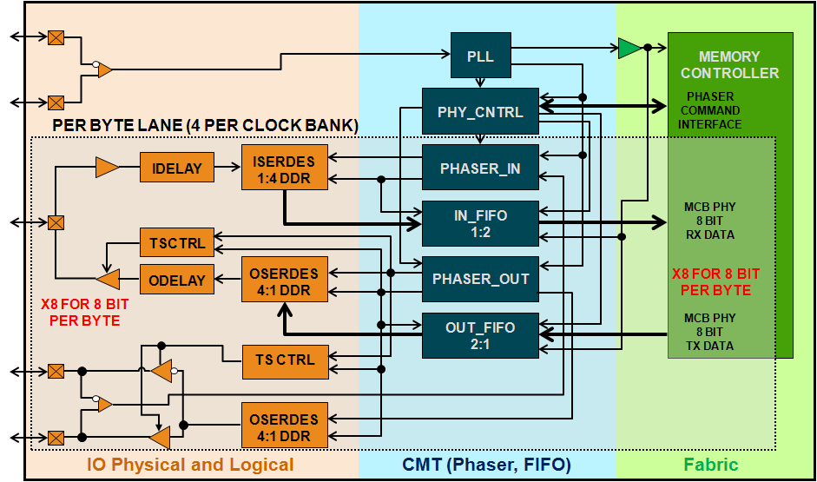
PHASER_IN and PHASER_OUT
Clock IN
DQ
DQS
Clock management tile and I/O tightly coupled for higher performance
Notes:
The full solution for managing the DQ/DQS relationship is provided primarily within the I/O and CMT columns.
The PLL is used to generate a reference for the PHASER_IN and PHASER_OUT blocks.
The PHASER_IN monitors the incoming DQS during memory reads to generate the ISERDES clocks. The ISERDES clocks are placed in the middle of the DQ data eye. This is done dynamically and is stable across process temperature and voltage.
Similarly, the PHASER_OUT uses the PLL reference to generate the OSERDES clock for the DQ. It also generates the DQS, which must be ½ bit period out of phase. This is done with extremely low jitter and duty cycle distortion.
The ISERDES transfers the capture data in a 1:4 mode to the hard IN_FIFO block, and the OSERDES transmits the data in 4:1 mode from the hard OUT_FIFO block.

Slide 11
Byte Lane Support
Each byte lane contains 12 pins
  8 (or 9) DQ data pins
  2 DQS / DQS# clock capable pins
  1 DM data mask pin
Each I/O bank supports four byte lanes
  Enabled by larger 50 I/O bank
  Within each byte lane, pins are pre-defined
    See pinout tables for correct connections
To support four lanes in one bank, you must use
an internally generated V_{REF}
  Not enough pins available for external V_{REF}
Byte 0
Byte 1
Byte 2
Byte 3
7 Series FPGAs
50 pin IO Bank
Up to 4 Bytes/IO bank
Notes:
For each byte lane, the DQS and DQS# must be placed on the specified pins.
The 8 or 9 DQs that are associated with a DQS and DQS# pair must be placed on the DQ pins in the byte lane.
Which DQ is placed on which pin is arbitrary; the user can swap pins to improve board routability.

Slide 12
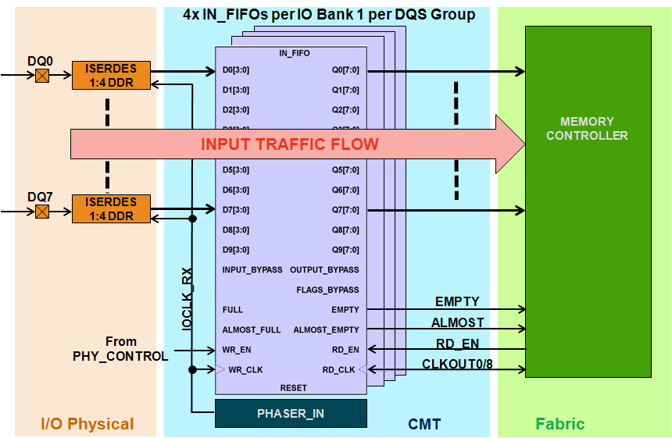
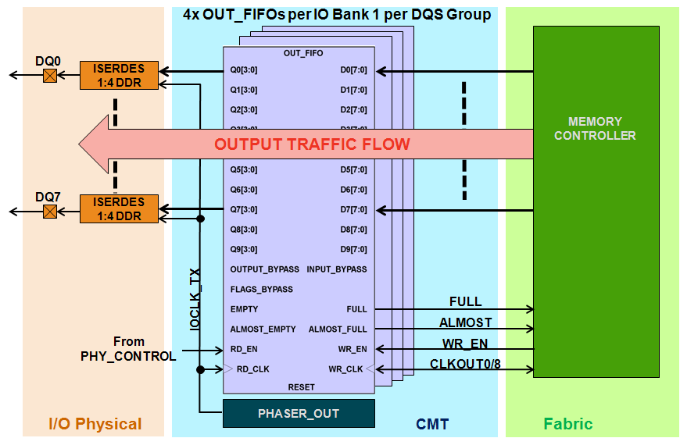
IO FIFO Blocks
IN FIFO per byte group
Data captured/generated by the ISERDES/ OSERDES is running at ½ the rate of the SDRAM
  The read and write data are on separate clocks
The data must be brought into the I/O fabric
  Needs to be at a lower clock rate
  All byte lanes need to be on a common clock
  Managed by the IN_FIFO and OUT_FIFO blocks
IO FIFO Clocking
  Uses DQS PHY aligned clock on I/O side
Uses fixed fabric clock on the fabric side
  Eases fabric design and decouples from I/O side
Provide 1:2 / 2:1 serialization/deserialization
  233-MHz fabric clock for 1866 Mbps I/O rate
OUT FIFO per byte group
Notes:
For read data, the ISERDES captures the data and deserializes it at a 1:4 deserialization rate. For a data rate at 1866 Mbps, this is four bits at 466 MHz.
The captured data is on a clock generated by the PHASER_IN block; a separate clock exists for each byte lane.
The remainder of the memory controller (and the user interface) usually runs on a single clock. It is therefore required to have clock-crossing FIFOs that bring this data into a single domain. This is the function of the FIFO_IN block.
In addition to clock crossing, the FIFO_IN can also do an additional (optional) 1:2 deserialization. Thus for a data rate at 1866 Mbps, the data for each bit in the byte lane is presented as 8 bits at 233 MHz.
The 1:2 deserialization in the FIFO_IN can be disabled so that lower speed memory controllers can use narrower datapaths.
The FIFO_OUT block does the same operation in reverse for the write data.

Slide 13
Lessons
Overview
Phaser and I/O FIFOs
Memory Controller
Memory Interface Generator (MIG)
Summary

Slide 14
Summary
All 7 series FPGAs have dedicated hard logic for implementing the physical layers of high-speed DDR3 and QDR II+ memory controllers
  PHASER_IN, PHASER_OUT, FIFO_IN, and FIFO_OUT
These blocks work in conjunction with the other logic in the I/O and CMT columns to generate complete PHY layers for these memories
  ISERDES, OSERDES, PLL

Slide 15
Where Can I Learn More?
User Guides
  7 Series FPGAs Memory Interface Solutions User Guide, UG596
    Describes the complete clocking structures
Xilinx Education Services courses
  www.xilinx.com/training
    Designing with the 7 Series Families course
    Xilinx tools and architecture courses
    Hardware description language courses
    Basic FPGA architecture, Basic HDL Coding Techniques, and other Free RELs!

Slide 16
Trademark Information
Xilinx is disclosing this Document and Intellectual Propery (hereinafter “the Design”) to you for use in the development of designs to operate on, or interface with Xilinx FPGAs. Except as stated herein, none of the Design may be copied, reproduced, distributed, republished, downloaded, displayed, posted, or transmitted in any form or by any means including, but not limited to, electronic, mechanical, photocopying, recording, or otherwise, without the prior written consent of Xilinx. Any unauthorized use of the Design may violate copyright laws, trademark laws, the laws of privacy and publicity, and communications regulations and statutes.
Xilinx does not assume any liability arising out of the application or use of the Design; nor does Xilinx convey any license under its patents, copyrights, or any rights of others. You are responsible for obtaining any rights you may require for your use or implementation of the Design. Xilinx reserves the right to make changes, at any time, to the Design as deemed desirable in the sole discretion of Xilinx. Xilinx assumes no obligation to correct any errors contained herein or to advise you of any correction if such be made. Xilinx will not assume any liability for the accuracy or correctness of any engineering or technical support or assistance provided to you in connection with the Design.
THE DESIGN IS PROVIDED “AS IS" WITH ALL FAULTS, AND THE ENTIRE RISK AS TO ITS FUNCTION AND IMPLEMENTATION IS WITH YOU. YOU ACKNOWLEDGE AND AGREE THAT YOU HAVE NOT RELIED ON ANY ORAL OR WRITTEN INFORMATION OR ADVICE, WHETHER GIVEN BY XILINX, OR ITS AGENTS OR EMPLOYEES. XILINX MAKES NO OTHER WARRANTIES, WHETHER EXPRESS, IMPLIED, OR STATUTORY, REGARDING THE DESIGN, INCLUDING ANY WARRANTIES OF MERCHANTABILITY, FITNESS FOR A PARTICULAR PURPOSE, TITLE, AND NONINFRINGEMENT OF THIRD-PARTY RIGHTS.
IN NO EVENT WILL XILINX BE LIABLE FOR ANY CONSEQUENTIAL, INDIRECT, EXEMPLARY, SPECIAL, OR INCIDENTAL DAMAGES, INCLUDING ANY LOST DATA AND LOST PROFITS, ARISING FROM OR RELATING TO YOUR USE OF THE DESIGN, EVEN IF YOU HAVE BEEN ADVISED OF THE POSSIBILITY OF SUCH DAMAGES. THE TOTAL CUMULATIVE LIABILITY OF XILINX IN CONNECTION WITH YOUR USE OF THE DESIGN, WHETHER IN CONTRACT OR TORT OR OTHERWISE, WILL IN NO EVENT EXCEED THE AMOUNT OF FEES PAID BY YOU TO XILINX HEREUNDER FOR USE OF THE DESIGN. YOU ACKNOWLEDGE THAT THE FEES, IF ANY, REFLECT THE ALLOCATION OF RISK SET FORTH IN THIS AGREEMENT AND THAT XILINX WOULD NOT MAKE AVAILABLE THE DESIGN TO YOU WITHOUT THESE LIMITATIONS OF LIABILITY.
The Design is not designed or intended for use in the development of on-line control equipment in hazardous environments requiring fail-safe controls, such as in the operation of nuclear facilities, aircraft navigation or communications systems, air traffic control, life support, or weapons systems (“High-Risk Applications”). Xilinx specifically disclaims any express or implied warranties of fitness for such High-Risk Applications. You represent that use of the Design in such High-Risk Applications is fully at your risk.
© 2009 Xilinx, Inc. All rights reserved. XILINX, the Xilinx logo, and other designated brands included herein are trademarks of Xilinx, Inc. All other trademarks are the property of their respective owners.

Slide 17
7 Series Memory Controllers
Part 2

Slide 18
Objectives
After completing this module, you will be able to:
Describe the Memory Interface Generator (MIG) design flow

Slide 19
Lessons
Overview
Phaser and I/O FIFOs
Memory Controller
Memory Interface Generator (MIG)
Summary

Slide 20
Memory Controller Operations
Users normally want external memory to be a single flat memory space
DDR3 SDRAM is organized into banks, pages, and words
  Different operations are required to access data
    ACTIVATE to open a page in a bank
    PRECHARGE to close a page in a bank
    READ/WRITE to access/modify data in an open page
    REFRESH to refresh the dynamic RAM cells
  Timing between commands is complex and crucial
    ACTIVATE to READ, READ to WRITE, for example
Page management is complex and can have a significant impact on overall performance
  No one page management policy is ideal for all applications
This is an ideal application for fabric logic
Notes:
While SDRAMs provide exceptional memory density and excellent data throughput, they are complex devices.
Accessing data is a multi-step process involving opening and closing pages, performing refreshes, etc.
Different applications may need different paradigms for managing these operations. For example, the address bit ordering, which determines the organization of the pages and banks, can have a significant impact on performance; video and packet applications may be better served by different orderings.
As a result, it makes the most sense to implement this aspect of the memory controller in the FPGA fabric.
The soft controller, though, can take advantage of the dedicated resources provided by the IO and CMT columns for managing the physical layer.

Slide 21
MIG Memory Controller
A DDR3 memory controller is provided through the Memory Interface Generator
Leveraged from the Virtex®-6 FPGA DDR3 reordering controller architecture
  Programmable bank machines for high efficiency
Advanced features
  One quarter rate for higher data rates (up to 1866 Mbps) with the 28-nm fabric speed
  Self refresh for lower memory power consumption
DDR3 Memory Controller
Reordering
Bank Machines
¼ Rate
Notes:
A controller that performs all the required operations is provided through the Memory Interface Generator.
This controller performs all the operations to translate the user interface requirements to the commands required for the DDR3 SDRAM.
The memory controller is leveraged from the Virtex-6 FPGA MIG memory controller, but utilizes the new I/O and CMT column resources for the PHY layer.

Slide 22
User Interfaces
Two user interfaces are provided by the MIG memory controller
  Native user interface
    Leveraged from the Virtex-6 FPGA MIG memory controller
    Can be used in legacy designs
  AXI4 Interface
    Utilizes the AXI4 protocol
    Xilinx recommends for new designs
    Required for multi-port designs
Both solutions provide a single high-speed, wide interface to the memory controller
Notes:
The AXI4 bus protocol is becoming the de facto standard for all FPGA IP. It provides a set of bus protocols that range from streaming interfaces to simple slave interfaces to complex split transaction interfaces.
AXI4 will be the basis for all future embedded design solutions; all IP will eventually move to AXI4, and can be accessed via “shims” until the migration is complete.
All new designs should consider using the AXI4 user interface.

Slide 23
Multi-Port Support
AXI4 is, by nature, a point-to-point protocol
  Complex systems are built using AXI interconnect blocks
An AXI4 interconnect block can be used to create a multi-port memory controller
  Provides a configurable number of AXI4 protocol user ports
  Each port is independent, but accesses underlying memory controller
    Different clocks and port widths are supported
AXI 4Interconnect Block
Memory Controller
AXI4 User Interface Ports
External
Memory
AXI4
Notes:
AXI4 interconnect blocks are provided by Xilinx as IP.

Slide 24
Lessons
Overview
Phaser and I/O FIFOs
Memory Controller
Memory Interface Generator (MIG)
Summary

Slide 25
Memory Interface Generator (MIG)
Customize your memory controller and interface design
  Memory architecture, data rate, bus width
  CAS latency, burst length
  I/O bank assignments
  Generates RTL source code and UCF from hardware-verified IP
Delivered as part of the ISE® software (CORE Generator™ interface)
Memory interfaces supported for 7 series FPGAs
  DDR3 SDRAM
  QDRII+ SRAM
  RLDRAM II
Notes:
AW: Is RLDRAM II going to be supported – it currently is not available

Slide 26
MIG Design Flow
Open CORE Generator interface
Integrate MIG .ucf constraints to overall design constraints file
Run MIG, choose your memory parameters and generate rtl and ucf files
Import RTL and build options into ISE project
Synthesize design
Customize MIG design
Place and route design
Integrate/customize MIG memory RTL testbench
Timing simulation
Perform functional simulation
Verify in hardware
Optional RTL customization
Notes:
After launching the MIG from the CORE Generator interface, use the wizard to set the system and memory parameters.
The wizard generates the RTL and UCF files, which are the HDL code and constraints files.
These are generated from a library of hardware-verified designs and your inputs are used to directly modify these files.
The code is not encrypted and you have the flexibility to change and customize the RTL files.
After the optional code change, you can perform additional simulations.
The next step is to import the files in the ISE software project followed by synthesis, place and route, timing simulation if needed, and, finally, verification in hardware.

Slide 27
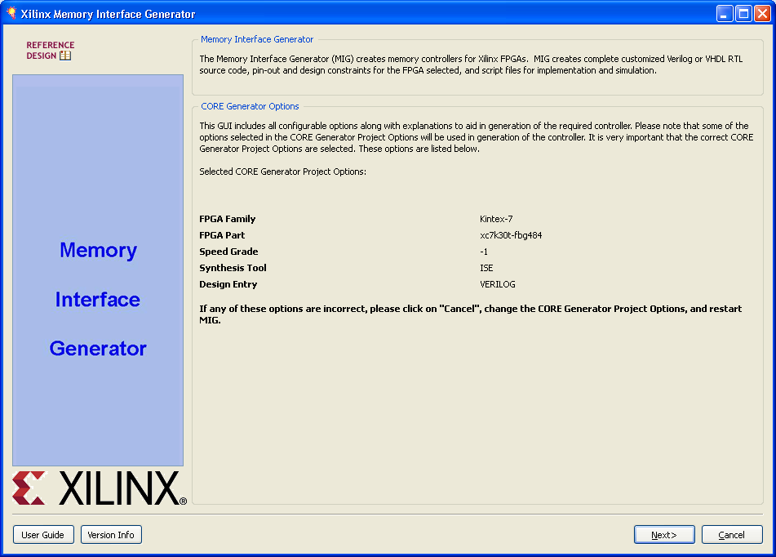
MIG Runs Through the CORE Generator Interface
Settings for the CORE Generator interface for device and design entry

Slide 28
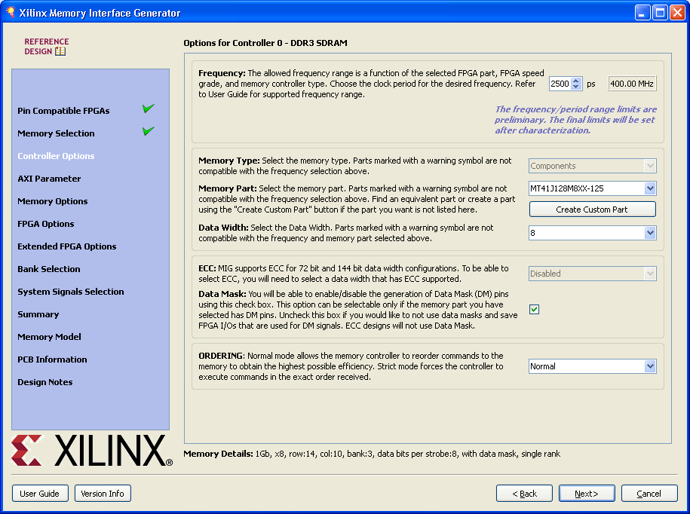
MIG Memory Selection
Check marks to indicate which step you are on and what is next
Notes:
Here is where you choose what memory devices and configuration you want to use.
Many of the more common chips and DIMMs can be chosen from the drop-down list. Parts from different manufacturers are often compatible, so even if you are using a different part, one of the selections in the drop-down list may be appropriate.
If necessary, you can create a custom part by entering all the timing parameters in the “Create Custom Part” page.
The tool determines how many parts (and hence DQS pairs) are used from the Data Width selection.

Slide 29
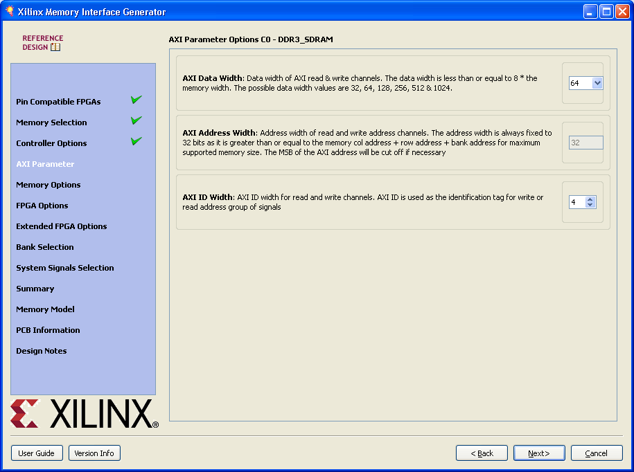
AXI Interface Options
Options for the AXI4 user interface, if selected
Notes:
The wizard allows you to customize the AXI4 interface if it was selected earlier. The data width, address width, and ID width are configurable.

Slide 30
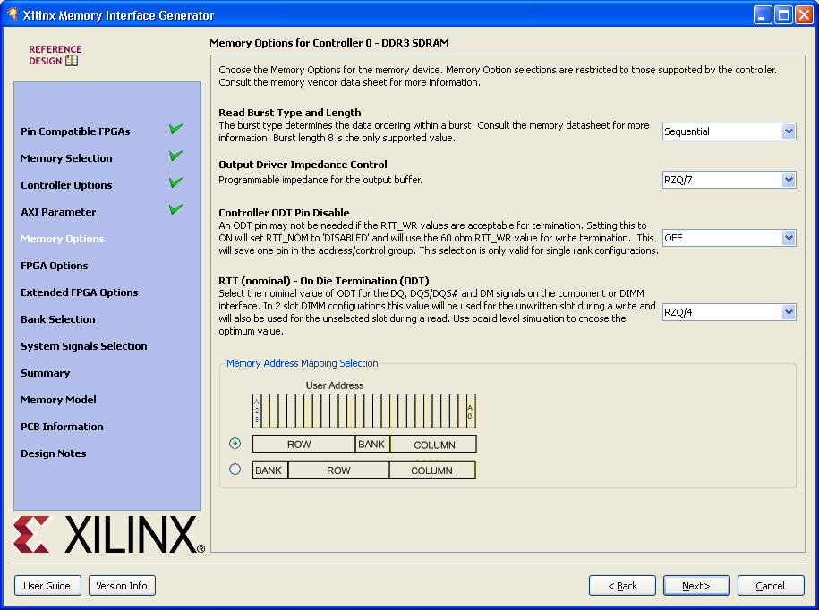
MIG Memory Options
Options for DDR3 mode register settings
Notes:
The wizard enables you to set a variety of options like the burst type and termination options.
Some of these options (burst type) will be sent to the DDR3 SDRAM’s mode register on startup.
This page also allows you to determine how the flat address presented to the user will be mapped to banks, rows, and columns.

Slide 31
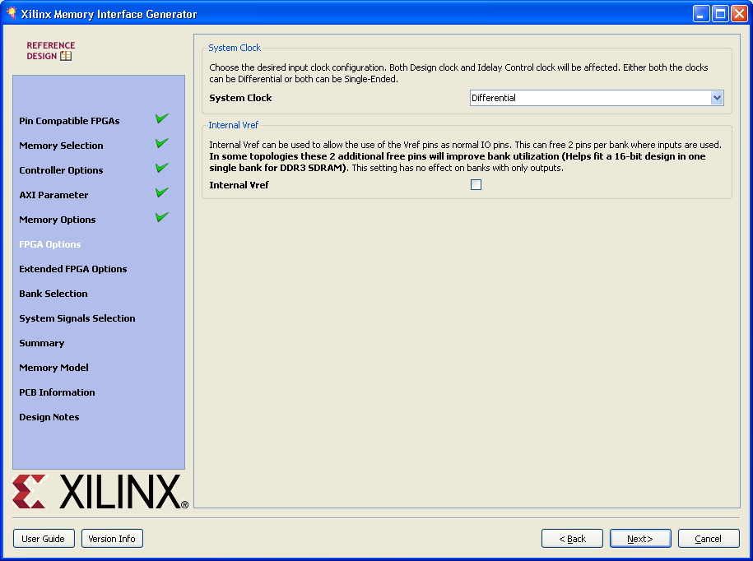
MIG FPGA Options
Options for FPGA controller and physical layer settings
Notes:
This page allows you to configure how what kind of system clock will be used and whether to use the internal Vref.
If the internal Vref is not used, then the VREF pins on the FPGA must be used. This will prevent having four byte lanes in a bank.

Slide 32
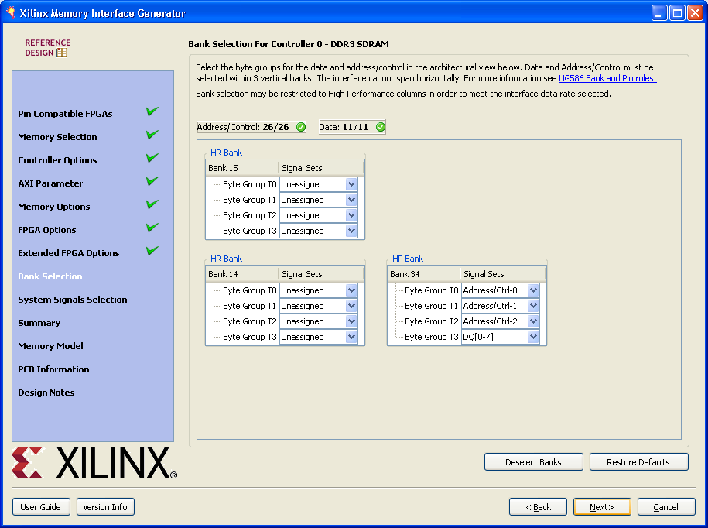
MIG Bank Selection
Allows you to choose which banks and byte lanes will be used for the interface
Notes:
Bank selection for the I/O assignments is one of the more important assignments because it determines the board layout and is recommended before any board layout plans are done.
Because the pin mapping within each byte lane is fixed (aside from DQ pin swapping within the byte lane), pin selection is relatively simple.

Slide 33
Lessons
Overview
Phaser and I/O FIFOs
Memory Controller
Memory Interface Generator (MIG)
Summary

Slide 34
Summary
These resources are used by the soft memory controller generated by the Memory Interface Generator (MIG)
  The MIG generates a complete memory controller with either a native user interface or an AXI4 user interface

Slide 35
Where Can I Learn More?
User Guides
  7 Series FPGAs Memory Interface Solutions User Guide, UG596
    Describes the complete clocking structures
Xilinx Education Services courses
  www.xilinx.com/training
    Designing with the 7 Series Families course
    Xilinx tools and architecture courses
    Hardware description language courses
    Basic FPGA architecture, Basic HDL Coding Techniques, and other Free RELs!

Slide 36
Trademark Information
Xilinx is disclosing this Document and Intellectual Propery (hereinafter “the Design”) to you for use in the development of designs to operate on, or interface with Xilinx FPGAs. Except as stated herein, none of the Design may be copied, reproduced, distributed, republished, downloaded, displayed, posted, or transmitted in any form or by any means including, but not limited to, electronic, mechanical, photocopying, recording, or otherwise, without the prior written consent of Xilinx. Any unauthorized use of the Design may violate copyright laws, trademark laws, the laws of privacy and publicity, and communications regulations and statutes.
Xilinx does not assume any liability arising out of the application or use of the Design; nor does Xilinx convey any license under its patents, copyrights, or any rights of others. You are responsible for obtaining any rights you may require for your use or implementation of the Design. Xilinx reserves the right to make changes, at any time, to the Design as deemed desirable in the sole discretion of Xilinx. Xilinx assumes no obligation to correct any errors contained herein or to advise you of any correction if such be made. Xilinx will not assume any liability for the accuracy or correctness of any engineering or technical support or assistance provided to you in connection with the Design.
THE DESIGN IS PROVIDED “AS IS" WITH ALL FAULTS, AND THE ENTIRE RISK AS TO ITS FUNCTION AND IMPLEMENTATION IS WITH YOU. YOU ACKNOWLEDGE AND AGREE THAT YOU HAVE NOT RELIED ON ANY ORAL OR WRITTEN INFORMATION OR ADVICE, WHETHER GIVEN BY XILINX, OR ITS AGENTS OR EMPLOYEES. XILINX MAKES NO OTHER WARRANTIES, WHETHER EXPRESS, IMPLIED, OR STATUTORY, REGARDING THE DESIGN, INCLUDING ANY WARRANTIES OF MERCHANTABILITY, FITNESS FOR A PARTICULAR PURPOSE, TITLE, AND NONINFRINGEMENT OF THIRD-PARTY RIGHTS.
IN NO EVENT WILL XILINX BE LIABLE FOR ANY CONSEQUENTIAL, INDIRECT, EXEMPLARY, SPECIAL, OR INCIDENTAL DAMAGES, INCLUDING ANY LOST DATA AND LOST PROFITS, ARISING FROM OR RELATING TO YOUR USE OF THE DESIGN, EVEN IF YOU HAVE BEEN ADVISED OF THE POSSIBILITY OF SUCH DAMAGES. THE TOTAL CUMULATIVE LIABILITY OF XILINX IN CONNECTION WITH YOUR USE OF THE DESIGN, WHETHER IN CONTRACT OR TORT OR OTHERWISE, WILL IN NO EVENT EXCEED THE AMOUNT OF FEES PAID BY YOU TO XILINX HEREUNDER FOR USE OF THE DESIGN. YOU ACKNOWLEDGE THAT THE FEES, IF ANY, REFLECT THE ALLOCATION OF RISK SET FORTH IN THIS AGREEMENT AND THAT XILINX WOULD NOT MAKE AVAILABLE THE DESIGN TO YOU WITHOUT THESE LIMITATIONS OF LIABILITY.
The Design is not designed or intended for use in the development of on-line control equipment in hazardous environments requiring fail-safe controls, such as in the operation of nuclear facilities, aircraft navigation or communications systems, air traffic control, life support, or weapons systems (“High-Risk Applications”). Xilinx specifically disclaims any express or implied warranties of fitness for such High-Risk Applications. You represent that use of the Design in such High-Risk Applications is fully at your risk.
© 2009 Xilinx, Inc. All rights reserved. XILINX, the Xilinx logo, and other designated brands included herein are trademarks of Xilinx, Inc. All other trademarks are the property of their respective owners.

