Slide 1
Semantic HTML

Slide 2
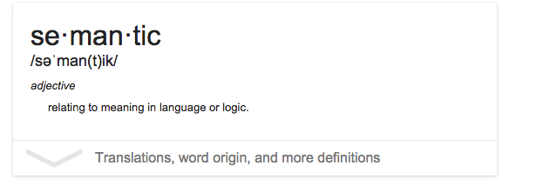
Semantic HTML
Semantic HTML
Commonly known as “semantic markup”

Slide 3
Semantic HTML
What it means to you
Naming things (elements) what they are (or as close as you can)

Slide 4
Semantic HTML
In practice
Lists are <ul></ul> and <ol></ol> respectively
Links are <a></a>
Paragraphs are <p></p>
Headings are <h1></h1>…<h6></h6>
Images are <img>
Videos are <video></video>

Slide 5
Semantic HTML
Benefits of Semantic HTML
Accessibility
Search Engine Optimization
Maintainability
CSS targeting

Slide 6
Semantic HTML
Benefits: SEO
Local Business Schema
Hours, location, phone, category etc.
Ecommerce
Product details
More relevant in search situations
Generally more intelligent results based on newer and more semantic tags.

Slide 7
Semantic HTML
Sounds Simple Right?
Lists are <ul></ul> and <ol></ol> respectively
Links are <a></a>
Paragraphs are <p></p>
Headings are <h1></h1>…<h6></h6>
Images are <img>
Videos are <video></video>
Got it?

Slide 8
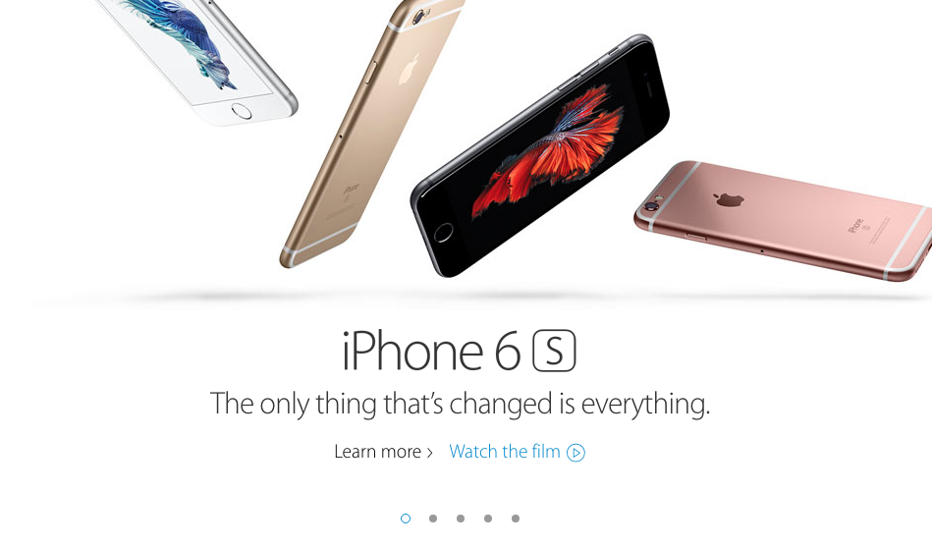
Semantic HTML
Where it gets tricky
What is iPhone 6s? A heading? The single line? The Learn more?

Slide 9

Semantic HTML
Where it gets tricky cont.
What element should each of these be?

Slide 10
Semantic HTML
Bottom Line
Just do your best. HTML isn’t as flexible as it could be but just do your best and limit ambiguous tags (span, div etc.) as much as possible.

Slide 11
Newer and More Semantic Elements

Slide 12
Newer and More Semantic Elements
Some Newer and Semantic HTML Elements
Navigation (<nav> </nav>)
Footer (<footer> </footer>)
Side Bar (<aside> </aside>
Article (<article> </article>
Section (<section> </section>
Figure ( <figure> </figure>

Slide 13
Newer and More Semantic Elements
Navigation
<nav></nav>
Contains links for a navigation block
NOT used to wrap individual links
Usually only one but possibly more

Slide 14

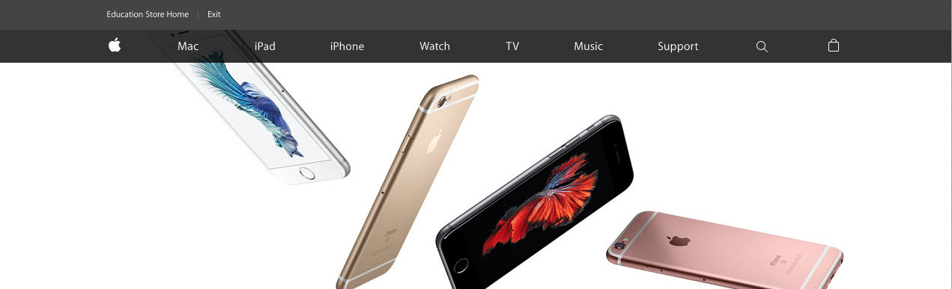
Newer and More Semantic Elements
Navigation Examples
Newer and More Semantic Elements

Slide 15
Newer and More Semantic Elements
Footer
<footer></footer>
Defines website footer
Typically only one per site but possibly more

Slide 16
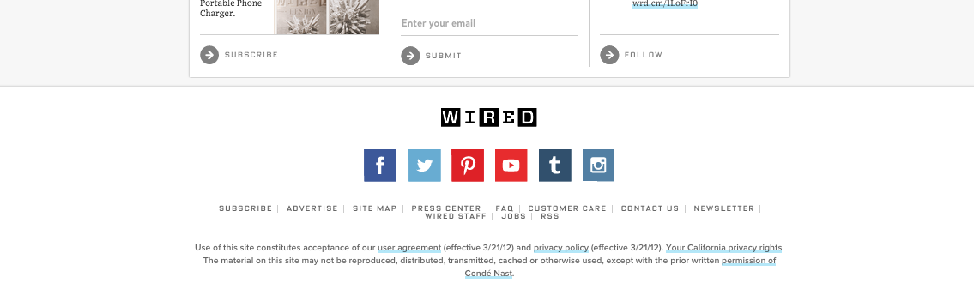
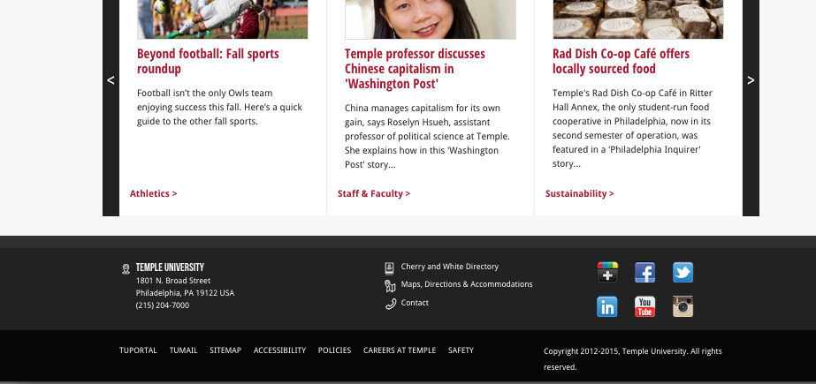
Newer and More Semantic Elements
Footer Examples
Newer and More Semantic Elements

Slide 17
Newer and More Semantic Elements
Side Bar
<aside></aside>
Defines a sidebar that has contextual navigation or more content. Note: some ambiguity
Typically only one per site but possibly more

Slide 18

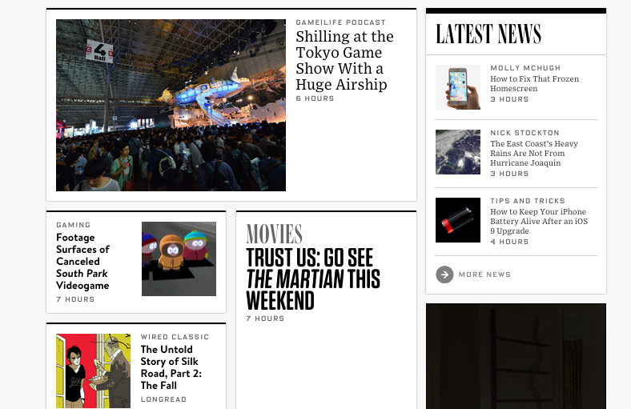
Newer and More Semantic Elements
Sidebar Examples
Newer and More Semantic Elements

Slide 19
Newer and More Semantic Elements
Figure
<figure>
<img>
<figcaption></figcaption>
</figure>
Defines a visual (graphic, image etc)
No limit to how many
No nesting of figures

Slide 20

Newer and More Semantic Elements
Figure Example

Slide 21
Newer and More Semantic Elements
Section
<section></section>
Distinguishes sections of a website
If a section of a page is different from another
Typically many on a page.
Note: Somewhat ambiguous

Slide 22
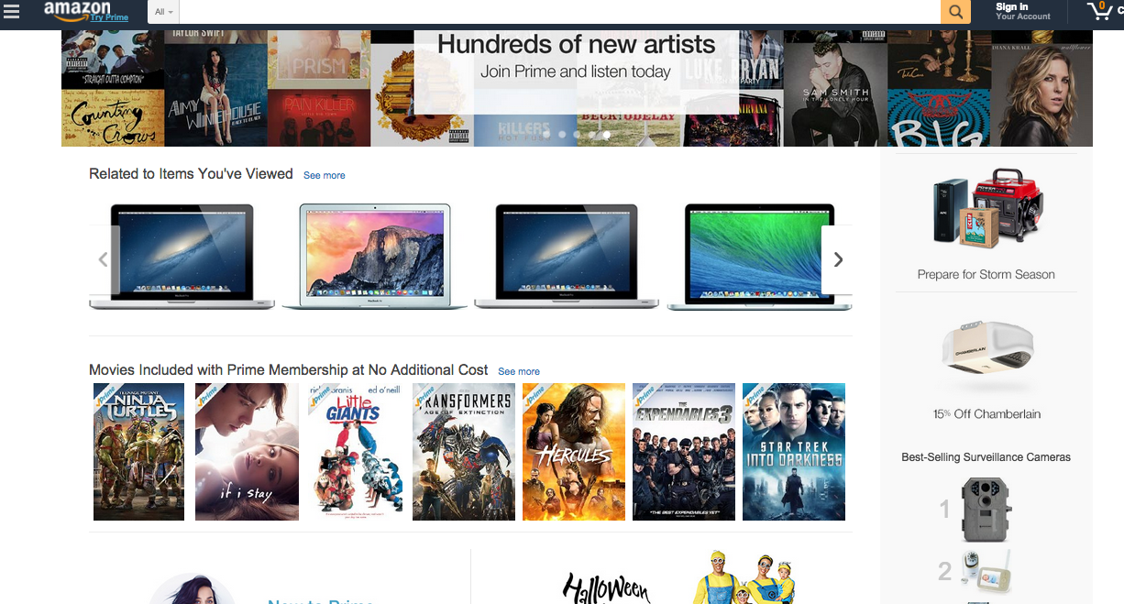
Newer and More Semantic Elements
Section Example

Slide 23
Newer and More Semantic Elements
Article
<article></article>
Defines a single piece of content
If a piece of content is unique from another
Typically many on a page. Especially on landing page
Try not to nest <article> tags

Slide 24
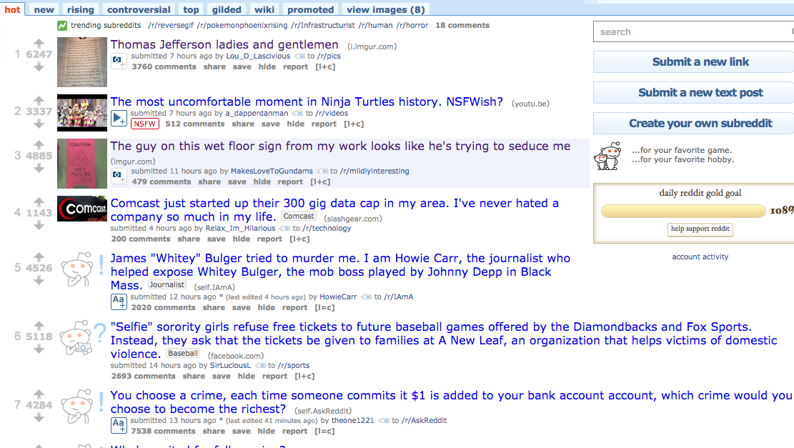
Newer and More Semantic Elements
Article Example 1
Newer and More Semantic Elements

Slide 25
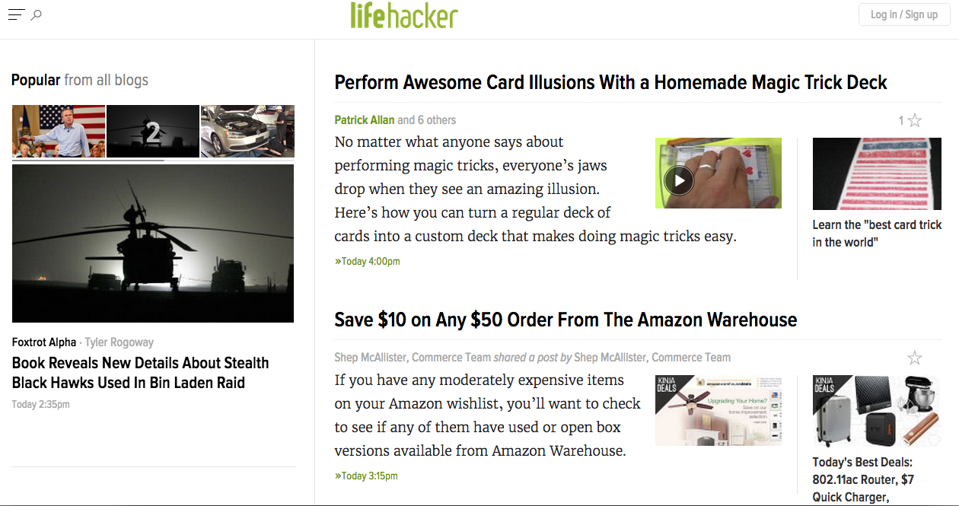
Newer and More Semantic Elements
Article Example 2
Newer and More Semantic Elements

Slide 26
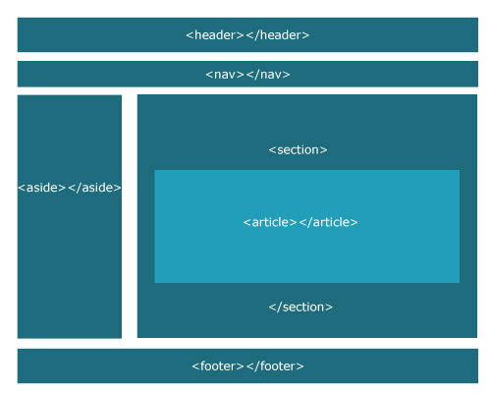
Newer and More Semantic Elements
A Common Page Layout

