Slide 1
Development Tools and Platforms (making development easier)

Slide 2
Development Tools and Platforms
Up to this point
You’ve done everything manually. Writing your HTML/CSS, creating files and directories from scratch.
Development Tools and Platforms

Slide 3
Development Tools and Platforms
Upsides of doing everything manually
Relatively quick spinup for a small site
Granular control of markup and aesthetics
Good practice
Development Tools and Platforms

Slide 4
Development Tools and Platforms
Downsides of doing everything manually
Easy to make mistakes
Very tedious for medium to large sites
Very time consuming (see previous)
Generally unmaintainable
Development Tools and Platforms

Slide 5
Development Tools and Platforms
In the real world
Web developers use a diverse stack of tools, frameworks, systems and services to assist production.
Development Tools and Platforms

Slide 6
Development Tools and Platforms
Few examples
Content Management Systems (CMS)
Frontend Frameworks
CSS Extensions
Development Tools and Platforms

Slide 7
Content Management Systems

Slide 8
Content Management Systems (CMS)
What is a CMS?
A web publishing platform that allows you to create, delete, manage and generally organize content within a singe interface and promotes multiuser collaboration.
Development Tools and Platforms

Slide 9
Content Management Systems (CMS)
Benefits of a CMS
Quickly create, edit and generally publish content.
Easy to manage the website. No coding necessary.
Typically low maintenance after initial setup
Development Tools and Platforms

Slide 10
Content Management Systems (CMS)
When you would want a CMS
Little development knowledge within a team
More than one person administering content
Development Tools and Platforms

Slide 11
Content Management Systems (CMS)
Wordpress
Big community
Many themes/plugins (most free)
Learning resources available
Troubleshooting easy as googling
Relatively low learning curve vs other CMSs
Friendly and intuitive interface for admins
Development Tools and Platforms

Slide 12
Content Management Systems (CMS)
Drupal
Big community
Many themes/plugins (most free)
Learning resources available
Troubleshooting easy as googling
Relatively high learning curve for developers/content admins
More technically apt and capable than wordpress
Development Tools and Platforms

Slide 13
Content Management Systems (CMS)
Squarespace, Wix, Weebly etc.
Proprietary systems
Limited aesthetic control
No custom functionality opportunities
Extremely easy to spin-up a website without any technical abilities
Not-free, but saves lots of money on dev costs
Development Tools and Platforms

Slide 14
Content Management Systems (CMS)
Downsides of a CMS
Nontrivial initial setup and development ($)
Steep learning curve for anything custom ($$)
Themes
Plugins
Sometimes very complicated for simple tasks ($$$)
Development Tools and Platforms

Slide 15
Content Management Systems (CMS)
Verdict
Content management systems can be powerful for medium to large websites but are certainly overkill for small websites. Would not recommend for your final projects
Development Tools and Platforms

Slide 16
Frontend Frameworks

Slide 17
Frontend Frameworks
Definition: Frontend
The aspects of development that relate to what the end-user sees and interacts with. Writing HTML and CSS are frontend concerns for example.
Development Tools and Platforms

Slide 18
Frontend Frameworks
What is a frontend framework?
A comprehensive set of prewritten code that speeds development by limiting the amount of custom HTML and CSS that needs to be written.
Development Tools and Platforms

Slide 19
Frontend Frameworks
Bootstrap
From the creators of twitter
A comprehensive CSS library for creating modular components
Aesthetically cohesive
Lets you focus more time on content and less time on design and development
Look at the demos: http://getbootstrap.com/examples/theme/
Development Tools and Platforms

Slide 20
Frontend Frameworks
Foundation
A CSS library for creating responsive layouts
Less time writing media queries and CSS for your layouts
Small learning curve, but very powerful once you make sense of it
Check it out: http://foundation.zurb.com/
Development Tools and Platforms

Slide 21
Frontend Frameworks
Verdict
Frontend frameworks are excellent resources to get your site looking decent and up running quickly. I recommend learning them for your next project.
Development Tools and Platforms

Slide 22
CSS Extensions

Slide 23
CSS Extensions
What is a CSS extension?
A modified version of the CSS language that adds layers of functionality. Speeds up CSS writing tremendously with shorthand syntax and formulas that do much of the heavy lifting for you.
Development Tools and Platforms

Slide 24
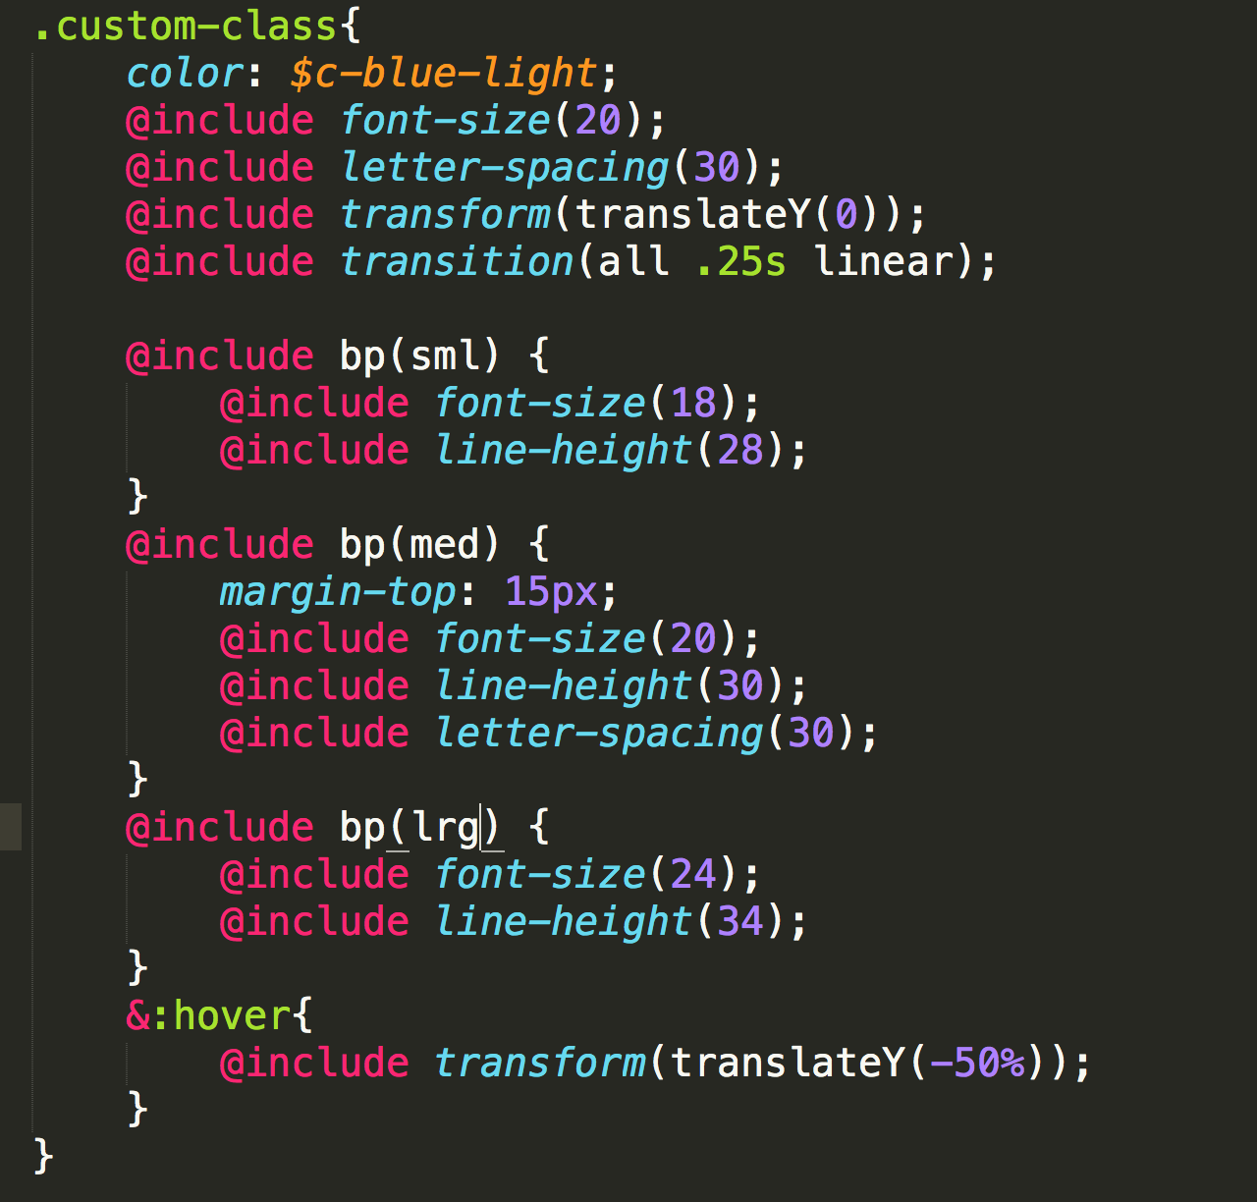
CSS Extensions
Example Pre-compiled
Custom variables for colors($c-blue-light)
Font-sizing function
Breakpoint code: bp(sml),bp(med),bp(lrg)
Transform and transition shorthand
Note: this is not CSS.
Development Tools and Platforms

Slide 25
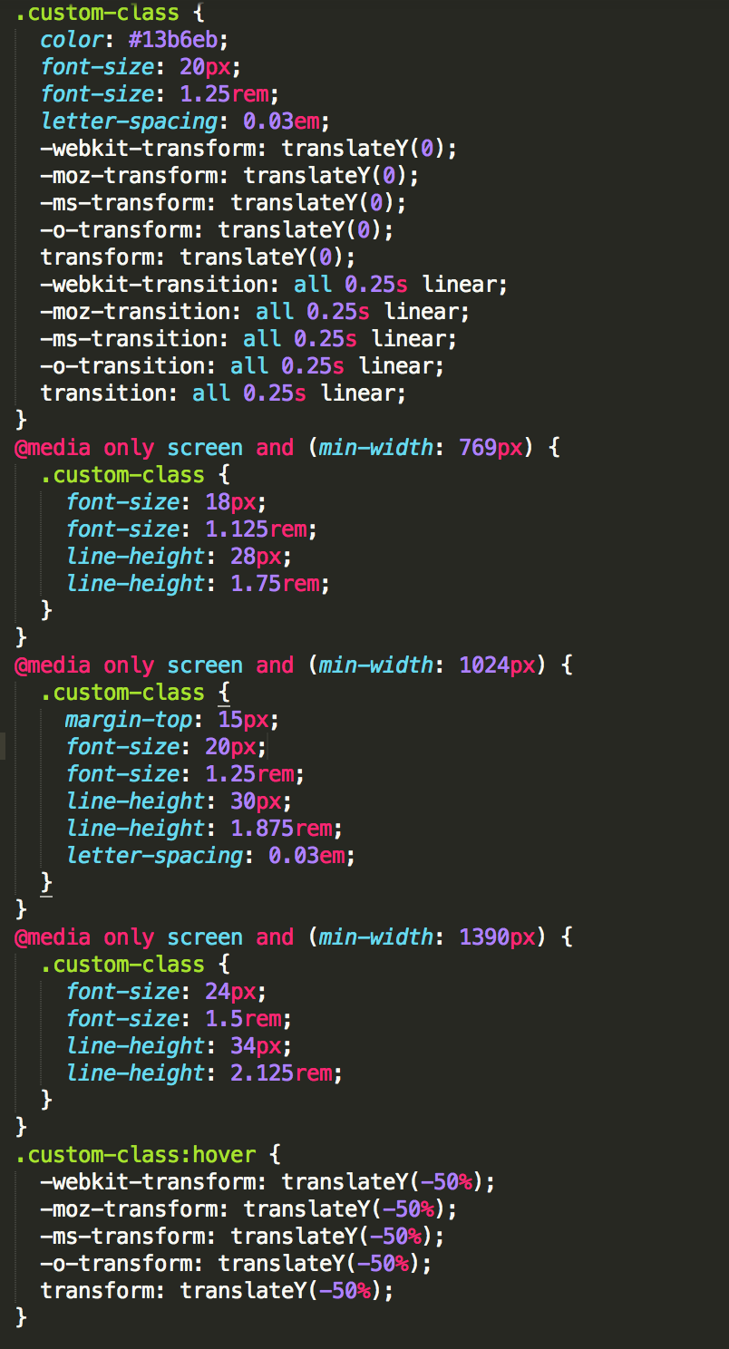
CSS Extensions
Example Compiled
Result of the previous code
This is CSS
Note the two files you need to keep track of
Development Tools and Platforms

Slide 26
CSS Extensions
Downsides of CSS Extensions
The need to compile your code into browser-readable CSS
To satisfy the above, you need certain software programs
Learning even more syntax
Medium learning curve with the addition of new files and syntax
Development Tools and Platforms

Slide 27
CSS Extensions
Verdict
CSS Extensions provide a valuable set of functions to frontend developers that will speed up styling. But the benefits are only obtained after a medium learning curve. I don’t suggest you using them until you have a very good grasp on CSS. Until then, regular CSS will do you fine. But simply knowing about them can be useful.
Development Tools and Platforms

