Slide 1

Dapr Agents 101
LLM Integration with Dapr Agents
Using External Tools in Dapr Agents
Agentic Workflows with Dapr Agents
Document Agents with Dapr and Chainlit
MCP Integration in Dapr Agents
Augmented LLM in Dapr Agents
Stateful LLMs with Dapr Agents
Advanced Prompt Chaining in Dapr Agents
Dynamic Routing Strategies for Dapr Agents
Orchestrating Complex Workflows in Dapr Agents
Evaluator-Optimizer Patterns with Dapr Agents
Notes:
Hi everyone, and welcome back to this series on building AI Agents with Dapr Agents. In our last video, we touched on using tools within our Agents, so let’s go a little deeper into that topic.

Slide 2
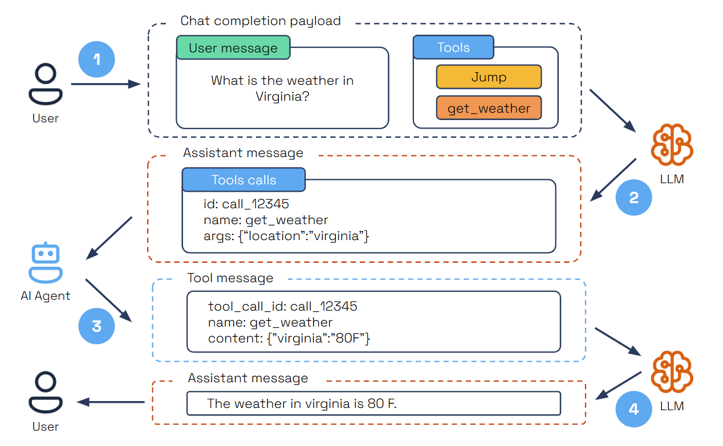
Tool Calling
Notes:
With tool selection, Agents dynamically select the appropriate tool for a given task, using LLMs to analyze requirements and choose the best action. This is supported directly through LLM parametric knowledge and enhanced by Function Calling, ensuring tools are invoked efficiently and accurately.
Tool Calling is an essential pattern in autonomous agent design, allowing AI agents to interact dynamically with external tools based on user input. One reliable method for enabling this is through OpenAI's Function Calling capability. This feature allows developers to describe functions to models trained to generate structured JSON objects containing the necessary arguments for tool execution, based on user queries.
So taking this example here,
The user submits a query specifying a task and the available tools.
The LLM analyzes the query and selects the right tool for the task.
The LLM provides a structured JSON output containing the tool’s unique ID, name, and arguments.
The AI agent parses the JSON, executes the tool with the provided arguments, and sends the results back as a tool message.
The LLM then summarizes the tool's execution results within the user’s context to deliver a comprehensive final response.
This pattern is highly flexible and supports multiple iterations of tool selection and execution, empowering agents to handle dynamic and multi-step tasks more effectively.

Slide 3
Let’s dive into the code
How to create tools for Dapr Agents
How Dapr Agents use Tools
Working with Agent Memory
Persistent Agent Memory in Dapr
Adding Observability in Dapr Agents
Notes:
Now that we’ve gone into some detail around tools in Dapr, let’s see how they work in action. We’ll take a look at how we can create tools for our Dapr Agents and how we can use them. We’ll also look at how we can work with Agent memory, and how we can add some observability in Dapr Agents so we can see which tools our Agents are selecting for specific tasks.

