Slide 1


Slide 2
Dapr Agents 101
LLM Integration with Dapr Agents
Using External Tools in Dapr Agents
Agentic Workflows with Dapr Agents
Document Agents with Dapr and Chainlit
MCP Integration in Dapr Agents
Augmented LLM in Dapr Agents
Stateful LLMs with Dapr Agents
Advanced Prompt Chaining in Dapr Agents
Dynamic Routing Strategies for Dapr Agents
Orchestrating Complex Workflows in Dapr Agents
Evaluator-Optimizer Patterns with Dapr Agents

Slide 3
Workflow Systems
Used to automate business processes, and implement durable execution concept.
They consist of:
An authoring environment to create the workflow
An engine to run the workflow
A state store to persist the workflow state

Slide 4





Dapr Workflows
Receive message
Start
Get a secret & invoke an API
Activity A
External Event
Wait for event
Invoke an API
Activity B
Activity C
Store event result
Activity D
End
Publish message

Slide 5
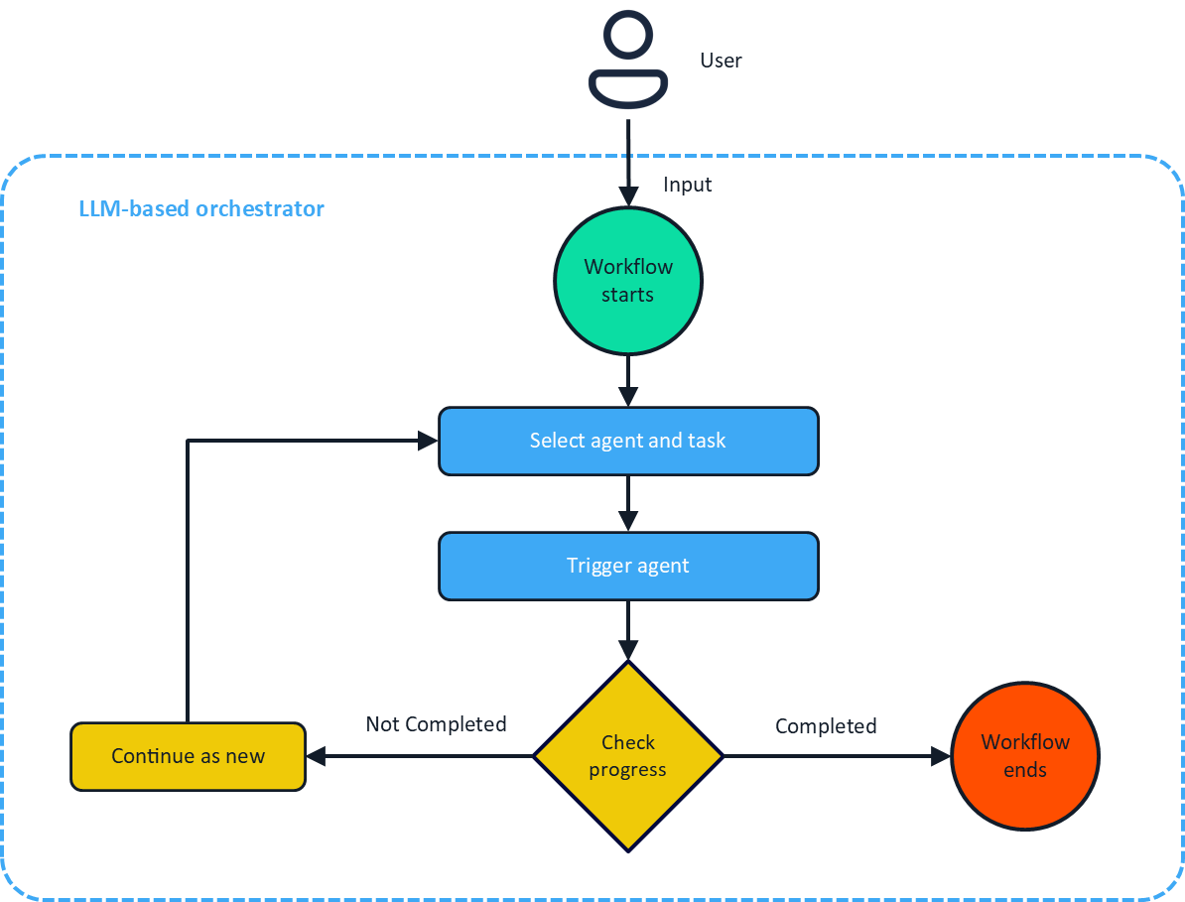
Durable Agents

Slide 6
Agent Collaboration in Workflows
Random
Encourages diversity in responses and strategies
Simplifies orchestration
Useful for exploratory or brainstorming tasks
Round Robin
Ensures equal participation among agents
Ideal for predictable task distribution
Each agent takes turns in a predefined order
LLM-Based
Task Context
Chat History
Agent Metadata

Slide 7
Let’s dive into the code
Sequential Task Execution in LLM-based workflows
Parallel Task Execution in LLM-based workflows

