Slide 1


Slide 2
Dapr Agents 101
LLM Integration with Dapr Agents
Using External Tools in Dapr Agents
Agentic Workflows with Dapr Agents
Document Agents with Dapr and Chainlit
MCP Integration in Dapr Agents
Augmented LLM in Dapr Agents
Stateful LLMs with Dapr Agents
Advanced Prompt Chaining in Dapr Agents
Dynamic Routing Strategies for Dapr Agents
Orchestrating Complex Workflows in Dapr Agents
Evaluator-Optimizer Patterns with Dapr Agents

Slide 3
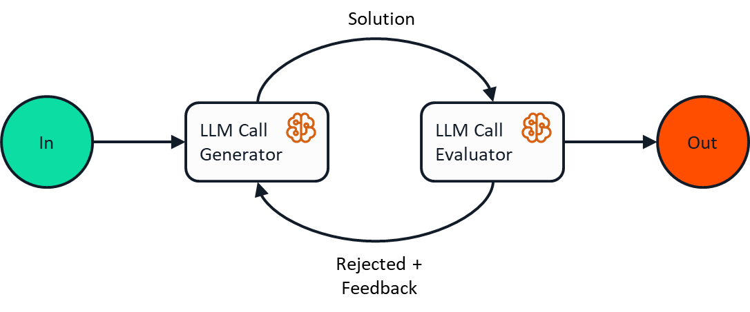
Evaluator-Optimizer Pattern

Slide 4
Let’s dive into the code
Evaluator-Optimizer in Action
Components of the pattern
How we can use this to return quality results.

