Slide 1


Slide 2
Dapr Agents 101
LLM Integration with Dapr Agents
Using External Tools in Dapr Agents
Agentic Workflows with Dapr Agents
Document Agents with Dapr and Chainlit
MCP Integration in Dapr Agents
Augmented LLM in Dapr Agents
Stateful LLMs with Dapr Agents
Advanced Prompt Chaining in Dapr Agents
Dynamic Routing Strategies for Dapr Agents
Orchestrating Complex Workflows in Dapr Agents
Evaluator-Optimizer Patterns with Dapr Agents

Slide 3
The MCP Protocol
Model Context Protocol
An open protocol that standardizes how apps provide context to LLMs
MCP Provides a standardized way to connect AI models to different data sources and tools.

Slide 4
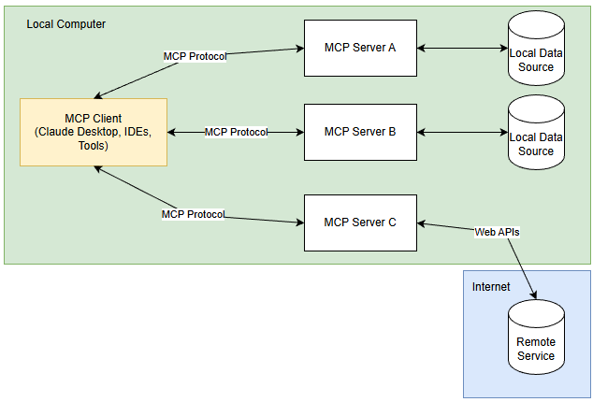
MCP Architecture
Hosts (Like Claude Desktop) access data through MCP
Protocol clients maintain 1:1 connections with servers.
Servers expose specific capabilities through MCP.
Data could be local (file systems, DBs) and remote (APIs).

Slide 5
MCP Support in Dapr
Dapr Agents include support for MCP
Agents can discover and invoke tools through a standardized interface.
MCP clients fetch all available tools from server and prepares them for use in Agent.
Agents invoke these tools at runtime, expanding their behavior.

Slide 6
Let’s dive into the code
MCP Agent with SSE Transport.
Create our MCP tools
Create our SSE Server
Create our Agent that connects to tools over MCP with SSE Transport.

