Slide 1

Notes:
Hello everyone! Welcome to this video series on building agents with Dapr! It’s been 6 months since I’ve posted my last video – no real reason for a the long time away – I got a new job, I’ve been planning for my wedding later this year, and let’s be honest I’ve been lazy :D
Anyway, as some of you know I’m a huge fan of the Dapr framework, I’ve been building systems with it for a while now, so I’ve spent a bit of time getting my head around the Dapr Agents framework and I’m gearing up to speak at a few conferences on Dapr Agents, so it’s a good excuse for me to come back to creating YouTube videos, and talk about how we can build Agents with the Dapr Framework.

Slide 2
Dapr Agents 101
LLM Integration with Dapr Agents
Using External Tools in Dapr Agents
Agentic Workflows with Dapr Agents
Document Agents with Dapr and Chainlit
MCP Integration in Dapr Agents
Augmented LLM in Dapr Agents
Stateful LLMs with Dapr Agents
Advanced Prompt Chaining in Dapr Agents
Dynamic Routing Strategies for Dapr Agents
Orchestrating Complex Workflows in Dapr Agents
Evaluator-Optimizer Patterns with Dapr Agents
Notes:
So far I have about 12 videos planned for this series – I’m recording them all ahead of time and releasing them all at the same time, just going to a do a massive drop like an album – There may be MORE videos on the Dapr framework, depending on how folks react to this series, if there’’s anything I missed, anything they want to see extra. So remember to subscribe to the channel if you want to keep up to date with the series, and any other videos I publish in the future.
In this series, we’ll start with the basics of Dapr Agents (this video) – before moving into how LLMs integrate with Dapr Agents, how we can use external tools in our agents, how agentic workflows work in Dapr Agents, How can we work with external documents and how MCP integration works in Dapr Agents.
The second half of the series, we’ll start diving into some patterns we can implement in Dapr Agents. This includes how we can augment LLMs in Dapr Agents, how we can orchestrate workflows in Dapr Agents, Prompt Chaining and how we can optimize our Agents performance using the Evaluator-Optimizer Pattern.
This series is going to assume that you have some knowledge of AI Agents – This series is going to focus on the Dapr Agent Framework, we’re not going to spend too much time on the basic of agents themselves. That being said, we will start with the basics of the Dapr Agent framework and build our knowledge up incrementally. You don’t necessarily have to watch the videos in order either, you can start here and then jump into patterns, or jump into agentic workflows, however you want to learn.
For now, let’s start with the basics

Slide 3
What are Dapr Agents?
Benefits of Dapr Agents
Core Principles
Building our first Dapr Agents
Notes:
For now, let’s start with the basics – In this video we’ll tackle what Dapr Agents are and their benefits, the core principles behind Dapr Agents before jumping into some code and building our first Dapr Agents.

Slide 4
Dapr Agents
“A framework for developers that simplifies the creation of AI Agents that reason, act, and collaborate using Large-Language Models (LLMs)”
Notes:
Dapr Agents is an open-source framework for building and orchestrating LLM-based autonomous agents, designed to simplify the complexity of creating scalable agentic workflows and microservices.

Slide 5
Benefits
Durable Agents using Dapr Workflows
Decoupled Infrastructure
Multiple choice of LLMs and State Stores
Vendor neutral + Open Source
Production-ready reliability, security, and observability.
Notes:
Dapr Agents is built on Dapr, which offers built-in APIs and patterns such as state management, Pub/Sub messaging, service invocation, and virtual actors—that eliminate the need to recreate foundational components from scratch. By integrating with Dapr, Dapr Agents empowers developers to focus on the intelligence and behavior of LLM-powered agents while leveraging a proven framework for scalability and reliability.
Rather than reinventing microservices, Dapr Agents enables developers to design, test, and deploy agents that seamlessly integrate as collaborative services within larger systems. Whether experimenting with a single agent or orchestrating workflows involving multiple agents, Dapr Agents simplifies the exploration and implementation of scalable agentic workflows.

Slide 6








Agent-Centric Design
Planning
Memory
Interaction
Environment
User
Observation
Delegate tasks
Tools
Outside world
Notes:
Dapr Agents is designed to place agents, powered by LLMs, at the core of task execution and workflow orchestration. This principle emphasizes:
LLM-Powered Agents: Dapr Agents enables the creation of agents that leverage LLMs for reasoning, dynamic decision-making, and natural language interactions.
Adaptive Task Handling: Agents in Dapr Agents are equipped with flexible patterns like tool calling and reasoning loops, allowing them to autonomously tackle complex and evolving tasks.
Seamless Integration: Dapr Agents’ framework allows agents to act as modular, reusable building blocks that integrate seamlessly into workflows, whether they operate independently or collaboratively.

Slide 7
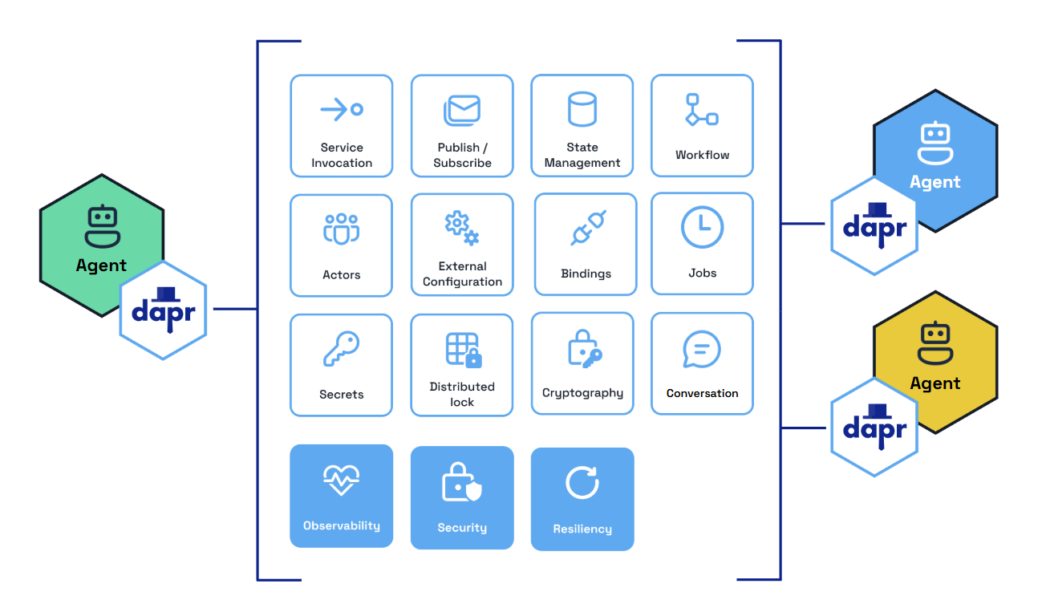
Decoupled Infrastructure Design
Notes:
Dapr Agents ensures a clean separation between agents and the underlying infrastructure, emphasizing simplicity, scalability, and adaptability:
Agent Simplicity: Agents focus purely on reasoning and task execution, while Pub/Sub messaging, routing, and validation are managed externally by modular infrastructure components.
Scalable and Adaptable Systems: By offloading non-agent-specific responsibilities, Dapr Agents allows agents to scale independently and adapt seamlessly to new use cases or integrations.

Slide 8
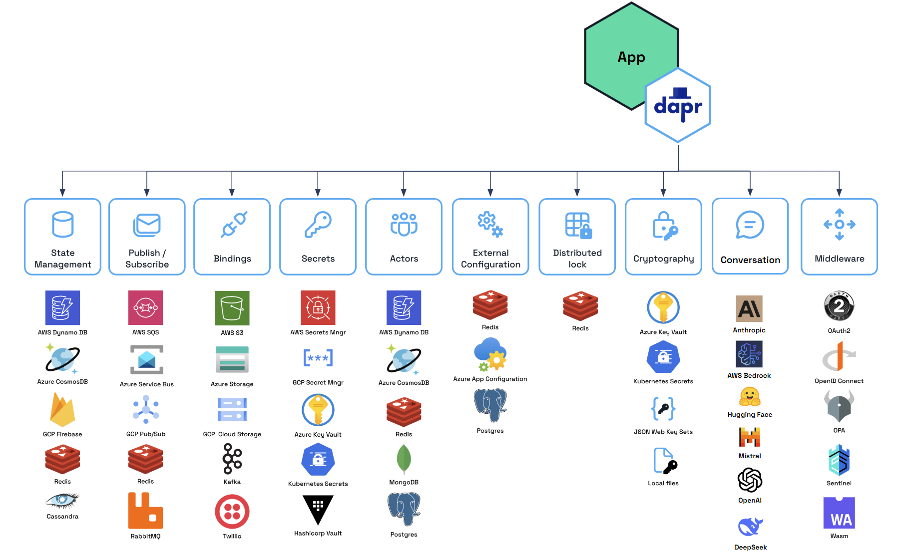
Modular Component Model
Notes:
Dapr Agents utilizes Dapr's pluggable component framework and building blocks to simplify development and enhance flexibility:
Building Blocks for Core Functionality: Dapr provides API building blocks, such as Pub/Sub messaging, state management, service invocation, and more, to address common microservice challenges and promote best practices.
Interchangeable Components: Each building block operates on swappable components (e.g., Redis, Kafka, Azure CosmosDB), allowing you to replace implementations without changing application code.
Seamless Transitions: Develop locally with default configurations and deploy effortlessly to cloud environments by simply updating component definitions.
Scalable Foundations: Build resilient and adaptable architectures using Dapr’s modular, production-ready building blocks.

Slide 9
Actor-Based Model for Agents
Stateful Agents
Dynamic Lifecycle Management
Location Transparency
Scalable Execution
Notes:
Dapr Agents leverages Dapr’s Virtual Actor model to enable agents to function efficiently and flexibly within distributed environments. Each agent in Dapr Agents is instantiated as an instance of a class, wrapped and managed by a virtual actor. This design offers:
Stateful Agents: Virtual actors allow agents to store and recall information across tasks, maintaining context and continuity for workflows.
Dynamic Lifecycle Management: Virtual actors are automatically instantiated when invoked and deactivated when idle. This eliminates the need for explicit creation or cleanup, ensuring resource efficiency and simplicity.
Location Transparency: Agents can be accessed and operate seamlessly, regardless of where they are located in the system. The underlying runtime handles their mobility, enabling fault-tolerance and dynamic load balancing.
Scalable Execution: Agents process one task at a time, avoiding concurrency issues, and scale dynamically across nodes to meet workload demands.
This model ensures agents remain focused on their core logic, while the infrastructure abstracts complexities like state management, fault recovery, and resource optimization.

Slide 10
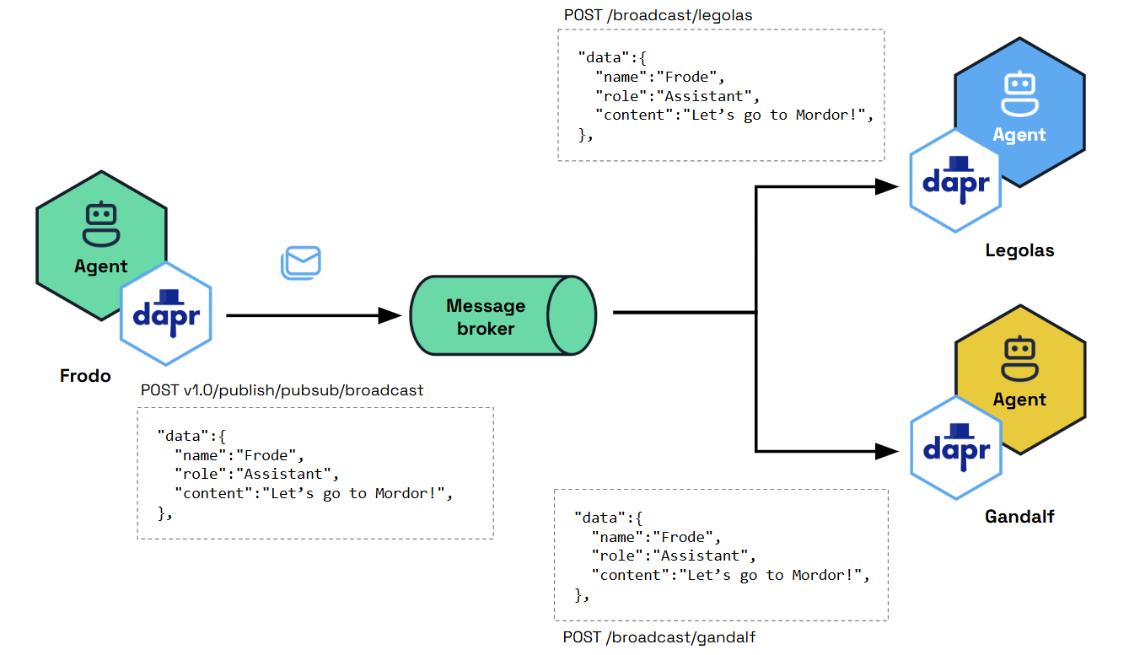
Message-Driven Communication
Notes:
Dapr Agents emphasizes the use of Pub/Sub messaging for event-driven communication between agents. This principle ensures:
Decoupled Architecture: Asynchronous communication for scalability and modularity.
Real-Time Adaptability: Agents react dynamically to events for faster, more flexible task execution.
Seamless Collaboration: Agents share updates, distribute tasks, and respond to events in a highly coordinated way.

Slide 11
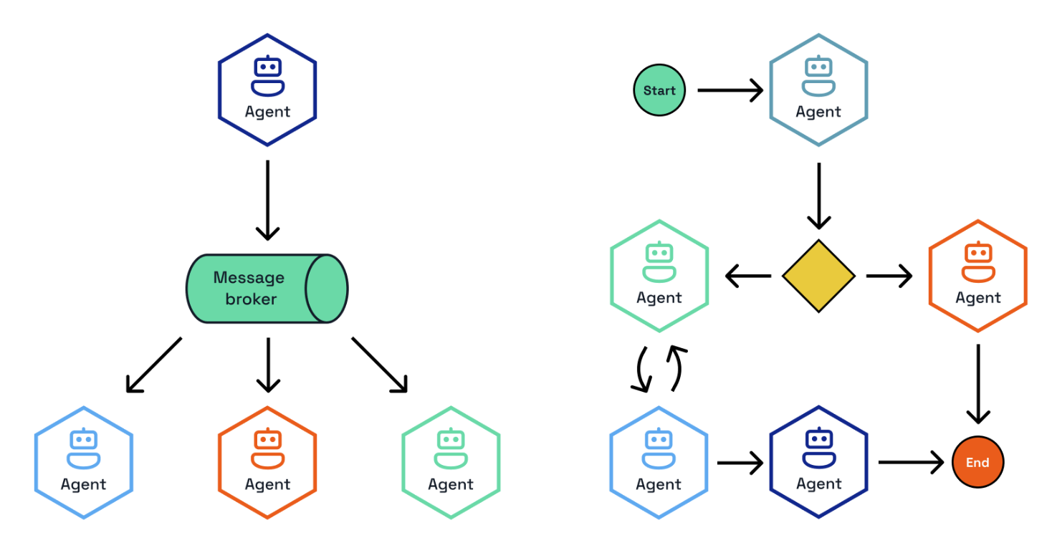
Workflow-Oriented Design
Notes:
Dapr Agents embraces workflows as a foundational concept, integrating Dapr Workflows to support both deterministic and event-driven task orchestration. This dual approach enables robust and adaptive systems:
Deterministic Workflows: Dapr Agents uses Dapr Workflows for stateful, predictable task sequences. These workflows ensure reliable execution, fault tolerance, and state persistence, making them ideal for structured, multi-step processes that require clear, repeatable logic.
Event-Driven Workflows: By combining Dapr Workflows with Pub/Sub messaging, Dapr Agents supports workflows that adapt to real-time events. This facilitates decentralized, asynchronous collaboration between agents, allowing workflows to dynamically adjust to changing scenarios.
By integrating these paradigms, Dapr Agents enables workflows that combine the reliability of deterministic execution with the adaptability of event-driven processes, ensuring flexibility and resilience in a wide range of applications.

Slide 12
Let’s dive into the code
Basic LLM interactions
Simple Agent with Tools
Durable, Stateful Agents
Simple Workflows
Agents with Vector Stores
Notes:
That’s given us a solid foundation on Dapr Agents – Let’s dive into some code and explore some basic agents.
We’ll start with Agents that interact with LLMs, then we’ll look at external tools and how we can use them in Dapr Agents. We’ll then take a look at Durable, Stateful Agents, Simple Workflows, and Agents with Vector Stores.

