Slide 1

Dapr Agents 101
LLM Integration with Dapr Agents
Using External Tools in Dapr Agents
Agentic Workflows with Dapr Agents
Document Agents with Dapr and Chainlit
MCP Integration in Dapr Agents
Augmented LLM in Dapr Agents
Stateful LLMs with Dapr Agents
Advanced Prompt Chaining in Dapr Agents
Dynamic Routing Strategies for Dapr Agents
Orchestrating Complex Workflows in Dapr Agents
Evaluator-Optimizer Patterns with Dapr Agents
Notes:
Hey everyone! Welcome back to this series on building AI Agents with Dapr Agents! In our previous video we took at look at how we can call external tools in our Dapr Agents to enhance the capability of our agents by handling dynamic and multi-step tasks more effectively.
Now in this video, we’re going to cover agentic workflows in Dapr Agents, and how we can use workflows to support both deterministic and event-driven task orchestration

Slide 2
Workflow Systems
Used to automate business processes, and implement durable execution concept.
They consist of:
An authoring environment to create the workflow
An engine to run the workflow
A state store to persist the workflow state
Notes:
“If you watnt to automate business processes that don’t break when things go wrong? That’s where durable workflows come in.
They’re built on three key parts:
🛠️ Authoring Environment – where you design the workflow logic
🚀 Workflow Engine – runs the steps, handles retries, and orchestrates execution
🗃️ State Store – saves progress so your workflow can pause, resume, or recover from failure
Together, they let you build resilient, long-running processes that scale. Whether it’s approvals, data pipelines, or multi-agent orchestration—this pattern keeps your logic alive and reliable."

Slide 3





Dapr Workflows
Receive message
Start
Get a secret & invoke an API
Activity A
External Event
Wait for event
Invoke an API
Activity B
Activity C
Store event result
Activity D
End
Publish message
Notes:
Dapr Agents supports both deterministic and event-driven workflows to manage multi-agent systems via Dapr Workflows. Deterministic workflows provide clear, repeatable processes, while event-driven workflows allow for dynamic, adaptive collaboration between agents in centralized or decentralized architectures.

Slide 4
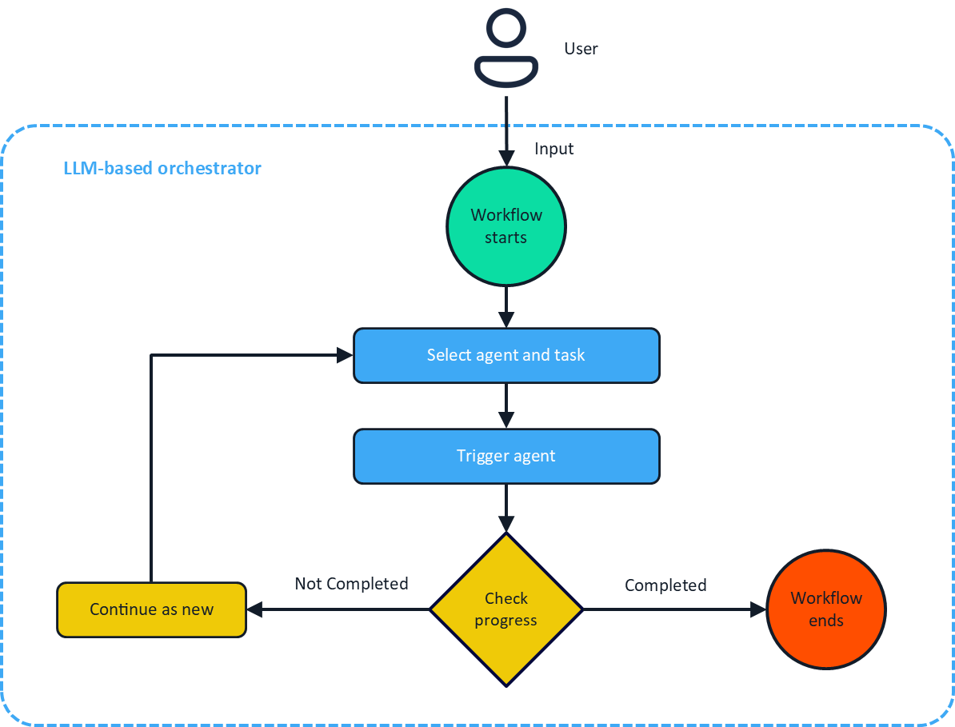
Durable Agents
Notes:
DurableAgent¶
The DurableAgent class is a workflow-based agent that extends the standard Agent with Dapr Workflows for long-running, fault-tolerant, and durable execution. It provides persistent state management, automatic retry mechanisms, and deterministic execution across failures.
Key Characteristics: - Workflow-based execution using Dapr Workflows - Persistent workflow state management across sessions and failures - Automatic retry and recovery mechanisms - Deterministic execution with checkpointing - Built-in message routing and agent communication - Supports complex orchestration patterns and multi-agent collaboration
When to use: - Multi-step workflows that span time or systems - Tasks requiring guaranteed progress tracking and state persistence - Scenarios where operations may pause, fail, or need recovery without data loss - Complex agent orchestration and multi-agent collaboration - Production systems requiring fault tolerance and scalability

Slide 5
Agent Collaboration in Workflows
Random
Encourages diversity in responses and strategies
Simplifies orchestration
Useful for exploratory or brainstorming tasks
Round Robin
Ensures equal participation among agents
Ideal for predictable task distribution
Each agent takes turns in a predefined order
LLM-Based
Task Context
Chat History
Agent Metadata
Notes:
workflows enable the coordination of multiple agents to achieve shared goals. In Dapr Agents, workflows serve as a higher-level framework for organizing how agents collaborate and distribute tasks.
Workflows can orchestrate agents, each equipped with their own built-in patterns, to handle different parts of a larger process. For example, one agent might gather data using tools, another might analyze the results, and a third might generate a report. The workflow manages the communication and sequencing between these agents, ensuring smooth collaboration.
Workflows can also define loops similar to agent patterns. Instead of relying on an agent’s built-in tool-calling loop, you can design workflows to orchestrate tool usage, reasoning, and action. This gives you the flexibility to use workflows to define both multi-agent collaboration and complex task handling for a single agent.
Random Workflow¶
In a Random Workflow, the next agent to handle a task is selected randomly. This approach:
Encourages diversity in agent responses and strategies.
Simplifies orchestration in cases where task assignment does not depend on specific agent roles or expertise.
Random workflows are particularly useful for exploratory tasks or brainstorming scenarios where agent collaboration benefits from randomness.
Round Robin Workflow¶
The Round Robin Workflow assigns tasks sequentially to agents in a fixed order. This method:
Ensures equal participation among agents.
Is ideal for scenarios requiring predictable task distribution, such as routine monitoring or repetitive processes.
For example, in a team of monitoring agents, each agent takes turns analyzing incoming data streams in a predefined order.
LLM-Based Workflow¶
The LLM-Based Workflow relies on the reasoning capabilities of an LLM to dynamically choose the next agent based on:
Task Context: The nature and requirements of the current task.
Chat History: Previous agent responses and interactions.
Agent Metadata: Attributes like expertise, availability, or priorities.
This approach ensures that the most suitable agent is selected for each task, optimizing collaboration and efficiency. For example, in a multi-agent customer support system, the LLM can assign tasks to agents based on customer issues, agent expertise, and workload distribution.

Slide 6
Let’s dive into the code
Sequential Task Execution in LLM-based workflows
Parallel Task Execution in LLM-based workflows
Notes:
Let’s dive into some code – In this demo I’m going to show you have we can use Agentic workflows to orchestrate both sequential and parallel tasks using Dapr Agent’s workflow capabilities in Large-Language Model based workflows

