Slide 1

Dapr Agents 101
LLM Integration with Dapr Agents
Using External Tools in Dapr Agents
Agentic Workflows with Dapr Agents
Document Agents with Dapr and Chainlit
MCP Integration in Dapr Agents
Augmented LLM in Dapr Agents
Stateful LLMs with Dapr Agents
Advanced Prompt Chaining in Dapr Agents
Dynamic Routing Strategies for Dapr Agents
Orchestrating Complex Workflows in Dapr Agents
Evaluator-Optimizer Patterns with Dapr Agents
Notes:
Hi everyone, welcome back to this series on building AI Agents with Dapr Agents!
So far in this series, we’ve covered the basics of Dapr Agents, what they are, and how we can use them to build AI Agents.
Now we’re going to dive into some patterns that we can implement to build effective agents using Dapr Agents, starting with the Augmented LLM pattern in Dapr Agents. These videos will describe what the pattern is at a high level, before jumping straight into the code to show how we can implement the pattern. I’m not going to spend too much time going over theory, we’ve done that. These pattern videos are going to concentrate more on the code.

Slide 2
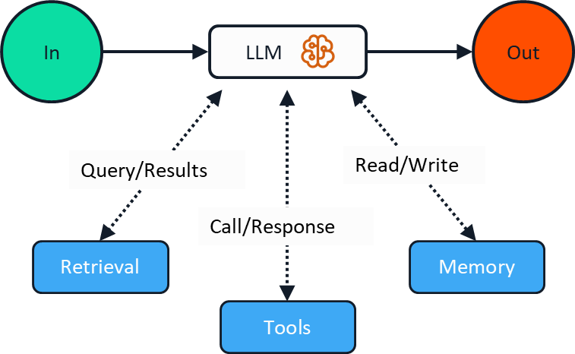
Augmented LLM Pattern
Notes:
That being said, let’s cover the Augmented LLM pattern.
This pattern is a foundational building block for agentic systems. It enhances a language model with external capabilities such as memory, tools, and retrieval systems. This pattern enables LLMs to overcome their inherent limitations by connecting them to the outside world, allowing them to remember context across interactions and access external data or services.
Use Cases
Personal Assistants: Remembering user preferences and accessing calendars, emails, or other personal data
Customer Support: Retrieving product information or account details to provide accurate assistance

Slide 3
Let’s dive into the code
Augmented LLM Pattern implementation in Dapr
Agent Configuration
Memory Persistence
Tool integration
Notes:
So let’s see how the Augumented LLM pattern works in action.
We’ll see how we can configure our agents with specific roles and instructions, how we can augment LLMs using tool integration and memory persistence, and how we can configure our agents to use tools that we define.

