Slide 1

Dapr Agents 101
LLM Integration with Dapr Agents
Using External Tools in Dapr Agents
Agentic Workflows with Dapr Agents
Document Agents with Dapr and Chainlit
MCP Integration in Dapr Agents
Augmented LLM in Dapr Agents
Stateful LLMs with Dapr Agents
Advanced Prompt Chaining in Dapr Agents
Dynamic Routing Strategies for Dapr Agents
Orchestrating Complex Workflows in Dapr Agents
Evaluator-Optimizer Patterns with Dapr Agents
Notes:
Hi everyone, welcome back to this series on building AI Agents with Dapr Agents!
This is our final video of the series (or the planned one anyway) where we’ll take a look at the evaluator-optimizer pattern in Dapr Agents.

Slide 2
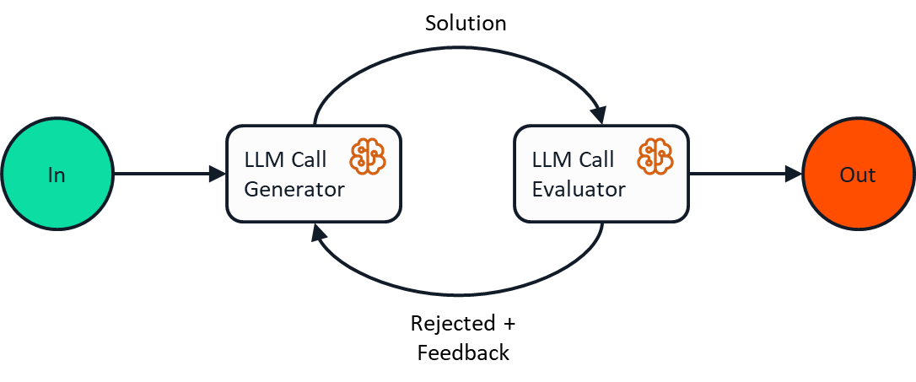
Evaluator-Optimizer Pattern
Notes:
The Evaluator-Optimizer pattern features two complementary LLM roles in a feedback loop: one generates content while another evaluates it, leading to iterative improvements until quality criteria are met.
Use Cases
Content Creation: Refining written content to match specific style guidelines or quality standards
Translation: Improving literary translations that require nuanced understanding and expression
How It Works
The key components of this implementation are:
Generator LLM: Creates or refines a travel plan based on user request and feedback
Evaluator LLM: Scores the plan and provides structured feedback for improvement
Feedback Loop: Enables a simple round of generation and evaluation
Quality Criteria: Checks if the plan meets requirements or needs further refinement
The implementation demonstrates how multiple LLMs can work together in a feedback loop to improve content quality
This pattern is ideal when:
There are clear evaluation criteria for the generated content
Iterative refinement improves output quality
LLM responses can be improved through explicit feedback

Slide 3
Let’s dive into the code
Evaluator-Optimizer in Action
Components of the pattern:
Generator LLM
Evaluator LLM
Feedback Loops
How we can use this to return quality results.
Notes:
Let’s see this in action! We’ll build a simple example of how we can implement the evaluator optimizer pattern in action, set up the different LLMs components that both generate content and then evaluate it as part of our feedback loop, and how that feedback loop returns a result that meets our quality criteria.

