Slide 1

Dapr Agents 101
LLM Integration with Dapr Agents
Using External Tools in Dapr Agents
Agentic Workflows with Dapr Agents
Document Agents with Dapr and Chainlit
MCP Integration in Dapr Agents
Augmented LLM in Dapr Agents
Stateful LLMs with Dapr Agents
Advanced Prompt Chaining in Dapr Agents
Dynamic Routing Strategies for Dapr Agents
Orchestrating Complex Workflows in Dapr Agents
Evaluator-Optimizer Patterns with Dapr Agents
Notes:
Hi everyone, welcome back to this series on building AI Agents with Dapr Agents!
We’re making some great progress – This will be the last “theory” video I’ll do before diving into patterns that we can implement with Dapr Agents.
So in this video, we’ll cover how we can integrate MCP or the Model Context Protocol in Dapr Agents. Now I’m planning to do a series on working with MCP sometime in the future, where I’ll dive a little deeper on how it works, how we can build MCP servers and clients using best practices, but for now – we’ll touch on the basics of MCP and how we can use configure MCP Clients in Dapr Agents.

Slide 2
The MCP Protocol
Model Context Protocol
An open protocol that standardizes how apps provide context to LLMs
MCP Provides a standardized way to connect AI models to different data sources and tools.
Notes:
So MCP is an open protocol that standardizes how applications provide context to LLMs.
Think of MCP like a USB-C port for AI applications.
Just as USB-C provides a standardized way to connect your devices to various peripherals and accessories, MCP provides a standardized way to connect AI models to different data sources and tools.
MCP helps you build agents and complex workflows on top of LLMs. LLMs frequently need to integrate with data and tools, and MCP provides:
A growing list of pre-built integrations that your LLM can directly plug into
The flexibility to switch between LLM providers and vendors

Slide 3
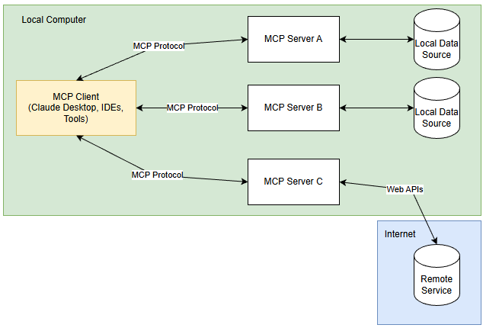
MCP Architecture
Hosts (Like Claude Desktop) access data through MCP
Protocol clients maintain 1:1 connections with servers.
Servers expose specific capabilities through MCP.
Data could be local (file systems, DBs) and remote (APIs).
Notes:
At its core, MCP follows a client-server architecture where a host application can connect to multiple servers:
MCP Hosts: Programs like Claude Desktop, IDEs, or AI tools that want to access data through MCP
MCP Clients: Protocol clients that maintain 1:1 connections with servers
MCP Servers: Lightweight programs that each expose specific capabilities through the standardized Model Context Protocol
Local Data Sources: Your computer’s files, databases, and services that MCP servers can securely access
Remote Services: External systems available over the internet (e.g., through APIs) that MCP servers can connect to

Slide 4
MCP Support in Dapr
Dapr Agents include support for MCP
Agents can discover and invoke tools through a standardized interface.
MCP clients fetch all available tools from server and prepares them for use in Agent.
Agents invoke these tools at runtime, expanding their behavior.
Notes:
Dapr Agents includes built-in support for the Model Context Protocol (MCP), enabling agents to dynamically discover and invoke external tools through a standardized interface. Using the provided MCPClient, agents can connect to MCP servers via two transport options: stdio for local development and sse for remote or distributed environments.
Once connected, the MCP client fetches all available tools from the server and prepares them for immediate use within the agent’s toolset. This allows agents to incorporate capabilities exposed by external processes—such as local Python scripts or remote services without hardcoding or preloading them. Agents can invoke these tools at runtime, expanding their behavior based on what’s offered by the active MCP server.

Slide 5
Let’s dive into the code
MCP Agent with SSE Transport.
Create our MCP tools
Create our SSE Server
Create our Agent that connects to tools over MCP with SSE Transport.
Notes:
Let’s take a look this in action! We’ll go through how we can build a simple Dapr Agent that uses tools exposed via a MCP server over Server-Sent Events. We’ll set up a simple standalone server, create some MCP tools in it and connect our agent to them using SSE communication.

