Slide 1

Dapr Agents 101
LLM Integration with Dapr Agents
Using External Tools in Dapr Agents
Agentic Workflows with Dapr Agents
Document Agents with Dapr and Chainlit
MCP Integration in Dapr Agents
Augmented LLM in Dapr Agents
Stateful LLMs with Dapr Agents
Advanced Prompt Chaining in Dapr Agents
Dynamic Routing Strategies for Dapr Agents
Orchestrating Complex Workflows in Dapr Agents
Evaluator-Optimizer Patterns with Dapr Agents
Notes:
Hi everyone, welcome back to this series on building AI Agents with Dapr Agents!
In this video we’re going to dive into our second pattern Stateful LLMs with Dapr Agents

Slide 2
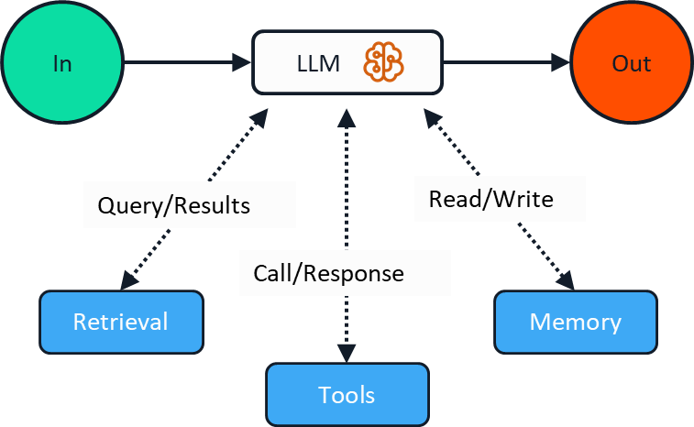
Stateful LLM
Durable workflow
Notes:
The Stateful LLM pattern extends the Augmented LLM pattern by adding persistence, reliability, and workflow capabilities. This pattern enables LLMs to maintain state across sessions and handle long-running operations that can survive system restarts.
Use Cases
Mission-Critical Applications: Where reliability and fault tolerance are essential
Long-Running Tasks: Operations that may take minutes, hours, or days to complete
Distributed Systems: Applications running across multiple services or regions
How It Works
The key components of this implementation are:
Persistent Memory: The agent stores conversation state in Dapr's state store, enabling it to remember context across sessions and system restarts.
Workflow Orchestration: Long-running tasks are managed through Dapr's workflow system, providing:
Durability - workflows survive process crashes
Observability - track status and progress
Recoverability - automatic retry on failures
Tool Integration: A flight search tool is defined using the @tool decorator, which automatically handles input validation and type conversion.
Service Exposure: The agent exposes REST endpoints to start and manage workflows.
Key Differences from Augmented LLM Pattern
Persistence: State survives across restarts, unlike the in-memory state of basic agents
Reliability: Automatic failure recovery and retry mechanisms
API Access: REST endpoints for workflow management
Observability: Ability to track and monitor workflow progress
Durability: Can handle long-running tasks spanning minutes, hours, or days

Slide 3
Let’s dive into the code
Stateful LLM Pattern implementation in Dapr
Persistent Memory
Workflow Orchestration
Tool Integration
Service Exposure
Notes:
Let’s dive into the code and see how we can implement the Stateful LLM pattern in Dapr, and how we can use workflow orchestration, persistent memory, tools, and service exposure to build and track the progress of our Agents that implement this pattern

