Slide 1


Slide 2
Dapr Agents 101
LLM Integration with Dapr Agents
Using External Tools in Dapr Agents
Agentic Workflows with Dapr Agents
Document Agents with Dapr and Chainlit
MCP Integration in Dapr Agents
Augmented LLM in Dapr Agents
Stateful LLMs with Dapr Agents
Advanced Prompt Chaining in Dapr Agents
Dynamic Routing Strategies for Dapr Agents
Orchestrating Complex Workflows in Dapr Agents
Evaluator-Optimizer Patterns with Dapr Agents

Slide 3
What are Dapr Agents?
Benefits of Dapr Agents
Core Principles
Building our first Dapr Agents

Slide 4
Dapr Agents
“A framework for developers that simplifies the creation of AI Agents that reason, act, and collaborate using Large-Language Models (LLMs)”

Slide 5
Benefits
Durable Agents using Dapr Workflows
Decoupled Infrastructure
Multiple choice of LLMs and State Stores
Vendor neutral + Open Source
Production-ready reliability, security, and observability.

Slide 6








Dapr Agent Interactions
Planning
Memory
Interaction
Environment
User
Observation
Delegate tasks
Tools
Outside world

Slide 7
Agent-Centric Design
LLM-Powered Agents
Adaptive Task Handling
Seamless Integration

Slide 8
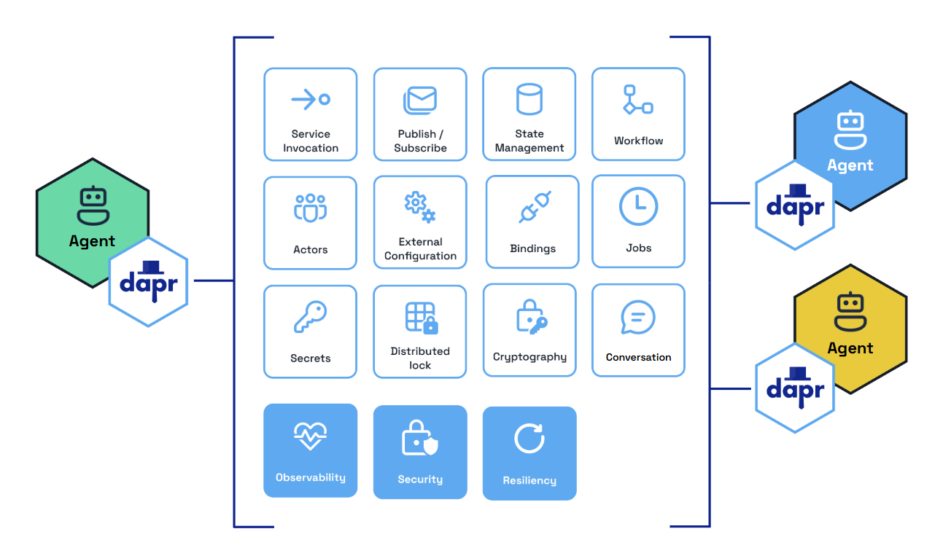
Decoupled Infrastructure Design

Slide 9
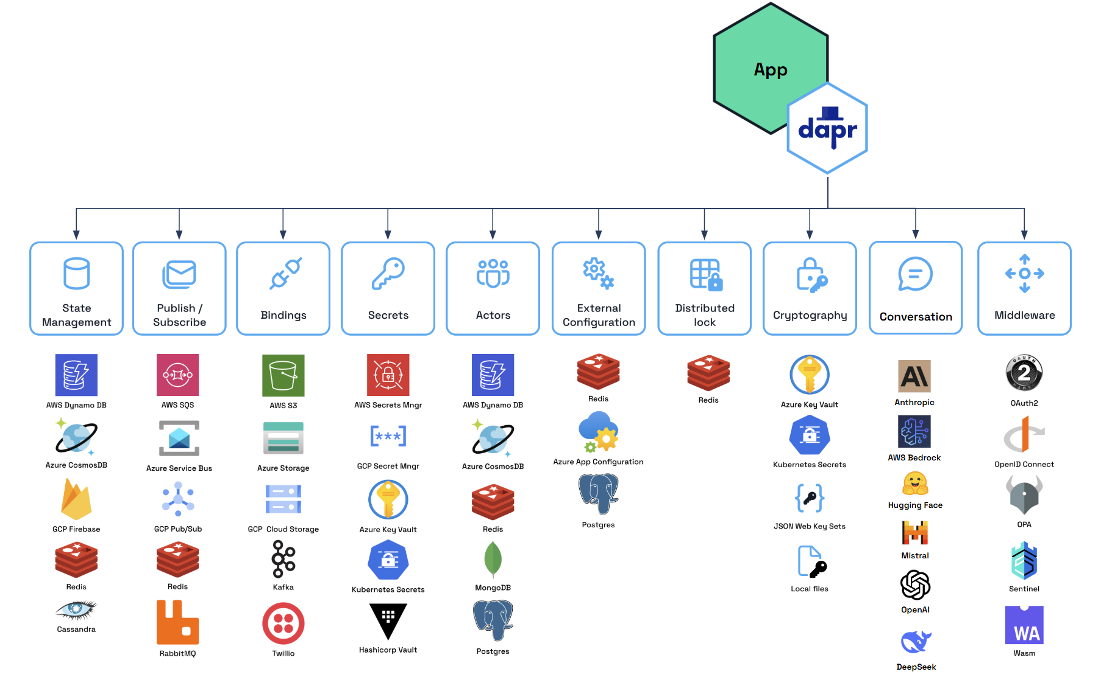
Modular Component Model

Slide 10
Actor-Based Model for Agents
Stateful Agents
Dynamic Lifecycle Management
Location Transparency
Scalable Execution

Slide 11
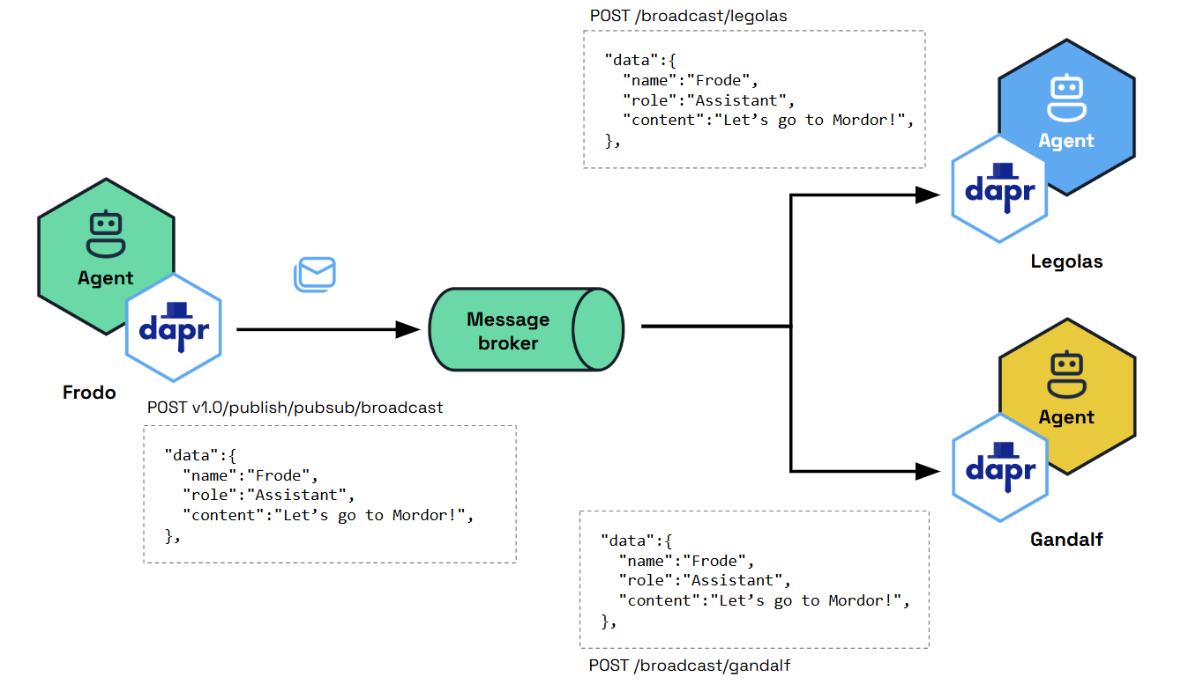
Message-Driven Communication

Slide 12
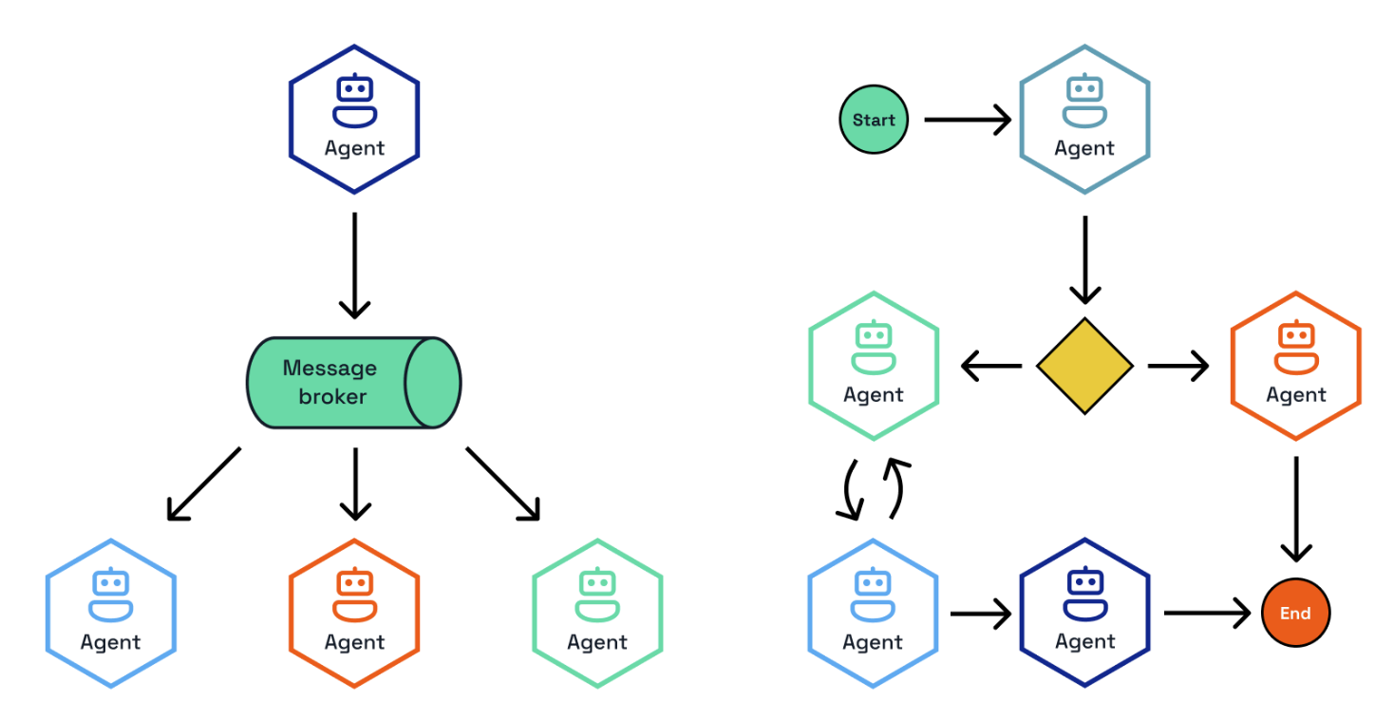
Workflow-Oriented Design

Slide 13
Let’s dive into the code
Basic LLM interactions
Simple Agent with Tools
Durable, Stateful Agents
Simple Workflows
Agents with Vector Stores

