Slide 1


Slide 2
Dapr Agents 101
LLM Integration with Dapr Agents
Using External Tools in Dapr Agents
Agentic Workflows with Dapr Agents
Document Agents with Dapr and Chainlit
MCP Integration in Dapr Agents
Augmented LLM in Dapr Agents
Stateful LLMs with Dapr Agents
Advanced Prompt Chaining in Dapr Agents
Dynamic Routing Strategies for Dapr Agents
Orchestrating Complex Workflows in Dapr Agents
Evaluator-Optimizer Patterns with Dapr Agents

Slide 3
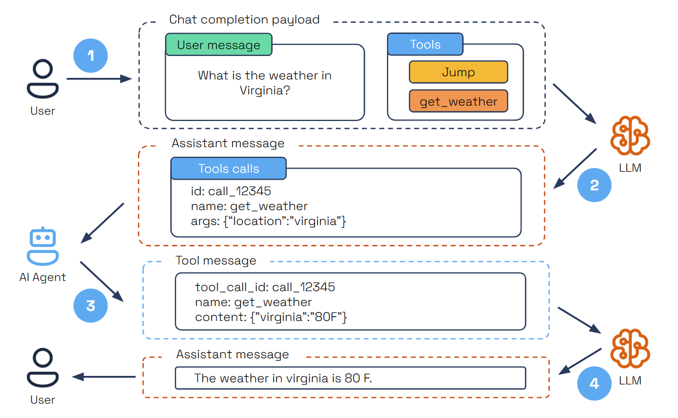
Tool Calling

Slide 4
Let’s dive into the code
How to create tools for Dapr Agents
How Dapr Agents use Tools
Working with Agent Memory
Persistent Agent Memory in Dapr
Adding Observability in Dapr Agents

