Slide 1
What’s new for Cloud Native developers in .NET 8?
Will Velida
Lead Software Engineer @ Mantel Group
@willvelida

Slide 2

whoami
Lead Software Engineer at Azenix by Mantel Group.
Former MSFTer and Microsoft MVP based in Auckland – Moved to Melbourne this year
.NET and Azure developer with experience in banking, agriculture, and health industries.
Former average rugby player.

Slide 3
Agenda
Native AOT
Resiliency improvements
New metrics in ASP.NET Core
.NET Aspire

Slide 4
Native AOT (Ahead-of-time)
Smaller apps
Faster Startup
Less Memory Apps

Slide 5
How does native AOT work?
C# is compiled to Intermediate Language (IL) on build.
IL is compiled to platform code on publish.
Published app:
Has no JIT (Just-in-time) complier
Still contains a runtime & GC (is still “managed”)
Is single-file
Is trimmed to reduce app size
Is OS & architecture specific, e.g. linux-x64
Notes:
Publishing your app as Native AOT produces an app that’s self contained and that has been ahead-of-time complied to native code.
They have faster startup time and smaller memory footprints
These apps can run on machines that don’t have the .NET runtime installed.
The Native AOT deployment model uses a ahead-of-time complier to compile intermediate language to native code at time of publish.
Native AOT apps don’t use a just in time complier when the application runs, meaning they can run in restricted environments where a JIT isn’t allowed.
They target a specific runtime environment, such as Linux x64 or Windows x64

Slide 6
Why Native AOT with ASP.NET Core?
Minimized disk footprint
Reduced startup time
Reduced memory demand
Notes:
Publishing and deploying a native AOT app gives us the following benefits:
- when publishing with native AOT, a single executable is produced containing just the code from external dependencies need to support the program. This reduced size leads to smaller container images and reduced deployment time from smaller images.
- Native AOT apps can show a reduced start-up time, which means the app can serve requests quicker, and it can improve deployment where container orchestrators need to manage transition from one version of the app to another.
- Native AOT apps can have reduced memory demands, depending on the workload. This can lead to greater deployment density and improved scalability.

Slide 7
Native AOT Demo

Slide 8
Resiliency Improvements

Slide 9
Failures will happen!
Network outages
Transient service errors
Remote service outage
Notes:
One thing we can be sure of about when we deploy cloud services is that failures will always happen.
They could be network outages, transient errors, remote services going offline etc.

Slide 10
Two new packages!
NuGet package | Description
📦 Microsoft.Extensions.Resilience | This NuGet package provides mechanisms to harden apps against transient failures.
📦 Microsoft.Extensions.Http.Resilience | This NuGet package provides resilience mechanisms specifically for the HttpClient class.
The Microsoft.Extensions.Http.Polly NuGet package is deprecated. Use either of the aforementioned packages instead.
Notes:
So Microsoft have introduced two new packages for resilience!
In .NET programming, resilience is achieved by designing apps that can handle failures and recover quickly.

Slide 11
Built on Polly - .NET resilience library
Handles Transient failures
Protects system resources
Policies that you can implement include:
Retry – Try again if something fails.
Circuit breaker – Stop trying if something is broken or busy.
Timeout – Give up if something takes too long.
Fallback – Do something else if something fails.
Rate limiting – Limit how many requests you make or accept.
Notes:
The two new NuGet packages for resilience are built on top of Polly
Polly is a .NET resilience and transient fault-handling library that allows you to create resilience strategies such as retry, timeouts etc in a fluent and thread-safe manner.

Slide 12
Resiliency Demo
Notes:
Let’s jump into another demo.

Slide 13
Microsoft.Extensions.Http.Resilience
AddResilienceHandler
Used for custom resilience pipelines
Used when standard resilience or standard hedging is not suitable
AddStandardResilienceHandler
Recommended out-of-the-box resilience solution.
AddStandardHedgingHandler
Improves latencies, increases costs
Can send requests concurrently
Supports routing
Used for idempotent request only.
Notes:
Adding resiliency to our client

Slide 14
New metrics in ASP.NET Core

Slide 15
System.Diagnostics.Metrics
ASP.NET Core now provides runtime metrics through System.Diagnostics.Metrics.
Designed in collaboration with OpenTelemetry Community.
Metrics offer improvements, such as:
New counters, gauges, and histograms.
Reporting with multi-dimensional values.
Integration with wider cloud native ecosystem by aligning to OpenTelemetry standards.
Notes:
System.Diagnotics.Metrics APIs are the newest cross-platform APIs, and Microsoft worked with OpenTelemetry project to design them.
It’s available for .NET 6+, and the API add support for things such as:
Histograms and percentiles
Multi-dimensional metrics
Strongly typed high-performance listener API
Multiple simultaneous listeners
Listener access to unaggregated measurements
Although the API was designed with OpenTelemetry in mind, it can work with .NET built in listener APIs directly.

Slide 16
Metrics Demo

Slide 17
.NET Aspire

Slide 18
What is .NET Aspire?
Stack for building resilient, observable, and configurable cloud-native apps in .NET
Includes a set of components enhanced with cloud-native fundamentals, such as Telemetry, Resilience, Configuration, Health Checks, and Composition
Makes it easy to discover, acquire, and configure dependencies for cloud-native apps

Slide 19
Why .NET Aspire?
Intention is to improve experience of building .NET Cloud-Native Apps.
Provides an opinionated set of tools and patterns to help build and run distributed apps.
.NET Aspire is designed to help you with:
Orchestration: provides features for running and connecting multi-project apps and dependencies
Components: NuGet packages for commonly used services, such as Redis or Postgres, with standard interfaces
Tooling: Cool tooling with Visual Studio and dotnet CLI.

Slide 20
Orchestration
Aspire streamlines the configuration and connection of different parts of your app.
Provides abstractions for managing service discovery, container configurations etc. with having to handle low level implementation details.
Helps with the following concerns:
App Composition – specifying the .NET projects, containers, executables etc that make up the app.
Service Discovery and connection string management.

Slide 21
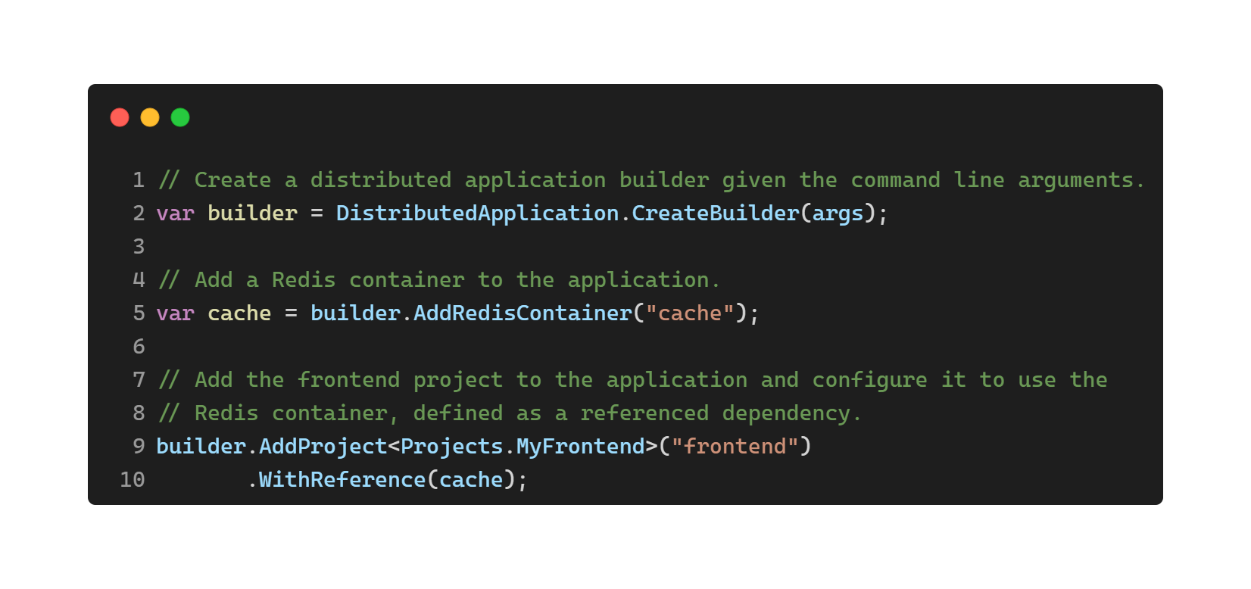
Orchestration example

Slide 22
Components
NuGet packages designed to simplify connections to popular services and platforms.
Handle cloud-native concerns through standard configuration patterns, such as health-checks and telemetry.
Designed to work with .NET Aspire Orchestration, capable of flowing their configurations through dependencies based on .NET project and package references.

Slide 23
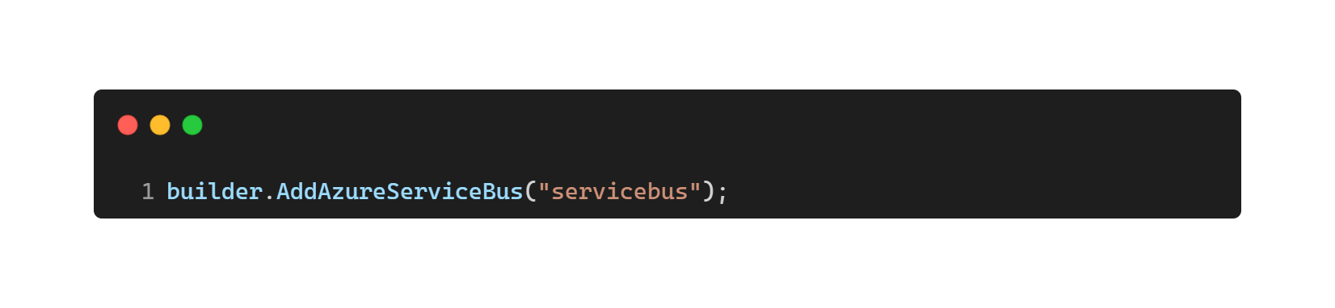
Component Example
Registers a ServiceBusClient as a Singleton in the DI container to connect to Service Bus
Applies ServiceBusClient configurations either inline through code or through configuration.
Enables corresponding health checks, logging and telemetry specific to Azure Service Bus

Slide 24
.NET Aspire Demo and Walkthrough

Slide 25
Catch up on dotnetconf!
https://www.dotnetconf.net/agenda

Slide 26


Thanks for listening!
https://github.com/willvelida/talks/tree/main/whats-new-cloud-native-dev-dotnet8
https://www.dotnetconf.net/agenda

