Slide 1
Building AI Agents with Semantic Kernel SDK
Will Velida | Lead Platform Engineer @ Mantel Group
@willvelida
July 2024

Slide 2

$ whoami
Lead Platform Engineer at Mantel Group.
Former MSFTer and Microsoft MVP
.NET and Azure background, with experience in banking, agriculture, retail, health, and insurance industries.
Former average rugby payer.

Slide 3

What we’re going to talk about today
What is the Semantic Kernel?
Key Concepts of Semantic Kernel

Slide 4
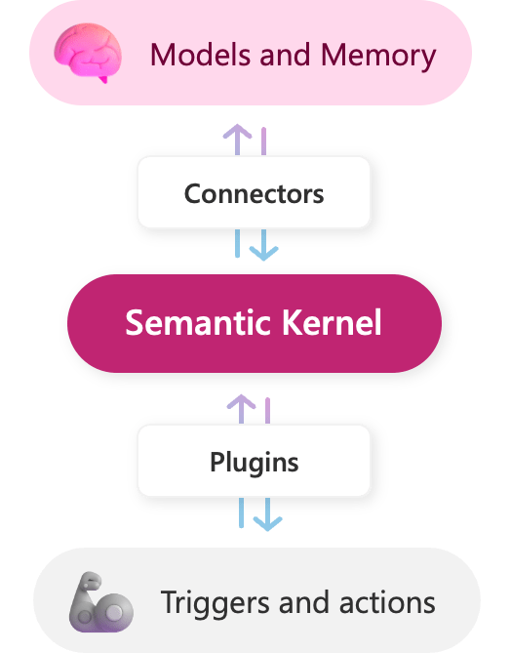
What’s Semantic Kernel
Semantic Kernel is an open source SDK that enables you to build your own custom AI agents.
Combining LLMs with native code, you can get AI agents that understand and respond to natural language prompts to complete a variety of tasks.
AI Agents are programs that achieve predetermined goals.
They can achieve these with some or minimal intervention.
Notes:
Semantic Kernel is a lightweight, open-source development kit that lets you easily build AI agents and integrate the latest AI models into your C#, Python, or Java codebase. It serves as an efficient middleware that enables rapid delivery of enterprise-grade solutions.

Slide 5
What’s Semantic Kernel
Integrates LLMs like OpenAI, Azure OpenAI, and Hugging Face with languages like C#, Python, and Java.
You can create “plugins” to interface with LLMs and perform various tasks.
Through these plugins, you can use LLMs in your applications without having to learn the details of that model’s API.
Notes:
Semantic Kernel integrates LLMs like OpenAI, Azure OpenAI, and Hugging Face with conventional programming languages like C#, Python, and Java. Developers can create "plugins" to interface with the LLMs and perform various tasks.
The Semantic Kernel SDK also provides built-in plugins that can quickly enhance an application.
Developers can easily utilize LLMs in their own applications without having to learn the intricacies the model's API.

Slide 6
Key Components of the Semantic Kernel SDK
AI Orchestration Layer
This enables integration of AI models and plugins.
Connectors
Developers use these connectors to integrate LLMs into their existing applications.
These serve as a bridge between your app code, and the AI model
Plugins
Semantic Kernel SDK operates on plugins
Plugins consist of prompts that you want the AI model to respond to, and functions that can complete tasks.
You can use built-in plugins, or create your own.
This layer is responsible for combining these components to craft user interactions
Notes:
The key components of the Semantic Kernel SDK are:
AI Orchestration Layer
The core of the Semantic Kernel stack is an AI orchestration layer that allows the seamless integration of AI models and plugins. This layer is responsible for combining these components to craft innovative user interactions.
Connectors
The Semantic Kernel SDK offers a set of connectors that enable developers to integrate LLMs into their existing applications. These connectors serve as the bridge between the application code and the AI models.
Plugins
The Semantic Kernel SDK operates on plugins, essentially serving as the "body" of the AI app. Plugins consist of prompts that you want the AI model to respond to and functions that can complete specialized tasks. Developers can use built-in plugins, or create their own.
For developers eager to delve into AI development, the Semantic Kernel SDK opens the door to creating your own AI agent. The SDK seamlessly integrates models and custom plugins that enable you to create unique and impactful user experiences.

Slide 7
Why use Semantic Kernel?
Simplified Integration of AI capabilities into existing apps.
Reduced learning curve to use LLMs.
Enhanced Reliability for LLM applications.
Notes:
the process of integrating AI into applications can be complex and time-consuming, requiring developers to learn different APIs and navigate the intricacies of each service. The Semantic Kernel SDK solves that problem by providing a layer of abstraction, allowing developers to focus on creating great features instead.
Enterprise solutions can benefit from implementing the Semantic Kernel SDK in the following ways:
Streamlined Integration
The Semantic Kernel SDK offers a simplified integration of AI capabilities into existing applications, providing a cohesive solution for enterprise products.
Reduced Learning Curve
Directly using the APIs of large language models (LLMs) requires learning the intricacies of each service. The Semantic Kernel SDK provides an abstraction layer, minimizing the learning curve for developers.
Enhanced Reliability
The Semantic Kernel SDK allows developers to create a streamlined, reliable AI experience compared to the potential unpredictability of prompts and responses from LLMs used directly. The SDK supports the ability to fine tune prompts and plan tasks to create a controlled and predictable user experience.
The Semantic Kernel SDK is a valuable tool for adopting AI into your applications. It simplifies the challenges of using direct APIs, cuts down on the learning curve, and incorporates the latest AI developments. It offers a streamlined pathway for developers to quickly create new AI solutions or enhance existing products and applications.

Slide 8
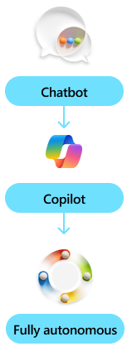
What are agents?
Agents are software-based entities that use AI models to do work for you.
For example, we have chatbots to answer questions.
Agents built to work alongside you is typically referred to as a Copilot.
Agents can also handle repetitive tasks (labelled as fully autonomous)
Notes:
Agents are software based entities that leverage AI models to do works for you. They are built to perform a wide range of tasks and called different names based on the jobs they do.
For example, an agent built to answer questions is referred to as a chatbot due to it’s chat-based experience. These agents are typically grounded in your own data, like company documents.
An agent built to work along side you is typically called a copilot. These agents help you complete tasks like writing emails or creating other office artifacts by providing recommendations that you choose to either accept or reject.
An agent built to handle repetitive tasks are usually labeled as fully autonomous. They respond to events and perform actions without needing intervention. This is different from a copilot in that it’s doing work for you instead of alongside you.
Semantic Kernel provides you with the infrastructure to build any kind of agent you need without being an expert in AI.

Slide 9
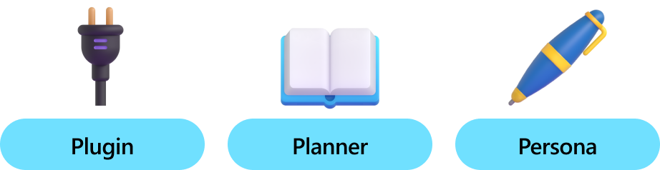
Building our First Agent
Notes:
An agent is made up of three core building blocks that harmoniously work together to complete tasks for you.

Slide 10
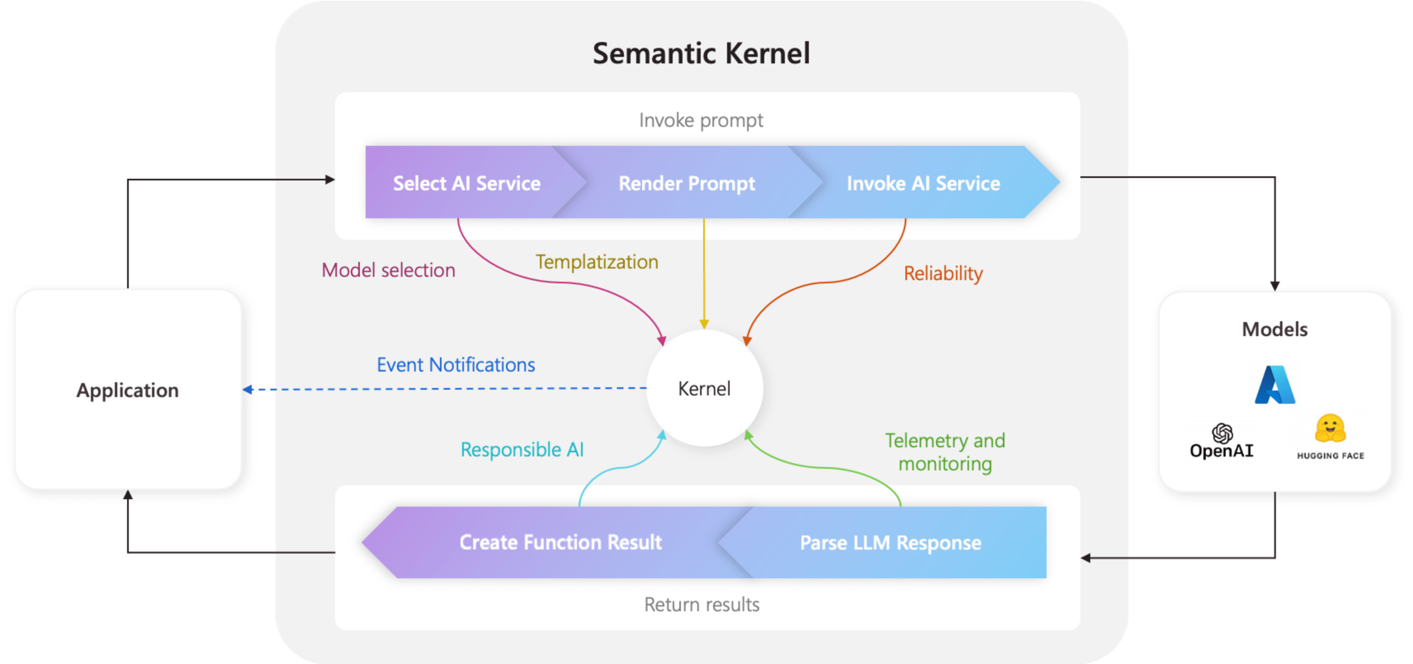
The kernel is at the center of your agents
Notes:
The kernel is the central component of Semantic Kernel. At its simplest, the kernel is a Dependency Injection container that manages all of the services and plugins necessary to run your AI application. If you provide all of your services and plugins to the kernel, they will then be seamlessly used by the AI as needed.
Because the kernel has all of the services and plugins necessary to run both native code and AI services, it is used by nearly every component within the Semantic Kernel SDK to power your agents. This means that if you run any prompt or code in Semantic Kernel, the kernel will always be available to retrieve the necessary services and plugins.
This is extremely powerful, because it means you as a developer have a single place where you can configure, and most importantly monitor, your AI agents. Take for example, when you invoke a prompt from the kernel. When you do so, the kernel will...
Select the best AI service to run the prompt.
Build the prompt using the provided prompt template.
Send the prompt to the AI service.
Receive and parse the response.
And finally return the response from the LLM to your application.
Throughout this entire process, you can create events and middleware that are triggered at each of these steps. This means you can perform actions like logging, provide status updates to users, and most importantly responsible AI. All from a single place.

Slide 11
Adding AI Services to Semantic Kernel
Services | C# | Python | Java
Chat Completion | Yes | Yes | Yes
Text generation | Yes | Yes | Yes
Embedding generation | Yes | Yes | Yes
Text-to-image | Yes | No | No
Image-to-text | Yes | No | No
Text-to-audio | Yes | No | No
Audio-to-text | Yes | No | No
Notes:
One of the main features of Semantic Kernel is its ability to add different AI services to the kernel. This allows you to easily swap out different AI services to compare their performance and to leverage the best model for your needs. In this section, we will provide sample code for adding different AI services to the kernel.
Within Semantic Kernel, there are interfaces for the most popular AI tasks. In the table below, you can see the services that are supported by each of the SDKs.
In most scenarios, you will only need to add chat completion to your kernel, but to support multi-modal AI, you can add any of the above services to your kernel.

Slide 12
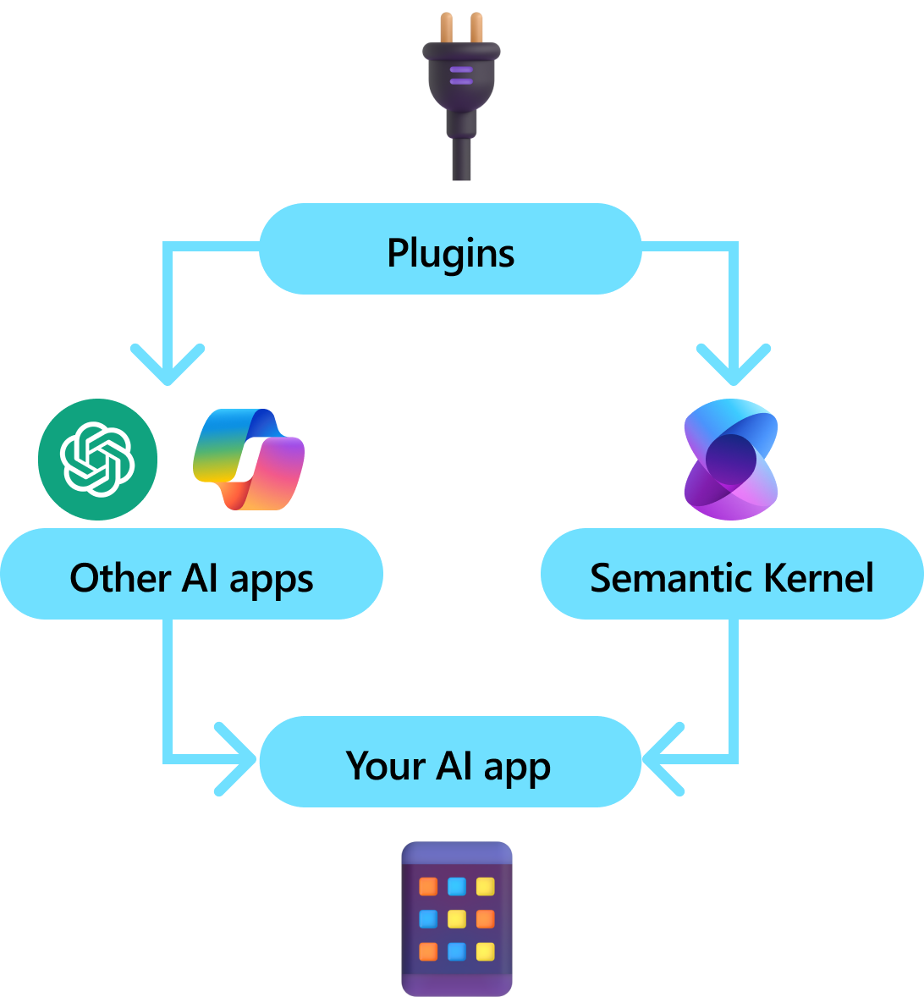
Plugins
Key component of Semantic Kernel
With Plugins, you can encapsulate your existing APIs in a collection that can be used by AI
Uses function calling to perform planning and to invoke your APIs.
With function calling, LLMs can request a particular function.
Semantic Kernel then routes the request to the appropriate function, and returns results back to LLM for the LLM to generate a final response.
Notes:
Plugins are
With plugins, you can encapsulate your existing APIs into a collection that can be used by an AI. This allows you to give your AI the ability to perform actions that it wouldn’t be able to do otherwise. a key component of Semantic Kernel
Behind the scenes, Semantic Kernel leverages function calling, a native feature of most of the latest LLMs to allow LLMs, to perform planning and to invoke your APIs.
With function calling, LLMs can request (i.e., call) a particular function. Semantic Kernel then marshals the request to the appropriate function in your codebase and returns the results back to the LLM so the LLM can generate a final response.
In enterprise scenarios, plugins are valuable because they encapsulate a set of functionality that mirrors how enterprise developers already develop services and APIs.
Plugins also play nicely with dependency injection. Within a plugin's constructor, you can inject services that are necessary to perform the work of the plugin (e.g., database connections, HTTP clients, etc.). This is difficult to accomplish with other SDKs that lack plugins.

Slide 13
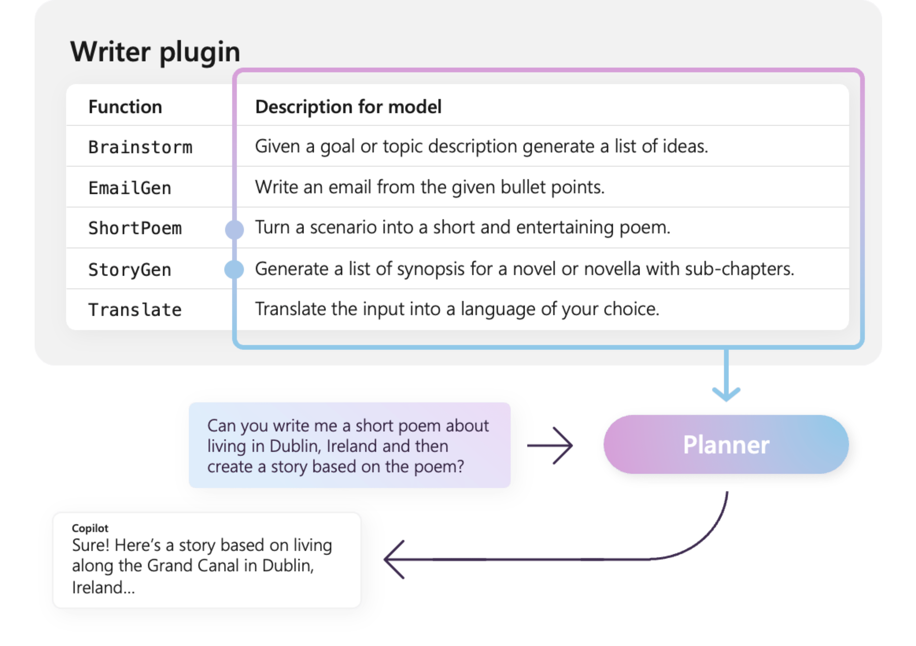
Anatomy of plugins
Plugins are a group of functions that can be exposed to AI apps and services.
They can then be orchestrated by an AI app to accomplish user requests.
With Semantic Kernel, you can invoke these functions automatically with function calling.
To power automatic orchestration with function calling, plugins need to provide details how they behave.
Includes input, output, and side effects, otherwise AI will not correctly call the function.
Notes:
At a high-level, a plugin is a group of functions that can be exposed to AI apps and services
The functions within plugins can then be orchestrated by an AI application to accomplish user requests. Within Semantic Kernel, you can invoke these functions automatically with function calling.
Just providing functions, however, is not enough to make a plugin. To power automatic orchestration with function calling, plugins also need to provide details that semantically describe how they behave. Everything from the function's input, output, and side effects need to be described in a way that the AI can understand, otherwise, the AI will not correctly call the function.
For example, the sample WriterPlugin plugin on the right has functions with semantic descriptions that describe what each function does. An LLM can then use these descriptions to choose the best functions to call to fulfill a user's ask.
In the picture on the right, an LLM would likely call the ShortPoem and StoryGen functions to satisfy the users ask thanks to the provided semantic descriptions.

Slide 14
What is a Planner?
Role | Message
🔵 User | Please toggle all the lights
🔴 Assistant (function call) | Lights.get_lights()
🟢 Tool | { "lights": [ { "id": 1, "name": "Table Lamp", "isOn": true, "brightness": 100, "hex": "FF0000" }, { "id": 2, "name": "Ceiling Light", "isOn": false, "brightness": 0, "hex": "FFFFFF" } ] }
🔴 Assistant (function call) | Lights.change_state(1, { "isOn": false }) Lights.change_state(2, { "isOn": true })
🟢 Tool | { "id": 1, "name": "Table Lamp", "isOn": false, "brightness": 0, "hex": "FFFFFF" }
🟢 Tool | { "id": 2, "name": "Ceiling Light", "isOn": true, "brightness": 100, "hex": "FF0000" }
🔴 Assistant | The lights have been toggled
Notes:
Once you have multiple plugins, you then need a way for your AI agent to use them together to solve a user’s need. This is where planning comes in.
Early on, Semantic Kernel introduced the concept of planners that used prompts to request the AI to choose which functions to invoke.
Since Semantic Kernel was introduced, however, OpenAI introduced a native way for the model to invoke or “call” a function: function calling.
Other AI models like Gemini, Claude, and Mistral have since adopted function calling as a core capability, making it a cross-model supported feature.
Because of these advancements, Semantic Kernel has evolved to use function calling as the primary way to plan and execute tasks.
At its simplest, function calling is merely a way for an AI to invoke a function with the right parameters.
Today's LLM models are capable of iteratively calling functions to solve a user's need. This is accomplished by creating a feedback loop where the AI can call a function, check the result, and then decide what to do next.
For example, a user may ask the AI to "toggle" a light bulb. The AI would first need to check the state of the light bulb before deciding whether to turn it on or off.

Slide 15
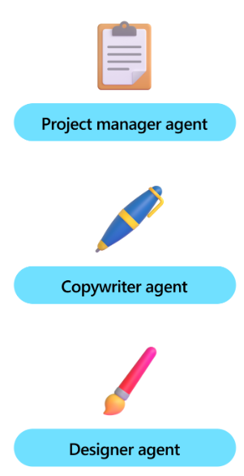
Giving your agents roles with Personas
Often called a meta prompt or instruction.
Personas are prompts that are used to influence how the agent responds to stimuli.
This allows you to influence how your agents plan tasks, generate responses, and interact with users.
You can create personas to represent different types of agents and tasks that they are responsible for.
Notes:
Often called a "meta prompt" or "instruction", the persona is a prompt that is used to influence how the agent responds to stimuli.
This allows you to influence how your agents plan tasks, generate responses, and interact with users.
For example, you can use the persona to explicitly tell the agent to ask for help if it doesn't know what to do, or to be more verbose when it is explaining something.
In Semantic Kernel, we often describe these prompts as "personas" because they're very similar to persona in user experience design. Just like how designers and UX researchers create personas to represent different types of users and the jobs-to-be-done they have, you can create personas to represent different types of agents and the tasks they are responsible for.
By doing so, you can create agents that are more consistent, more reliable, and more predictable. This is especially important when you're building agents that are responsible for critical tasks or that interact with users in sensitive situations.

Slide 16
Best practices for creating personas
Define clear objects
Reference specific roles
Provide examples and scenarios
Include fallback instructions
Iterate and Refine
Notes:
Creating effective personas involves careful consideration of the agent's intended role, the target audience, and the specific tasks the agent will perform. Here are some best practices to keep in mind:
1. Define clear objectivesBefore creating a persona, clearly define the objectives you want the agent to achieve. This includes understanding the tasks the agent will perform and the type of interactions you expect it to have with users.
2. Reference specific roles or public figuresA well-defined persona should include specific details about the agent's behavior, tone, and style. Avoid vague descriptions by referencing specific roles or public figures so that the LLM can better mimic their behavior.
3. Provide examples and scenariosTo help the agent understand its role better, provide examples and scenarios that illustrate the persona in action. This can include sample conversations, user stories, or use cases that demonstrate how the agent should respond in different situations.
4. Include fallback instructionsProvide instructions on what the agent should do when it encounters an unknown situation or is unable to provide a response. This can include asking for help, providing alternative solutions, or simply acknowledging that it doesn't have an answer.
5. Iterate and RefinePersonas are not static. Continuously test and refine your personas based on user feedback and performance data. This helps in improving the agent's effectiveness over time.

Slide 17
Demo: Building AI Agents with the Semantic Kernel

Slide 18





Connect with me!
willvelida.com
github.com/willvelida
twitter.com/willvelida
linkedin.com/in/willvelida
youtube.com/@willvelida

