Slide 1
Cloud-Native Platform Engineering on Azure
Will Velida | @willvelida
Lead Software Engineer and Microsoft MVP

Slide 2
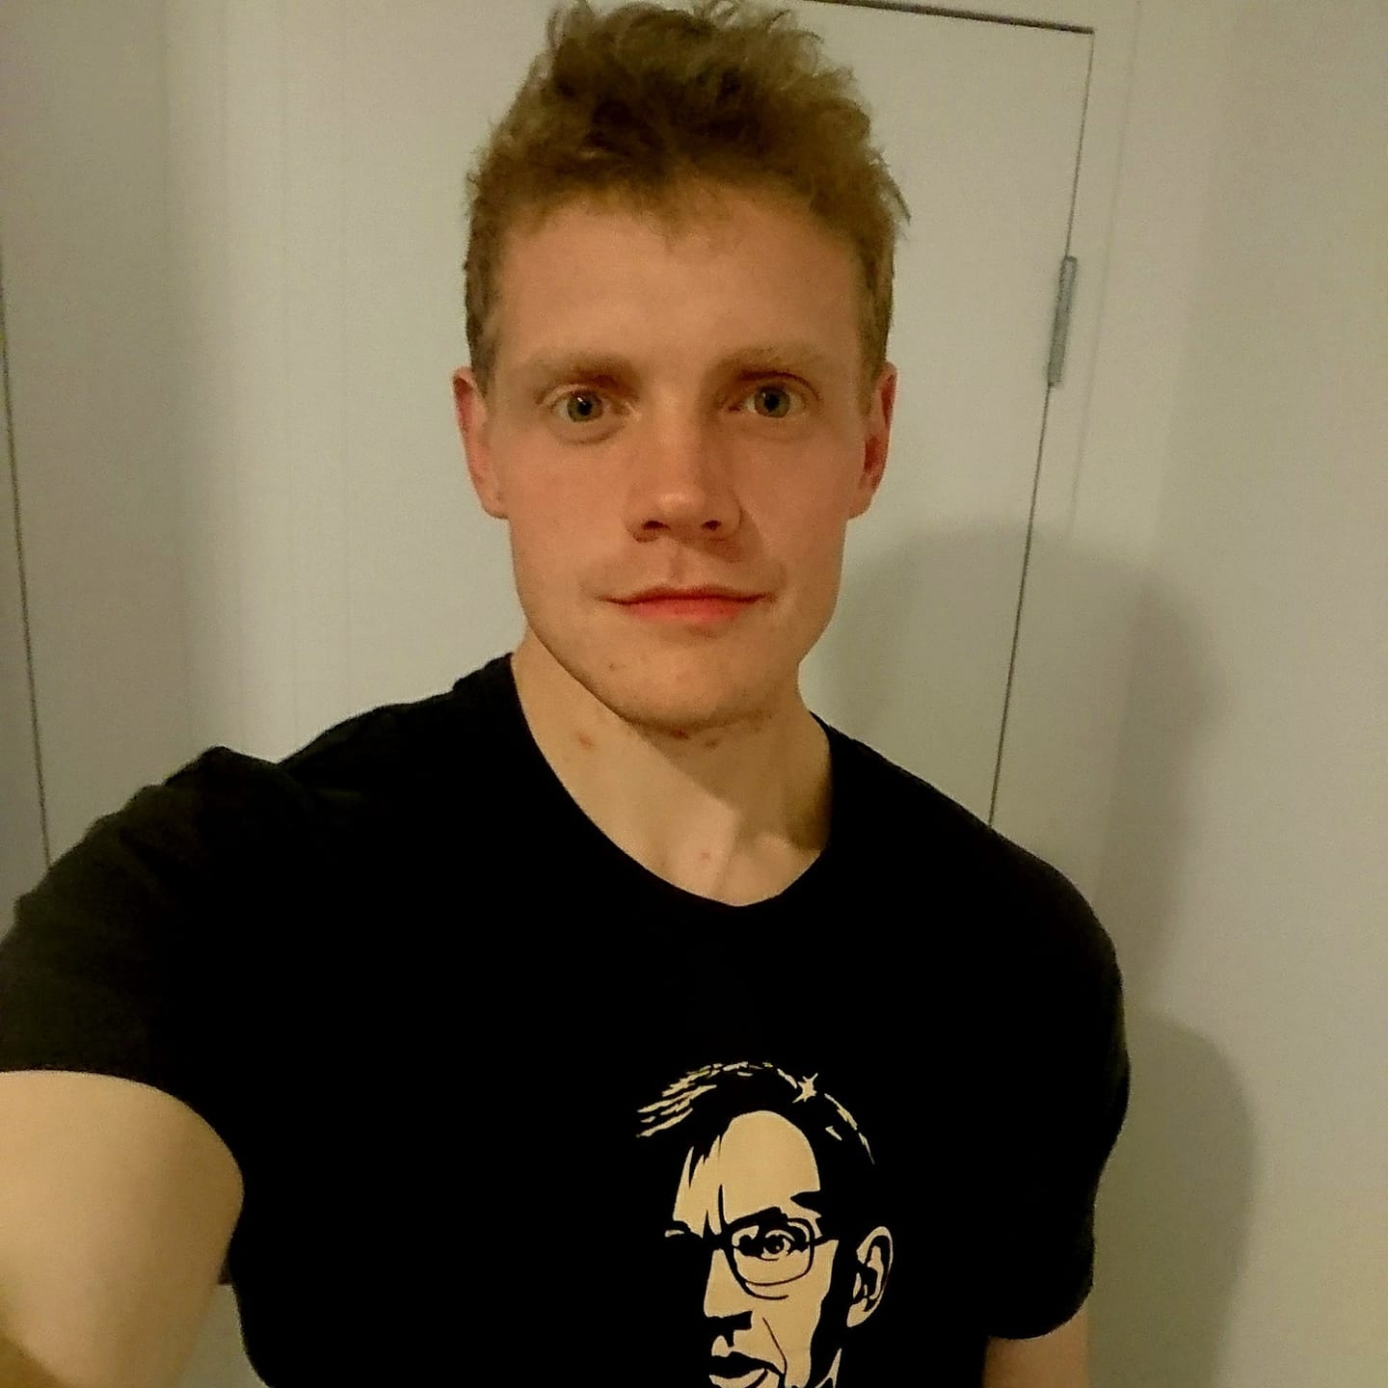
Whoami?
Lead Software Engineer @ Mantel Group
Microsoft MVP (Specializing in Kubernetes and Open Source)

Slide 3
Agenda
What is Platform Engineering?
Why is it needed?
Building Platforms on Azure

Slide 4



Challenges when developing for the cloud
Got security questions? Sure, we have weekly office hours, let’s wait till then
Read the wiki for our shared app services. We’re updating them all the time, so keep an eye on it
This is madness! I have deadlines and I just want to get started
Security
Architecture
Our DevOps team is slammed. We can set you up with a pipeline, but we’ll need to schedule some time to discuss your requirements
We have strict requirements for our cloud apps. We need to run audits before you even think of creating a DEV environment
DevOps
Cloud Ops
You

Slide 5
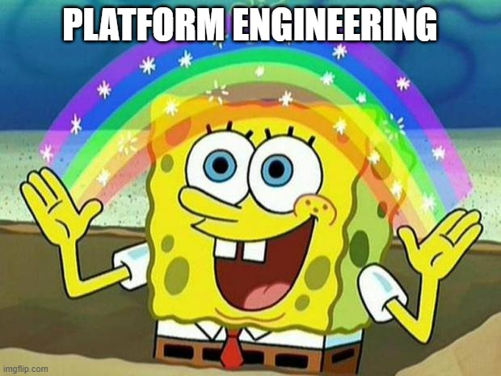
The answer?

Slide 7
“Platform Engineering is what DevOps should have been from the start – Just making it easy for Software Engineers to do their damn jobs and enjoy doing it. Except this time, we threw in some more jargon that recruiters love for some reason and are willing to pay us more for essentially the same work as we did as ‘DevOps Engineers’. But who am I to complain, I’ve got a wedding to pay for!”
- Will Velida, 2025

Slide 8
How easy is it for your developers to do their jobs?

Slide 9
But seriously….
Self-service with guardrails
Culture shift to product mentality
Helping developers deliver business value quickly through self-service.
Secure, governed development with flexibility.
Rapid project and team onboarding that’s secure.
Simplified shared APIs, service discovery etc. across teams.
Improved collaboration while maintaining tool choice
Optimization of costs
Engineering Platform managed as a product.
Developers are your primary customer.
Automate as much as possible (Everything-as-Code).
Security, architecture, and operations are also key!

Slide 10
The Principles of Platform Engineering
Each “customer” is important
Adopting a “product” mindset.
Empowering developers through self-service
Improve discovery, eliminate waste

Slide 11
Your Developers are now your customers
Give Developers what they need and want, while maintaining your organization guardrails.
Stakeholders work with Platform Engineers to codify expertise into templates and system capabilities.
This helps reduce cognitive load on your developers and enables faster problem solving.

Slide 12
What’s the optimal development path?

Slide 13
Unified Portals are not necessarily the answer
Ops, SREs, Developers all use different tools to get their work done.
Build on existing tools, rather than trying to build or introduce new ones.

Slide 14
Adopting a “product” mindset
Once you’ve established your internal developer platform, this becomes your “product” for developer experience.
It’s not enough just to build these tools, people have to use them too! (Just like actual products….)
It helps if developers like using your platform!
Use metrics to define success parameters.

Slide 15
How do we measure all this?

Slide 16
Empower developers through self-service
Allow developers to do their jobs within defined guardrails.
Guardrails are defined and agreed to by stakeholders.
Automate as much as possible (Everything-as-code pattern).
Work on guardrails together instead of silos.
Keep your organization sage, while providing a developer friendly experience and reduce developer toil.
The goal should be to increase productivity and reduce operational overhead.

Slide 17
Everything-as-code!
Through IaC, CI/CD, GitOps etc. we can enable self-service in a way that developers can understand.
We can also use code for policy and security.
Pushing configuration into code repositories allows developers to use them as central catalogs.

Slide 18
“Start right” through templates
Start Right
Automated policy, scanning, and governance
“Stay Right”
Development Teams

Slide 19
Azure Container Registry and Bicep Modules

Slide 20
Inventories to manage assets and prevent duplication

Slide 21
Azure Deployment Environments

Slide 22
Handling APIs in Azure
Azure API Center
Azure API Management

Slide 23
Sharing Common Libraries and SDKs

Slide 24

Platform Engineering Capability Model Survey
https://aka.ms/PECapabilitySurvey

Slide 25
Recap

Slide 26





Let’s keep in touch!
willvelida.com
github.com/willvelida
twitter.com/willvelida
linkedin.com/in/willvelida
youtube.com/@willvelida

