Slide 1

Building and operating cloud-native applications with Radius
Will Velida
Lead Software Engineer, Mantel Group
@willvelida
Notes:
Hi everyone! My name is Will Velida, and I’m a Lead Software Engineer for Mantel Group,

Slide 2
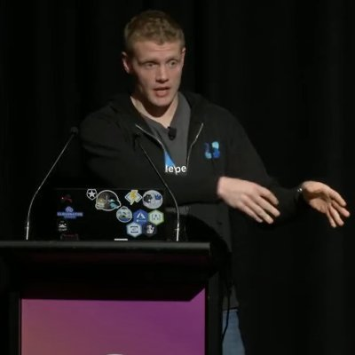
whoami?
Lead Software Engineer at Azenix by Mantel Group.
Former MSFTer and Microsoft MVP based in Auckland – Moved to Melbourne last year
.NET and Azure developer with experience in banking, agriculture, and health industries.
Former average rugby player.

Slide 3
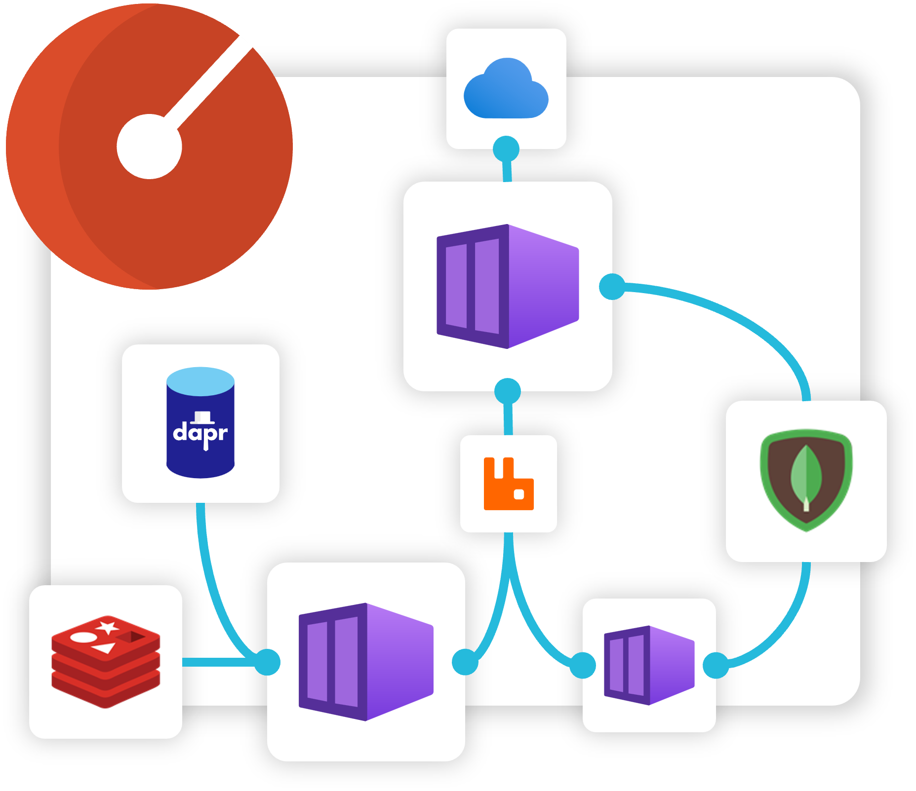
Agenda
What is Radius?
Radius Applications
Recipes
Environments
Radius Architecture
Demo

Slide 4
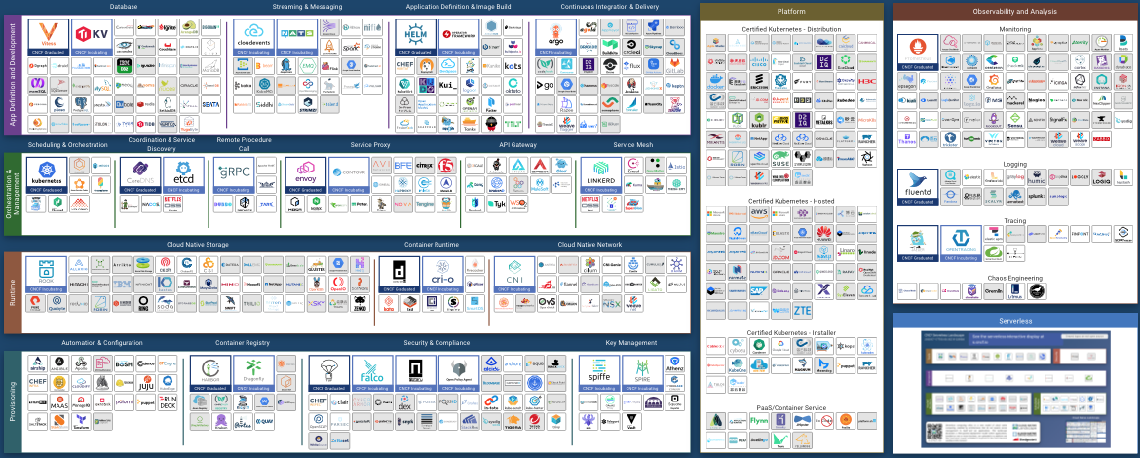
Applications are more than just Kubernetes!!!
Notes:
Anyone seen this diagram before?
There’s more to apps than Kubernetes! There’s so much more we need to think about (messaging, proxies, container registries, API gateways).

Slide 5
Common Problems
Applications are more than Kubernetes!
Developers, platform engineers, and IT Ops need to collaborate.
Applications lack an industry wide-definition.
Notes:
- Standardizing on Kubernetes has been successful for most enterprises, but this does come with more complexity than it’s worth. We also don’t just run our apps on Kubernetes. Maintaining and operating all our resources in our application is a full time job.
- We don’t develop in isolation anymore (and we really shouldn’t!!) To develop the type of complex apps that enterprises usually build, we need developers, platform engineers, and IT ops to collaborate. The tools that we use need to aid collaboration, not impede it.
- Platform engineers that support applications usually lack context about the architecture, while app developers lack context about the underlying cloud infrastructure. Together, we need a common understanding and visualization of what an application is.

Slide 6
Enter Radius
“Radius is an open-source, cloud-native application platform that enables developers and operators to develop and collaborate on cloud native apps across public and private clouds”

Slide 7
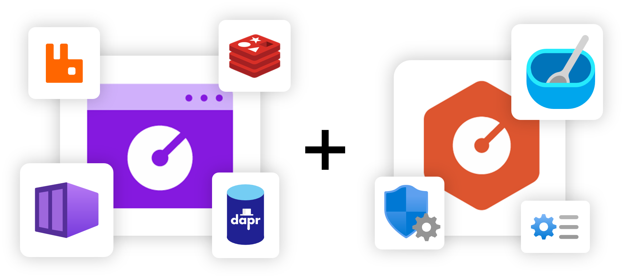
Developer + Operator Collaboration
Developers define applications and dependencies
Operators define environments .
Radius brings them together, deploying apps and infra that meet both requirements.

Slide 8
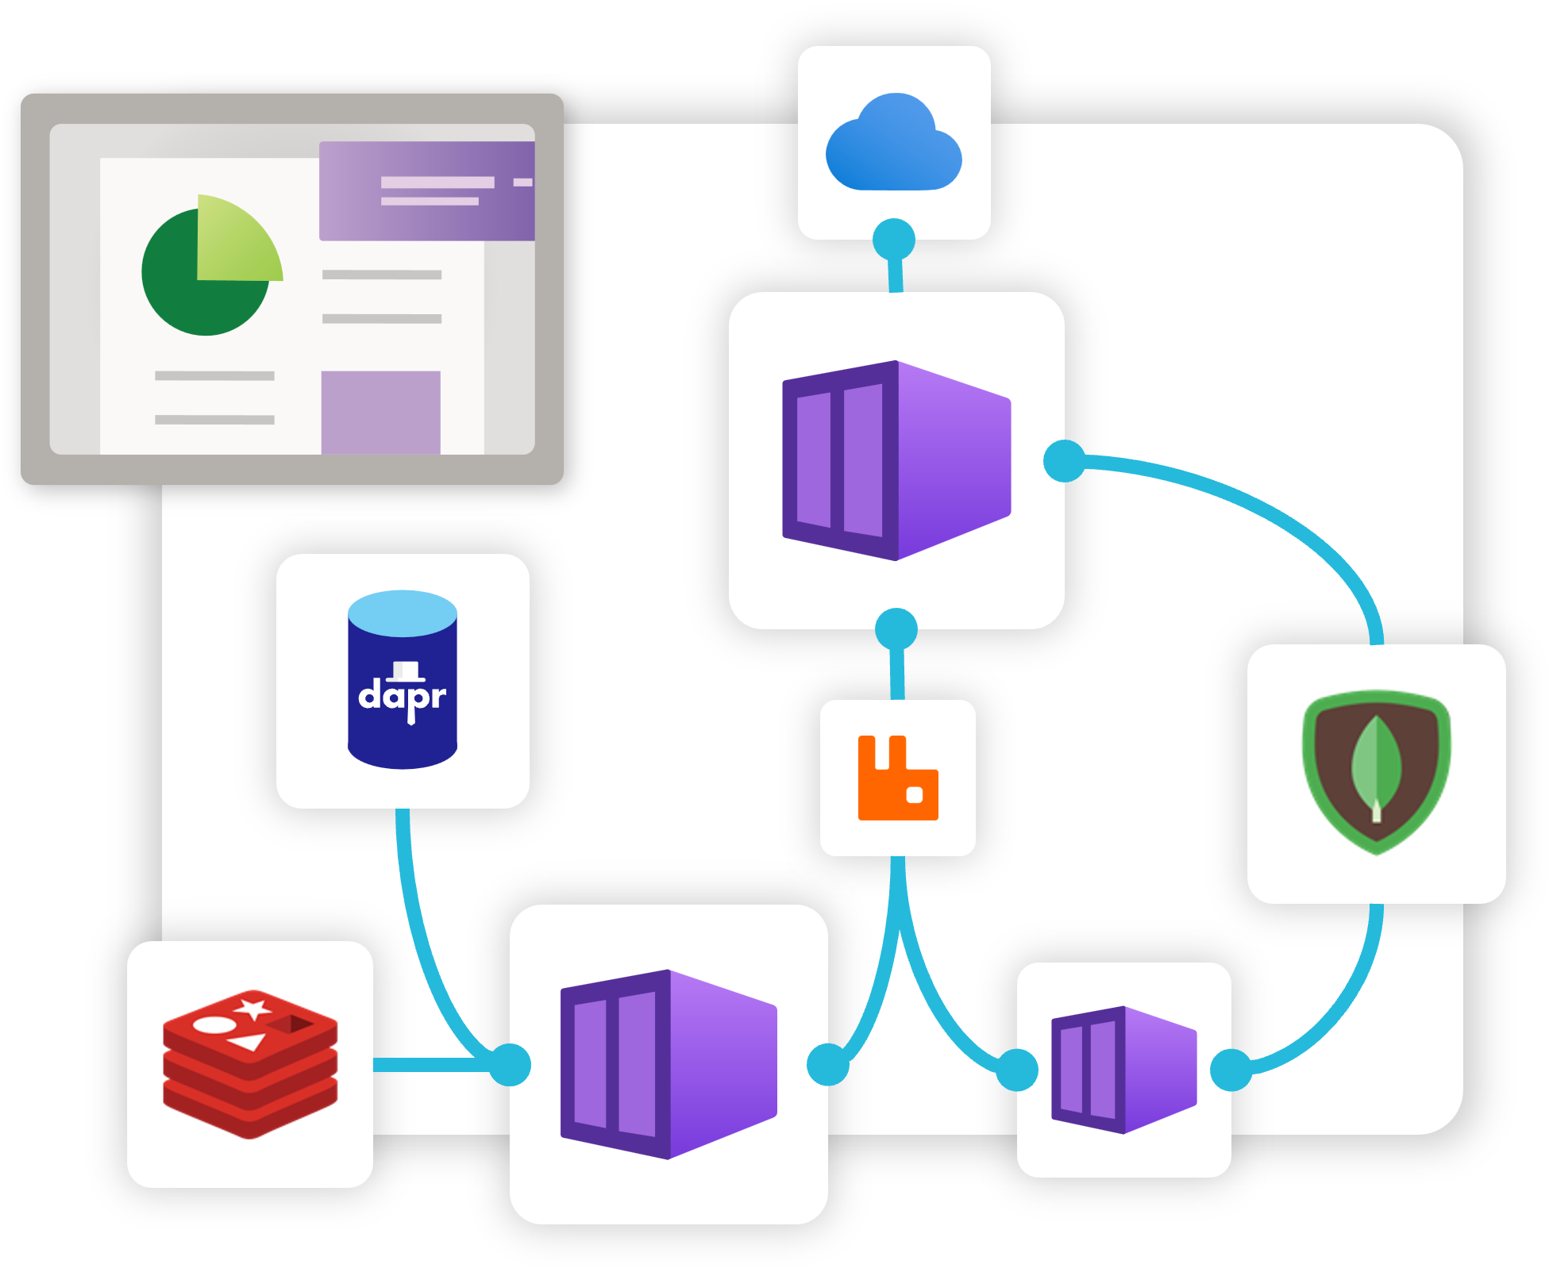
Applications
Primary resource that brings your application + infra together.
Includes services, dependencies, relationships.
Single description and view of entire app via an Application Graph
Notes:
Radius applications are the primary resource that brings all your services, dependencies and relationships together.
It gives you a single description of your application, allowing you to deploy and manage your application easily.
Radius applications capture this via an Application graph, which helps us deploy and understand our applications better.

Slide 9
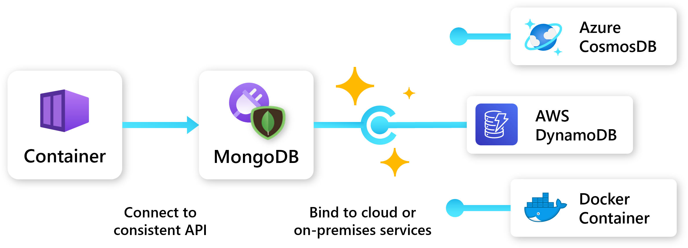
Application portability
Designed to be cloud + platform agnostic
Define app once, deploy to any platform that supports Radius.
Developers define app requirements.
Operators define environments and recipes that bind to those requirements.
Notes:
- Radius applications are designed to be cloud and platform agnostic.
- Once you define your application, you can deploy it to any cloud or platform that Radius supports. (Currently just Azure + AWS)
- This is great if we need to move our app between clouds, or between cloud and on-prem environments.
- Developers can define their requirements and dependencies, and operators can define their environments and Recipes that bind those requirements to the appropriate cloud resources.

Slide 10
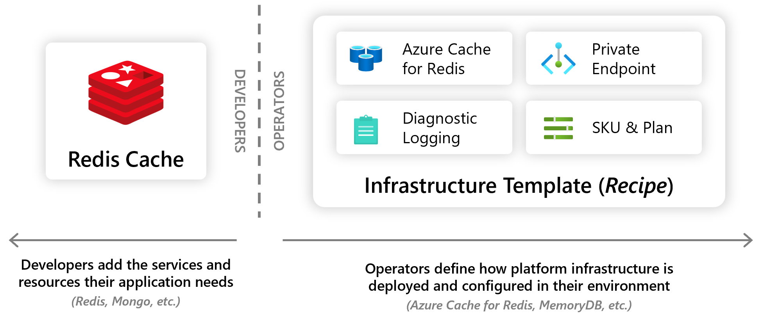
Radius Recipes
Recipes enable a seperation of concerns between Ops and developers by automating infra deployment.
Devs choose the resource they want.
Ops codify their environment with how these resources should be deployed.
Notes:
- Recipes enable a separation of concerns between IT operators and developers by automating infrastructure deployment.
- Developers select the resources they want in their apps, and Platform Engineers will codify in their environment how these resources should be deployed and configured.
- So when a developer deploys their application and its resources, Recipes automatically deploy the backing infrastructure and bind it to the developer’s resources.
- Currently, recipes support both Bicep and Terraform. You can use Recipes that Radius provides, or you can create your own custom recipes.

Slide 11
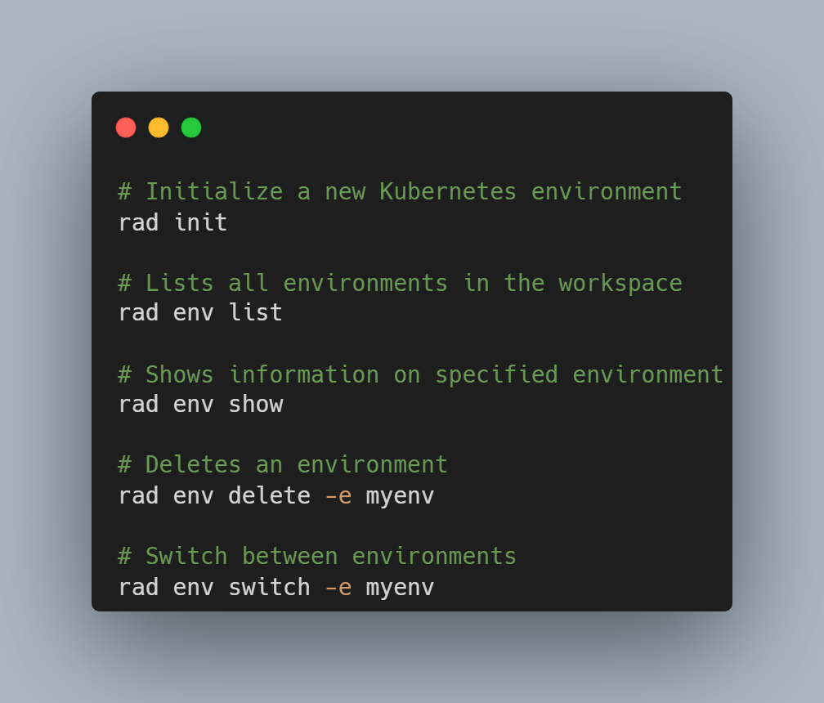
Environments
Prepared “Landing zones” for Radius apps.
Apps deployed to environments inherit container runtime, configuration, recipes, and other settings from the environment.
Environments are server-side resources that exist within the Radius Control Plane.
You can use the Radius API and rad CLI to work with environments.
Notes:
- Environments in Radius provide a landing-zone for apps that’s configured with the organizations chosen best-practices, settings, and Recipes.
- They encapsulate and store configuration for the compute platform, networking configuration, diagnostics, and other operational concerns.
- You can configure environments to vary across different types of deployments (like staging, production), deployment regions or even different clouds.
- Platform Engineers collaborate with app developers by managing the set of environments that developers can use
- When an app is deployed, Radius will bind the app to the configuration of the target environment, and apply the relevant settings.
- Operational configuration in the environment increases developer velocity because the app doesn’t need to change when it’s deployed across environments.

Slide 12
Radius Architecture
Overall Architecture of Radius has 3 parts:
General Resource Management API
Resource providers for cloud-native apps.
Tools for deploying and managing Radius apps via API.

Slide 13
General Resource Management API
API has single entry point for all authentication, authorization, routing etc.
This is called the Universal Control-Plane (UCP)
This receives all inbound HTTP traffic to the Radius API, which routes requests to resource providers.
Contains functionality for federating with separate resource managers.
Notes:
- The Radius API uses a centralized hub-and-spoke, where it’s a single entry point for authentication, authorization, routing etc.
- All HTTP traffic into the API comes through this central point, so it can be validated before being routed to the appropriate resource provider.
- This central service is called the Universal Control-Plane (UCP).
- This UCP is also a central point for extensibility, so each resource provider is registered centrally so that UCP knows where to send requests for that resource type.
- It also contains functionality for federating with separate resource managers as well as its resource providers. So the UCP can route requests to Azure or AWS to manage resources.

Slide 14
Radius provided resource providers
Applications.Core – Core resources of an app. Includes app itself, containers, gateways and routes.
Applications.Dapr – Integration with Dapr programming model. Supports management of Dapr building blocks and configuration.
Applications.Datastores – Abstractions for data-stores that can be used within an app.
Applications.Messaging – Abstractions for messaging systems that can be used within an app.
Bicep.Deployments – Functionality for processing Bicep deployments.
Notes:
- Role of resource provider is to perform CRUD operations associated with one or more resource types.
- Resource providers only accept traffic from UCP, so can assume that any requests they receive are authorized.
- Each resource provider and the set of resource types it handles must be registered with UCP.
- Applications.* resource provides implement the bulk of Radius’ user-facing functionality, including creating and managing the platform resources used to run an app, responding to the CLI, storing and retrieving dependency information like connection strings, executing recipes to create cloud infrastructure.

Slide 15
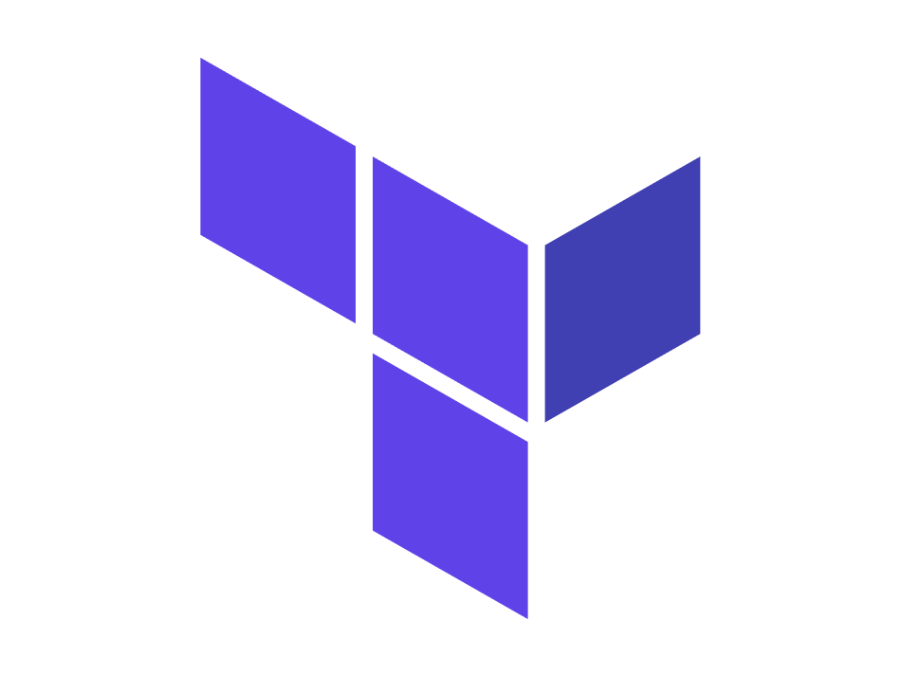

Tools to work with Radius
The rad CLI
Bicep
Terraform (still a work in progress)
Notes:
Tools that work with Radius do so via the API.
CRUD operations provided by resource providers are orchestrated by tools to perform tasks like app deployment, listing cloud resources in use that are being used by an app.
The rad CLI handles management of operational requests to the Radius API.
We can create resources in Radius declaratively within a Bicep file and deploy it via the rad CLI. Once we send this request, the CLI will monitor the Bicep deployments resource to display progress information to the user. (we’ll see an example of this in the demo later).
Terraform support is coming, The difference between Bicep is that it will process terraform deployments on the client that initiated the operation, and the provider will make requests to the API to create resources as needed.

Slide 16
Demo time!

Slide 17
Want to learn more?
Radius docs: https://docs.radapp.io/getting-started/
Github Repo: https://github.com/radius-project
HOL: https://github.com/radius-project/lab

Slide 18





Thanks for listening!
https://twitter.com/willvelida
https://www.youtube.com/@willvelida
https://www.willvelida.com/
https://www.linkedin.com/in/willvelida/
https://github.com/willvelida/

