Slide 1
Implementing scalable messaging patterns in Azure
Will Velida – Lead Software Engineer
@willvelida
NDC Sydney – February 2024
Notes:
Hey everyone, how are we all doing? Everyone enjoying NDC Sydney so far?
My name is Will Velida, I’m a Lead Software Engineer for the Mantel Group, and today we’re going to talk about implementing scalable messaging patterns in Azure.

Slide 2
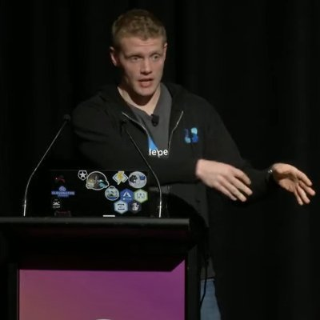
whoami
Lead Software Engineer at Mantel Group.
Former MSFTer and Microsoft MVP based in Auckland – Moved to Melbourne last year
.NET and Azure developer with experience in banking, agriculture, and health industries.
Former average rugby player.
Notes:
Just a bit who I am
Visit us a booth 2 ☺

Slide 3
Agenda
Events vs Messages
Messaging services in Azure
Patterns and the problems they solve
Takeaways
Notes:
Today, we’re going to start with the difference between events and messages, what they mean from an Azure perspective
Then we’re going to cover the messaging services available in Azure, the difference between them, what purpose they service.
Then we’ll talk about the problems we might face when dealing with messages in our architectures, and how we can use various patterns and features of Azure messaging systems to solve those problems.

Slide 4
Events vs Messages
Events
Messages
Lightweight notifications of conditions or state change.
Publisher has no expectation of how event is handled.
Consumers decide what to do with it.
Can be discrete or part of a series.
Raw data produced by a service to be consumed or stored elsewhere
Publisher has an expectation about how consumer handles message.
Contract exists between the two sides.
Notes:
There’s an important distinction between services that deliver events and those that deliver messages.
(Read points on events, then elaborate)
Discrete events report state change and are actionable. To move on, the consumer of that event only needs to know that something happened. It has that information, but not the data that triggered the event.
Series of events report conditions and can be analyzed. They are time-ordered and interrelated. Consumers need the sequence of events to analyze what happened next.

Slide 5

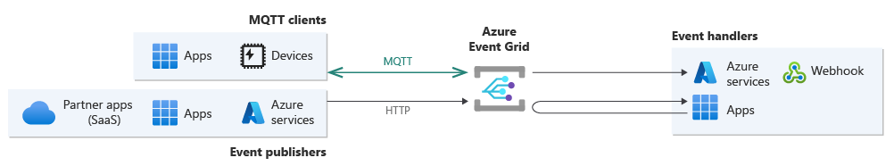
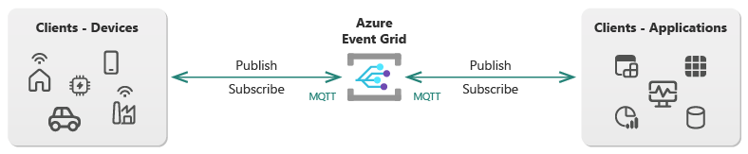
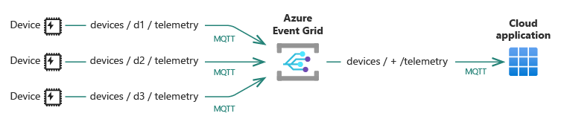
Azure Event Grid
Eventing backplane that enables event-driven, reactive programming.
Pub/Sub model.
Integrated with Azure and 3rd party services.
Not a data pipeline, doesn’t contain actual object that was updated.
Notes:
Event Grid is an eventing backplane that enables event-driven, reactive programming.
It uses Pub/Sub, where publishers emit events, but have no expectation about how the events are handled.
It’s deeply integrated with Azure Services and can be integrated with 3rd party services.
Events sent via Event Grid doesn’t deliver the actual object that was updated, just that something happened.
Event Grid is available as a PaaS service on Azure, and on Kubernetes with Azure Arc.

Slide 6

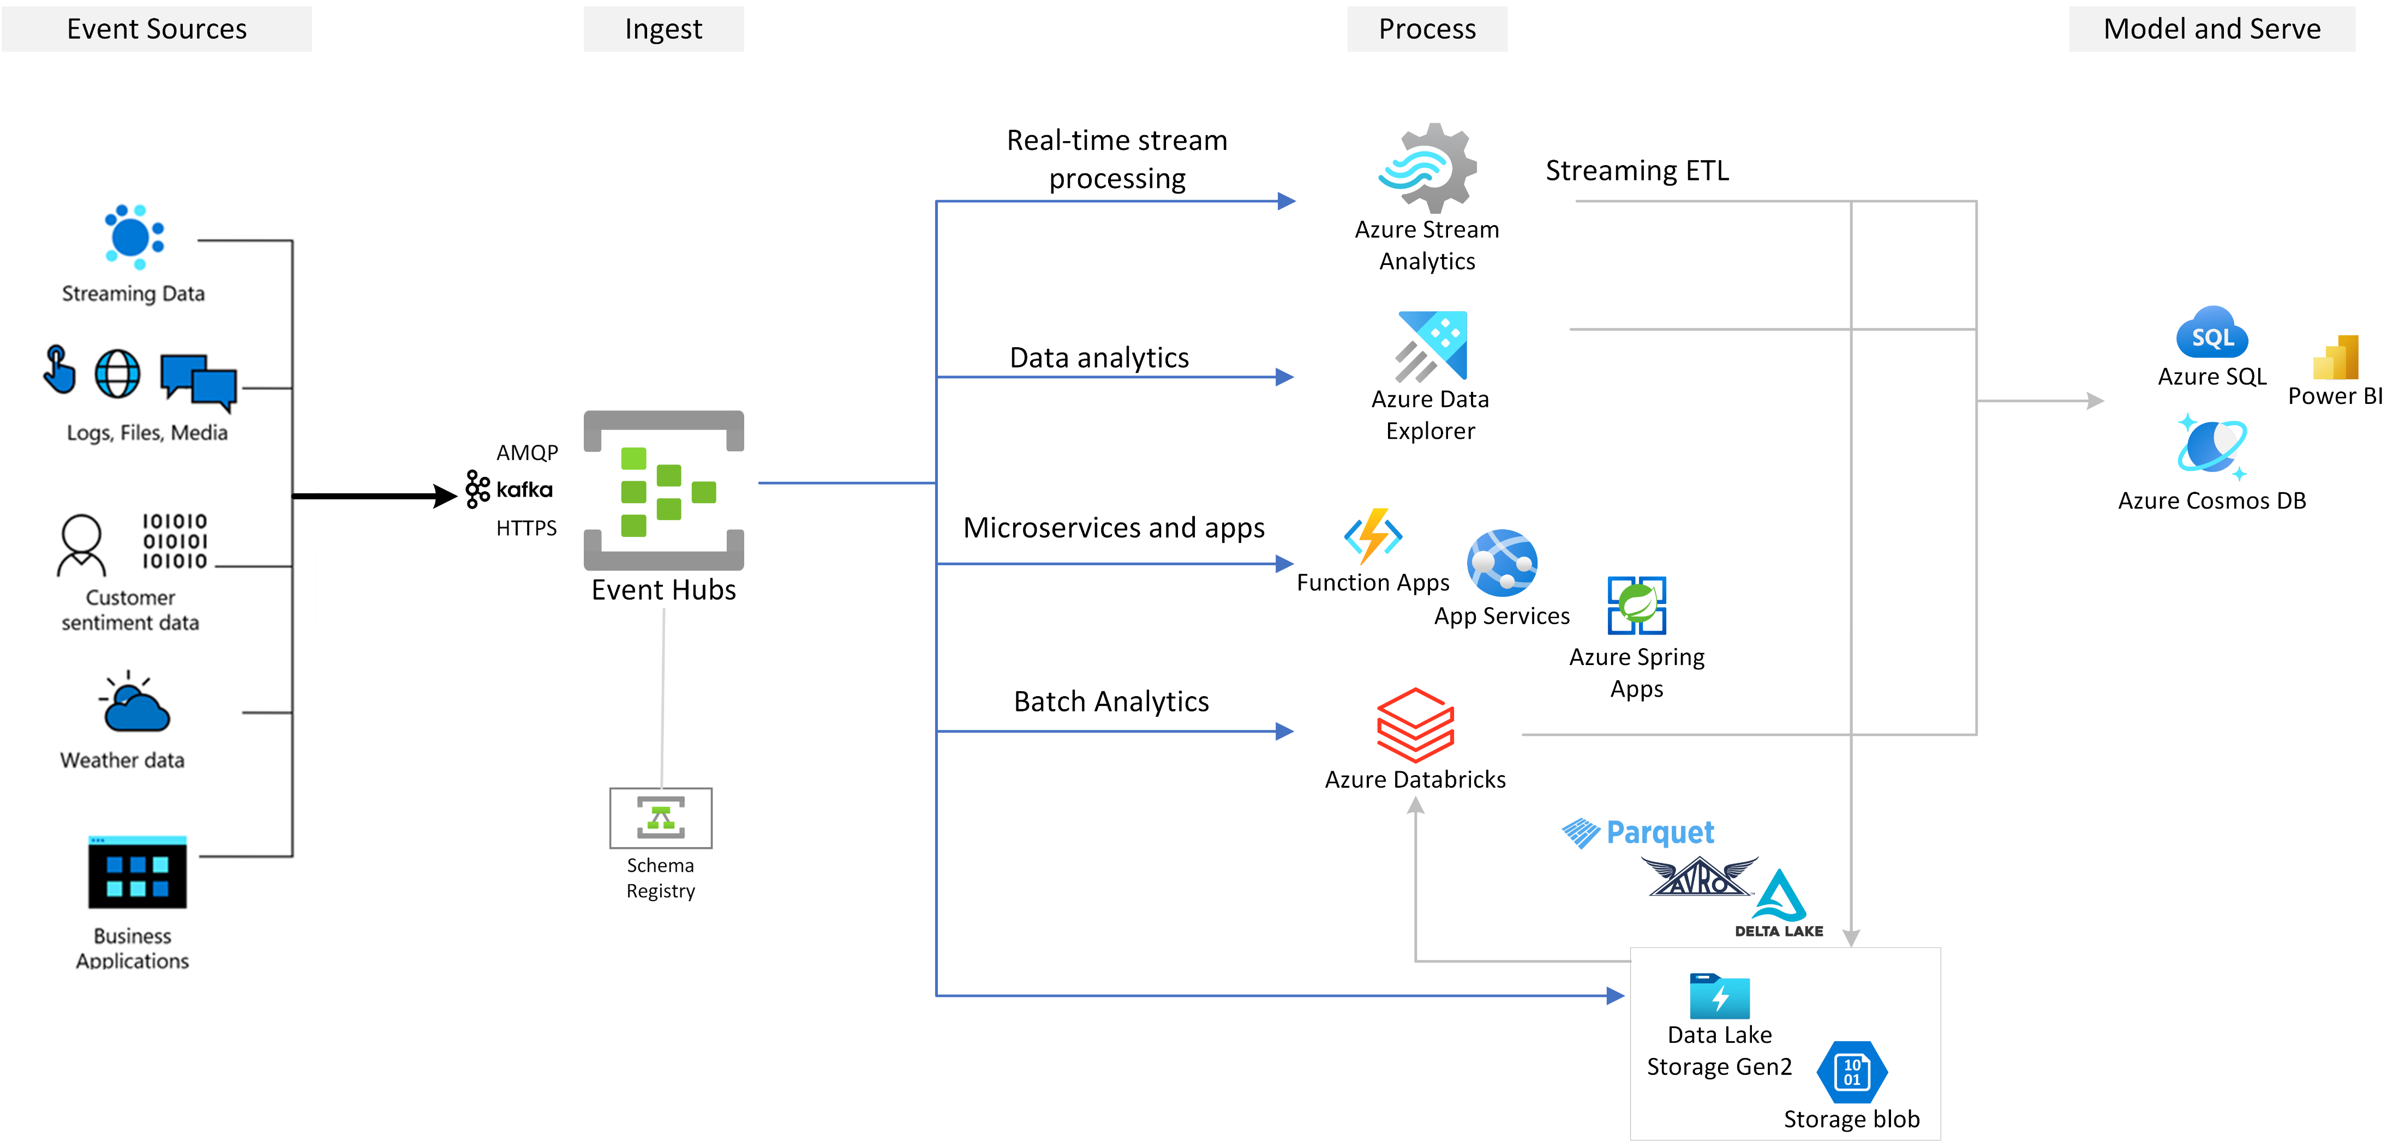
Azure Event Hubs
Big data streaming platform and event ingestion service.
Low latency, can receive and process millions of events per second.
Allows telemetry and event data to be made available to various stream processing infra.
At least once delivery.
Notes:
Azure Event Hubs is designed for big data streaming platforms and event ingestion service.
It can easily process millions of events per second, and can capture, retain and replay telemetry and event stream data.
That data can come from many concurrent sources, and be made available to various stream-processing infrastructures and analytics services.
It’s great for scenarios where you need low latency and you’re processing millions of events per second.
Events come with a guarantee of at least once delivery.

Slide 7

Azure Service Bus
Fully managed enterprise message broker with queues and pub/sub topics.
Transactions, ordering, duplicate detection, consistency.
Good for handling high-value messages that can’t be lost or duplicated.
Good for hybrid cloud solutions.
Advanced messaging features such as FIFO, Sessions, Transactions, DLQ, routing/filtering, duplicate detection and more.
At least once delivery of messages.
Notes:
Service Bus is a fully managed enterprise broker with message queues and pub/sub topics.
Service bus is designed for enterprise applications that need transactions, message ordering, duplicate detection and consistency.
In cloud native applications, service bus provides reliable state transition management for your business process, making it ideal for applications where you need to handle high-value messages that can’t be lost or duplicated.
In hybrid cloud solutions, you can service bus to connect from on-premises systems to cloud solutions.
It’s a brokered messaging system, meaning that until consumers are ready to receive messages, Service Bus will store messages in a queue or topic.
It provides advanced messaging features such as first-in first-out, batching/sessions, transactions, dead-lettering etc which I’ll talk about how we can use those features to implement these patterns.
You also have a guarantee of at-least once delivery of messages and the option for ordered delivery of messages.

Slide 8

Azure Storage Queues
Storage Queues are part of Azure Storage Infrastructure.
They allow you to store large numbers of messages and can be accessed via HTTP or HTTPS.
Queue messages can be up to 64KB in size and can store up to 80GB of messages in a queue.
Good for server-side logs of all the transaction executed against your queues.
Checkpointing for when workers processing a message crashes, and you need to pick up where it left off.
Notes:
Storage Queues are considered more a part of Azure Storage rather than messaging, but they do provide messaging functionality so it’s worth chatting about it.
Queue Storage is designed for storing large numbers of messages which you can access via HTTP or HTTPS.
Queues can contain millions of messages up to 80GBs worth in a queue. It’s good for when you want your applications to track progress of processing messages in the queue. If a worker crashes and you need to continue where you left out with another worker.
It’s also handy for when you require server side logs of all transactions executed against your queues.

Slide 9
Comparing messaging services
Service | Purpose | Type | When to use
Event Grid | Reactive Programming | Event distribution (discrete) | React to status changes
Event Hubs | Big data pipeline | Event streaming (series) | Telemetry and distributed data streaming
Service Bus | High-value enterprise messaging | Message | Order processing and financial transactions
Storage Queues | Storing large numbers of messages | Message | Tracking process for processing a message.
Notes:
So just from a high level, you can see that different messaging services in Azure serves different purposes, and some work better for events and others for messages.

Slide 10
Questions to ask
Are we dealing with messages or events?
Are we reacting to events, or are we processing events?
Do we need advanced capabilities for our messages?
How many events/messages do we need to process?
Do we need to architect our systems to handle events/messages?
Notes:
So before we start to think about the types of problems that we might face

Slide 11
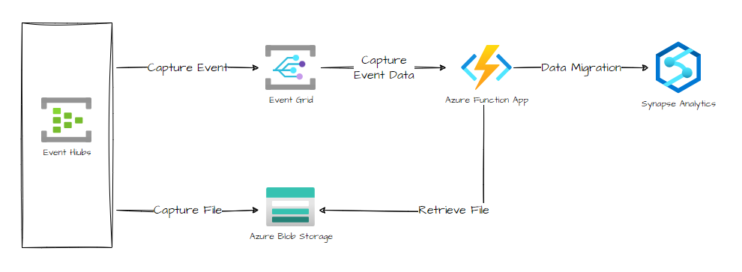
Using different services together.
Your architecture may need multiple services to fulfil different roles
Notes:
And even with the differences, it’s likely that we’ll need to use different services together to fulfill distinct roles.
We may want to link all these services together to react to events and create a pipeline.

Slide 12
Problem 1: Who’s interested in this message?
In distributed architectures, systems need to provide information to other systems when events happen.
Async messaging is great to decouple senders from consumers.
However, dedicated queues for each consumers doesn’t effectively scale.
How can we send events to all interested consumers without knowing who they are?
Notes:
The first issue we might ask ourselves is who’s interested in this message/event
Now asynchronous messages is a great way to decouple senders from consumers to avoid blocking the sender to wait for a response.
However, if we provisioned a dedicated queue for each consumer this wouldn’t effectively scale.
Also we need to consider who is actually interested in the message? How many consumers are interested in the message? How much of the message are they interested in

Slide 13
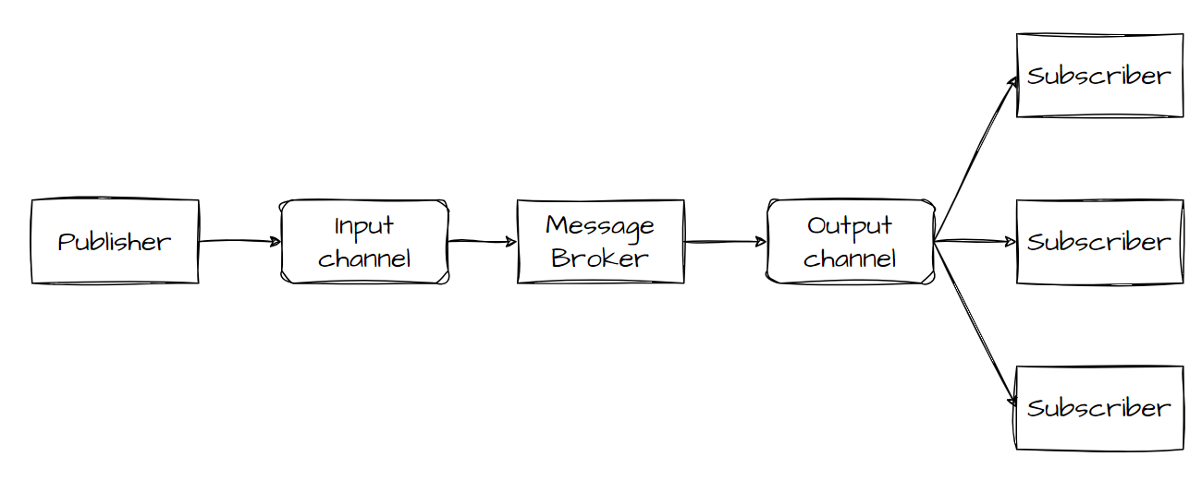
Good old Pub/Sub
Notes:
This is where good old pub/sub, or publish subscribe comes in.
Here we introduce an asynchronous messaging subsystem in.
In this, we have an input messaging channel used by the publisher.
We also have an output messaging chanel per consumer (called subscribers)>
The mechanism for copying each message from the input channel to the output channels for all subscribers interested in that message. This is typically handled by our message broker.

Slide 14
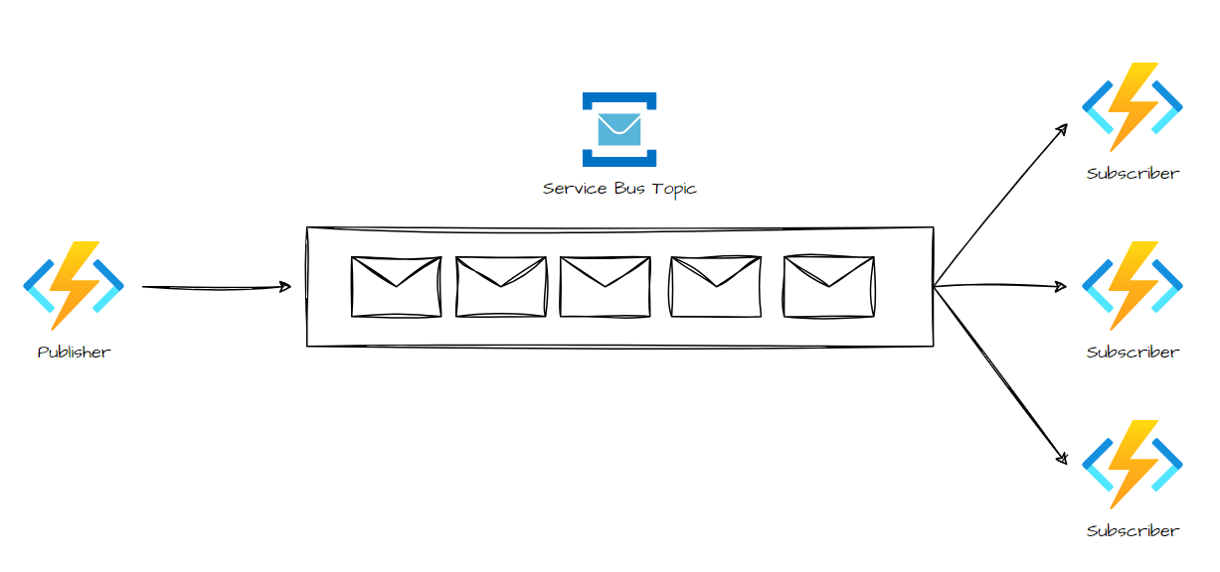
Notes:
So looking at this pattern from an Azure perspective, we could have an Azure Function that publishes a message to a Azure Service Bus topic.
We could have multiple Azure Functions that subscribe to that particular topic, and each subscriber receives a copy of that message from the topic.

Slide 15
Benefits and issues
Decouples systems + Separation of concerns
Increases scalability, reliability and testing.
Allows for deferred or scheduled processing.
Simpler integration between systems.
Handling subscribers.
Message security.
Ordering and Priority of messages.
Poison messages.
Message scheduling and expiration.
Scaling out subscribers.
Bi-directional communication
Notes:
And with this, we get the benefit of decoupling our systems that need to communicate with each other. If anything happens to a particular subscriber, we can use the message broker to handle the messages that can’t be picked up.
This pattern also gives us some control as to when we process messages. Subscribers have the option to pick up messages in off-peak hours, or at a certain schedule.
We’ll talk a little bit about scalability and reliability under load in a moment, but deferring communication responsibilities to the message broker can take away the responsibility handling increased load, the delivery of our messages etc, and allow our application to focus on its core capabilities. Integration between subsystems also becomes simpler since all we need to do is interact with the message bus.
Some things we need to keep in mind however, is how we handle subscribers. We need to be flexible enough to allow consumers to unsubscribe from channels when needed.
Security is also an issue. Who is authorized to listen to a queue?
If you’re concerned about ordering and priority, we’ll need to design our system to be idempotent to remove any dependencies on order handling.
Handling poison messages require a dead-letter queue so that messages can be returned to the queue, rather than causing systems to fail.
How our subscribers scale out needs to be considered. We’ll talk about later how we can use the Competing Consumers pattern to scale out our subscribers.
Finally, in pub/sub, communication is unidirectional. Which bring us to our next pattern

Slide 16
Problem 2: Do we need a response?
Some tasks that we initiate will be long-running.
This could be seconds, minutes, or even hours.
Not practical to wait for a response to that request.
This problem can apply to client-server and server-to-server requests.
Notes:
What happens when we need a response for our message?
There are times when we need an immediate response or acknowledgement that a message has been received, and something is happening.
Now, we may call an API can get an immediate response with the status of that response. Most of the time the response is quick, however we may make API calls that initiate background tasks that take seconds, minutes, even hours.
In these situations, it doesn’t make sense to wait for a response for that particular request,

Slide 17
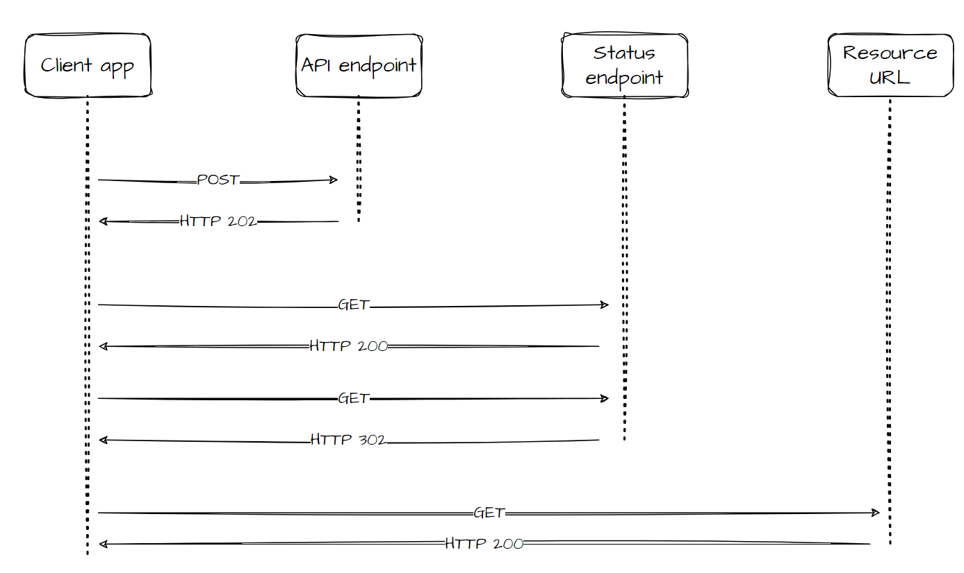
Async Request Reply
Notes:
So a solution to this is to use HTTP Polling. Polling is useful to client-side code, as it can be difficult to provide call-back endpoints or use long running connections.
So a client app makes a call to an API to trigger the long running operation on the backend.
The API responds as quickly as possible, using HTTP 202 code, telling us that the request has been received for processing.
That response holds a location reference pointing to an endpoint that we can poll to check the status of the long running operation.
Our API offloads processing to another component, such as a message queue.
Once the work is complete, the status endpoint can either return a resource that indicates completion, or redirect to another resource URL.

Slide 18
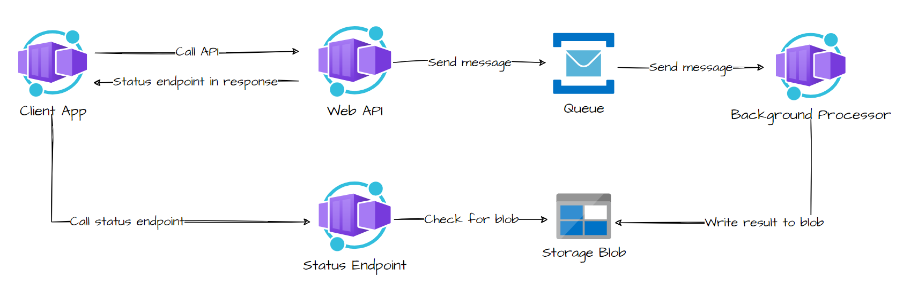
Notes:
Here’s an example of how we could implement this in Azure

Slide 19
Things to consider
HTTP 202 response from API should indicate the location and frequency that the client should poll for the response.
Great for client-side code, where it’s difficult to provide call-back endpoints or long-running connections add too much complexity.
Not suitable for real-time streaming, or for asynchronous notifications.
Not suitable when clients needs to collect many results, and received latency is important.

Slide 20
Problem 3: Dealing with large messages
Manipulating, receiving and sending large messages will be inevitable.
Content could be images, sound files, text documents etc.
Sending this directly to the message bus is not recommended.
Large messages can harm performance, cause bottlenecks etc.
Azure messaging platforms have limits on message size.
Notes:
Now some messages we deal with within our architecture may be very large, such as images, sounds files, etc.
Sending large messages directly to the bus is not recommended, because the larger our message the more resources and bandwidth will be consumed. This can cause bottlenecks in our solution.
Azure messaging services have limits on how big your message can be, because they are designed to handle huge quantities of small messages.

Slide 21
Messaging limits in Azure
Broker | Size Limit
Azure Service Bus | 256KB for standard tier 100MB for Premium tier.
Azure Event Hubs | 256KB for basic tier. 1MB for Standard, Premium and Dedicated.
Azure Event Grid | 512KB for MQTT. 1MB for events, custom topics, system topic and partner topic resources.
Azure Storage Queues | 64KB (48KB when using Base 64 encoding)
Notes:
Now looking at these limits, you might think that if you have deal with large messages, you can solve the problem by just scaling up! It’s my bosses problem now.
That’s not going to make you any friends, nor is it a practical way to deal with large messages.

Slide 22
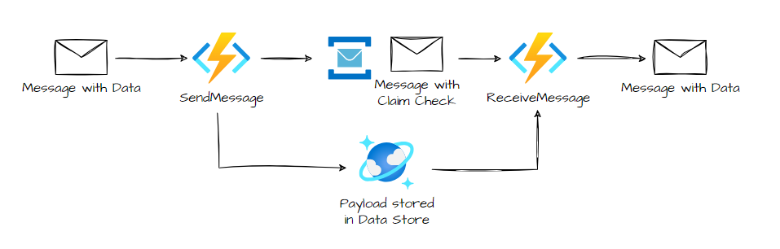
Claim Check Pattern
Notes:
So the solution here, is to split your message into two parts. A claim check or a reference, and the payload of the message.
Store the payload of the message into an external service, such as a database.
Get the reference of that message and send it to the message bus.
This reference acts like a claim check (hence the name), and a consumer can use that to retrieve the payload from the data store.
This pattern is useful when you need to deal with messages that can’t fit your chosen message bus technology.
It can also be used if the payload should only be accessed by services that are authorized to use it.
By offloading it to an external resource, you can apply stricter authentication and authorization rules in place to ensure that your payload is stored securely in the datastore.

Slide 23
Things to think about
Consider lifetime of the message data after consumption.
Storing and retrieving message data can cause additional overhead and latency.
Use Claim Check pattern when message is too large for the bus.
Can also be used if payload should only be accessed by service who needs it.
Notes:
Some things to keep in mind when using the Claim Check pattern.
If you don’t need to archive the message payload, go ahead and delete it, save some money on storage costs.
And because you’ve stored the payload of the data elsewhere, you need to consider the additional overhead and latency that external service involves. You may not want to use the claim check for EVERY message that gets passed to the bus, and include logic within your application when size limits of a message have been exceeded.

Slide 24
Problem 4: Prioritizing background processes
Message queues can be used to delegate tasks for background processing.
The order in which these requests are received aren’t usually important, but sometimes they need to be.
Higher priority requests should be processed earlier than lower priority ones.
Priority could apply to the task itself, users or tenants of our system etc.
Notes:
We touched a little on background processes earlier. In your architecture, some tasks are going to be more important than others.
The order of which requests are received usually aren’t too important, but there will be cases where they will have different priorities, so you need to process them faster than lower priority tasks.
Now priority could mean different things to different scenarios, it could apply to the task itself, if you’re working with multi-tenanted systems, you may users or tenants that have higher priority than others. It could even be a mixture of the two.

Slide 25
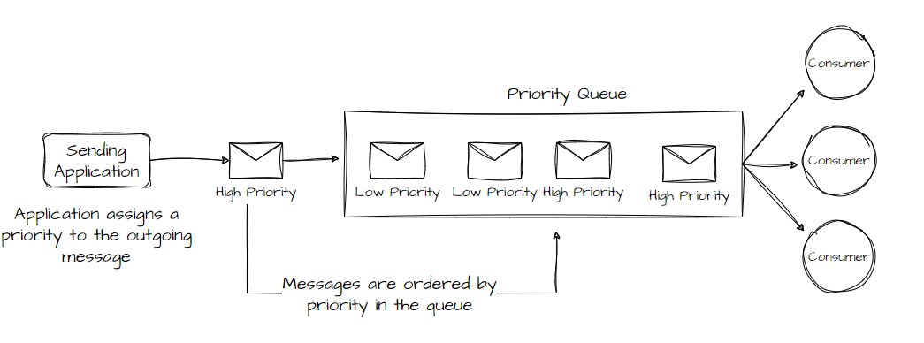
Priority Queue
Notes:
This is where the Priority Queue comes in. Queues usually work on a first-in first out basis, and consumers receive messages in the same order that they are posted to the queue.
However, some queues support priority messaging. So you application assigns a priority to the message, and messages in the queue are reordered so that those that have a higher priority are received before those that have a lower priority.

Slide 26
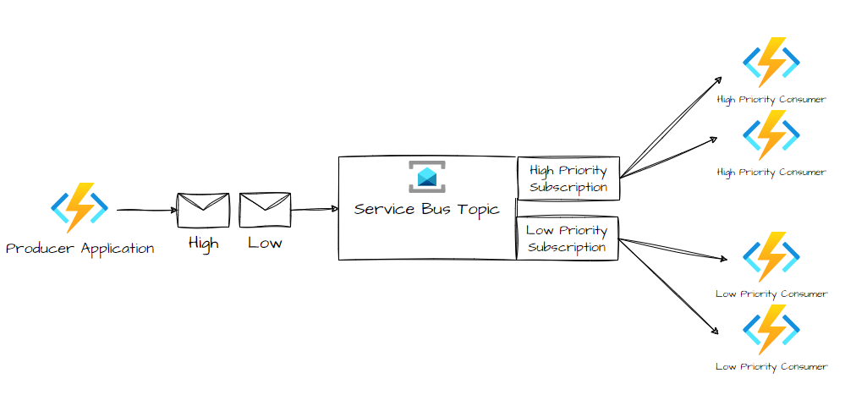
Implementing this in Azure
Notes:
Now in Azure, there’s no native support for automatic prioritization of messages via sorting. However, in Service Bus, there’s support for topics.
Using topics, you can create subscriptions that support a queueing mechanism that provides message filtering. You can use Topics that an application can post messages to, and within the metadata of that message, you can assign a priority to that message that you can filter on in Service Bus.
Now you may be thinking, like I have in the past, that maintaining different subscriptions of different priority levels introduces a lot of overhead.

Slide 27
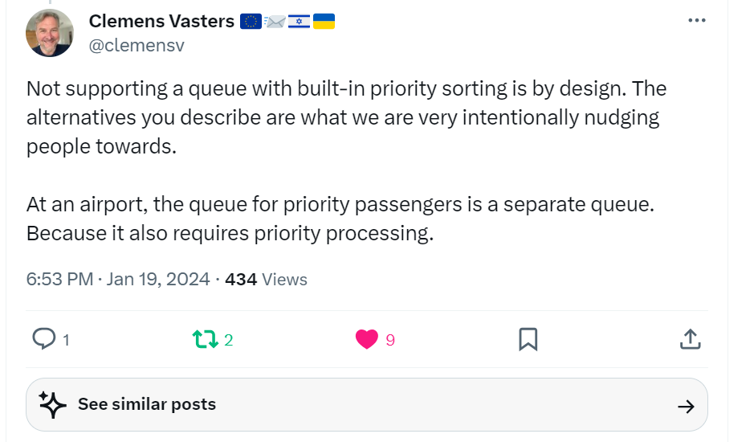
Notes:
But this is by design. This is Clemens Vasters, principal architect for messaging at Microsoft.
So the approach that Microsoft have a taken, is that for higher priority tasks or tenants, we should separate our queues. So using this analogy of airport processing, we separate our higher priority messages to a different queue, so we prioritize the processes of those messages.

Slide 28
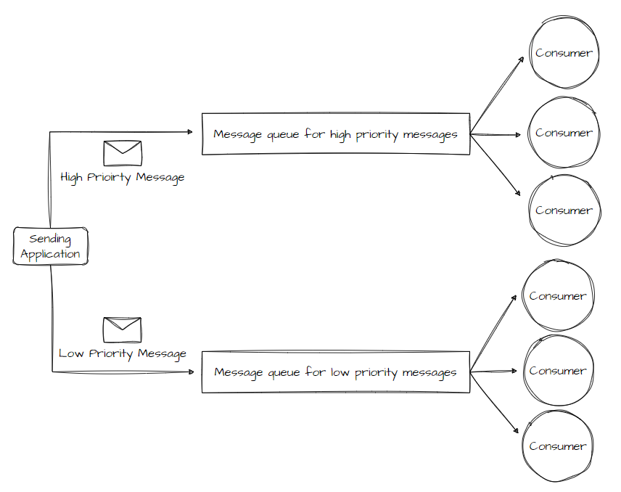
Notes:
So taking this approach, each queue has it’s own separate pool of consumers. Higher priority queues can have a larger pool of consumers that run on faster hardware than lower priority messages.
Another way you could implement this, is to implement a single pool of consumers that check for messages on higher priority queues first, and then only start to fetch messages from lower priority queues, once those messages have been processed.
Now with the single pool approach, higher priority messages are always received and processed before lower priority messages. Whereas with multiple pools, lower priority messages are always processed, but not as quickly as higher priority messages.
Be mindful that you don’t get into a situation where lower priority messages are never processed because they’re superseded by higher priority messages.

Slide 29
What does priority mean in your architecture?
Does your system handle multiple tasks that have different priorities?
Does your system have users or tenants with different priority levels?
Must all higher priority tasks be processed before any lower priority tasks are processed?
Does our infrastructure support the ability to process messages faster?
Do our consumers need to be partitioned for priority?
Notes:
So the questions we need to ask ourselves when thinking about priority for our messages, is what does priority actually mean to our architecture?
Do we have tasks

Slide 30
Problem 5: Handling large number of requests
Queues are used to pass requests from one service to another.
Number of requests can vary over time.
Nature of work performed to handle requests can also vary.
Single instances of consumers or the broker can get flooded with requests.
We can scale to multiple instances to handle this, but we need to coordinate to ensure that each message is delivered to a single consumer.
Notes:
And now that we move onto consumers of our message. One problem we may encounter is handling the large number of requests that come through our system, and how we can scale our consumers to handle that.
Because rather than passing requests through synchronously between services, implementing a message queue to deal with requests asynchoronously ensures that our applications don’t get blocked while processing is on-going.
Now the number of requests that our applications receive can vary over time for many reasons, and the work performed by those tasks can also vary.
If we have a single instance of our consumer, we can run into situations where it becomes flooded with requests. Or the messaging broker itself might be overloaded with messages.
To handle this, we could run multiple instances of the consumer, but we need to ensure that they are co-ordinated so that one message is delivered to a single consumer.
We also need to consider load balancing across consumers to prevent a single instance becoming a bottleneck.

Slide 31
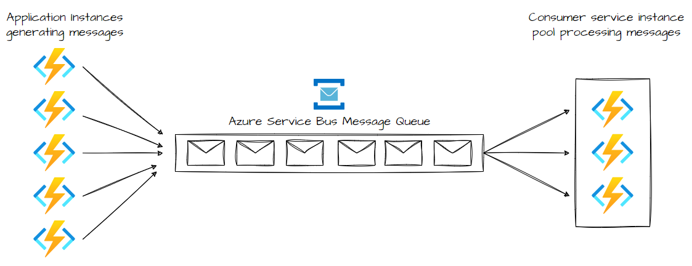
Competing Consumers
Notes:
So the answer to this is to use a message queue to implement the communication channel between the application and instances of the consumer service.
Applications post requests in the form of messages to the queue, and instances of our consumer service receive messages from the queue and process them. This approach allows the same pool of consumers to handle messages from any instance of the application.
This is different from Pub/Sub, where all consumers get passed every message. In Competing Consumers, each message is passed to a single consumer.
Now using Azure Functions and Service Bus Queues, we can implement this pattern via triggers and bindings in Azure Functions.
Service Bus enables consumers to use PeekLock mode when it retrieves a message from the queue. This won’t remove the message from the queue, but it will hide it from other consumers.
The Functions runtime receives the message in PeekLock mode, and if the function successfully executes, it completes the message. If the function runs longer than the PeekLock period, the lock is renewed as long as the function is running.
Functions can scale in and out based on the depth of the queue, and multiple instances of that function can independently pull and process messages.

Slide 32
What benefits does this pattern provide?
Provides a load-level system that handles variation of volumes.
Improves reliability, scalability and resiliency.
Doesn’t require complex coordination.
Notes:
So what we achieve with the competing consumers pattern, is the ability to use the messaging queue to act as a buffer between our producer and consumers and use it to load-level the variation in volume.
We also benefit from improved reliability, since we aren’t sending messages to a specific consumer, should that consumer instance fail, the producer isn’t blocked from doing further work, and another consumer instance can pick it up.
Scalability is also a benefit here, as consumers are able to dynamically scale as the volume of messages increase. For transactional read operations, we can gain a little extra resiliency. Should we read and process messages as part of a transactional process, and an instance fails, we can use competing consumers to ensure that messages are returned to the queue so that another consumer can pick it up.
If messages continuously fail however, use dead letter queues.

Slide 33
Things to keep in mind
Ordering of messages.
Designing our services for resiliency.
Poison messages.
Handling results.
Scaling the messaging system.
Ensuring reliability of the messaging system.
Notes:
The order of which messages are received isn’t guaranteed. Idempotency will be important to factor in here, so that if a consumer fails, we will need to minimize the effects that processing a message more than once will have.
Malformed messages (or poison messages) may cause our instances to fail, so we need to ensure that those messages are not returned to the queue, and capture that poison message elsewhere, such as a DLQ to analyze the message if necessary.
Now because we’ve decoupled the producer and consumer, there’s no direct communication between the two. If we need to send back a result from our consumer to the producer, we’ll need a way to do that in a manner that’s accessible by both.
In Azure, we can do this using worker processes to pass back results to the application using a dedicated message reply queue, but this does require correlation of the message between the two.
For scaling, we need to be mindful of messages overwhelming a single queue. In some cases, we could look at partitioning our broker to send messages from specific producers to particular queues, or distribute messages across multiple message queues.

Slide 34
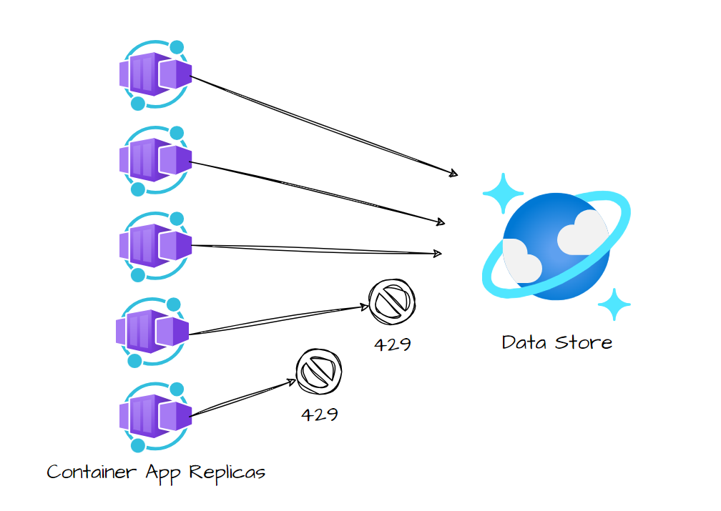
Queue-Based Load Leveling
Many tasks require invoking services.
With heavy loads, this can cause performance or reliability issues.
If the same service is used by several services, can be difficult to predict volume of requests.
Peak demand may cause services to overload.
Notes:
That covers scaling from the consumer side. Those situations can be quite complex to handle, particularly when it comes to partitioning consumers of our messages. These design choices aren’t trivial.
More consumers, more orchestration required, more queues, more complexity.
If your workloads are a lot simpler, introducing a single queue can help level the load between app instances and other resources.
Take the following example, we have a bunch of container app resources performing heavy writes to a Cosmos DB container. For those who’ve worked with Cosmos DB before, 429 errors will be familiar.
Here, we see our container app resources overwhelming our Cosmos DB database with concurrent requests.

Slide 35
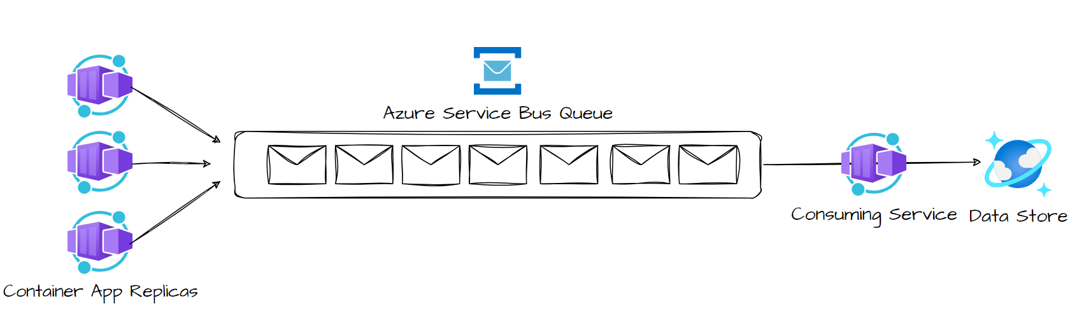
Notes:
And here, we can implement a queue to level the load between our application instances and the data store.
We read messages from the queue, and perform the write requests from a single instance.
In our application code, we implement logic that controls the rate at which we pass requests to the data store, to prevent the store from being overwhelmed.
If we don’t do this, as some of you may ask, we’ll just reintroduce the same problem further down the processing.

Slide 36
Things to keep in mind
Application logic that controls rate at which services handle messages to avoid overwhelming resources.
Message queues are a one-way communication mechanisms.
Can lose information.
Can trail behind the system.
Autoscaling can cause increased contention for resources.
Notes:
So as you can probably guess, implementing this logic in the application layer needs to be tested to ensure that your resources aren’t going to be overwhelmed. That may introduce the need for more queues and instances to handle your volume.
Again, if you need a reply from your service, you’ll need to implement that yourself.
Depending on how much load you experience, you can run into situations where your system is always queuing up more requests than you’re processing. You may also lose information depending on the persistence of the Queue.
If your queue crashes or drops information there’s a possibility that messages will be lost.
Autoscaling can introduce some interesting problems in this pattern. Increased contention for resources that services share effectively cancel out the effectiveness of using the queue to level the load.

Slide 37
Problem 6: Do messages need to be processed in a sequence?
We often need to process a sequence in the order they arrive, while scaling out.
This isn’t straightforward in distributed architectures.
Workers can scale independently and often pull messages independently.
Notes:
Let’s talk about ordering!
Often, we need to process a sequence of messages in the order that they arrive, while still being able to scale out to handle increased load.
Now in distributed architectures, this isn’t straightforward, because works scale independently and can pull messages independently, like we talked about in the Competing Consumers pattern.

Slide 38
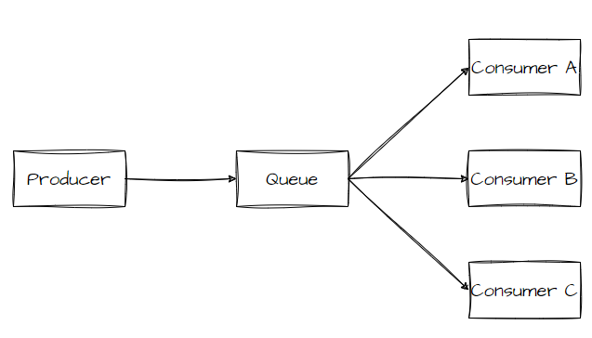
Sequential Convoy
Push related messages into categories within the queueing system
Have the queue listeners lock and pull only from one category, one message at a time.
Notes:
They way that we can solve this is to push related messages into categories within the queuing system, and have the queue listeners lock and pull only from one category, one message at a time.

Slide 39
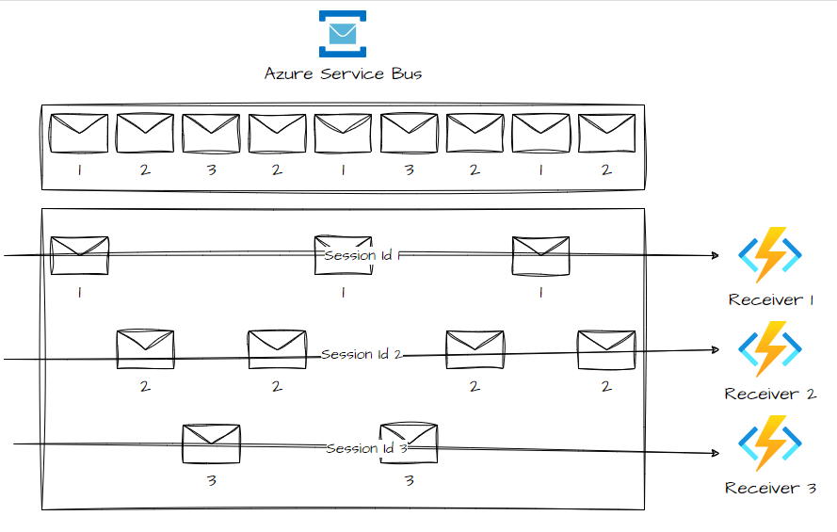
Notes:
In Service Bus, we can uses Sessions to provide that concurrent de-multiplexing of interleaved message streams while preserving and guaranteeing ordered delivery.
A session receiver is created by clients accepting a session. When the session is accepted and held by the client, that client holds an exclusive lock on all messages with that session’s ID in the queue or subscription. It will also hold exclusive locks on all messages with the session ID that will arrive late.
With the lock, we can renew it should we need that session to stay alive. You should treat this session lock like an exclusive lock on a file, meaning that the application should close the session if we no longer need it.

Slide 40
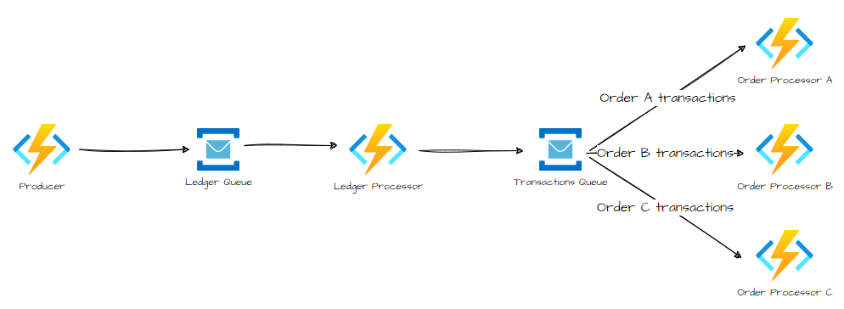
Notes:
So using a practical example in Azure, we can implement the Sequential Convoy using Sessions, and our consumers can utilise the PeekLock functionality to receive messages for that session.
So say we’ve got a order-tracking application, we process each ledger message in the order its received, and send each transaction to another queue where we set the category to the order ID, A transaction doesn’t span multiple orders, so consumers process each category in parallel but in a FIFO manner within the category.
Our Ledger processor function takes care of processing one transaction at a time, and setting the session ID of the message to match the order ID.
Our consumers listen to the secondary queue, where they process all messages with matching order IDs in order from the queue, using peek-lock mode.

Slide 41
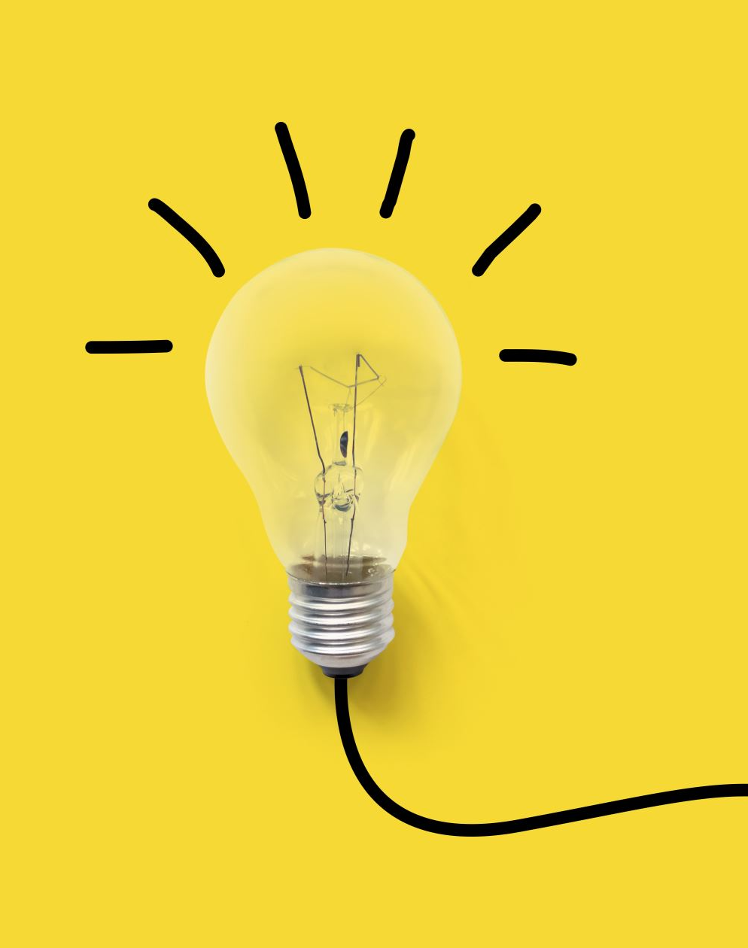
Things to think about
Category/scale unit
Throughput
Service capabilities
How do you add new categories of message to the system.
Out of order messages may still occur.
Notes:
In that prior scenario, we used our order ID as our category. For your own scenarios, you need to think about what property of your incoming message can you scale out on.
You should also consider how easy it is to add new categories of messages to the system. Using our ordering example, if we needed to onboard a new customer, could we have a set of ledger processors that distribute the work per customer IDs?
For high throughput scenarios, do we need to think about how we can enforce a start/end message, sort it by time and then process it as a batch? If it’s very high, do we need to reconsider our FIFO requirements.
Messages may be received out of order, due the network latency when sending numbers. One method you could think about implementing is using sequence numbers to verify the order of your messages. Another is to use a flag to indicate that the last message you process is the last in the transaction.

Slide 42
Problem 7: Handling distributed transactions
Ensuring data consistency across service-specific databases can be a challenge.
Two-phase commit protocols require ALL participants to commit or roll-back.
Not all technologies support this.
Interprocess communication doesn’t help either, as all services must be available to work. This reduces overall system availability.
Notes:
Which leads us nicely to talk about our final problem. Handling distributed transactions. I was in a team where we had to do this, and it was a nightmare.
In microservice architecture, Having a database per microservice provides a lot of benefits for us at a microservice level. We can have each domain data use the best data stroe type and schema for that particular microservice.
However, ensuring data consistency across service-specific databases poses a lot of challenges.
Distributed transactions like two-phase commit protocols require all participants in a transaction to commit or roll-back before the transaction can proceed. However, not all technologies support this.
Another limitation is interproces communication synchronicity and availability. Operating system-provided IPC allows separate processes to share data,
For all distributed transactions to commit, all our participating services must be available, which can potentially reduce overall system availability.

Slide 43
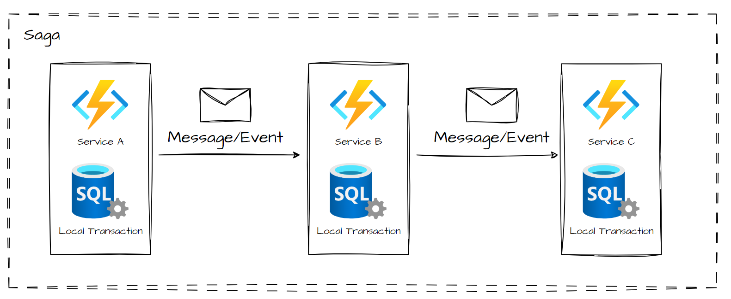
Saga Pattern
Notes:
So the approach we need to take here, is to perform a sequence of local transactions within a Saga pattern.
Each local transaction is the atomic work effort performed by a saga participant.
Each local transaction updates the database and publishes a message or event to trigger the next local transaction in the saga.
If a local transaction fails, the saga executes a series of compensating transactions that undo the changes that were made by the preceding local transaction

Slide 44
Saga Transactions
Compensable Transactions – transactions that can potentially be reversed by processing another transaction with the opposite effect.
Pivot Transactions – go/no-go point in a sage. If this commits, the saga will run until done, or it can be the last compensable or first retryable transaction in the saga.
Retryable Transactions – Transactions that follow the pivot transaction and are guaranteed to succeed
Notes:
There are different types of transactions that we can implement within a Saga
Compensable Transactions – transactions that can potentially be reversed by processing another transaction with the opposite effect.
Pivot Transactions – go/no-go point in a sage. If this commits, the saga will run until done, or it can be the last compensable or first retryable transaction in the saga.
Retryable Transactions – Transactions that follow the pivot transaction and are guaranteed to succeed
There are two common saga implementation approaches that I’ll discuss today

Slide 45
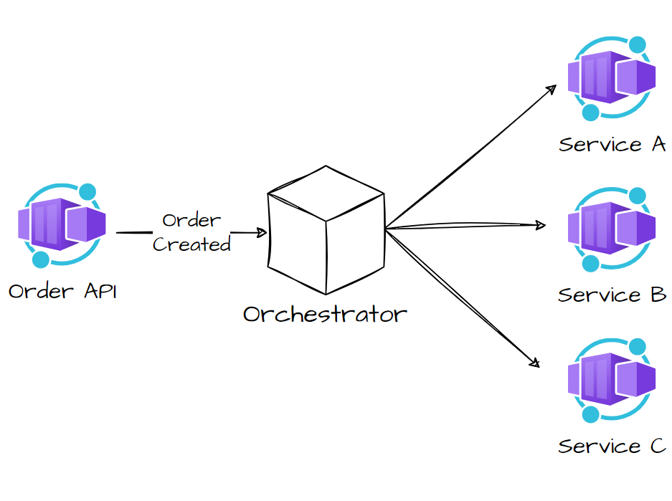
Approach 1: Orchestration
Notes:
The first is Orchestration.
Orchestration is a way to coordinate sagas where a centralized controller tells the saga participants what local transactions to execute.
The saga orchestrator handles all the transactions, and tell the participants which operation to perform based on events.
The orchestrator executes saga requests, stores and interprets the states of each task, and handles failures by using compensating transactions

Slide 46
Benefits and drawbacks
Good for complex workflows.
Suitable when there is control over every participant in the process.
Doesn't include cyclical dependencies.
Saga participants doesn’t need to know about other participants.
Additional design complexity requires coordination logic.
Orchestrator becomes the point of failure, as it manages the complete workflow.
Notes:
Read points
For complex workflows, it’s handy for involving many participants or new participants added over time.

Slide 47
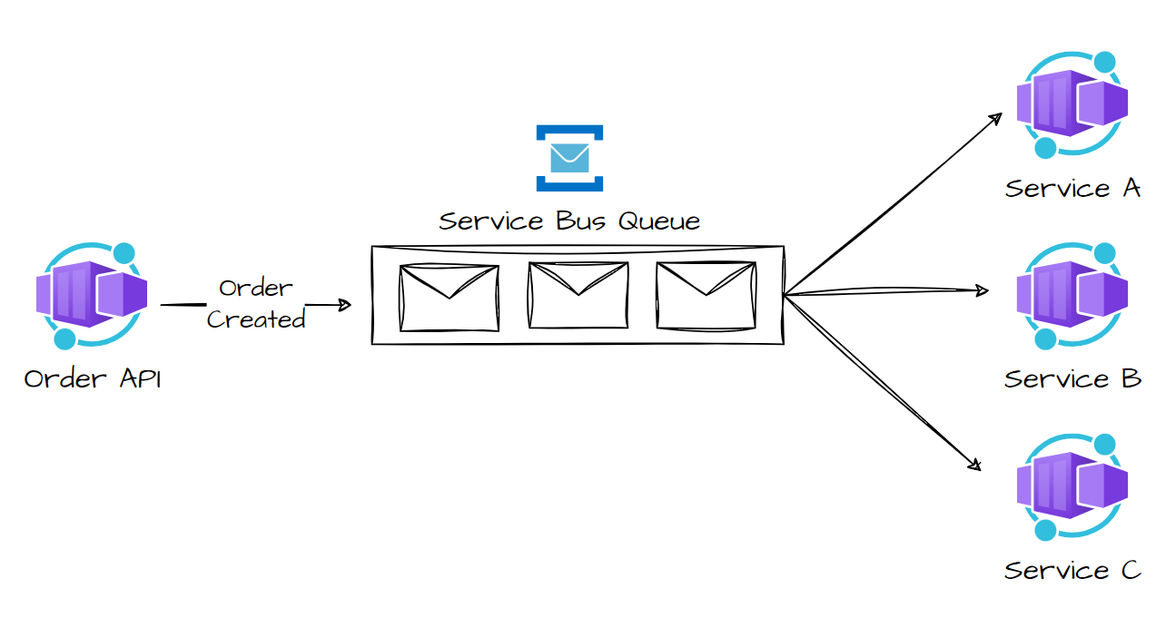
Approach 2: Choreography
Notes:
Our second approach is to use Choreography.
With Choreography, we can coordinate sagas where participants exchange events without a centralized point of control.
Each local transaction publishes domain events that trigger local transactions in other services
A client publishes a request to a message queue, as messages arrive, they are published to subscribers interested in that message.
Each subscriber does it’s thing, and responds to the message queue with the success or failure of that operation.
This way, the services choreograph the workflow among themselves without having to depend on an orchestrator or having direct communication between them

Slide 48
Benefits and drawbacks
Good for simple workflows.
Doesn’t require additional service implementation and maintenance.
Doesn’t introduce a single point of failure
Difficult to track participants to system.
Risk of cyclic dependencies between saga dependencies.
Integration testing is a challenge!
Notes:
The choreography approach is really useful for simple workflows that don’t require coordination logic.
Because there’s no orchestrator, we don’t require additional service implementation and maintaince and there’s no single point of failure, since the responsibility of the worklflow is distributed across the saga participants.
However, as your workflow grows and you add more participants, the complexity increases as it’s difficult to track which saga participants listen to which commands.
There is also a risk of cyclic dependency between saga participants because they have to consume each other’s commands.
And finally, integration testing can be a nightmare! All services have to be running to simulate a transaction.

Slide 49
Things to consider
Saga pattern may require a new way of thinking.
Hard to debug.
You NEED to implement observability.
Data can’t be rolled back.
Must be able to handle transient errors and provide idempotence.
Durability challenges exist due to lack of data isolation.
Implement semantic locks, commutative updates, pessimistic views etc. to prevent anomalies.
Notes:
The Saga pattern is a challenge to implement. Distributed transactions may require a new way of thinking of how to coordinate the transaction and maintain data consistency across multiple microservices.
(Kinda one of the reasons why you should ask yourselves “Do you need microservices”)
It’s hard to debug. As more participants are involved in the saga, this only gets more challenging. Your best bet is to implement observability to monitor and track the saga workflow.
Data can’t be rolled back, because saga participants commit changes to their local databases.
And your implementation must be capable of handling a set of potential transient failures, so idempotency must be provided to reduce side-effects and ensure data consistency.
The lack of participant data isolation imposes durability challenges, you must implement countermeasures to reduce anomalies like lost updates, dirty reads, and nonrepeatable reads.

Slide 50
Takeaways
Messages or Events?
How can message brokers break up your architecture?
How complex is your architecture?
Is the order of your messages important?
Who’s listening to your messages? How will they scale?

Slide 51





Thanks for listening!
https://twitter.com/willvelida
https://www.youtube.com/@willvelida
https://www.willvelida.com/
https://www.linkedin.com/in/willvelida/
https://github.com/willvelida/

