Slide 1


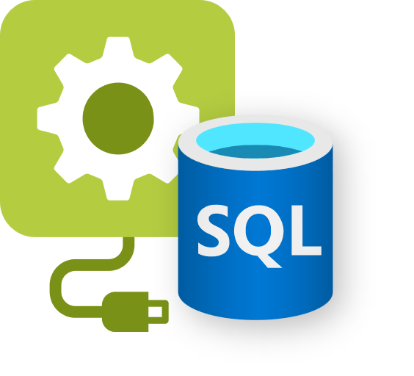

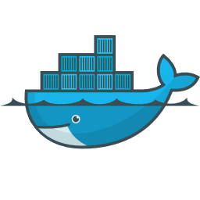
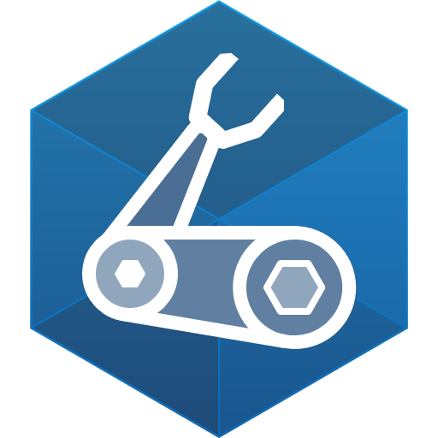

Recipes
Azure
SQL DB
Container
SQL DB
AWS RDS
SQL Edge
Container
Services access consistent connection strings and values
Infrastructure automatically deployed and configured
Leverage your existing IaC templates
Bicep
Extensible…
Notes:
Hi everyone, my name is Will Velida, I’m a software engineer and cloud architect and in this video, we’re going to talk about Recipes in Radius
Recipes enable a separation of concerns between IT operators and developers by automating infrastructure deployment.
Developers select the resource they want in their app (Mongo Database, Redis Cache, Dapr State Store, etc.), and IT operators codify in their environment how these resources should be deployed and configured (lightweight containers, Azure resources, AWS resources, etc.).
When a developer deploys their application and its resources, Recipes automatically deploy the backing infrastructure and bind it to the developer’s resources.

Slide 2
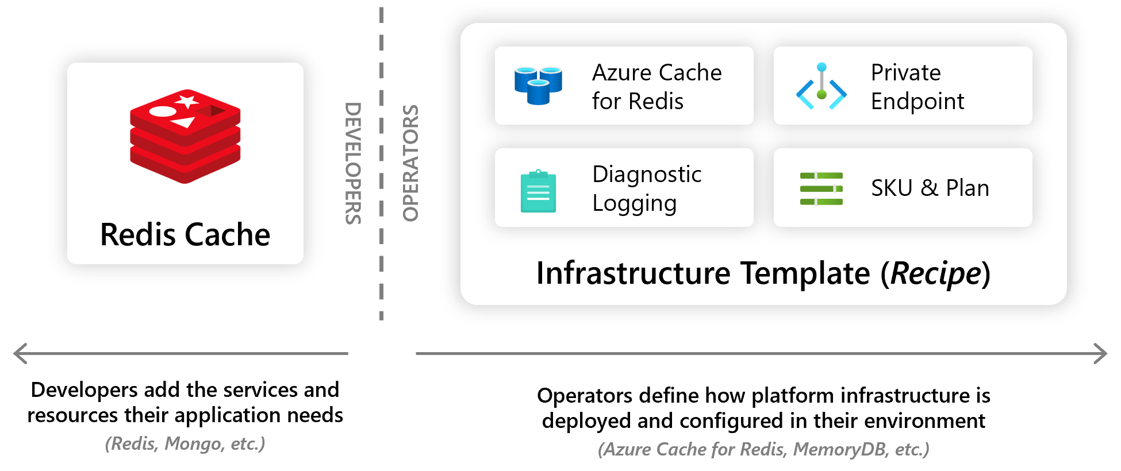
Notes:
So in this example, I’m building an application and in that I want to use a cache. As a developer, I can define in my Radius application that I want to use a cache, so I can define that as a resource in my app.
What IT Operators and Platform Engineers will do, is codify how this cache should be deployed and configured. So in this example, this cache will be deployed onto Azure. We’re integrating it into a VNET, so we need a private endpoint for it. We may also want to enable diagnostic logging for the cache as well.
When a developer deployes their application and its resources, Recipes automatically deploy the backing infrastructure and bind it to the developer’s resources. Let’s build an app that uses a recipe.

