Slide 1

Building and operating cloud-native applications with Radius
Will Velida
Lead Software Engineer, Mantel Group
@willvelida

Slide 2
Agenda
What is Radius?
What’s the point?
Recipes and Environments

Slide 3
Cloud native applications are more than just Kubernetes!

Slide 4
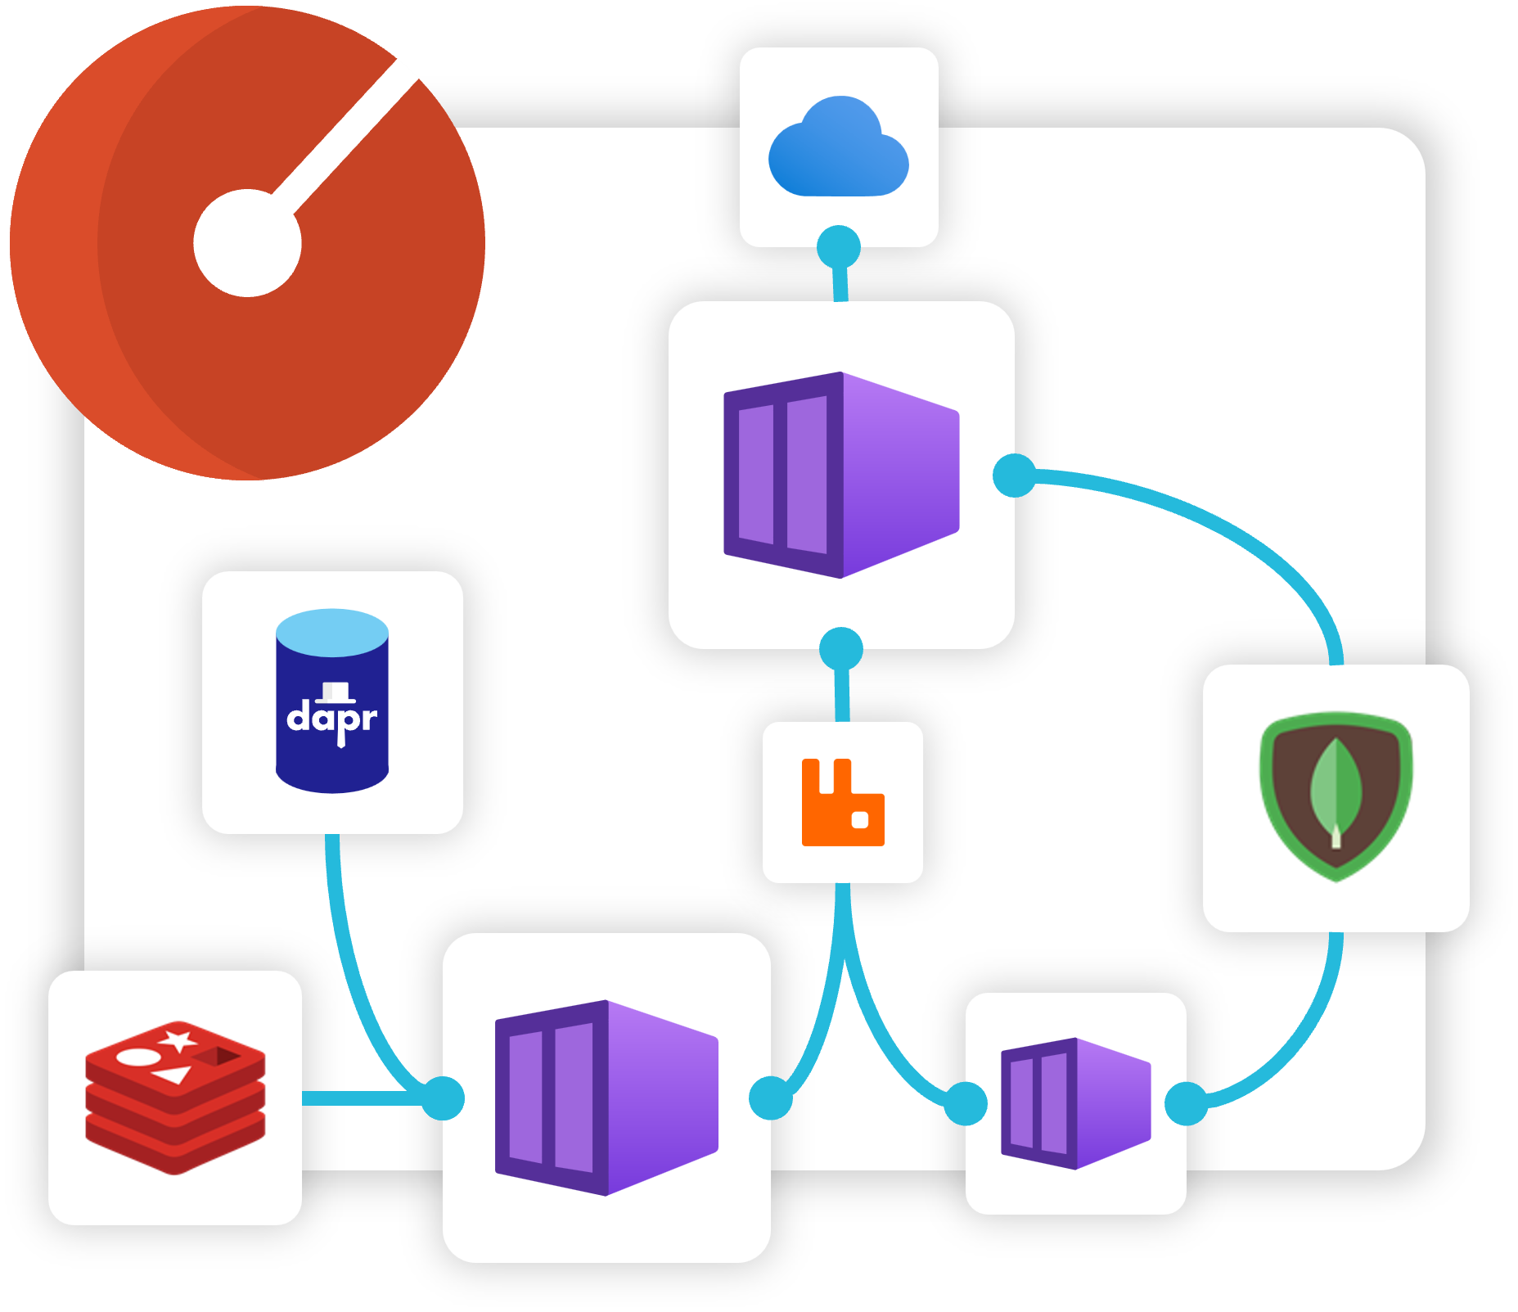
Enter Radius
Radius is an open-source, cloud-native application platform that enables developers and operators to develop and collaborate on cloud native apps across public and private clouds

Slide 5
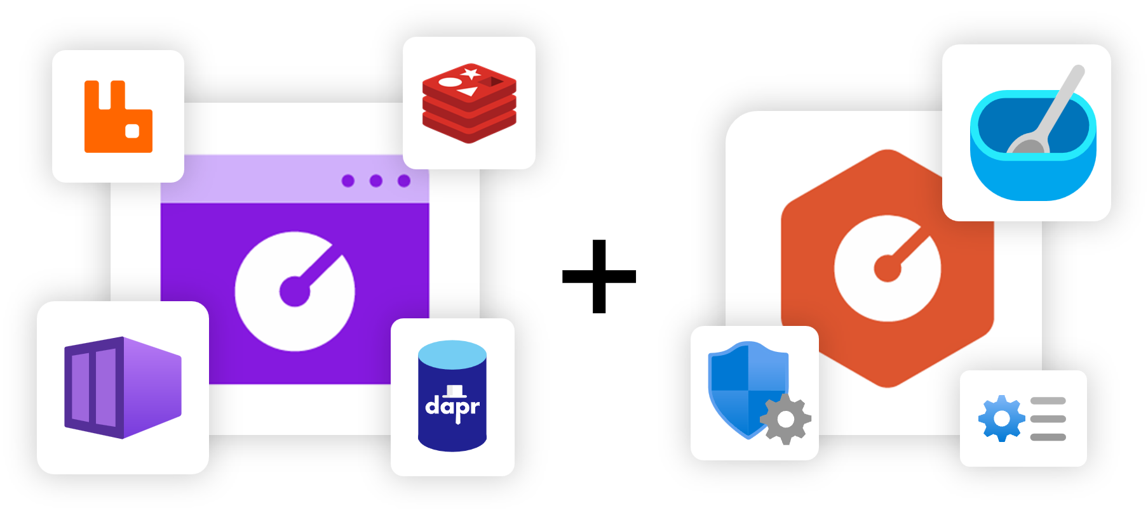
Developer + Operator Collaboration
Developers define applications and dependencies
Operators define environments .
Radius brings them together, deploying apps and infra that meet both requirements.

Slide 6
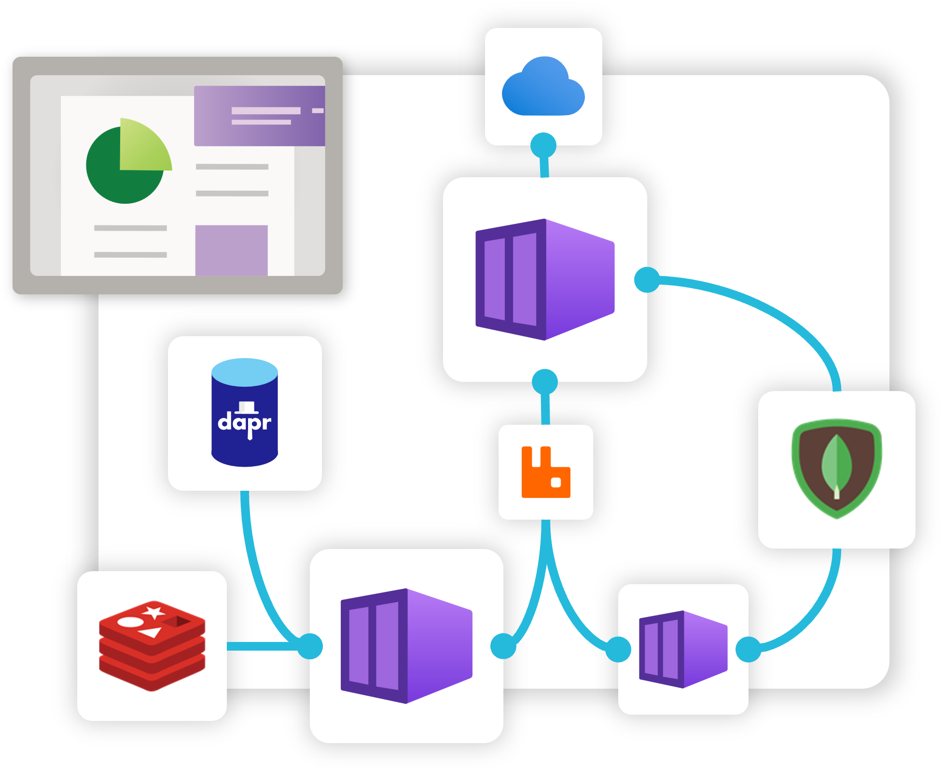
Radius Applications
Primary resource that brings your application + infra together.
Includes services, dependencies, relationships.
Single description and view of entire app

Slide 7
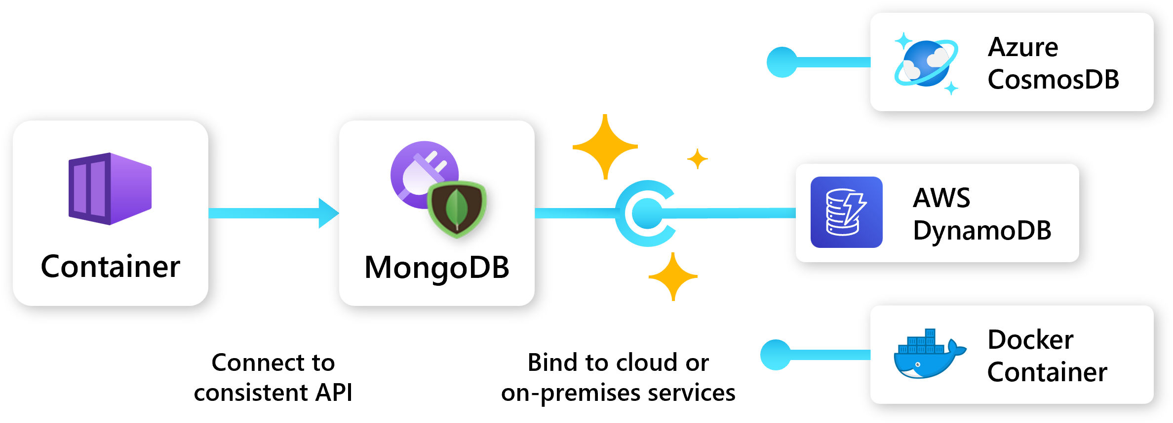
Application portability
Designed to be cloud + platform agnostic
Define app once, deploy to any platform that supports Radius.
Developers define app requirements.
Operators define environments and recipes that bind to those requirements.

Slide 8
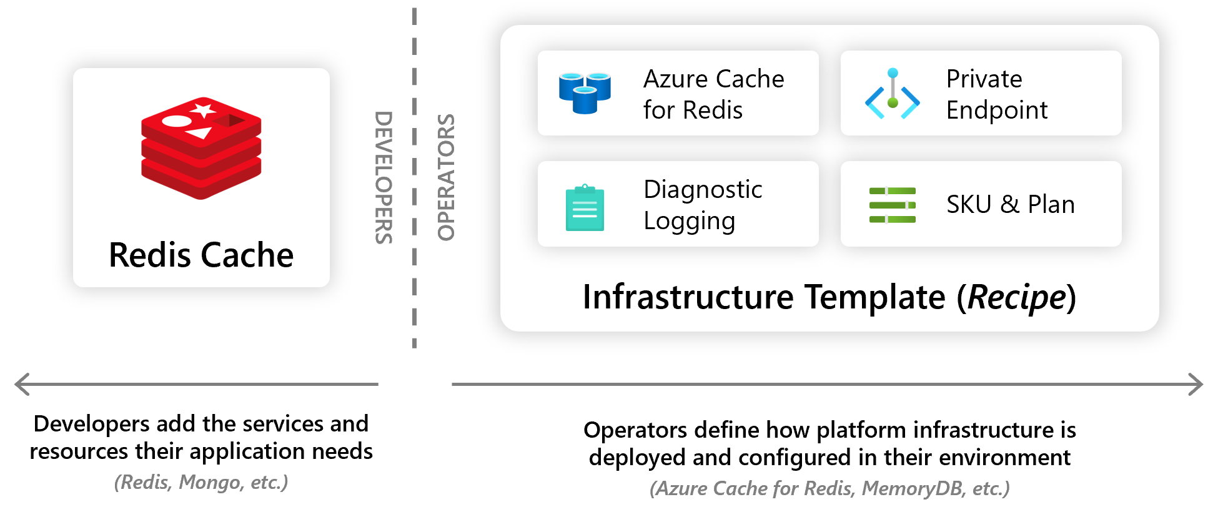
Radius Recipes
Recipes enable a seperation of concerns between Ops and developers by automating infra deployment.
Devs choose the resource they want.
Ops codify their environment with how these resources should be deployed.

Slide 9
Radius Architecture
Overall Architecture of Radius has 3 parts.
General Resource Management API
Resource providers for cloud-native apps.
Tools for deploying and managing Radius apps via API.

Slide 10
Demo time!

