Slide 1
Joint species distribution modelling of birds in California

Slide 2
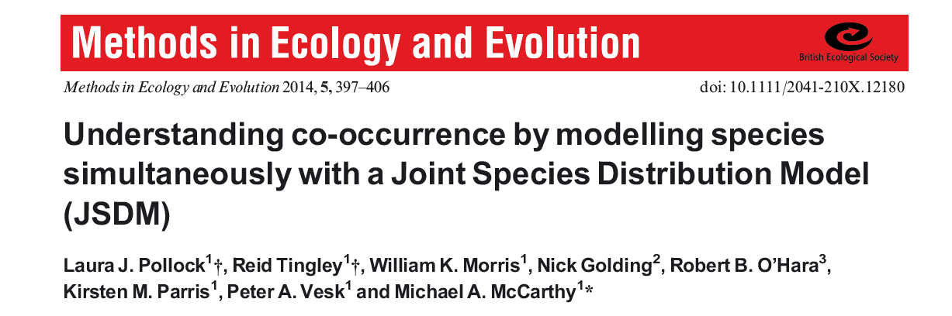
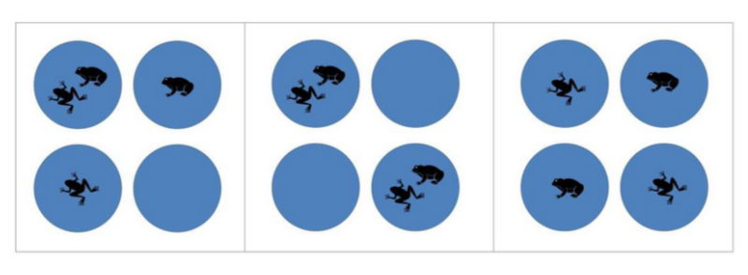
Methods:

Slide 3
Our Research question:
Does interspecific competition influence the distributions of four species in California?

Slide 4
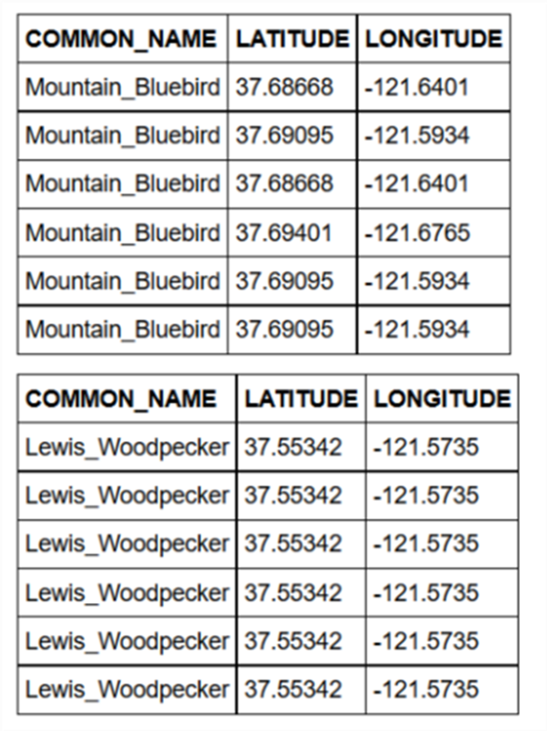
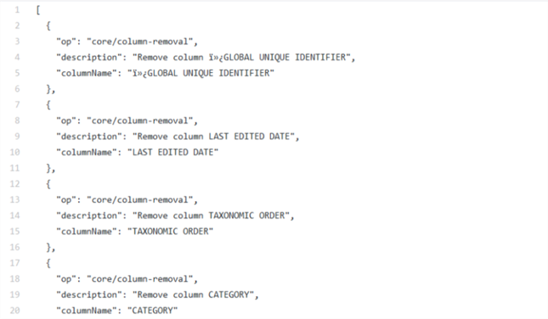
Ebird info cleaned in open refine
Converted into csv and combined in the same file

Slide 5
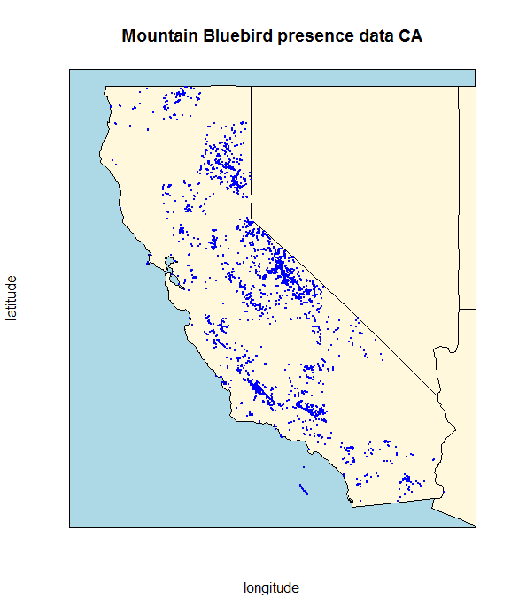
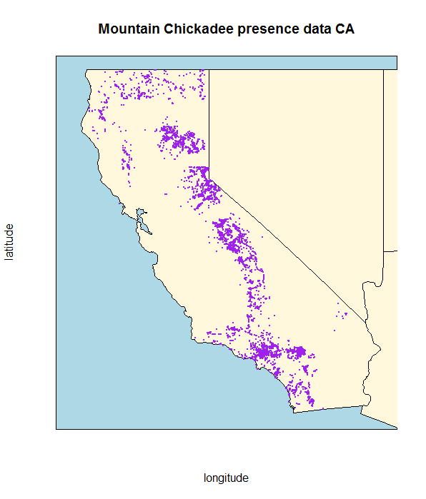

Slide 6
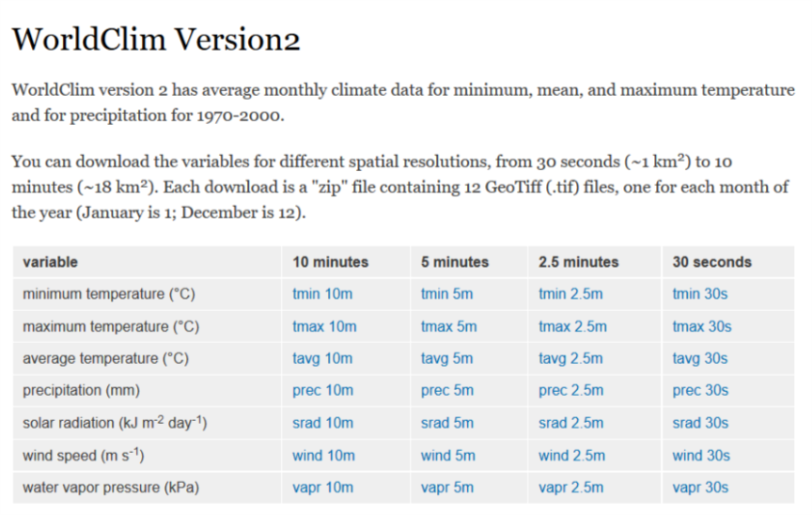
Climate data was taken from World Clim

Slide 7
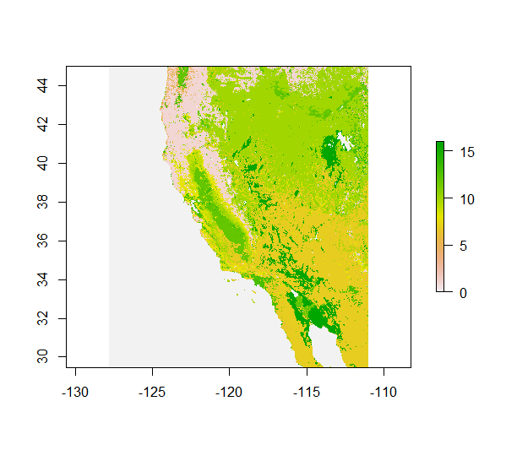
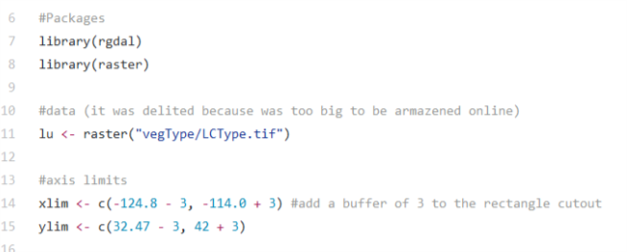
USGS Landuse raster – TIF of ca

Slide 8
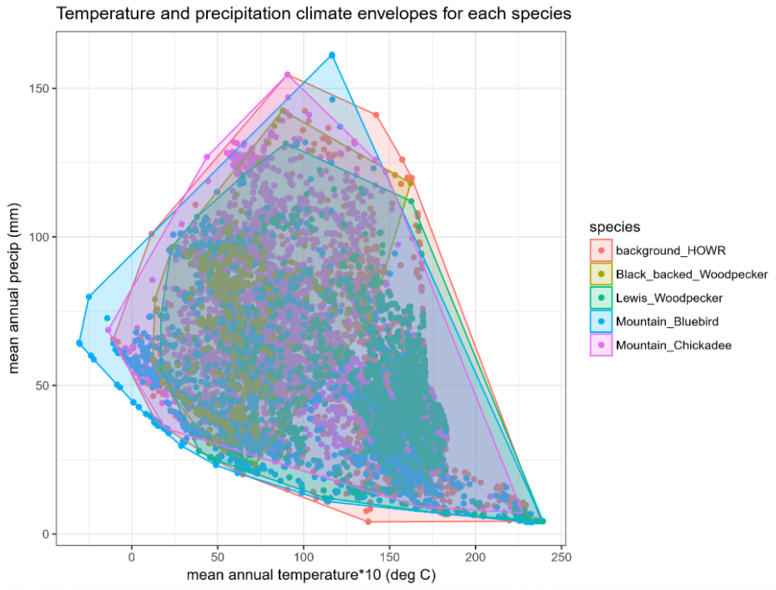
Species overlap in climate space

Slide 9
Model assumptions
Wrens are so common we can use them as background points
We only care about habitats where at least one of our species is present

Slide 10
Model output

Slide 11
Problems along the way

Slide 12
next steps?

