Slide 1
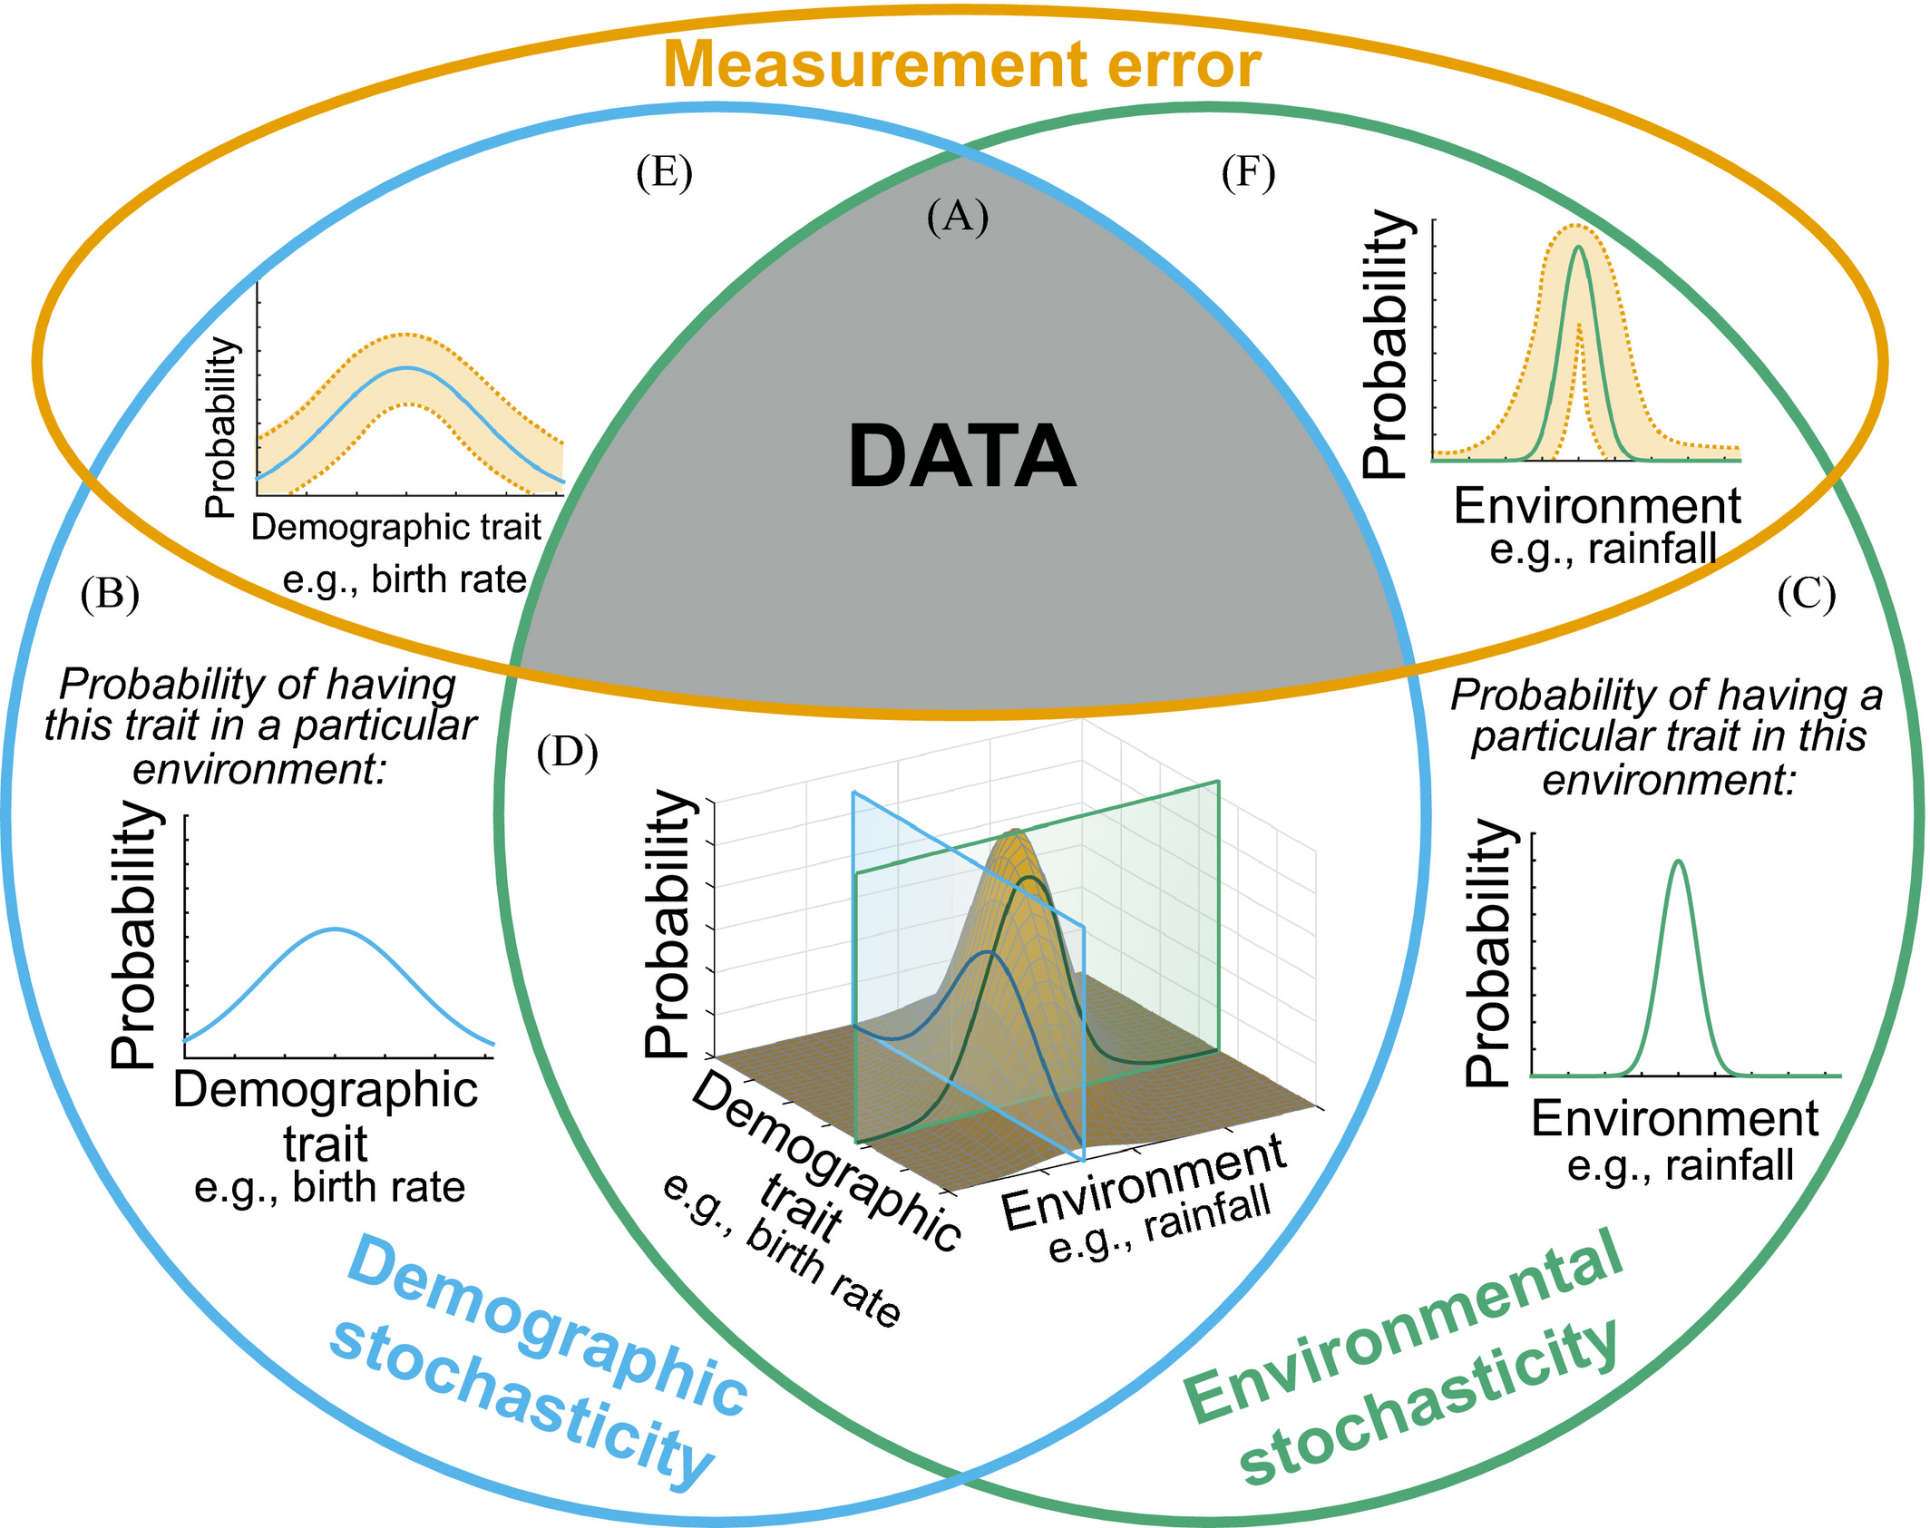
Model uncertainty
+
+
Demographic
Heterogeneity
+
Spatial
Heterogeneity

Slide 2
Model uncertainty
+
+
MODEL PREDICTION
+
Demographic
Heterogeneity
+
Spatial
Heterogeneity

Slide 3
Model uncertainty
+
+
MODEL PREDICTION
+
Demographic
Heterogeneity
+
Spatial
Heterogeneity

Slide 4
Model uncertainty
+
+
MODEL PREDICTION
+
Demographic
Heterogeneity
+
Spatial
Heterogeneity

Slide 5
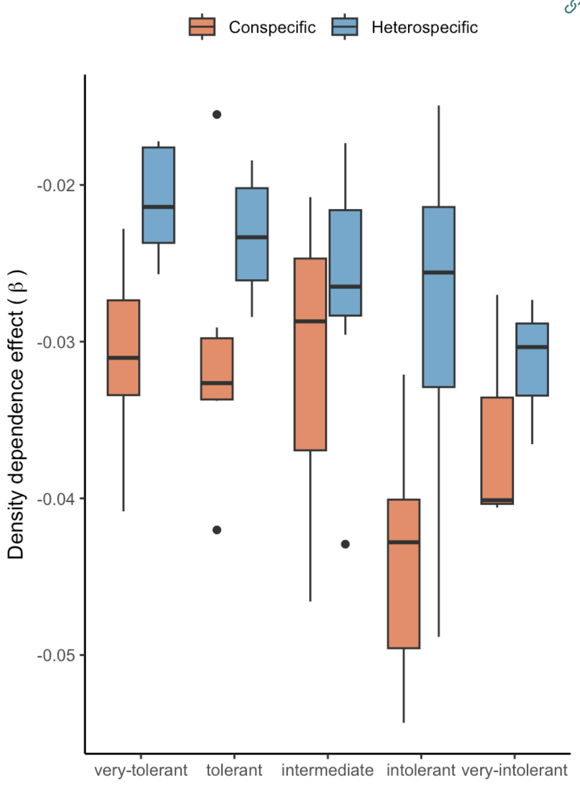
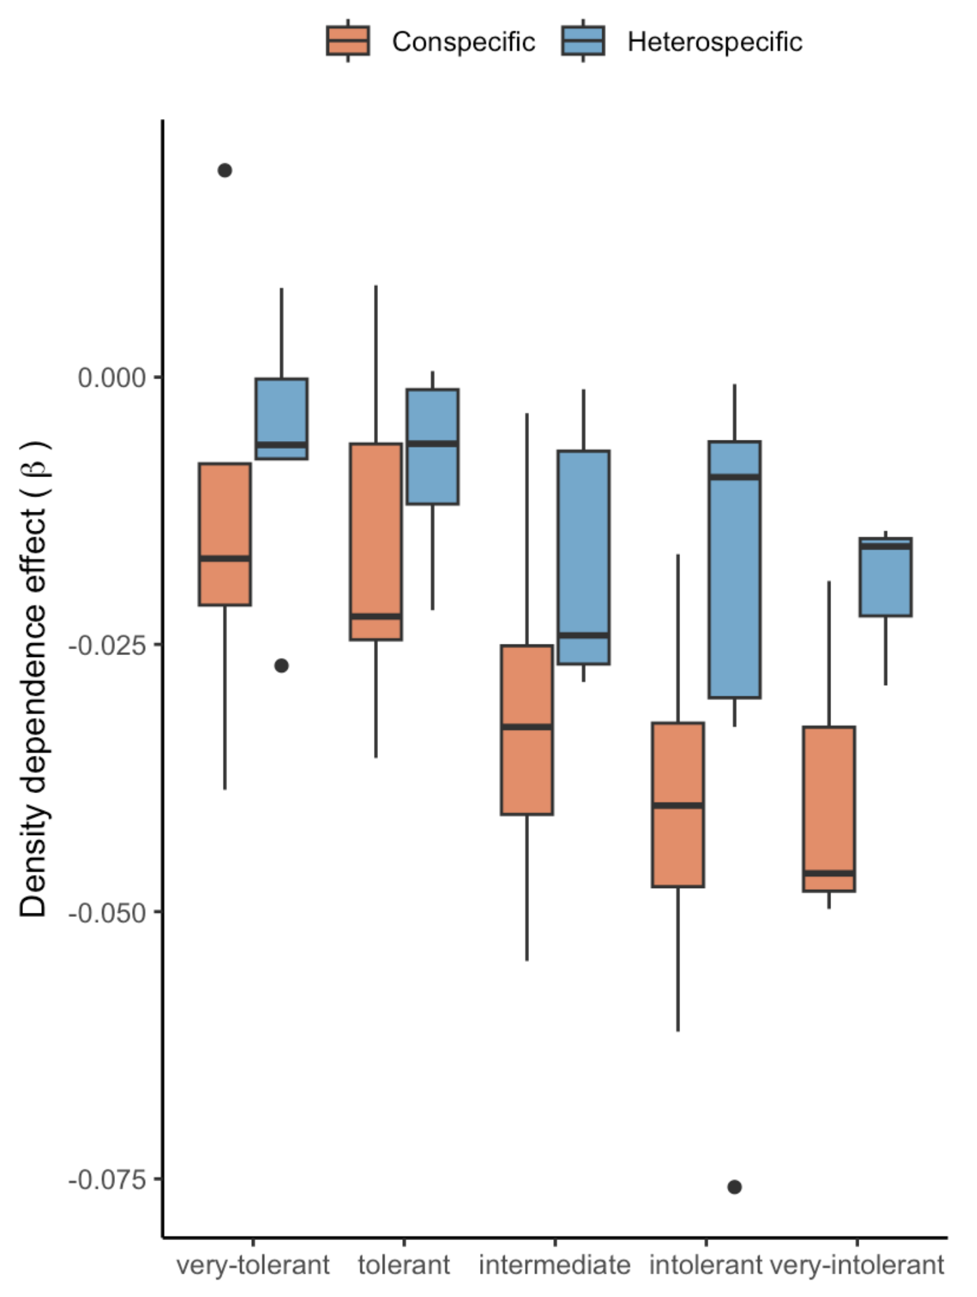
Growth
Survival

Slide 6
