Slide 1



Genome-wide selection in a guild of hymenopteran parasitoids
William Walton
Konrad Lohse, Graham Stone & Mike Ritchie

Slide 2
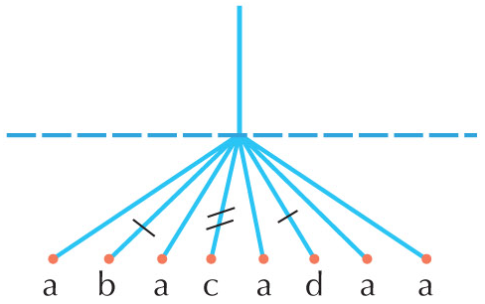
Selection and demography
Few studies have been able to show the ecological causes of selection
Demography can confound tests of selection due to their similar effects on the genome
Explicit modelling is the best way to control for it
Sudden changes in population size
could be associated with population
splits and range shifts, and influenced
by species ecology
Notes:
What I would like to do is to find the ecological causes of selection. Few studies have been able to do this, despite this being a fundamental question which is now possible to answer due to modern sequencing technologies.
One problem is that demography can confound tests of selection due to their similar effects on the genome.
For example, both bottlenecks and selective sweeps can produce star shaped genealogies with an excess of rare variants, like this figure.
The best way to control for demography is by modelling it explicitly, and then use the model as a null model on top of which to model selection.
Two events that have very strong effects on selection tests are bottlenecks and sudden changes in population size.
Finding how and when these events occur across species in a community could help us understand more about how ecology influences demography

Slide 3
Aims
Model population bottlenecks and step changes in population size in species across a community
Find how similar these are between species and how this is affected by species ecology
Use these demographic models as null models from which to model selective events
Use these selection models find how ecology influences selection

Slide 4
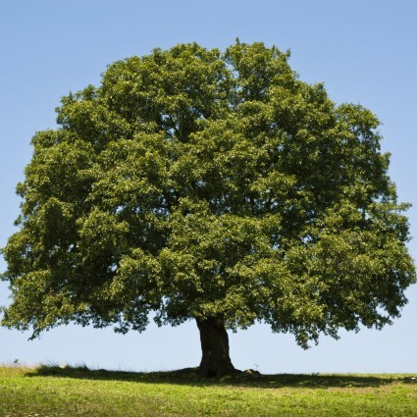
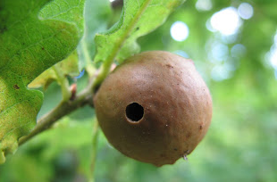
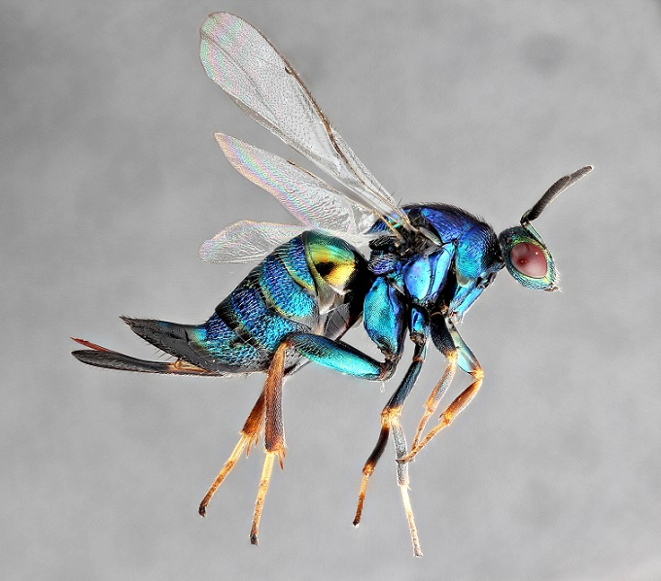
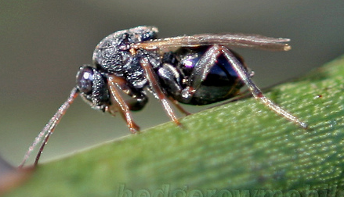
Oak gall wasp parasitoid system
Complex tri-trophic community of oak trees, gall wasps and parasitoids
Spans much of the Western Palearctic region
Many known interactions between species and trophic levels
Well studied ecology and phylogeography
Notes:
A comparative study of selection and demography such as this requires a system in which potentially confounding factors can be controlled for.
Ecologically closed so it can be considered in isolation of other communities.
Species closely related to control for evolutionary history
Panmictic populations so assumptions of models are fulfilled (structure creates linkage that looks like demography or selection)
Colocalised so there is control for habitat variation
Good existing data so species interactions are known and inferences can be seen in context of the phylogeography
Oak tree, gall on oak tree made by gall wasp (Andricus kollari?), inquiline (Synergus sp.), parasitoid (Ormyrus nitidulus)

Slide 5
Oak gall wasp parasitoid system
Each gall wasp species is attacked by many parasitoids
Each parasitoid can have several hosts
Species ranges overlap across the region
Haplodiploid

Slide 6
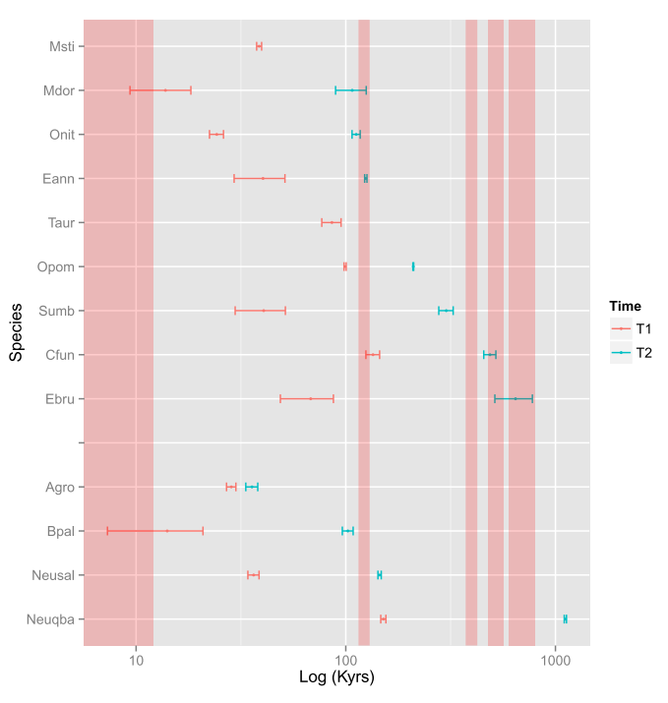
Oak gall wasp parasitoid system
At least three ice age refugia in Iberia, Hungary and Iran
Times of population splits have been estimated, using different samples and divergence data
Notes:
Refugia are places where populations were able to survive during glacial periods
Lynsey’s estimates used different samples and divergence instead of diversity
Known times of population splits will enable me to link them with times of population size changes

Slide 7
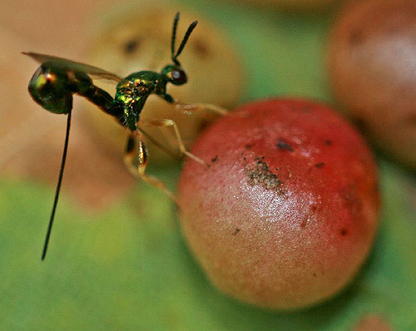
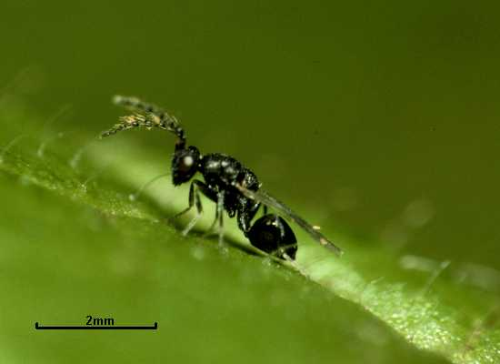
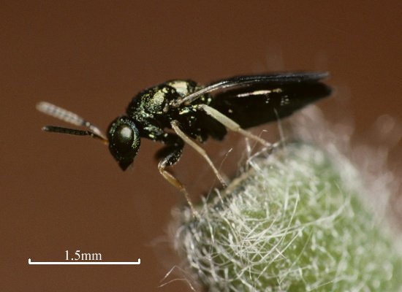
Species and existing data
Seven species in four families in the superfamily Chalcidoidea
Megastigmus dorsalis, M. stigmatizans and Torymus auratus in Torymidae
Ormyrus nitidulus and O. pomaceus in Ormyridae
Eurytoma brunniventris in Eurytomidae
Cecidostiba fungosa in Pteromalidae
Fragmented genome assemblies of five individuals in each species from Iberian populations
Notes:
Iberia was selected because it is well studied, panmictic and all species here have overlapping ranges there
Pictures: Taur, Onit, Ebru and Cfun

Slide 8
Blockwise site frequency spectrum (bSFS)
(1,0) (1,0) (1,1) (0,1) (3,0) (1,1) (0,0) (1,1)
An alignment of the genomes is split into blocks
A SFS is calculated for each block
The probability of each bSFS under a demographic model is calculated
Multiplying probabilities across blocks gives a composite likelihood
Models of instantaneous bottlenecks and step changes in population size were fitted
Notes:
I am using this method because it doesn’t require large sample sizes and well assembled genomes so it fits my data well
Models of bottlenecks and step changes in population size were fitted using the blockwise composite likelihood method described by Lohse et al. (2011).

Slide 9
Species | lnL null | lnL bottleneck | θ | Ne | Time T₁ | Strength T₂ | years
C. fungosa | -26954.2 | -26946.9 | 1.25267 | 267784 | 0.642868 | 0.234311 | 172149
E. brunniventris | -28518.1 | -28510.6 | 1.82274 | 583837 | 0.500202 | 0.169463 | 292037
M. dorsalis | -26087.0 | -26022.9 | 1.08152 | 138443 | 0 | 0.0859267 | 0
M. stigmatizans | -26768.0 | -26768.0 | 1.293 | 58305 | 0 | 0.16399 | 0
O. nitidulus | -24636.4 | -24120.9 | 1.51995 | 185269 | 0.0579716 | 0.384781 | 10740
O. pomaceus | -26482.1 | -26427.7 | 1.48272 | 284929 | 0.527481 | 0.466117 | 150294
T. auratus | -29960.5 | -29848.1 | 3.25691 | 709257 | 0.614549 | 0.509441 | 435873
Species | lnL null | lnL step change | θ | Ne | Time T₁ | Strength B₁ | years
C. fungosa | -26954.2 | -26950.6 | 1.08601 | 232156 | 4.00438 | 0.0050767 | 929643
E. brunniventris | -28518.1 | -28514.6 | 1.59855 | 517947 | 3.19725 | 0.0005883 | 1656006
M. dorsalis | -26087.0 | -26023.0 | 0.0259706 | 3363 | 0.0894048 | 0.0240534 | 301
M. stigmatizans | -26768.0 | -26534.9 | 0.0133541 | 609 | 0.181098 | 0.0103384 | 220
O. nitidulus | -24636.4 | -24142.1 | 0.380999 | 46441 | 0.68284 | 0.24511 | 31712
O. pomaceus | -26482.1 | -26466.1 | 1.04849 | 201484 | 3.54446 | 0.0010467 | 714152
T. auratus | -29960.5 | -29841.9 | 4.60327 | 1002454 | 0.124307 | 2.44719 | 124612
Notes:
Both models had a higher likelihood than the null model in all species
T. auratus and M. stigmatizans had a higher lnL for the step change model
All other species had higher lnL for the bottleneck model
I have shown by parametric bootstraps that Taur and Msti have significantly higher logL for the step change model than for the null. I am in the process of doing this for the other species at the moment.

Slide 10
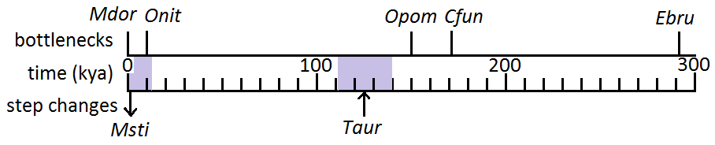
Results
Possible clusters in current interglacial period and around 150kya
Clusters could be due to common factors associated with those time periods such as glaciations
The only increase in Ne is seen in T. auratus during an interglacial period
Notes:
Looking at just the model that had the highest likelihood in each species, you see this

Slide 11
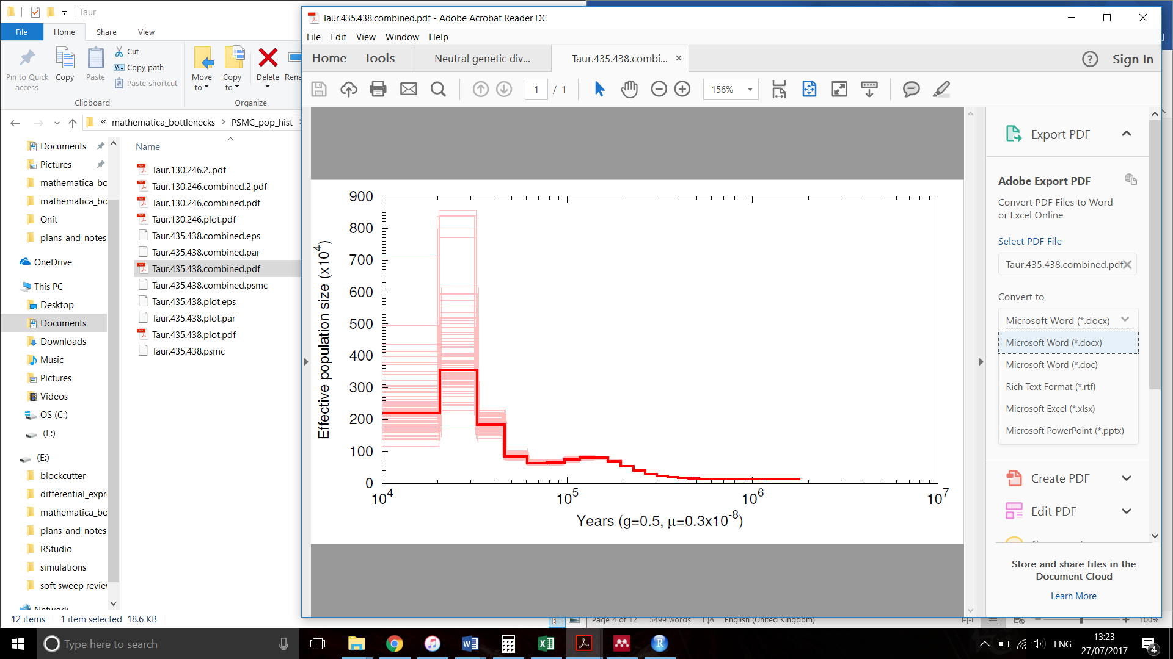
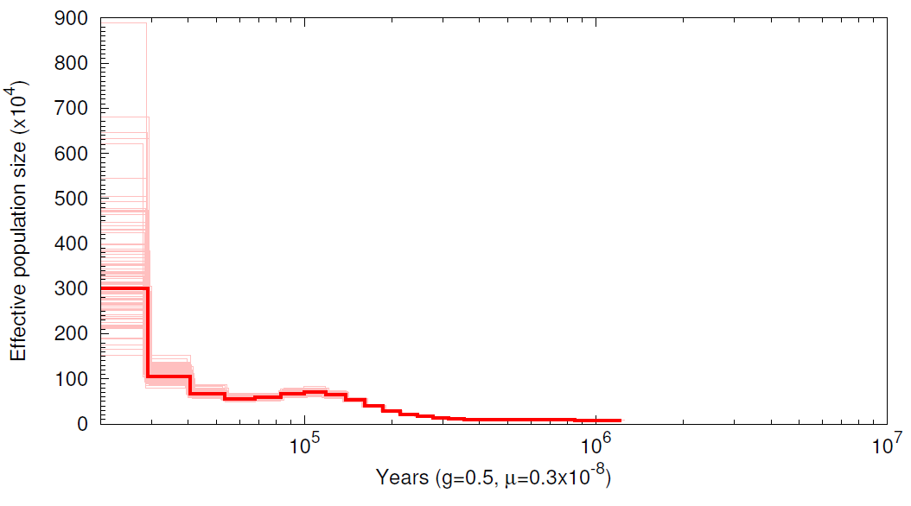
Checking results with Torymus auratus
Increase in Ne estimated to have occurred before Iberian and Hungarian populations split
Same increase therefore expected to be seen in Hungarian population
PSMC (Pairwise Sequentially Markovian Coalescent) performed to investigate this
Iberia
Hungary
Notes:
PSMC is a method of demographic inference that uses one diploid (or 2 haploid) sequences to infer a history of population size changes. It uses the distribution of heterozygous sites along the genome to infer recombination and coalescence events
The same increase in Ne is seen in both populations, showing that it did indeed occur before the populations split and it is not specific to the Iberian population.

Slide 12
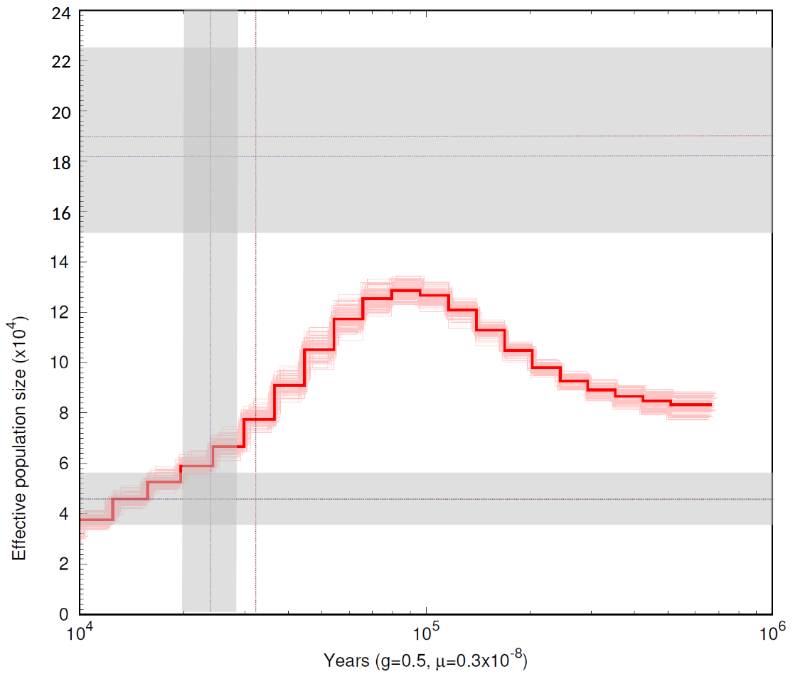
Checking results with Ormyrus nitidulus
Parametric bootstraps performed using msprime to get confidence intervals of step change
Compared to results from PSMC
Notes:
PSMC is a method of demographic inference that uses one diploid (or 2 haploid) sequences to infer a history of population size changes. It uses the distribution of heterozygous sites along the genome to infer recombination and coalescence events
Fairly concordant
bSFS parameters are the red dotted lines, blue dotted lines are the bootstrap medians, grey areas are the C.I.s.

Slide 13
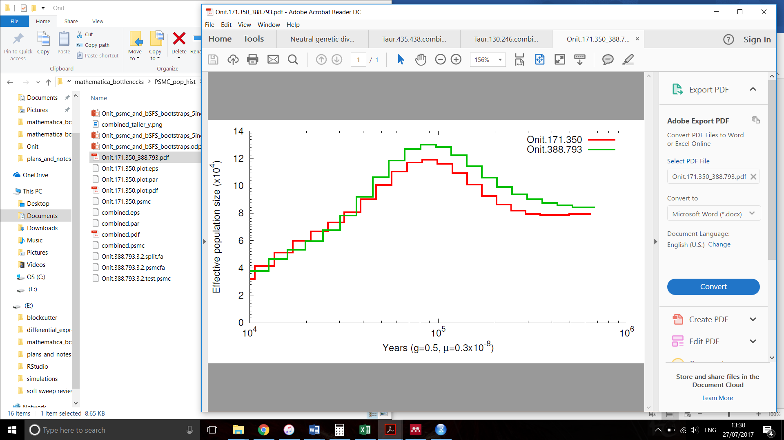
Population structure
Population structure is known to disrupt tests of demography and selection
Tested for using PSMC on two different pairs of individuals of O. nitidulus
Notes:
Little difference observed between the 2 pairs of individuals, so there doesn’t appear to be too much population structure and there was no further investigation of it

Slide 14
Genic vs intergenic regions
Selection on genic regions can affect tests of demography
Tests were repeated on genic and intergenic regions of O. nitidulus
Genes were predicted de novo using the gene prediction tool Augustus with Nasonia vitripennis used to train the software
24,103 genes predicted
Greater diversity found in intergenic regions
More recent, smaller changes in population size
But difference is small
Notes:
As well as demography affecting tests for selection, selection can affect tests for demography.
Nvit is in the family Pteromalidae, same as Cfun
Results do not greatly affect inferences

Slide 15
Conclusions and further work
Possible synchrony of changes in Ne across species
Possibly associated with climate
Test for significance between null, bottleneck and step change models
Find confidence intervals for parameters
Test for clustering in time of population size changes across species
Demographic models will be used as null models to infer selection

Slide 16
Chapter 2: Gene duplication
Gene duplication is one of the primary mechanisms generating diversity
Selection has been shown to act on duplicated genes
The action of selection in recently duplicated genes is less well understood
Species with high habitat diversity (generalists) may have stronger positive selection acting on duplicates
I aim to test for an elevated rate of evolution in recent duplicates and show how this varies according to species ecology and gene function
Notes:
Generalists are expected to have more duplicates that are under positive selection than specialists, due to the high habitat diversity driving positive selection in multiple different directions
With the expectation that functions enriched for duplicates in generalists are those involved in host interactions eg chemoreception
This requires a comparative approach and a system with similar requirements to the demography study, so I will use the gall wasp parasitoid system again

Slide 17
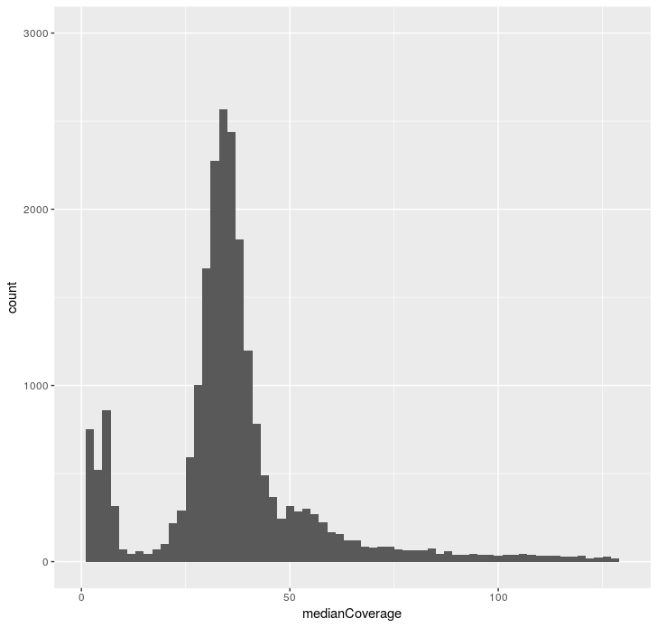
Identification of gene duplicates
A duplicated gene will map as one gene but have twice the expected coverage
There may also be differences between the two copies, appearing as heterozygous variant calls
Genes will be predicted using Augustus
Variant calling will be done with GATK
Genes with higher than expected
coverage and heterozygous calls will
make up a candidate set
Notes:
Heterozygotes are impossible in haploids so they must be duplicates or errors
I will then test for higher rate of evolution in duplicated genes, and find how this varies according to host range and gene function

Slide 18
Chapter 3: selection with bSFS
Current selection tests either do not utilise linkage information or require very well assembled genomes and large samples
The effects of demography on the genome can be very similar to those of selection
A test based on the bSFS method of demographic inference could be powerful and applicable to data from non model species
I will develop the bSFS method to apply it to the identification of selection
Notes:
I want to be able to test for selection. However, current selection tests…
However, the effects of demography…

Slide 19
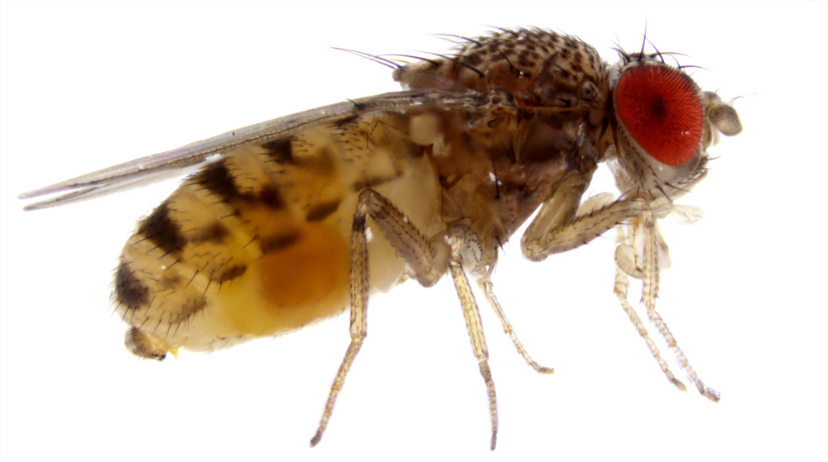
Selection in local adaptation
I will use the bSFS to identify genes involved in adaptation in the cactophilic fly Drosophila mojavensis
Separate populations adapting to different environments and host cacti in Southwestern US and Mexico
bSFS will be used to find estimates of selection with an outlier scan or in candidate gene sets
Duplicates, genes differentially expressed
between populations, sexes, and host cacti
Test for stronger selection compared to controls
Notes:
To test out the bSFS method of selection inference, and to investigate the action of selection in adaptation, I will look at Dmoj, because
Dmoj has populations that are quite highly diverged, so is good for investigating selection when there is more divergence than between populations in the parasitoid system
And I want to find out which genes are involved in this adaptation
The blockwise method could be used on data such as this as either a genome scan or on candidate gene sets to find genes under stronger selection than the rest of the genome.
As differentially expressed genes are thought to be important in adaptation

Slide 20
Chapter 4: Comparative selection
How does ecology influence the action of selection?
Do specialist species experience stronger selection in genes involved in host interactions due to closer coevolution?
Do duplicate genes experience stronger selection in generalists than in specialists due to pressure in multiple directions?
Notes:
Going back to my original question, I want to find out how ecology influences selection
Specifically, do specialist species…

Slide 21
Method
Comparative approach with oak gall wasp parasitoid system
Use demographic models as null models
bSFS method to infer selection
Candidate gene sets of controls, duplicates, and genes involved in host interactions
Test for correlation between strength of selection and host range
Test for association between timings of selective events and other historical events
Notes:
…other historical events such as population splits, glaciations and population size changes
Control for phylogeny using Felsenstein’s independent comparisons
If I can’t get the bSFS method to work for selection, I could instead use something like Sweepfinder that uses the CLR, or a haplotype based method although both of these require more individuals sequenced and haplotype methods require well assembled genomes. Maybe Sweepfinder? But I will still need to sequence a lot more individuals, won’t be able to use nearly as many species.

Slide 22
Sampling and sequencing
More species will be sampled to improve power
Species will be chosen based on abundance within Iberia and elsewhere in Europe, and host range
Eurytoma adleriae, Eupelmus annulatus and Eupelmus urozonus already have some individuals sequenced
Whole genome sequencing to get genic and intergenic data, and fit with existing data
Estimated cost of £2035 for three species
Notes:
Host ranges should be contrasting with the other species within their genera, so one has a wide and one a narrow host range. This will give the maximum power.

Slide 23
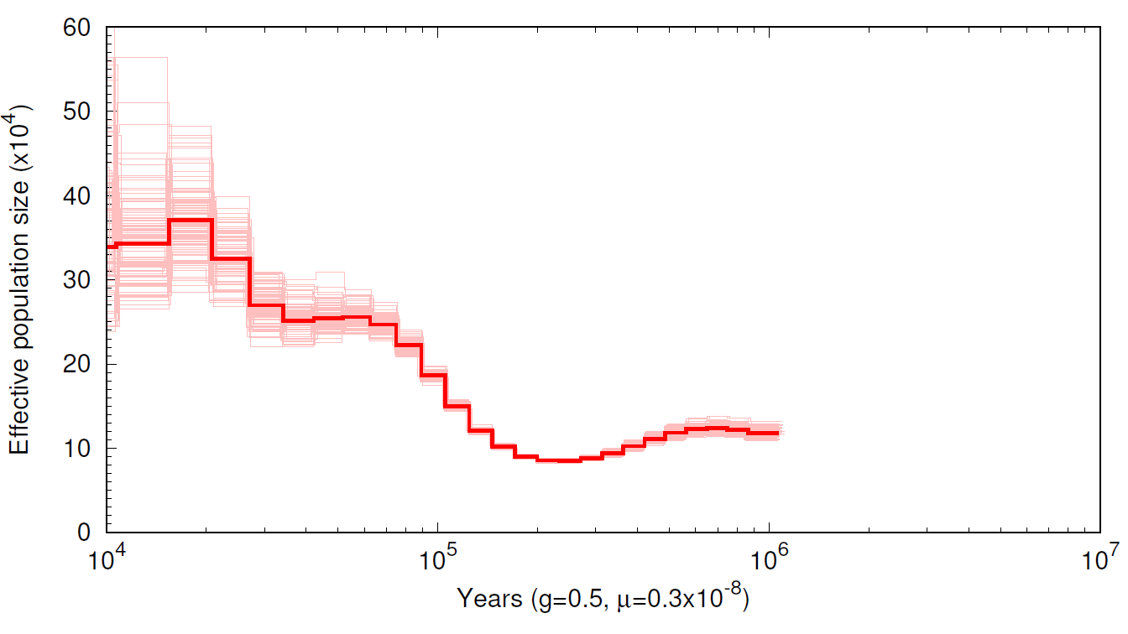
Ormyrus pomaceus

Slide 24
Functional categories of duplicates
Functional categories of duplicates will be determined by Gene Ontology or BLAST to the Nasonia vitripennis genome
Functional categories with a high proportion of duplicates are expected to include olfactory and gustatory receptor genes
Rate of loss of these is higher in specialist than generalist species, for example in Drosophila sechellia and D. simulans
Rate of evolution will be found
Notes:
Rate of evolution- haven’t decided what test yet. Dn/ds may be too long time scale, with too few differences between genes to work.
Are duplicates expected to have a higher rate of evo in specialists or generalists?
Stronger selection in generalists, but maybe higher rate in specialists if there is relaxation of functional constraint? Or if no relaxation then higher rate in generalists.

Slide 25
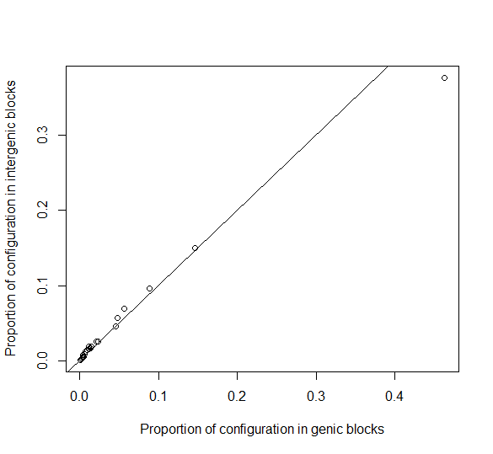
Effects of selection on the bSFS
Proportions of each possible mutational configuration in genic and intergenic blocks in O. nitidulus
Deviation from line x=y indicates selection
Positive selection is expected to reduce diversity and produce an excess of singletons
Simulations will confirm expectations
Notes:
Here I have tried to show how there is information in the bSFS to detect selection.
I have plotted proportions of each possible…
Where a mutational configuration is an arrangement of mutations on the branches of the genealogy in each block, or a SFS in a block
Lower diversity therefore more invariant blocks expected in genic regions
Positive selection in the form of selective sweeps is expected to leave an excess of singletons in genic blocks
The intergenic blocks in this graph are also affected by demography

