Slide 1
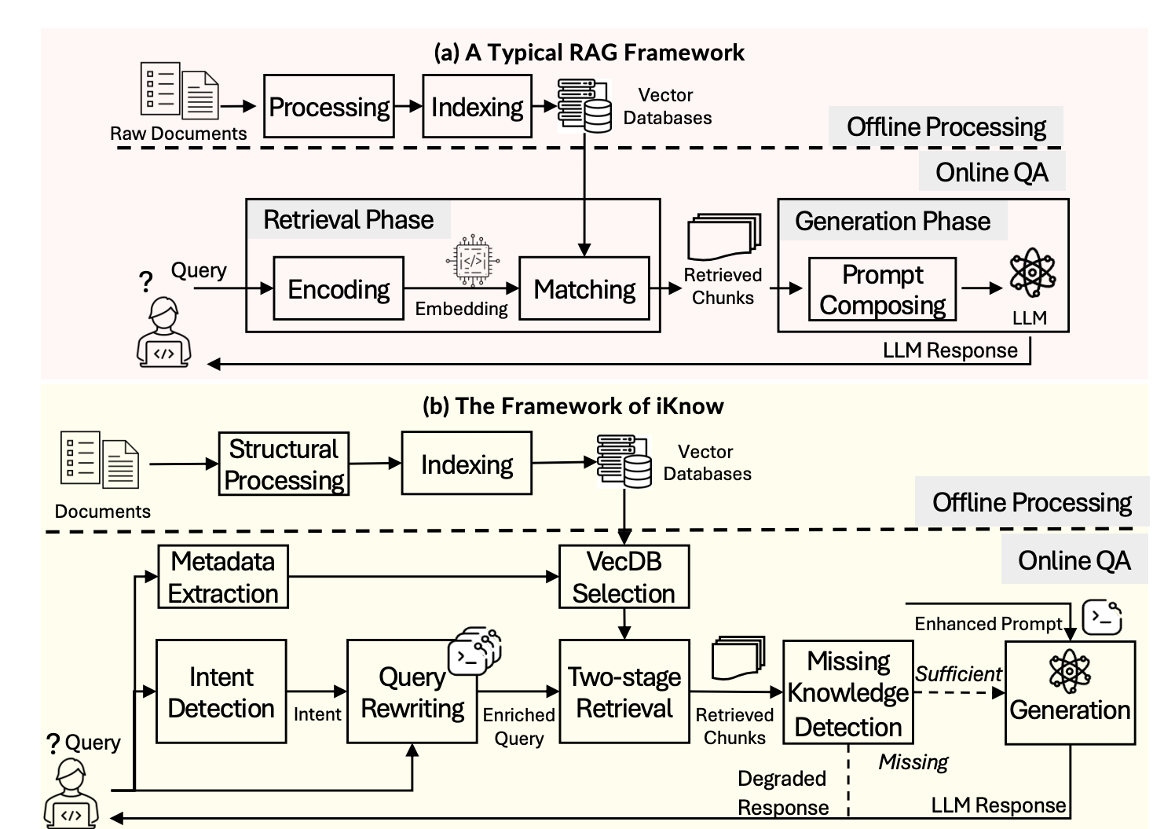
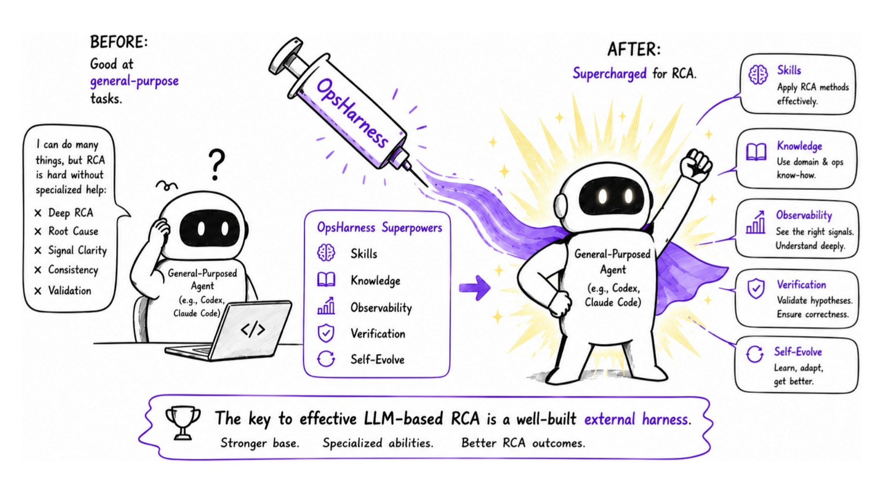
Agent Memory 引言 ｜高度垂直工作
Fig. 1. Layered Operational Knowledge K = (K0, K1, K2, K3)
Fig. 2. retrieval phase、generation phase
From General Agents to RCA Experts: A Self-Evolving Harness for Root Cause Analysis
iKnow: an Intent-Guided Chatbot for Cloud Operations with Retrieval-Augmented Generation
Haiyu Huang, Jiewei Lyu, Zhihan Jiang, Jinyang Liu, Xiao He, Tieying Zhang, Wu Xiang, Michael R. Lyu
Junjie Huang, Yuedong Zhong, Guangba Yu, Zhihan Jiang, Minzhi Yan, Wenfei Luan, Tianyu Yang, Rui Ren, Michael R. Lyu
The IEEE/ACM International Conference on Automated Software Engineering. 🏆 ACM SIGSOFT Distinguished Paper Award
arXiv:2608.25661v1
04
Notes:
左图：OpsHarness Fig. 1，图片由用户提供；论文来源：https://arxiv.org/abs/2608.25661v1 。红框强调 Knowledge。右图：iKnow Fig. 6，图片由用户提供；论文来源：https://jun-jie-huang.github.io/assets/papers/ase25_iknow.pdf ，会议信息与 Distinguished Paper Award：https://conf.researchr.org/details/ase-2025/ase-2025-papers/33/iKnow-an-Intent-Guided-Chatbot-for-Cloud-Operations-with-Retrieval-Augmented-Generat 。红框强调上方 Online QA。相似性仅指知识组织、检索/生成阶段与外部 Harness 机制，不表示任务对象或完整系统等同。

