Slide 1
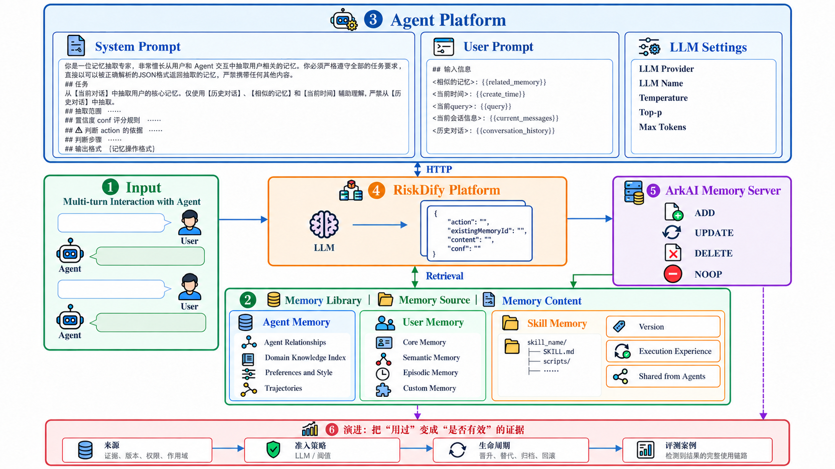
My Work 1 | Agent Memory
Fig. 1. ArkAI Memory 基础设施服务流

