Slide 1
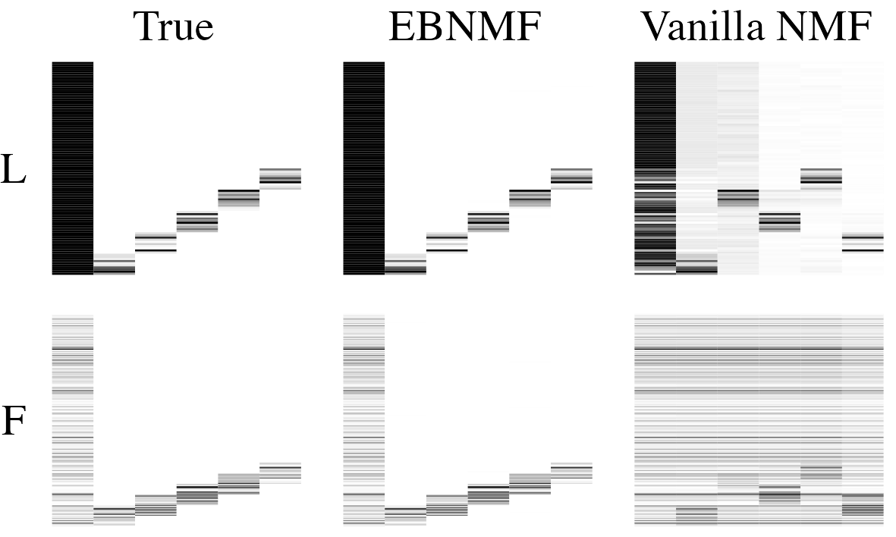
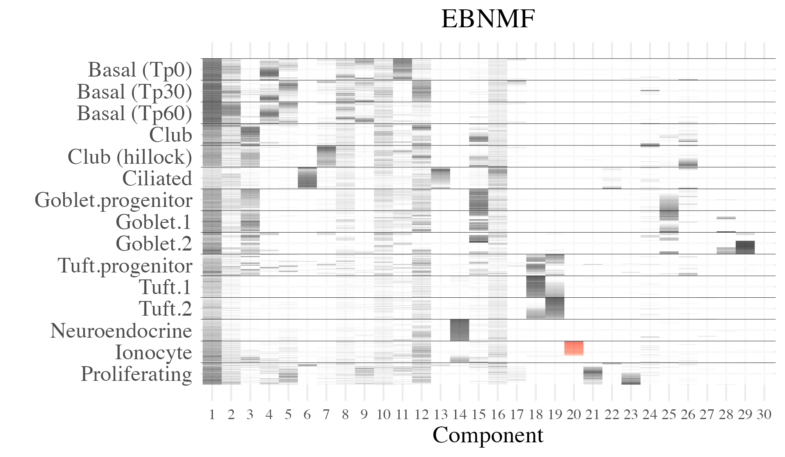
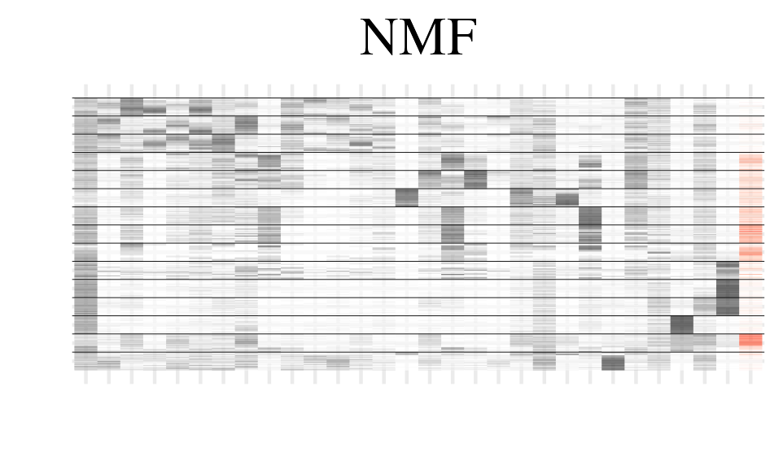
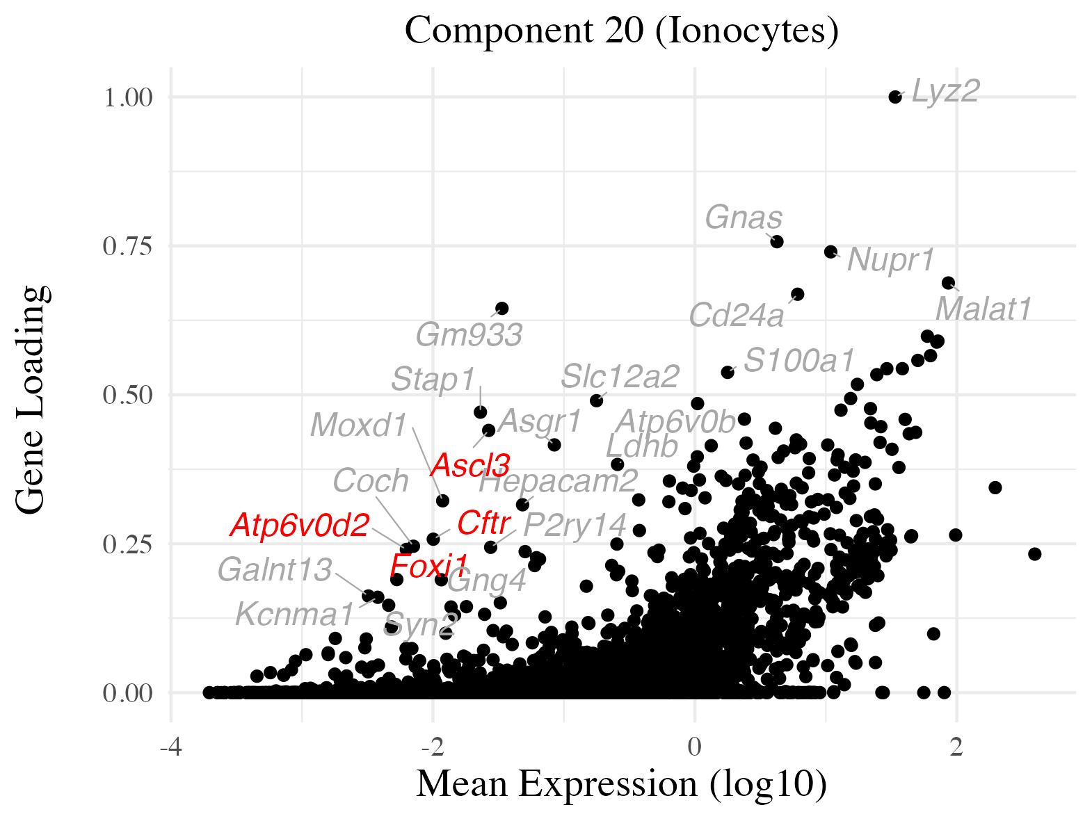


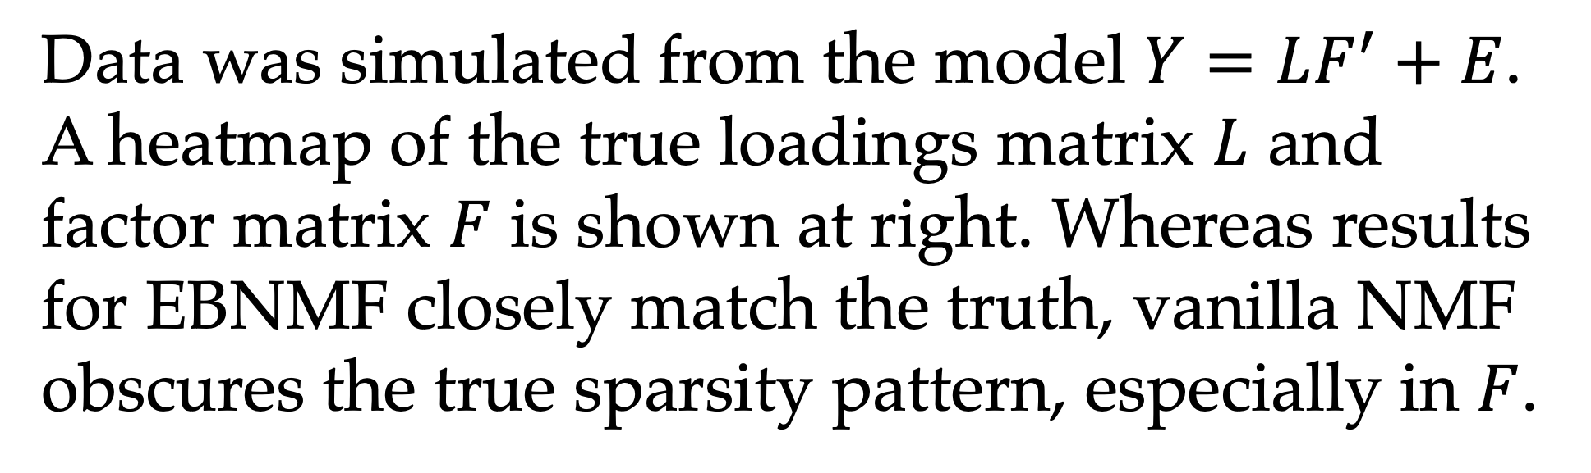

Identifying discrete and continuous structure in single-cell RNA sequencing data via empirical Bayes nonnegative matrix factorization
Jason Willwerscheid, Department of Mathematics and Computer Science, Providence College
Peter Carbonetto, Department of Human Genetics and Research Computing Center, The University of Chicago
Matthew Stephens, Departments of Human Genetics and Statistics, The University of Chicago
Introduction
Matrix factorization (MF) methods have been used in many studies to characterize structure in scRNA-seq data.
Since many interesting biological processes are active in only a small number of cell types, and are represented by only a subset of genes, it is useful to model sparsity.
Sparsity levels should be expected to vary across effects: at one extreme are effects that are unique to rare cell types; at the other are technical effects and ubiquitous biological processes.
Simulations
Model
The empirical Bayes matrix factorization (EBMF) model (cf. Wang and Stephens):
$Y=LF′+E$
$$ℓ_{ik}∼g_{k}^{\left(ℓ\right)}∈𝒢$$
$$f_{jk}∼g_{k}^{\left(f\right)}∈𝒢$$
$$e_{ij}∼𝒩(0, σ_{ij}^{2})$$
$Y$is a matrix of log-transformed counts.
$𝒢$is a family of distributions that is chosen in advance. A prior family $𝒢$with nonnegative support gives a nonnegative factorization.
We prefer to use the family of point-exponential distributions (mixtures of a point mass at zero and some exponential distribution).
The priors $g$ are estimated from the data, one for each factor $f_{⋅k}$and each set of loadings $ℓ_{⋅k}$.
The sparsity level of the priors $g$ can be adapted to the estimated sparsity of the respective factors.
Data was simulated from the model $Y=LF^{′}+E$. A heatmap of the true loadings matrix $L$ and factor matrix $F$ is shown at right. Whereas results for EBNMF closely match the truth, vanilla NMF obscures the true sparsity pattern, especially in $F$.
Real Data Example
At left is a heatmap of cell loadings $L$ for an EBNMF fit to 66,265 mouse epithelial cells from Montoro et al. Cell types are inferred by the authors. All cells are associated with a time point (Tp0, Tp30, or Tp60), but to avoid clutter only basal cells are split up. Common cell types are down-sampled to give equal space to each type.
EBNMF components clearly capture individual cell types and distinct time points. NMF (inset) and topic modeling (not shown) can identify similar structure, but both are much less sparse and less cleanly separate out cell types and time points.
EBNMF identifies continuous structure as well. For example, components 18 and 19 index continuous variation among tuft cells rather than fully discrete subtypes.
Background
Nonnegative matrix factorization (NMF) is the most commonly used MF method for scRNA-seq data.
Other methods that better model sparsity have been proposed, but they typically scale poorly or only include a single sparsity parameter.
Empirical Bayes nonnegative matrix factorization (EBNMF) can adaptively select a sparsity level for each factor.
Since the identification of pulmonary ionocytes is a primary contribution of Montoro et al., EBNMF component 20 (in red above) is of particular interest.
No such ionocyte-specific component exists in NMF or topic model fits (NMF component 30, in red, is the closest match).
Factor loadings for EBNMF component 20 are plotted at right. The availability of information about which genes determine cell structure (via$F)$is an important advantage of matrix factorization methods over, say, clustering methods.
Note the prominent position of Cftr, which the authors single out due to its role in cystic fibrosis. Other genes known to play a key role in ionocyte function include Foxi1, Ascl3, and Atp6v0d2.
Literature cited
Montoro et al. “A revised airway epithelial hierarchy includes CFTR-expressing ionocytes.” Nature 560: 319-324, 2018.
Wang and Stephens. “Empirical Bayes matrix factorization.” JMLR 22(120):1-40, 2021.
Software
We re-implemented EBMF from scratch to better handle very large datasets. Our R implementation is available at github.com/willwerscheid/flashier.

