Slide 1
Winter 2023 Egg Timer Presentations
07 December 2023
NCEE Brownbag Seminar

Slide 2
Using Enforcement Targeting Tool Scores to Evaluate Inspections and Enforcement
Will Wheeler

Slide 3
Introduction
Drinking Water Learning Agenda: Need for better understanding of inspections and enforcement and how they effect future violations
National Initiative: goal to reduce number of systems with health-based violations by a third
Enforcement Targeting Tool (ETT) scores are the primary tool states and regions use for SDWA targeting
Idea: Use these scores for causal inference

Slide 4
ETT Scores
Created by December 2009 Enforcement Response Policy
Points (10, 5, 1) per unresolved violations plus number of years left not addressed (max 5)
“Resolved” by return to compliance, formal enforcement, or time = reverts to zero points
Score >= 11 means a system is a priority for an enforcement response
Ideally, this would lead to an RD design

Slide 5
ETT Scores
Created by December 2009 Enforcement Response Policy
Points (10, 5, 1) per unresolved violation plus number of years left not addressed (max 5)
“Resolved” by return to compliance, formal enforcement, or time = reverts to zero points
Score >= 11 means a system is a priority for an enforcement response
Ideally, this would lead to an RD design
We don’t live in an ideal world, so I’m looking for advice

Slide 6
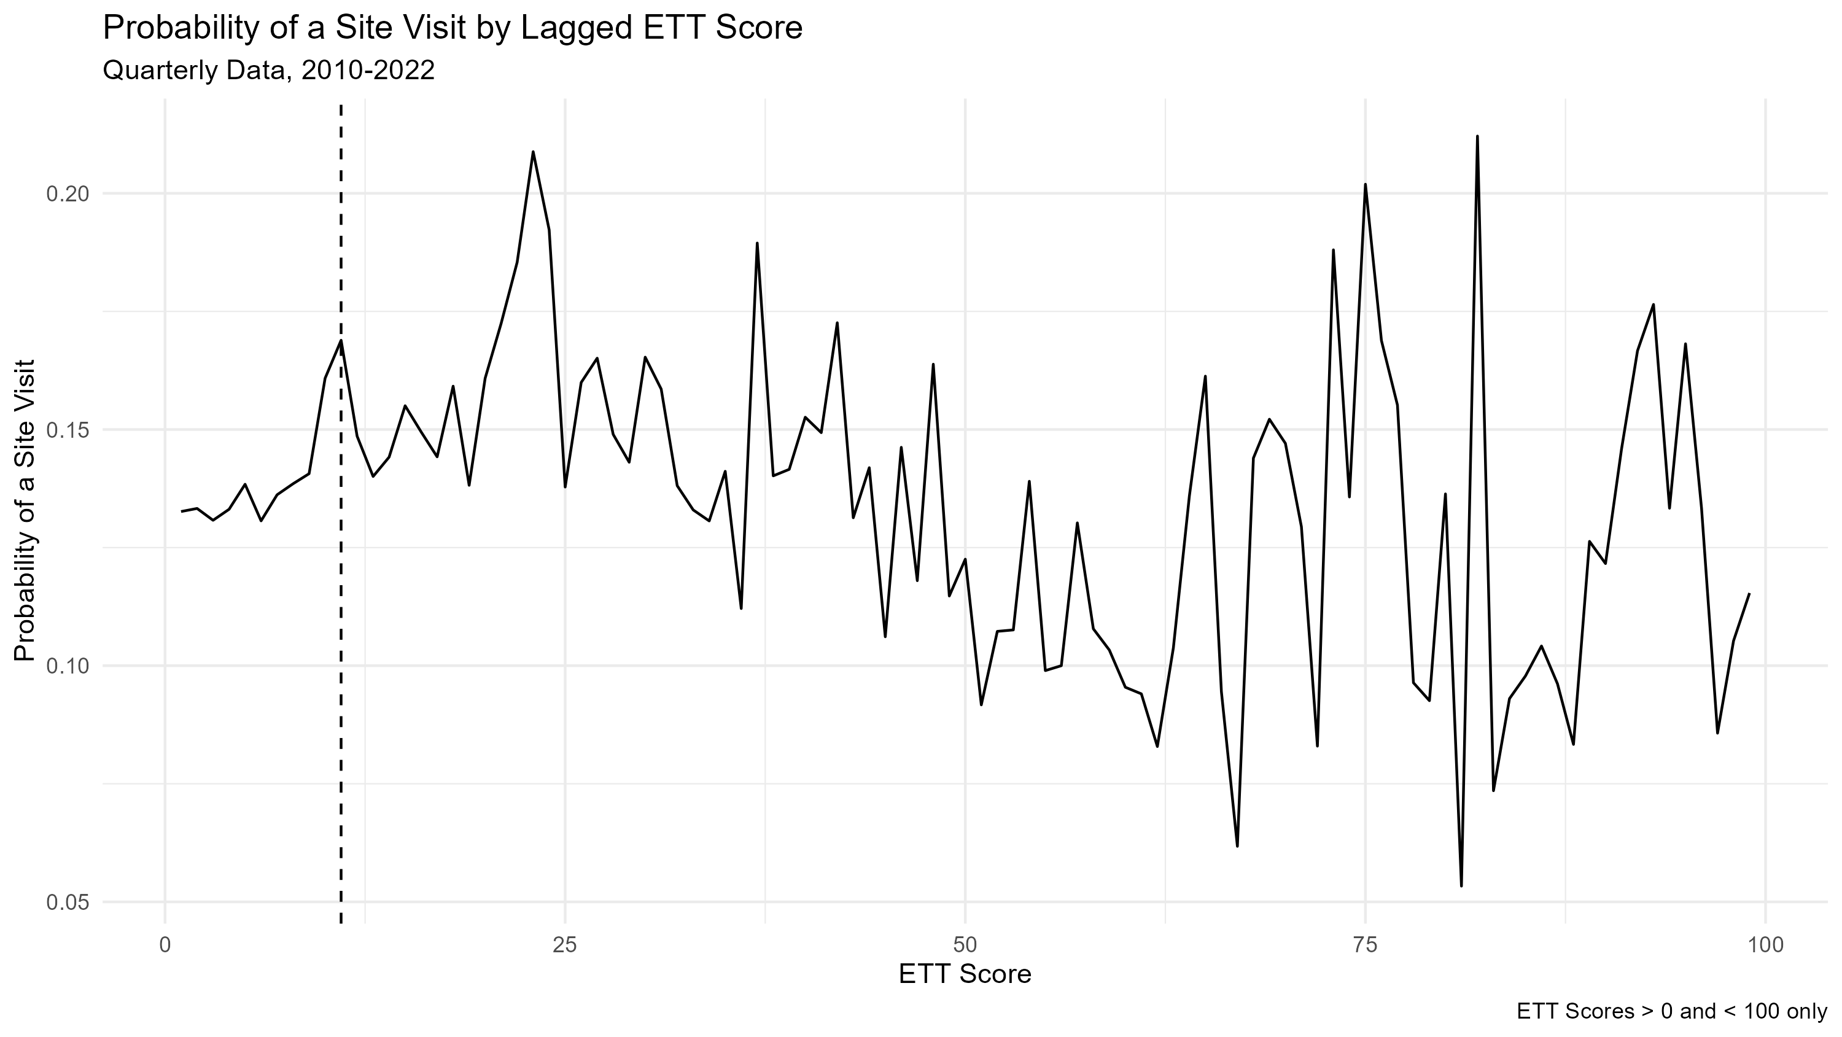

Slide 7
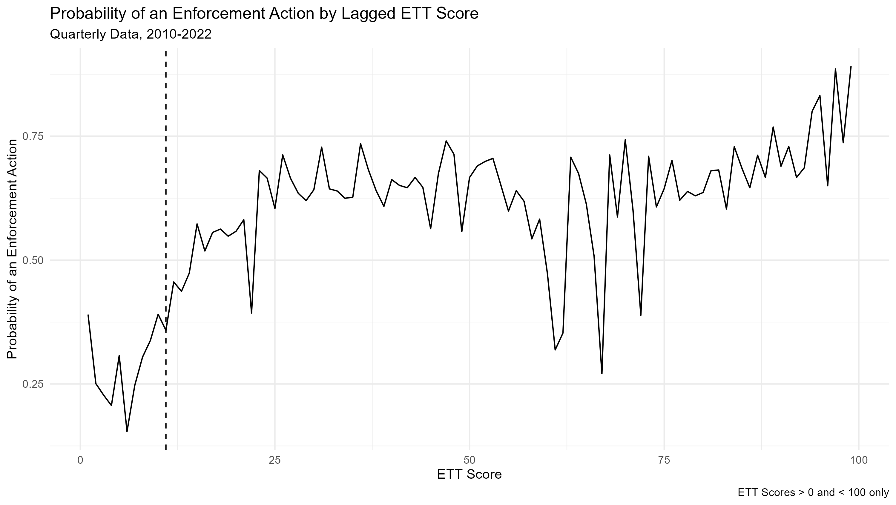

Slide 8
What to Do?
Probability of enforcement is increasing with score, system size category, differs for non-community systems (not all shown)
Not amenable to a simple RDD
Question about causal identification: State-specific RDD? Propensity score or other matching? Causal Forests?

Slide 9
Heat Waves and Inmate Mortality
Tina Bardot

Slide 10
Research Question
How do heat waves impact the excess mortality of individuals housed in the criminal justice system (i.e., inmates)?

Slide 11
Data
Restricted inmate mortality data from the Bureau of Justice Statistics (BJS) : Daily deaths, by facility (jails and state prisons), aggregated to city-level
Climate data from Oregon State: Parameter-elevation Regressions on Independent Slopes Model (PRISM) measuring daily max, min, and average temperatures
  Maybe precipitation or vapor pressure deficit (for a more nuanced climatic picture)
BJS Census of Jails (COJ) and Census of State and Federal Correctional Facilities (COCF) for prison populations across time, aggregated to city-level
National Center for Health Statistics data for general population mortality, county-level

Slide 12
Methods
Use daily-level Death in Custody (DIC) and temperature data to measure the relationship between extreme heat days (daily high > 80th percentile) and increased deaths
Determine mortality rates using city-level prisons and jails population census data
Use difference-in-differences approach to compare mortality rate with general population at the county level (aggregated)

Slide 13
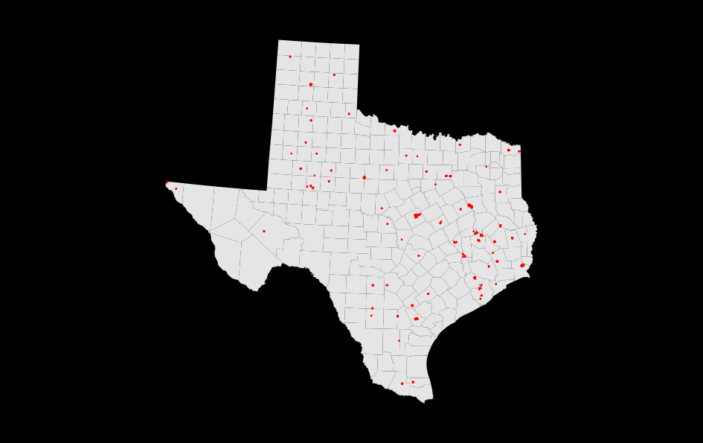
Facility polygons: Spatial dispersion
Spatial heterogeneity of facility locations, spread across rural and urban areas
(Data from Homeland Infrastructure Foundation-Level data)

Slide 14
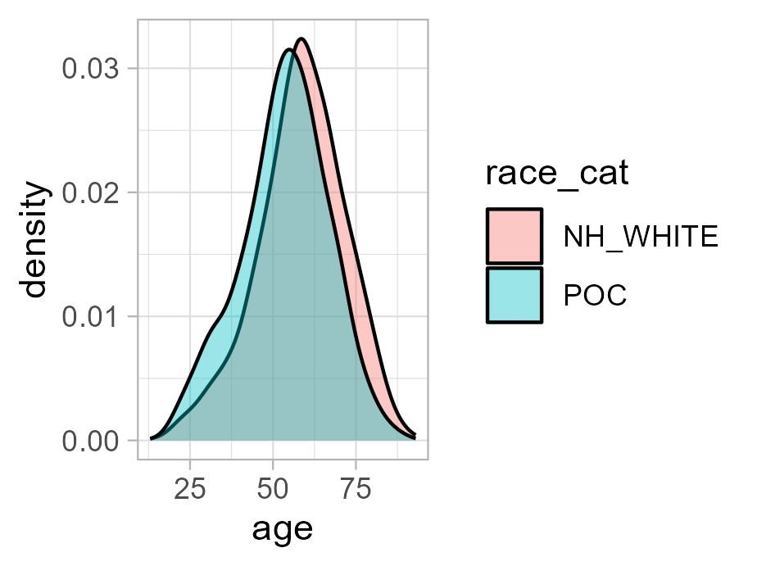
So far
Subset of Texas mortality (unrestricted dataset) shows disparities between Black, Hispanic, and non-Hispanic white individuals. Black individuals die 5 years younger than whites in Texas prisons

Slide 15
Next steps
Mortality modeling (“temperature extremes” and mortality)
Climatic modeling
Expand to entire US

Slide 16
Estimating a Coral Reef Damage Function for the Social Cost of Greenhouse Gases
Victoria Liu

Slide 17
Motivation
Various damage functions monetize climate damages using a combination of these impact categories:
Health
Energy
Labor productivity
Agriculture
Coastal regions
Omitted marine impacts to consider:
Fisheries – commercial, recreational, subsistence
Coral reefs – recreation and tourism, fishery habitat, shoreline protection
Research the monetized impacts on marine resources from climate change →
Estimation of a reduced form damage function for impacts to coral reefs

Slide 18
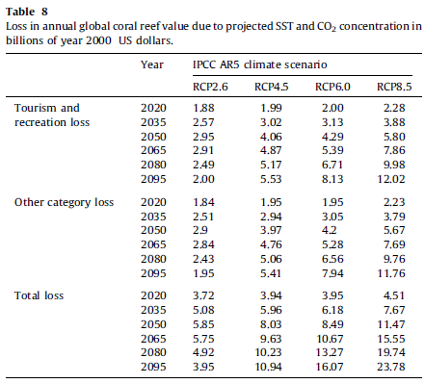
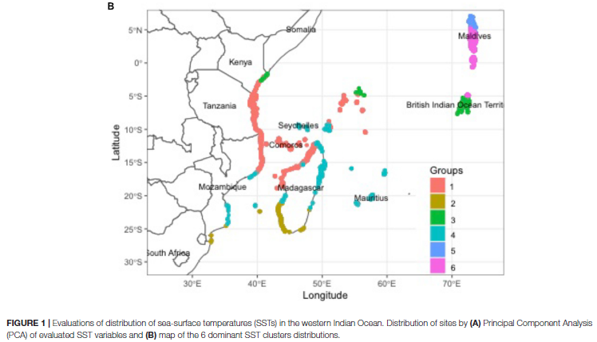
Literature Review
Physical Studies | Economic Studies
(McClanahan and Azali 2021) | (Chen et al. 2014)

Slide 19
Physical Model
Meta-analysis or existing model that estimates losses of coral reef area and services as a function of climate variables and other factors Output: change in % by region
Reduced Form Model
Coefficients from physical and economic model meta-analyses and coral reef area Output: reduced form damage function that expresses annual value of lost coral reef services in each region as a function of change in temperature from pre-industrial baseline
Coral Reef Area Data
GIS coral reef footprint dataset Output: total hectares by region
Economic Model
Meta-analysis of coral reef valuation papers that estimate a unit value for coral reef services Output: USD / hectare / year

Slide 20
References
Chen, Ping-Yu, Chi-Chung Chen, LanFen Chu, and Bruce McCarl. 2015. “Evaluating the economic damage of climate change on global coral reefs.” Global Environmental Change Volume 30 (January): 12-20. https://doi.org/10.1016/j.gloenvcha.2014.10.011
McClanahan, Tim Rice, and Maxwell Kodia Azali. 2021. “Environmental Variability and Threshold Model’s Predictions for Coral Reefs.” Frontiers in Marine Science Volume 8, Article 778121 (December). https://doi.org/10.3389/fmars.2021.778121

Slide 21
Coal Mining and Drinking Water Quality
Wes Austin and Daniel Kraynak

Slide 22
Research Question
What is the impact of coal mining on drinking water quality?
Literature: Systematic review (Boyles et al. 2017, Environment International ) “... could not reach conclusions on community health effects of MTR mining because of the strong potential for bias in the current body of human literature.”
Why now?
1
A new era of water quality research (thanks largely to Keiser, Shapiro, their coauthors and RAs, and Wes!)
Market-driven variation in mine closures over the past 10 years
2
What we have: Relatively fine spatial detail. Samples of many known contaminants. Information on mining technologies and changing production levels (mines opened/abandoned/sealed)
NCEE EggTimer

Slide 23
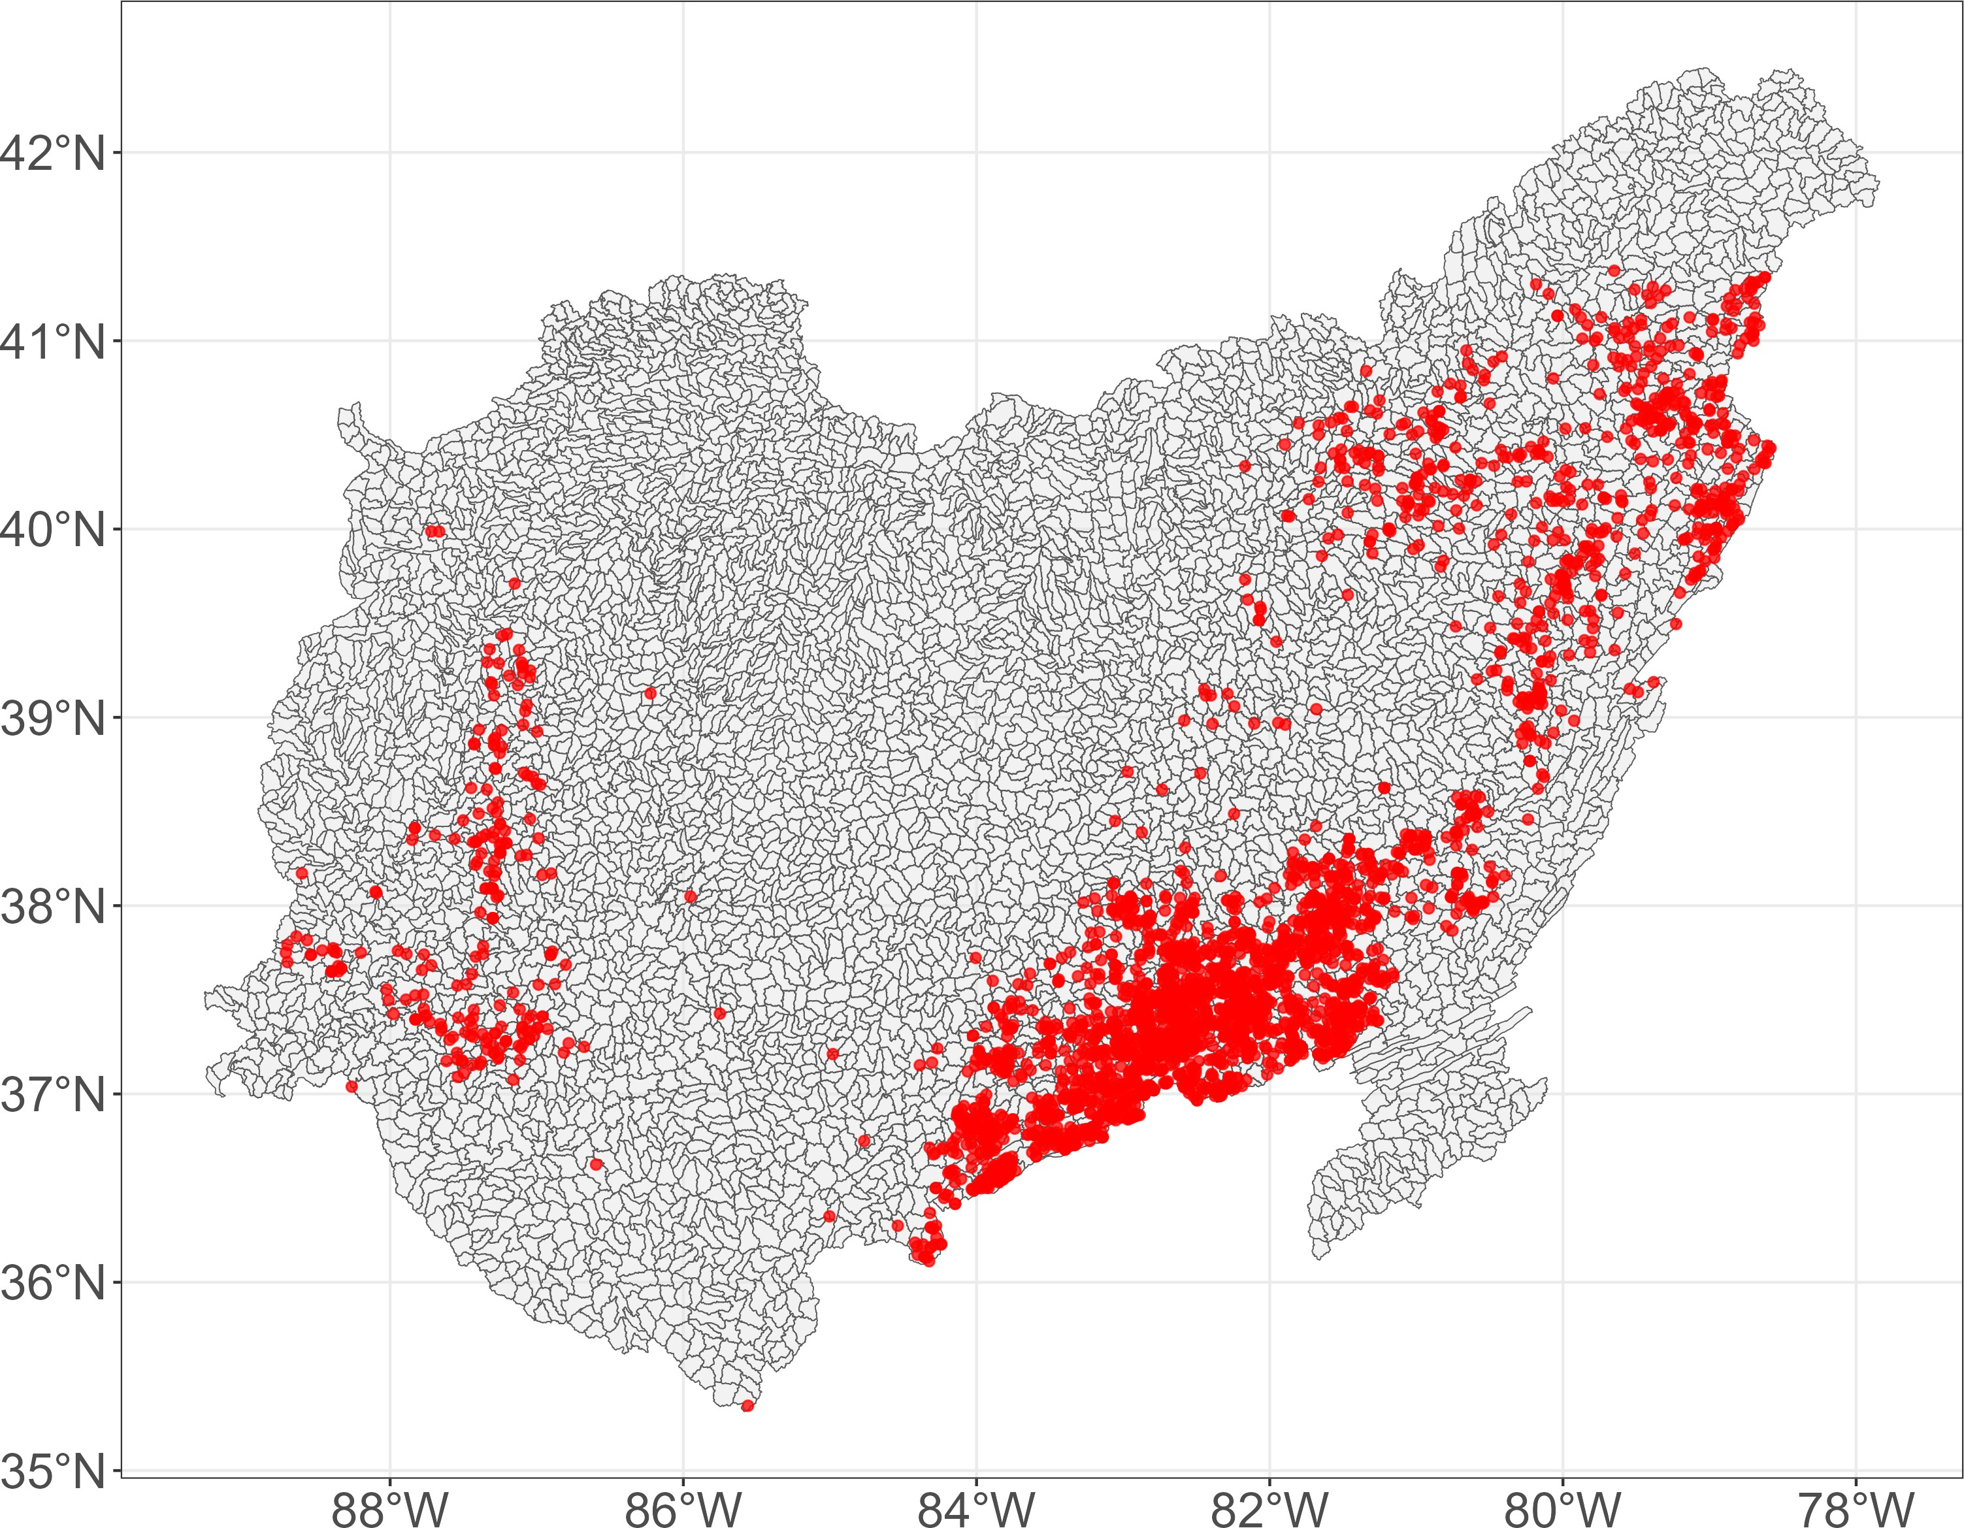
Data and Approach
Link Water Quality Database to “exposure” via coal mine location and production
Drinking Water Quality Database (Wes)
Millions of samples for a wide variety of analytes (2000-2019)
Samples tied to Public Water Systems (PWS)
PWS intakes link to HUC12s
Coal Mine Data (MSHA)
Annual production since (2000-2019), mine closure, technology
Broad trends: increasing production through 2010, decline and closures through 2020
Mine location (red) and HUC12s in Appalachia
NCEE EggTimer

Slide 24
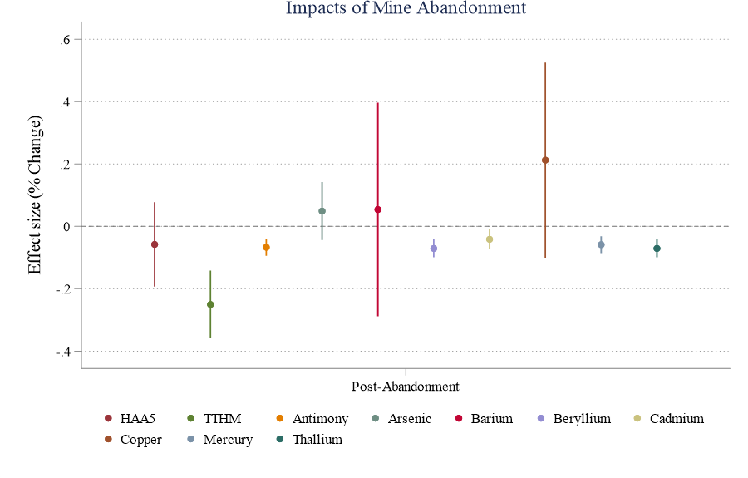
Exploratory results
asinh(P_{isy}) = β₁Post_{y} ∗ D_{sy} + β₂D_{sy} + πX_{sy} + γ_{s} + γ_{y} + ϵ_{isy}
NCEE EggTimer

Slide 25
To get in touch:
Austin.Wes@epa.gov,
Kraynak.Daniel@epa.gov
Thank you
NCEE EggTimer

Slide 26
References
Boyles, Blain, Rochester, etc. (2017). Systematic review of community health impacts of mountaintop removal mining. In Environment International (Vol. 107). Elsevier BV.
Keiser, D. A., & Shapiro, J. S. (2019). Consequences of the Clean Water Act and the demand for water quality. The Quarterly Journal of Economics, 134(1), 349-396.
Keiser, D. A., Mazumder, B., Molitor, D., & Shapiro, J. S. (2023). Water Works: Causes and Consequences of Safe Drinking Water in America.
NCEE EggTimer

Slide 27
TSCA prioritization and environmental justice
Adam Theising

Slide 28
Context: existing chemical prioritization under TSCA
There are 42,242 chemicals actively used in US at present; most(?) have faced limited formal assessment of risk to human health and the environment.
Prioritization is the process by which OPPT designates existing chemicals for risk assessment (and risk management, as needed).
  EPA has broad discretion in selecting candidates. Two statutory requirements:
    In general: work through the ~90 chemicals on the 2014 TSCA Work Plan
    Preference for Work Plan chemicals that are persistent, bioaccumulative, carcinogenic, or toxic.
Candidate selection factors used since 2016: cross-agency priorities, availability and quality of scientific information, workload management via simultaneous prioritization of a category of chemicals (solvents, flame retardants, etc.)
  Factor not considered thus far: extent of exposure, especially in PESS or EJ subpopulations

Slide 29
Research question and design
Question: Are the chemicals prioritized by EPA under TSCA Sec. 6 those that are most likely to impact EJ communities, even though EJ is not an explicit prioritization consideration?
Design: This first-pass analysis picks the low hanging fruit. I run a proximity/demographic analysis for communities within a 1km buffer of all TRI/NEI facilities with >100 lbs of air emissions of chemicals on the 2014 TSCA Work Plan in 2017.
  I observe emissions for 60% of the Work Plan chemicals (9 of the “first 10”, 13 of the “next 20”)
  Work Plan chems not prioritized thus far are intuitive comparison group given statutory requirements.
This current analysis is limited:
  Parallel water-release analysis using TRI/DMR in progress.
  What can be done on a national scale for worker/consumer good exposures?
Figures on following slides:
  Chemical-level demographic summary stats (population count w/in 1km across all facilities, % POC, % low income)

Slide 30
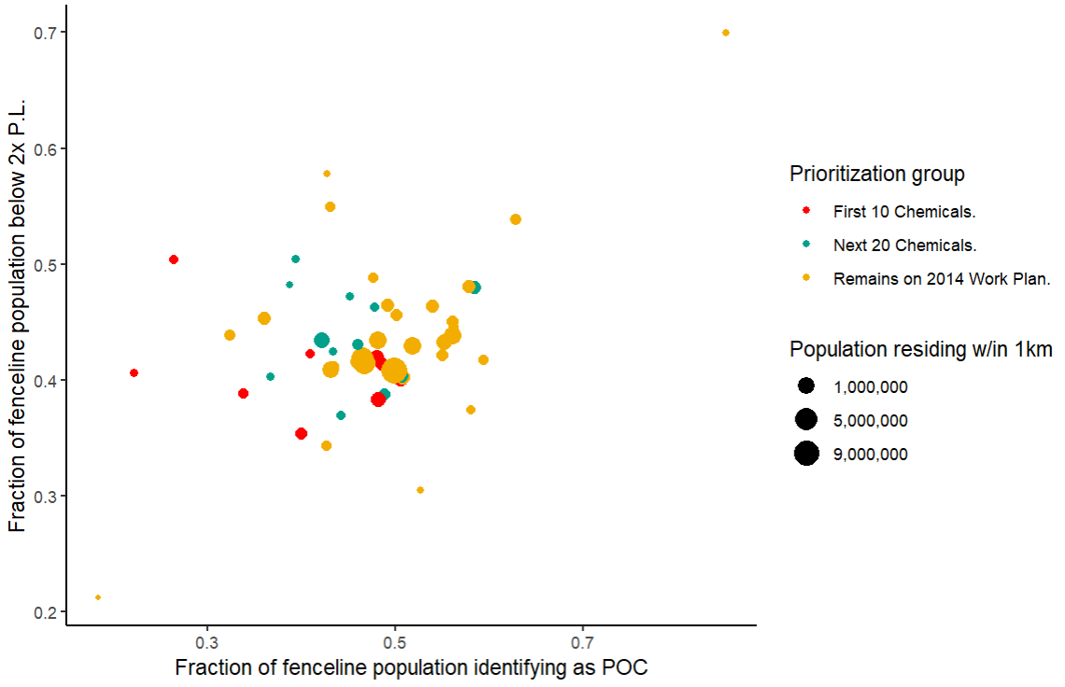
Retrospective analysis
Based on 2017 data from TRI, NEI, ACS. Each scatter point represents weighted demographic averages from facilities emitting a given chemical (coverage: 52/91 chems on the 2014 TSCA work plan.)

Slide 31
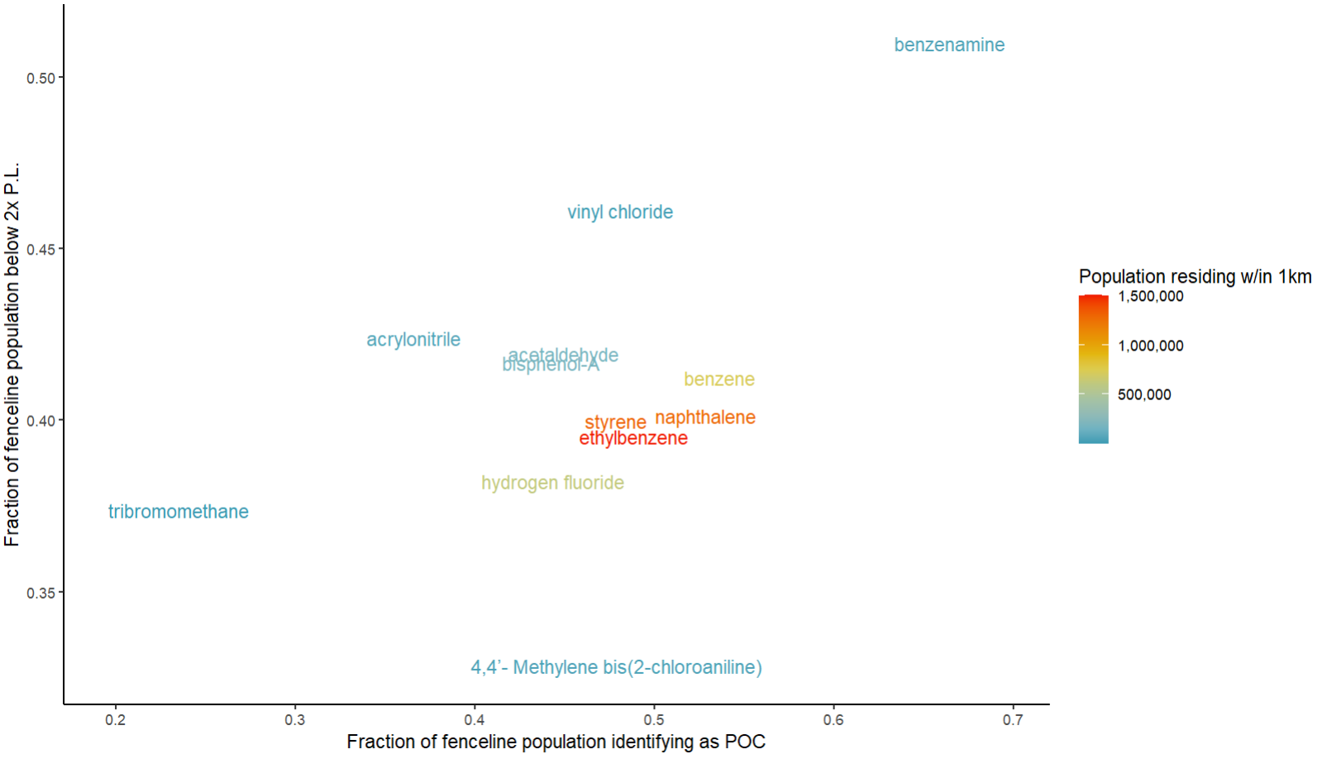
Looking ahead…
Additional chems under prioritization consideration: 4-tert-octylphenol, triglycidyl isocyanurate, 6PPD.

Slide 32
Questions for presenters?

