Slide 1
PM 2.5 Recalculation at Stationary Monitors
Drew Schreiber Will Wheeler

Slide 2
EPA PM 2.5 Monitoring Data
EPA’s PM 2.5 monitoring data housed in the Air Quality System (AQS) is one of our most important data sets
used to determine compliance with the NAAQS, in health effects research, to downscale satellite PM data
in 2024, EPA retroactively changed data for a specific monitor type in the AQS from 2017-2023
in 2023, about 400 monitors—nearly half of all PM2.5 monitors—with over 2 million hourly observations were affected by this change
original data is still in AQS

Slide 3
Timeline
July, 2016: EPA approved Teledyne 640/640X as Federal Equivalent Monitors for PM 2.5
two of a class of monitors that use optical sensors instead of the filters used in Federal Reference Monitors (cheaper and easier to maintain)
early 2017: states begain using these monitors in their monitoring systems
these monitors soon showed higher readings compared to collocated Reference Monitors
March, 2022: CASAC said , “The FEM bias needs to be addressed to make the FRMs and FEMs more comparable.”
May, 2024: final FRN “Update of PM2.5 Data From T640/T640X PM Mass Monitors”

Slide 4
Motivation
“The EPA believes it is important to update the historical data in AQS to ensure that the most scientifically accurate data are utilized in peer-reviewed research that support the NAAQS, in particularly when evaluating human health and ecosystem activities.”

Slide 5
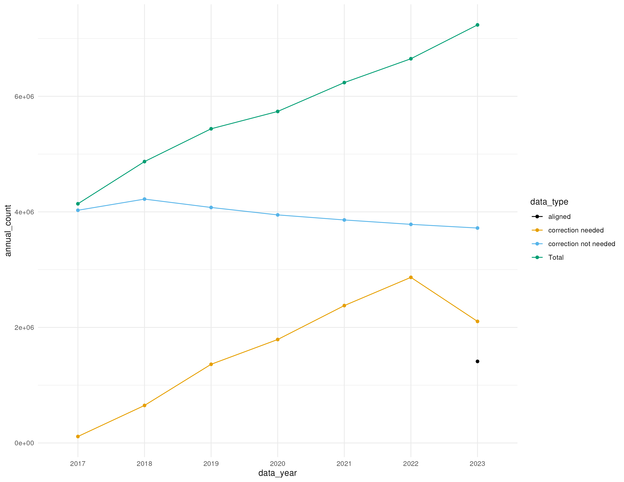
Increase in Use of FEMs
count_graph

Slide 6
{width = “100%”}

Slide 7
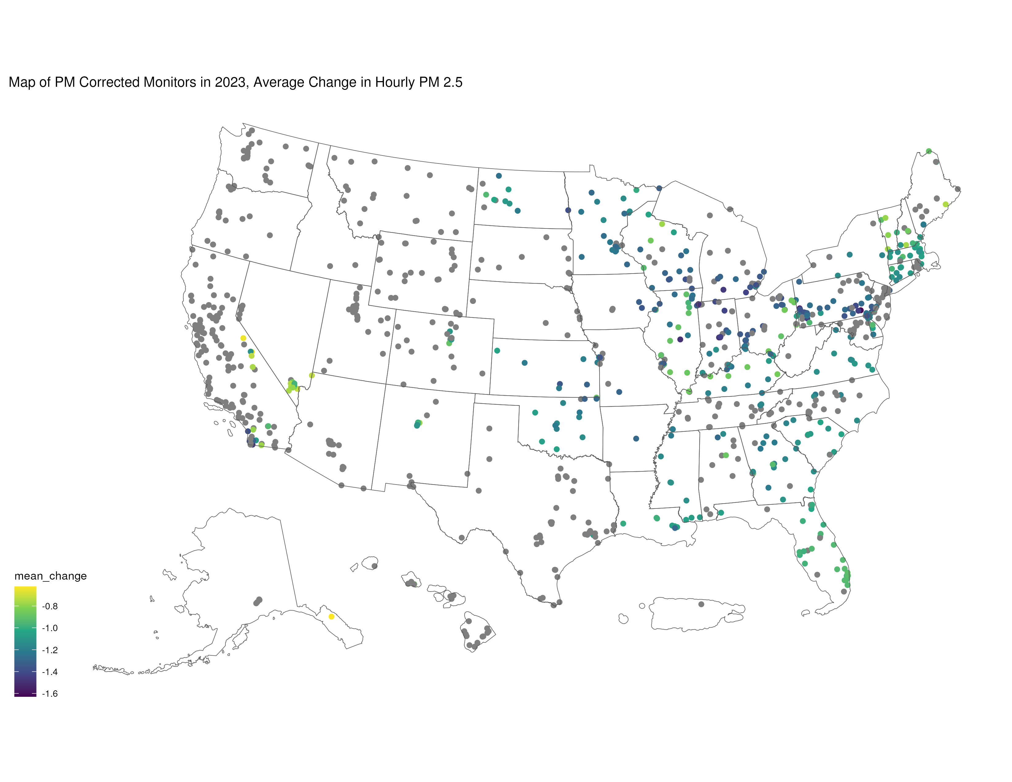
Map of Changes in Affected Monitors
monitor_map_changes

Slide 8
){width = 11in}

Slide 9
Next steps
Fully quantify extent of changes
Write “user’s guide” so researchers can correctly identify data

