Slide 1

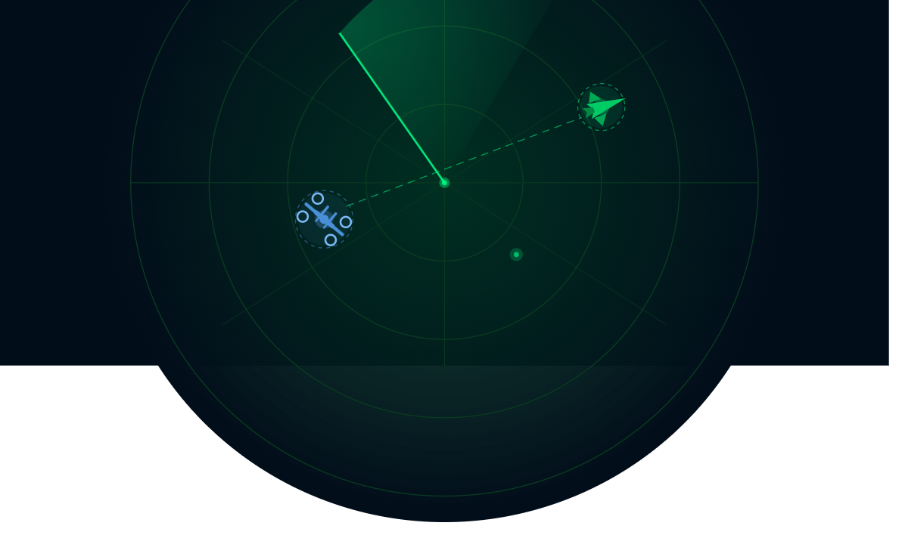
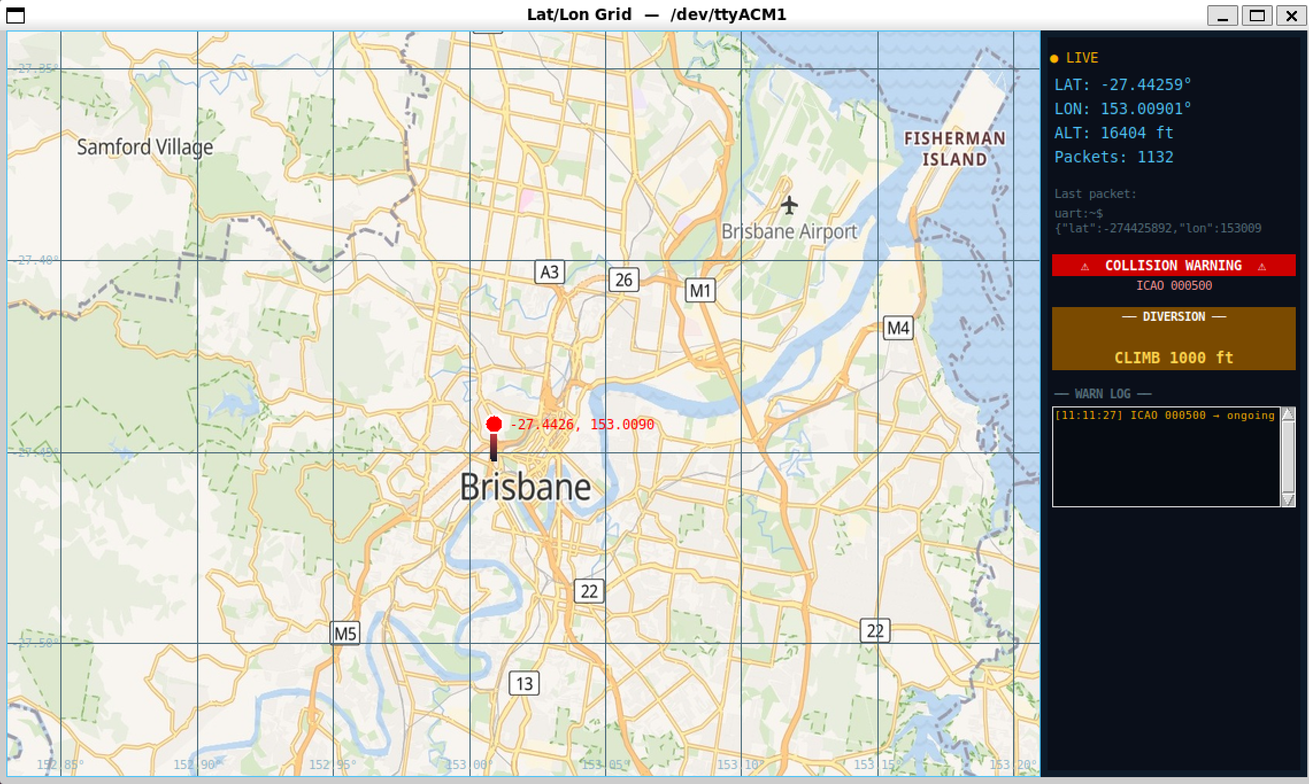
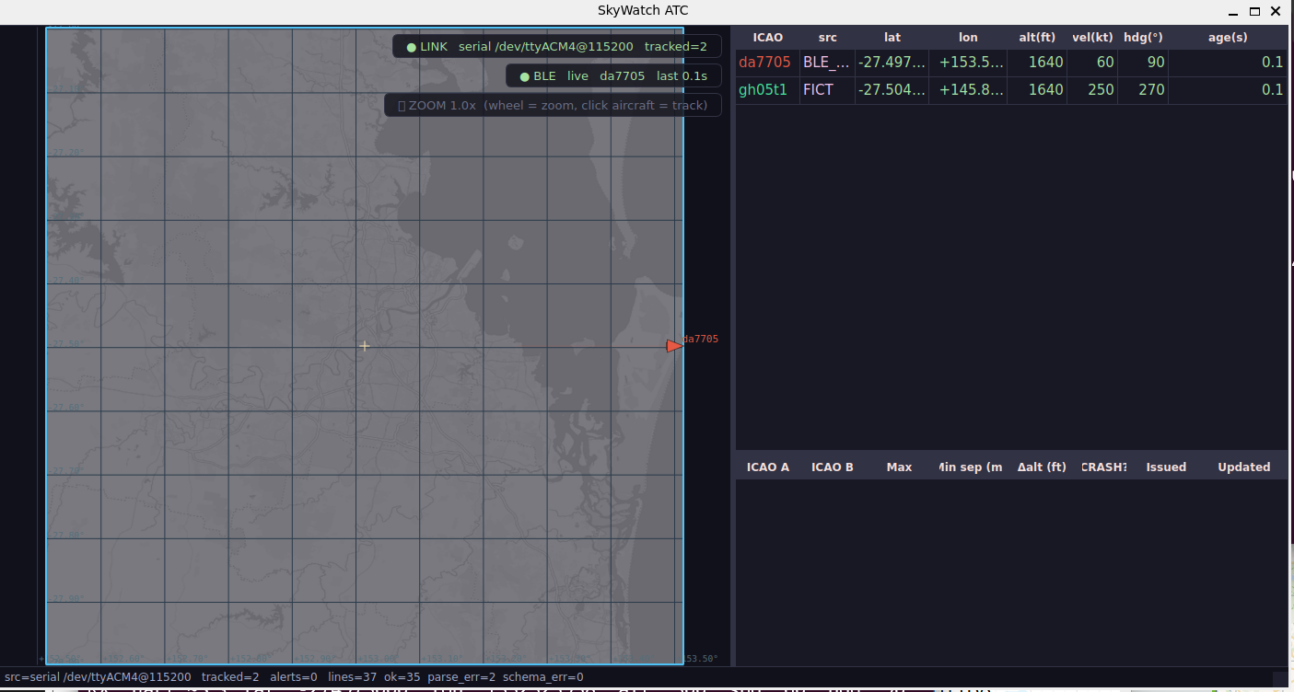
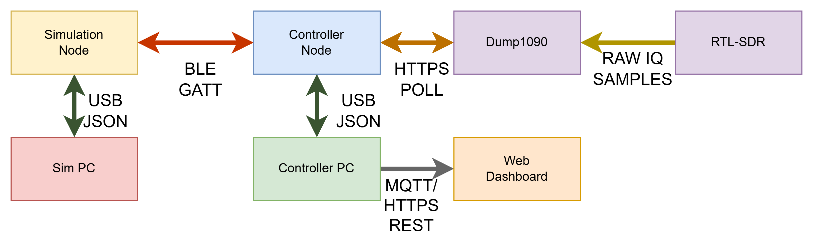
SKYWATCH
William Wrenn and Blaise Delforce – Vermillion-Puck
INTRODUCTION
Real-Time ADS-B Aircraft Surveillance and Collision Detection System
Small UAV operators flying in uncontrolled airspace have no cheap way to know if a manned aircraft is on a collision course with them. Standard ADS-B receivers show surrounding traffic but have no way to factor in the drone's own position, so conflict detection isn't possible.
Our system solves this by combining live ADS-B traffic with a BLE-transmitting simulated drone on a single conflict predictor. Built from an SDR, two nRF52840 boards and a piezo buzzer, it gives a solo operator real-time collision awareness at a fraction of the cost of existing solutions.
SYSTEM OVERVIEW
Input
SDR on Host PC receives 1090MHz ADS-B broadcasts from real aircraft, decoded by Dump1090 and forwarded as JSON to the Traffic Controller Board via USB Aircraft Node transmits simulated UAV telemetry over BLE GATT at 5Hz to the Traffic Controller Board
Process
Traffic Controller Board fuses both ADS-B and BLE feeds into a unified Aircraft Database Kalman filter smooths noisy position data and estimates future positions of the aircraft. Collision predictor evaluates all pairwise aircraft conflicts and calculates time-to-closest-approach
Output
Piezo buzzer triggers audible alert on collision detection BLE collision packet sent back to aircraft node Flight Controller GUI displays live position, collision warnings and timestamped event log Operational history published via MQTT to web dashboard
FINDINGS
BLE Communication
Stable 5Hz GATT connection, MTU 257 bytes, 38 byte drame, and remained connected for over 20 mins
Auto reconnect by a 2 second watchdog, with a connection LED.
Collision Detection
Kalman filter accuracy on smoothing noisy position data per aircraft
TCA computed pairwise at 5Hz, flags WARNING <500m / <30s, ADVISORY <1000m / <60s
Warning System
BLE collision packet delivered in ~1-5ms (<200ms spec), re-fired every 3s
100% collision history logged via MQTT + InfluxDB, timestamps
Flight Controller GUI
Live GPS tracking on Brisbane map, 32 aircraft capacity, 2Hz (500ms) refresh
Collision warning log displays ADVISORY / WARNING / CRASH events with timestamps
System Integration
ADS-B (115200 baud UART) and BLE feeds fused into single 32-entry aircraft DB Cooperative (ADS-B) and non-cooperative (BLE-sim) aircraft evaluated in same 5Hz conflict predictor
SDR Input
Dump1090 JSON parsed at 115200 baud
32 aircraft max capacity with aircraft removed after 10 seconds of no contact.
REFERENCES
FlightAware Dump1090 - github.com/flightaware/dump1090
Zephyr RTOS Documentation specs
Nordic Semiconductor nRF52840 specs
Generative AI (Claude, Anthropic) was used to assist with code development and project documentation
BLOCK DIAGRAM
System Hardware
Host PCs (
ADS-B Filter and RTLSDR/Stub Antennae
nRF52840 boards (2) (Controller & Sim)
Piezo buzzer
System Visualisation Software
Python Flight Sim GUI
Python ATC GUI view
MQTT Web dashboard
Dump1090 Software
System Networking
USB-CDC ACM Serial (Node-PC)
BLE GATT (Node-Node)
MQTT + HTTPS REST (Dashboard)
Dump1090 HTTPS Polling
System Algorithms
Kalman Localisation/Tracking
Sensor Data Fusion (BLE/SDR)
IoT (MQTT/HTTPS REST)
Geometric Collision Detection
System Firmware:
Kernel Mutex/Spinlock/threads for sharing and parallel computing
BLE Host Stack
Stack Overflow protection
USB CDC ACM Dual Interface
JSON Parsing
Reliable Operation:
Stale Entry Reaper
Inbuilt data Source tracking
BLE Auto-Reconnect
Sensing and Actuation
PC GUIs
RGB LEDs
SDR ADS-B RX
BLE Radio TX/RX

