Slide 1
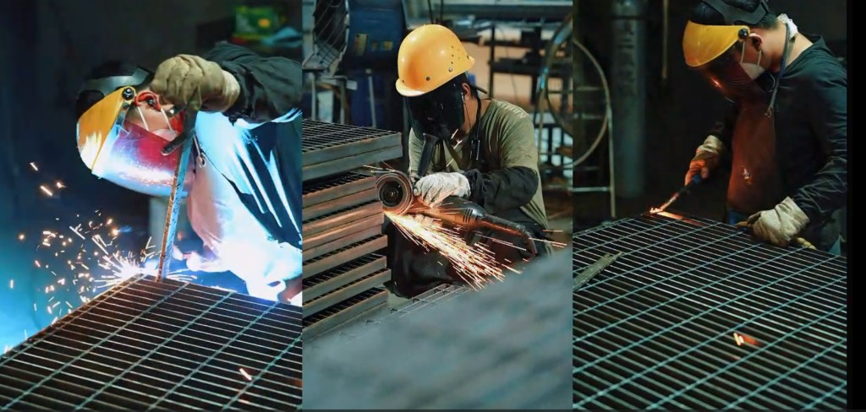

Customer Ordering Guide
How to specify, order, and receive
your steel grating from Wiberg
From inquiry to delivery — everything you need to know

Slide 2
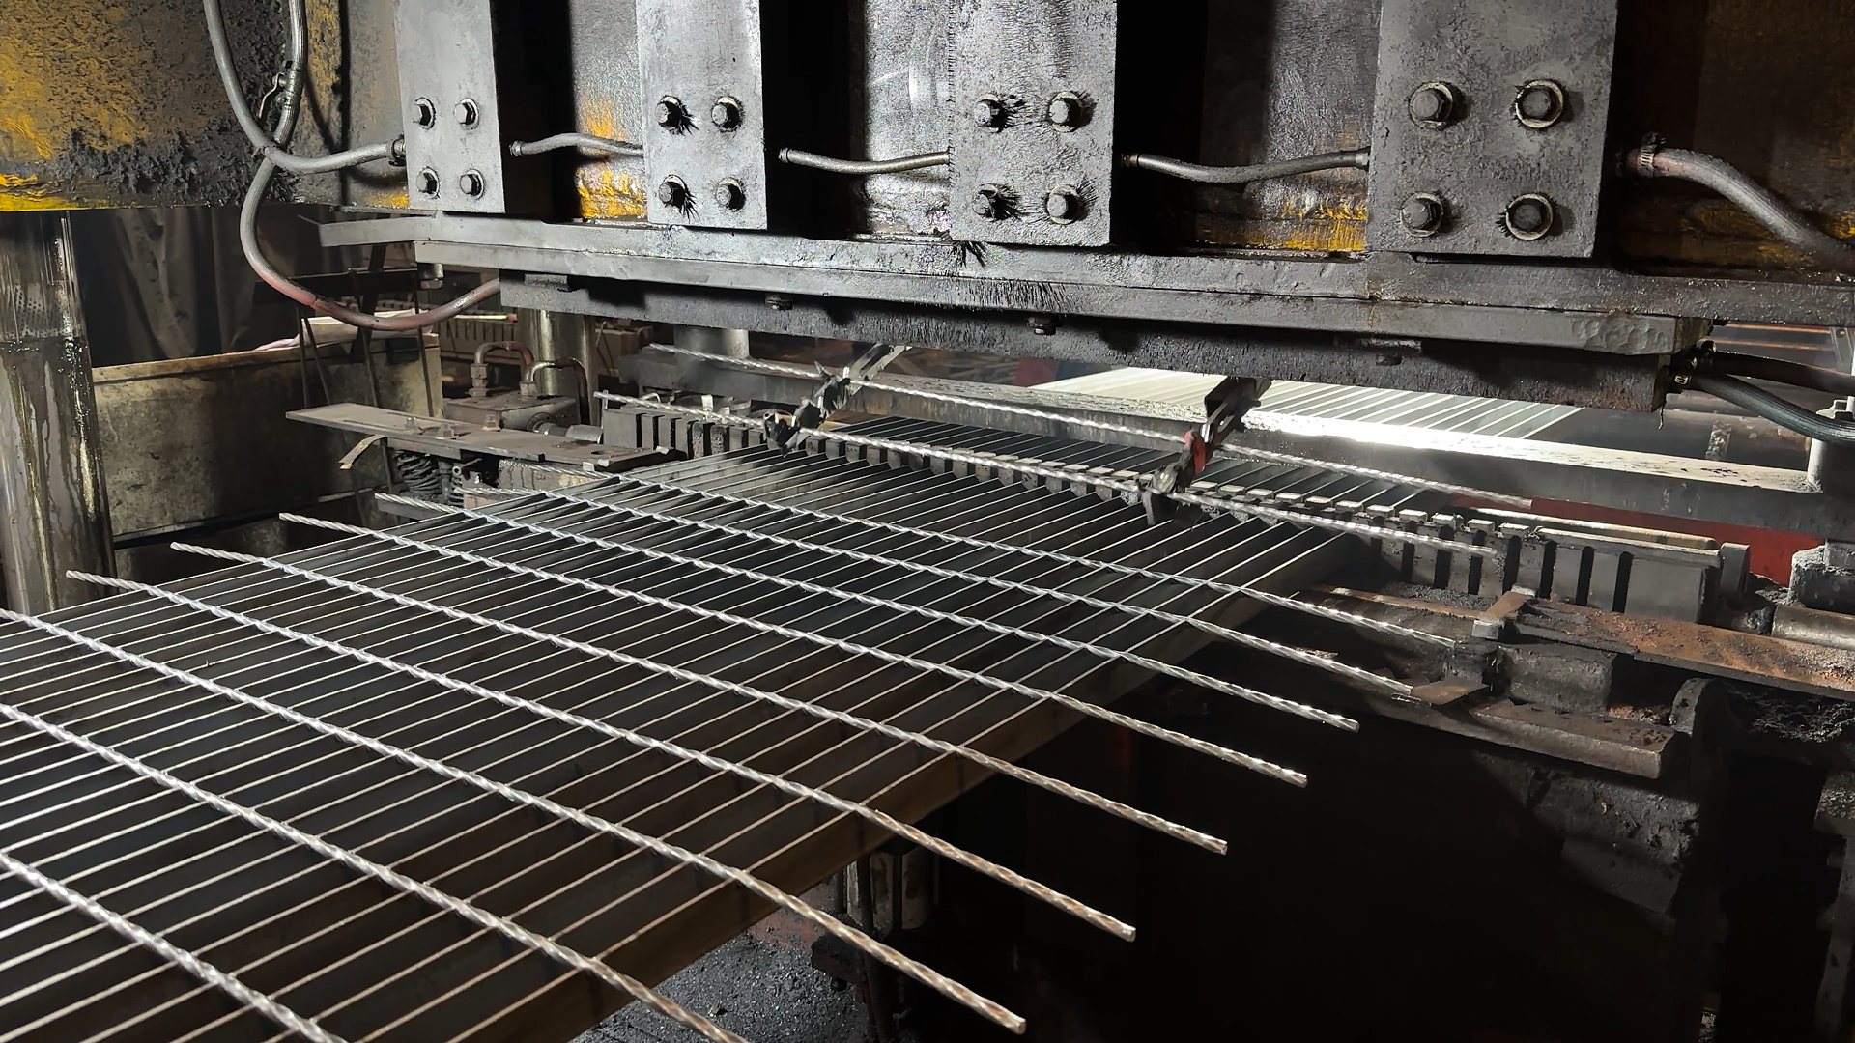
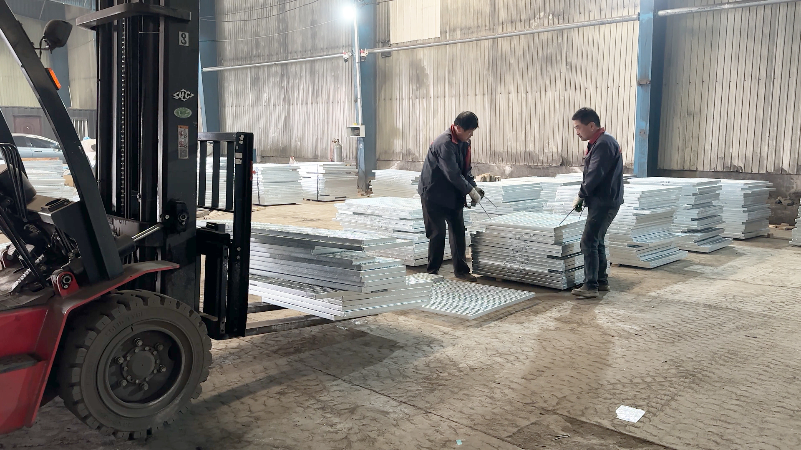
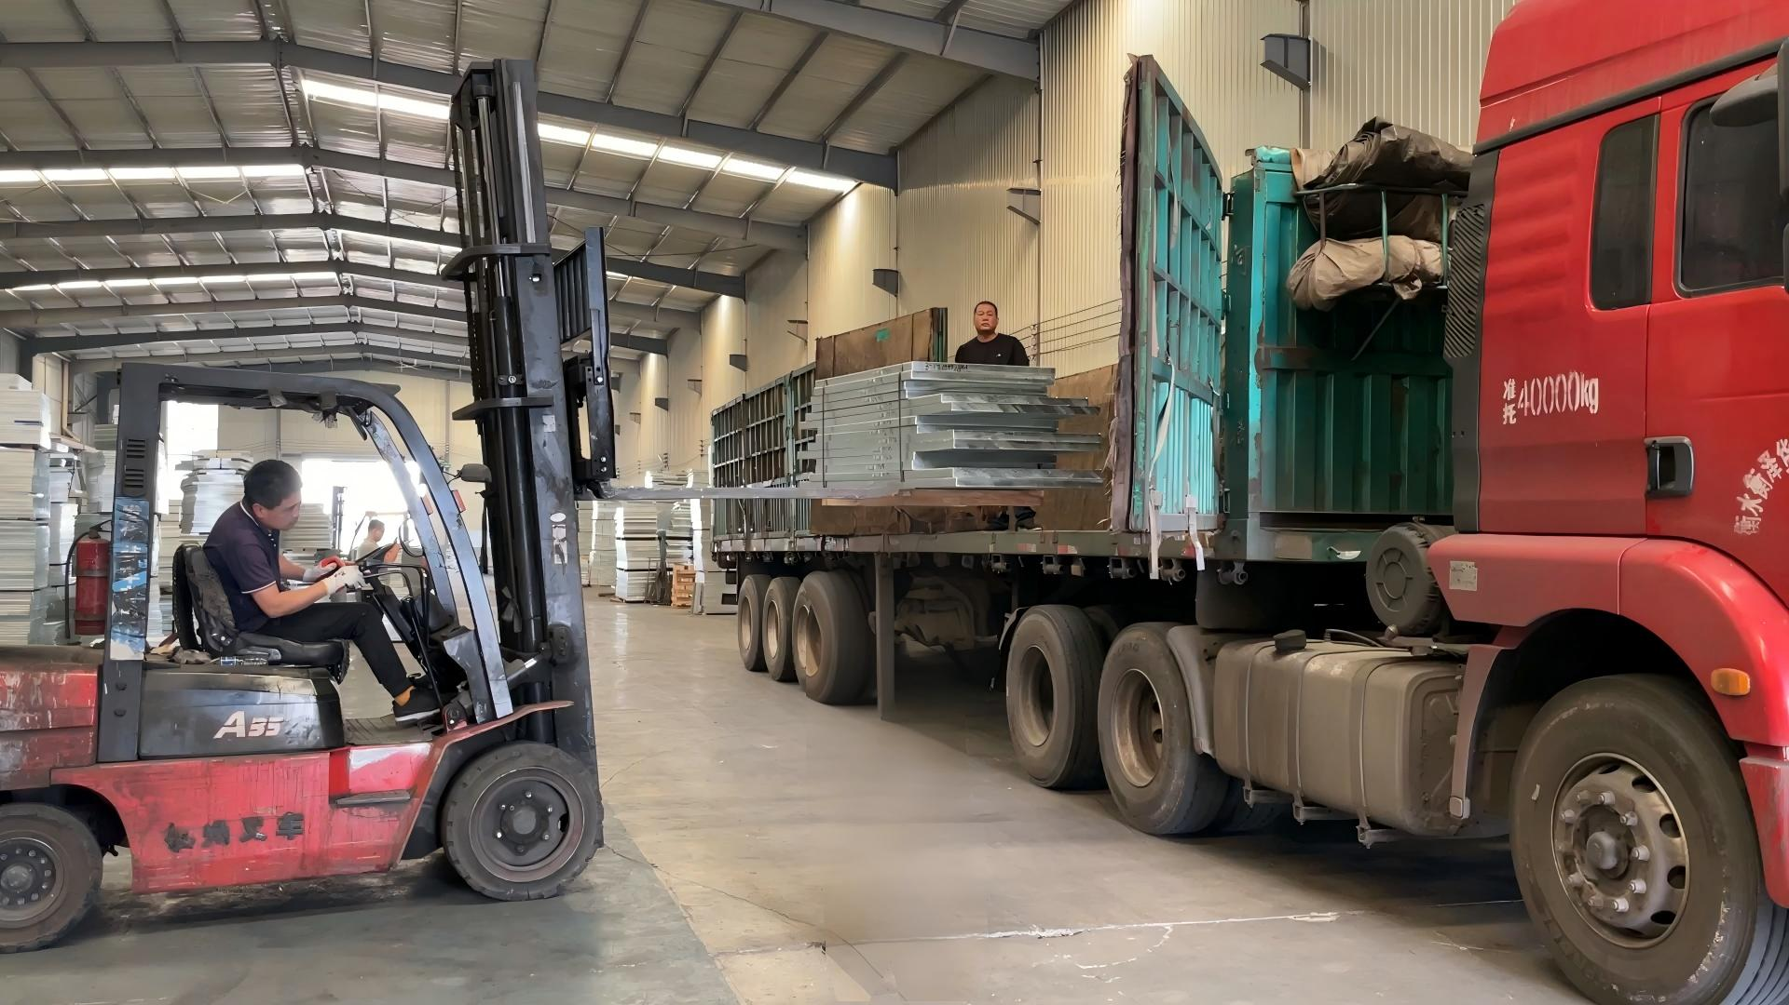
Order Process — From Inquiry to Delivery
1
2
3
4
5
6
Inquiry
Quotation
Order
Production
Shipping
Delivery
Send RFQ with product
type, spacing, material,
finish, size, quantity
Receive pricing,
technical confirmation,
and delivery schedule
Confirm PO, agree on
specs & payment terms,
shop drawings issued
Manufacturing, surface
treatment, QC inspection
and test reports
Export packing, container
loading, B/L & documents,
tracking provided
Arrival at destination
port or site, after-sales
support continues
Day 0
1–2 days
Day 3–5
15–25 days
3–5 days
15–35 days
Typical lead time: 4–8 weeks (inquiry to arrival), depending on quantity, complexity, and destination.
www.wiberg-grating.com | wibergmetal.com
2

Slide 3
What Information to Provide
The more complete your inquiry, the faster and more accurate our quotation.
✓
Product Type
Bar grating, stair treads, trench covers,
FRP grating, accessories, or platform packages
○
Load / Span
Design live load (kN/m² or psf), span,
deflection limit — helps verify bar size
✓
Spacing / Mesh
e.g. 30×100 (metric), 19-W-4 (US/NAAMM),
or "standard duty" — we'll confirm mapping
○
Drawings / Sketches
PDF, DWG, or hand sketch accepted.
Speeds up accurate quotation.
✓
Material & Finish
Carbon steel + HDG, stainless (304/316),
aluminum, painted, powder coated, untreated
○
Standards
Target standard: YB/T, ANSI/NAAMM,
EN, BS, AS — if specified by owner
✓
Panel Dimensions
Length × width (mm), bearing bar direction,
span, and support locations
○
Delivery Details
Destination port/site, incoterm
(FOB / CIF / DDP), timeline
✓
Quantity
Number of panels, m², or tonnes.
Approximate OK — we'll optimize.
○
Special Requirements
Cut-outs, banding, nosing, toe plates,
bolt holes, curved panels, platform assembly
✓ = Required for quotation ○ = Helpful (can discuss later)
www.wiberg-grating.com | wibergmetal.com
3

Slide 4
Product Quick-Reference
Product
Common Spec (metric)
Typical Use
Finish
Press-welded grating
30×100, 30×5 bar, 6mm cross
Platforms, walkways, mezzanines
HDG / painted
Close-mesh grating
20×50 or 30×50, 30×5
Pedestrian, heel-proof, ADA
HDG
Heavy-duty grating
40×100, 50×6 ~ 150×8 bar
Vehicle lanes, docks, heavy plant
HDG
Press-locked grating
30×100, 25×5 bar, flat cross
Architectural, clean finish
HDG / SS
Stair treads (welded)
T1–T3, 30×100 mesh, nosing
Industrial stairs, ladders
HDG + nosing
Stair treads (bolted)
T4–T6, bolt-on carriers
Retrofit, easy replacement
HDG + nosing
Trench / drain covers
30×100 or 30×50, framed
Plant trenches, drains, sumps
HDG / SS
FRP molded grating
38×38 mesh, 25/38 mm deep
Chemical, wet, non-conductive
As-molded
Accessories
Clips, brackets, banding, nosing
Fixing, edge trim, safety
Match grating
Not sure which product? Tell us the application and we'll recommend the right type.
www.wiberg-grating.com | wibergmetal.com
4

Slide 5
How to Read a Grating Specification
W-30-100, 30×5, Q235B, Serrated, Hot-Dip Galvanized
↑ Type ↑ Pitch ↑ Bar ↑ Steel ↑ Surface ↑ Finish
W / P / HD
Type
W = Welded, P = Press-locked, HD = Heavy-duty
30-100
Pitch (s₁ × s₂)
Bearing bar pitch 30 mm, cross bar pitch 100 mm
30×5
Bar size (H × T)
Bar height 30 mm, thickness 5 mm
Q235B / A36 / S235JR
Material grade
Steel grade — stainless quoted separately (304/316)
Plain / Serrated
Surface
Plain = smooth, Serrated = slip-resistant teeth
HDG / Painted / Untreated
Finish
Hot-dip galvanized (≥610 g/m²), powder coat, or bare
1000 × 6000
Panel size (L × W)
Net length × width in mm; state bearing bar direction
G305/30/100W
YB/T model code
Alternative designation per Chinese standard YB/T 4001.1
www.wiberg-grating.com | wibergmetal.com
5

Slide 6
Payment, Packing & Shipping
Payment Terms
Export Packing
Shipping & Logistics
• T/T: 30% deposit + 70% before shipment
• Steel strapping + plywood crate (standard)
• Incoterms: FOB Tianjin / CIF / DDP
• L/C at sight — accepted for larger orders
• Bundled with plastic corner protectors
• 20' GP / 40' GP / 40' HC / flat rack
• Other terms negotiable for repeat customers
• Fumigation-free plywood (ISPM-15)
• Container optimization for cost saving
• Currency: USD (EUR / RMB on request)
• Custom packing per buyer requirement
• Full B/L, packing list, CO, test certs
Documents Provided
✓ Commercial Invoice
✓ Mill Test Certificate (MTC / EN 10204 3.1)
✓ Packing List
✓ Galvanizing Certificate
✓ Bill of Lading (B/L)
✓ SGS / BV Inspection Report (optional)
✓ Certificate of Origin (CO)
✓ Shop Drawings (stamped)
www.wiberg-grating.com | wibergmetal.com
6

Slide 7
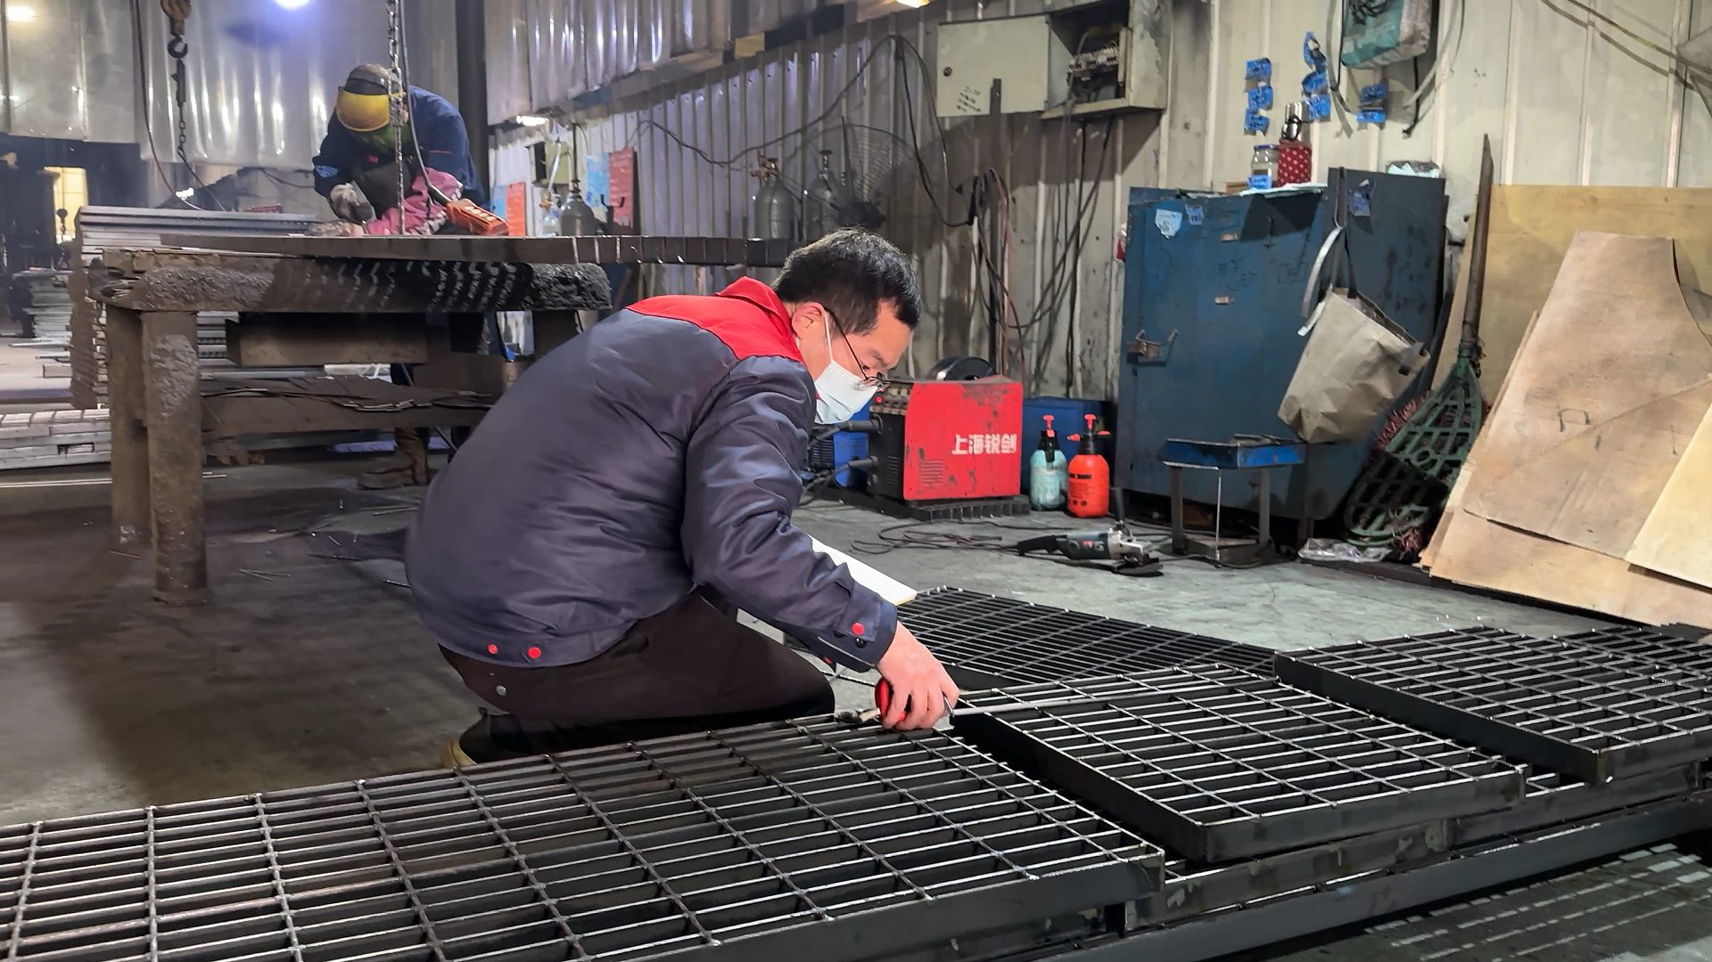
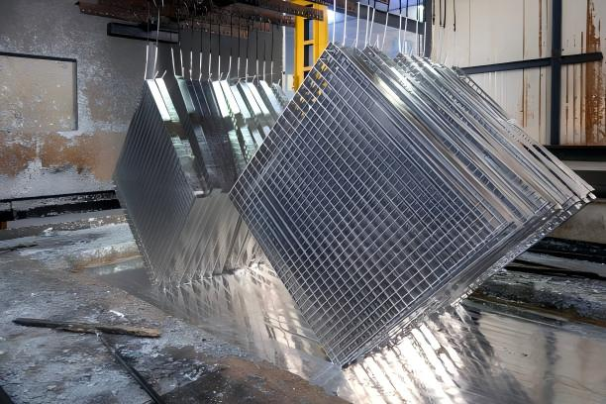
Quality Assurance
ISO 9001:2015
CE / EN 1090
Green Enterprise
SGS / BV
Quality management system
covering design, production,
inspection, and delivery
Structural steel certification
for European market
compliance
Environmental qualification
for sustainable manufacturing
processes
Third-party inspection
available on request
for pre-shipment QC
In-Process Quality Control
1. Raw material inspection — mill certs verified, bar dimensions checked
2. Welding QC — forge pressure monitoring, cross-bar pull-off test
3. Dimensional check — panel size, pitch, flatness tolerance per standard
4. Surface treatment — zinc coating thickness, adhesion test (HDG)
5. Final inspection — visual, dimensional, weight, and packing check
6. Loading supervision — container photos, loading plan, seal number recorded
www.wiberg-grating.com | wibergmetal.com
7

Slide 8
Ready to Order?
3 easy ways to start your inquiry:
1
2
3
Email Us
WhatsApp
Online RFQ
Send your requirements to
sales@wiberg-grating.com
or info@wibergmetal.com
Quick chat at
+86 132 7317 7087
Files & photos welcome
Fill out the form at
wibergmetal.com/rfq/
Upload drawings directly
Typical response: within 24 business hours · Mon–Sat 09:00–18:00 (UTC+8)
www.wiberg-grating.com | wibergmetal.com
ISO 9001 · CE / EN 1090 · SGS / BV Available
8

