Slide 1
HMM vs MEMM
Ivan Oropeza
Will Xie

Slide 2
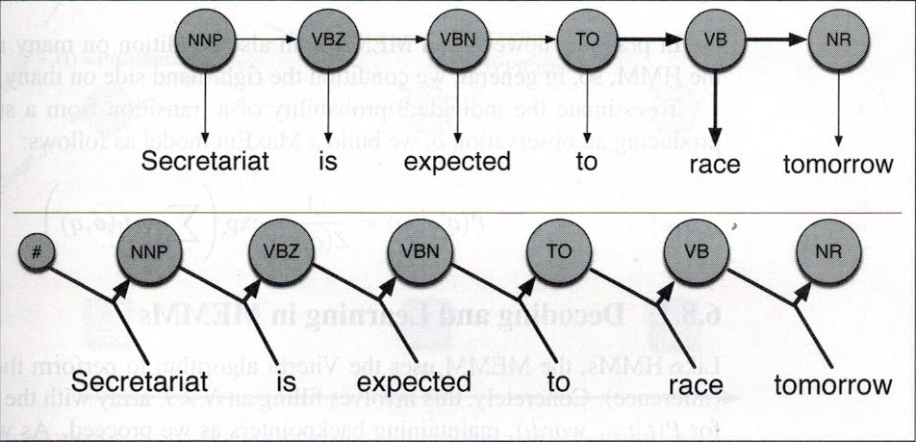
Maximum Entropy Markov Models (MEMM)
Models: P( C_t | O, C_t-1 ) instead of P( C_t | C_t-1 ), P( O | C_t )

Slide 3
Maximum Entropy Markov Models (MEMM)
Multinomial logistic regression model
Define set of features of observation and previous classification
Examples:
Words ending with “-ing” tend to be verbs
Capital letters are associated with nouns

Slide 4
Corpus
Brown
Wall Street Journal (WSJ)

Slide 5
Supervised Learning (HMM)
Emission_CPT = P( q_t | q_t-1 )
Transition_CPT = P( w_k | q_t )
q_t is state at time t and w_k is k_th symbol of observation sequence
Counting problem
P(q_t), P( w_k, q_t ), P( q_t, q_t-1 )

Slide 6
Smoothing
Sparse data → can't calculate all P( W | C )
Laplace Smoothing (add one smoothing)
P ( <U> | C ) = 1
P ( C ) ++

Slide 7
Preliminary Results
Cross Validation @ 20
82.27% accurately tagged words in WSJ
81.52% accurately tagged words in Brown
Brown is more general than WSJ
Helps explain difference in scores

