Slide 1
Part-of-speech (POS) Tagging Using Graphical Models
Ivan Oropeza and William Xie
November 17, 2014
CS 395T Graphical Models
Prof. Pradeep Ravikumar

Slide 2
POS Tagging For Text
POS tagging is helpful in understanding the semantics of a language.
The POS of a word is influenced by its definition and context
E.g. The race car was in a race.
(Adjective)
(Noun)
Notes:
Classic problem in NLP
Hard
Multiple part of speech
Semantic dependent
Debatable part of speech for some usage of words

Slide 3
POS Tagging methods
Hidden Markov Model (HMM)
Maximum Entropy Markov Model (MEMM)
Conditional Random Field (CRF)
Notes:
Traditionally done by hand
HMM: tags as hidden states
HMM: Viterbi, Baum-Welch

Slide 4
POS Tagging methods
Hidden Markov Model (HMM)
Maximum Entropy Markov Model (MEMM)
Conditional Random Field (CRF)

Slide 5
Maximum Entropy Model (MaxEnt)
Based on logistic regression
Generalized to multiple discrete-valued classes
Define features for observations using Indicator functions
Notes:
Discuss indicator function

Slide 6
Maximum Entropy Markov Models (MEMM)
Offspring of HMM and MaxEnt model
Incorporates specific features into HMMs
Words ending with “-ing” tend to be verbs
Capital letters are associated with proper nouns

Slide 7
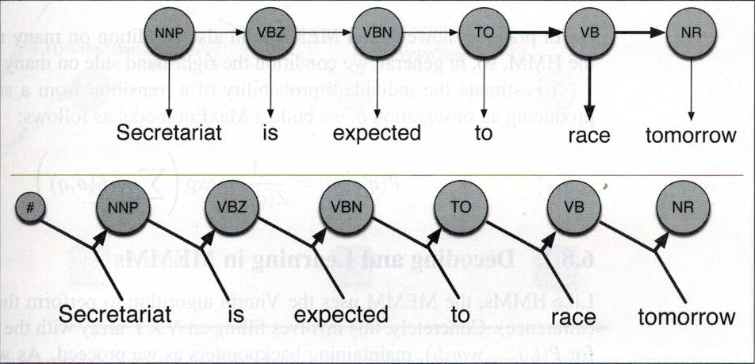
Maximum Entropy Markov Models (MEMM)
HMM:
MEMM:

Slide 8
Corpora
Brown Corpus
500 randomly chosen English language text
Each with 2,000 or more words
~ 1 million words
Wall Street Journal (WSJ) Corpus
Based on Wall Street Journal articles
~ 3 million words
Notes:
General / diverse vs specialized
Popular benchmark
Ease of accessibility

Slide 9
Brown Corpus Example
[ He/PRP ]
tried/VBD to/TO ignore/VB
[ what/WP ]
[ his/PRP$ own/JJ common/JJ sense/NN ]
told/VBD
[ him/PRP ]
,/, but/CC
[ it/PRP ]
[ was/VBD n't/RB possible/JJ ]
;/: ;/:
[ her/PRP$ motives/NNS ]
were/VBD too/RB blatant/JJ ./.
Notes:
General / diverse vs specialized
Popular benchmark
Ease of accessibility

Slide 10
Supervised Learning
A counting problem
Can find , ,
Transition probability, emission probability

Slide 11
Smoothing
Training with sparse data → can't calculate for words we did not see during the training phase
Laplace Smoothing (add one smoothing)
For emission probabilities:
Replace unknown word, , with

Slide 12
HMM Results
Cross Validation at 20
82.27% accurately tagged words in WSJ
81.52% accurately tagged words in Brown
WSJ corpus’s topics have less variations compared to Brown’s. Consequentially, the word choices across the corpus are similar.
Helps explain difference in scores

Slide 13
Remaining tasks
Implementation of MEMM
Compare the POS tag accuracy for tags with defined features
E.g. feature “-ing” for tag “verb”
Compare general accuracy between the two models

Slide 14
References
Daniel Jurafsky and James H. Martin. 2009. Speech and Language Processing (2nd Edition). Prentice-Hall, Inc., Upper Saddle River, NJ, USA.
Andrew McCallum, Dayne Freitag, and Fernando Pereira. 2000. Maximum Entropy Markov Models for Information Extraction and Segmentation. In Intl. Conf. on Machine Learning.
W. N. Francis and H. Kucera. 1979. Brown Corpus Manual. http://www.hit.uib.no/icame/brown/bcm.html
Eugene Charniak, Don Blaheta, Niyu Ge, Keith Hall, John Hale, and Mark Johnson. 2000. BLLIP 1987-89 WSJ Corpus Release 1. Philadelphia: Linguistic Data Consortium

