Slide 1
Machine Learning HW3 - Image Classiﬁcation

Slide 2
Objective
Solve image classiﬁcation with convolutional neural networks.
Improve the performance with data augmentations.
Understand how to utilize unlabeled data and how it beneﬁts.

Slide 3
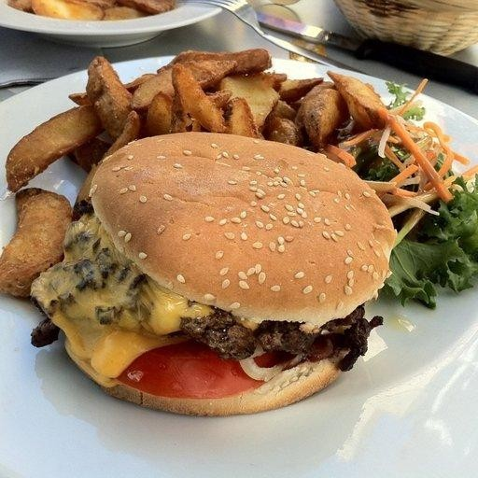
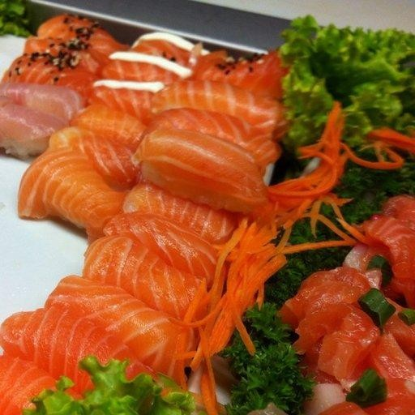
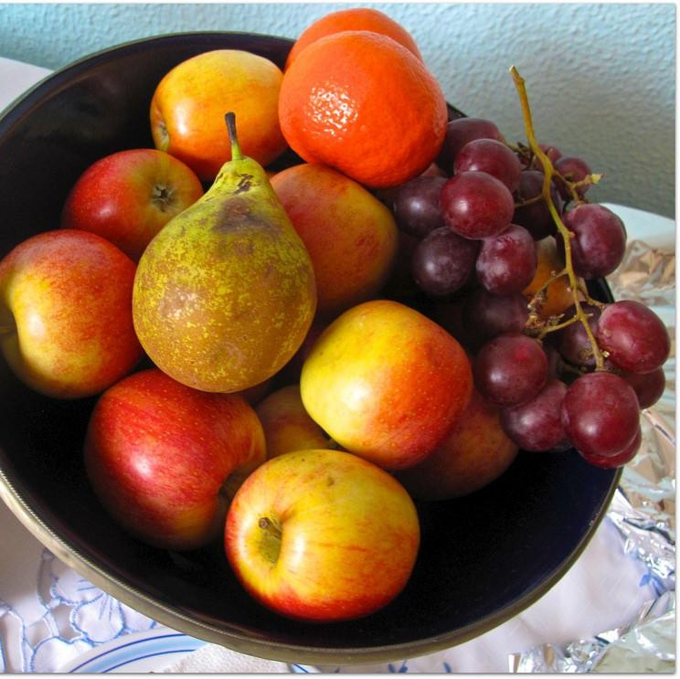
Task - Food Classiﬁcation

Slide 4
Task - Food Classiﬁcation
The images are collected from the food-11 dataset classiﬁed into 11 classes.
The dataset here is slightly modiﬁed:
Training set: 280 * 11 labeled images + 6786 unlabeled images
Validation set: 60 * 11 labeled images
Testing set: 3347 images
DO NOT utilize the original dataset or labels.
This is cheating.

Slide 5
Task - Food Classiﬁcation
logits
(not normalized)
probability (normalized)
-0.25
+3.02
0.004
0.114
+0.56 _{softmax} 0.009 -3.90 0.001
-0.01 | 0.005
+0.25 | 0.007
-0.47 | 0.003
+5.00 | 0.831
-1.32 | 0.001
+1.14 | 0.017
-0.28 | 0.004
CNN
model

Slide 6
Kaggle link: here
Requirements
This homework is in three levels:
Easy
Medium
Hard
You can easily ﬁnish the easy level by running the example code.
For the rest, we recommend you start with the same code.
We already prepared some TODO blocks for you.
DO NOT pre-train your model on other datasets.
If you use some well-known model architecture (e.g., ResNet), make sure
NOT to load pre-trained weights as initialization.
Sample code link: here

Slide 7
Requirements - Easy
Build a convolutional neural network using labeled images with provided codes.
Public simple baseline: 45.786 (accuracy, %)

Slide 8
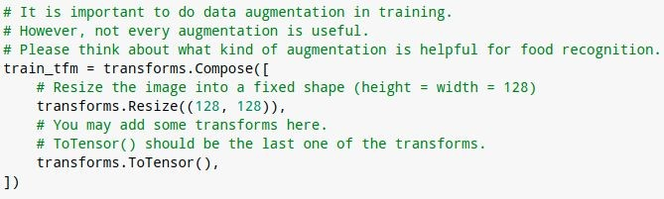
Requirements - Medium
Improve the performance using labeled images with diﬀerent model architectures or data augmentations.
Public medium baseline: 52.839 (accuracy, %)
You can achieve the baseline by adding a few lines to the example code.

Slide 9
Requirements - Hard
Improve the performance with additional unlabeled images.
Public strong baseline: 68.559 (accuracy, %)
Do it on your own (by ﬁnishing TODO blocks in the example code).
Using unlabeled testing data here is allowed.
Hint: semi-supervised learning, self-supervised learning

Slide 10
Semi-supervised Learning
There are many ways to do semi-supervised learning.
E.g., generate pseudo-labels for unlabeled data and train with them.
training
labeling
ﬁltering
labeled data
CNN
model
unlabeled data
subset of data
combining

Slide 11
training
labeling
ﬁltering
Pseudo-labels
labeled data
CNN
model
unlabeled data
subset of data
combining
logits
(not normalized)
probability (normalized)
-0.25
+3.02
+0.56
-3.90
-0.01
+0.25
-0.47
+5.00
-1.32
+1.14
-0.28
0.004
0.114
0.009
0.001
0.005
0.007
0.003
0.831
0.001
0.017
0.004
softmax
CNN
model
conﬁdent enough?
pseudo-label = 7
yes

Slide 12
Kaggle Submission Format
The submitted predictions should be in CSV format.
The ﬁrst row is “Id, Category”
The rest of rows are “{id}, {prediction}” (e.g., 0005, 8)
There should be (3347 + 1) rows in total.
Your submission name should be
<學號>_<科系縮寫>_<任意名稱>
Example:711183116_csie_ta
Id | Category
0001 | 0
0002 | 9
0003 | 4
0004 | 5

Slide 13
Grading Policy
Public simple baseline:
Public medium baseline:
Public strong baseline:
+1pt
+1pt
+1pt
Private simple baseline:
Private medium baseline:
Private strong baseline:
+1pt
+1pt
+1pt
Submit your code:
+4pt

Slide 14
Code Submission
Submit your code via 數位學苑.
<student_id>_hw3.zip
DO
Specify the source of your code. (You may refer to Academic Ethics Guidelines)
Organize your code and make it easy to read (not necessary).
DO NOT
Submit empty or garbage ﬁles.
Submit the dataset or model.
Compress your codes into other formats like .rar or .7z and simply rename it to .zip.
If we ﬁnd you cheating or your code problematic, you will be punished.
Course ﬁnal score * 0.9 for the ﬁrst time, or fail the course otherwise.

Slide 15
Bonus
If you successfully get 10 pts:
Your code will be made public to students.
You can submit a report in PDF format brieﬂy describing what you have done (in English, less than 100 words) for extra 0.5 pts.
Reports will also be made public to students.
Report template

Slide 16
Deadline
Kaggle deadline:
Code submission:
2023/04/15 23:59:59
2023/04/18 23:59:59
Late submissions are NOT accepted.

Slide 17
Should You Have Any Ǫuestions...
E-mail
kafuchino0410@gmail.com
The title must start with [hw3].

Slide 18
Useful Resources
Semi-supervised learning
https://speech.ee.ntu.edu.tw/~tlkagk/courses/ML_2016/Lecture/semi%20(v3).pdf
https://www.youtube.com/watch?v=fX_guE7JNnY&ab_channel=Hung-yiLee
MixMatch: https://arxiv.org/abs/1905.02249
Noisy student: https://arxiv.org/abs/1911.04252
PyTorch
https://pytorch.org/
Torchvision
http://pytorch.org/vision/stable/index.html

