Slide 1
Machine Learning HW4

Slide 2
Outline
Task Description
Dataset
Data segmentation
Kaggle
Guidelines

Slide 3
Task Introduction
Self-attention
Proposed in GOOGLE's work, Attention is all you need . It combines the strengths of RNN (consider whole sequence) and CNN (processing parallelly).
Main goal: Learn how to use transformer.

Slide 4
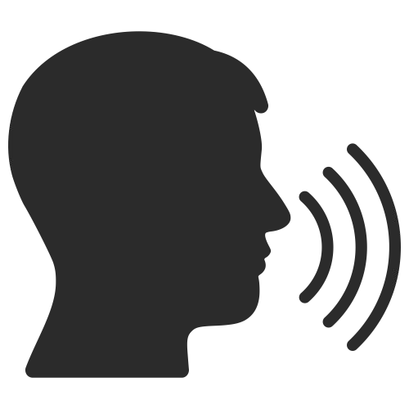

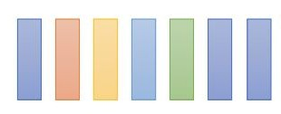
HW2: Phoneme classiﬁcation
Machine
Task: Multiclass Classiﬁcation
Framewise phoneme prediction from speech.
M M M AH AH SH SH IH IH IH N N N N ...
What is a phoneme?
A unit of speech sound in a language that can serve to distinguish one word from the other.
bat / pat , bad / bed
Machine Learning → M AH SH IH N L ER N IH NG

Slide 5
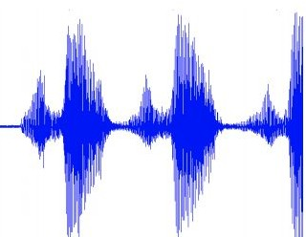
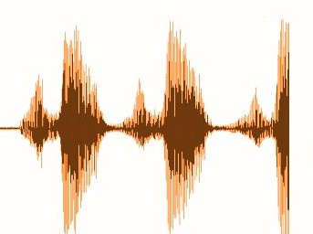


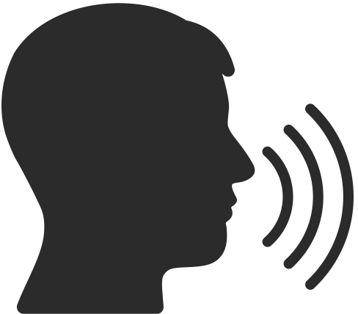
HW4: Speaker classiﬁcation
Task: Multiclass Classiﬁcation
Predict speaker class from given speech.
Speaker 1
Speaker 2

Slide 6
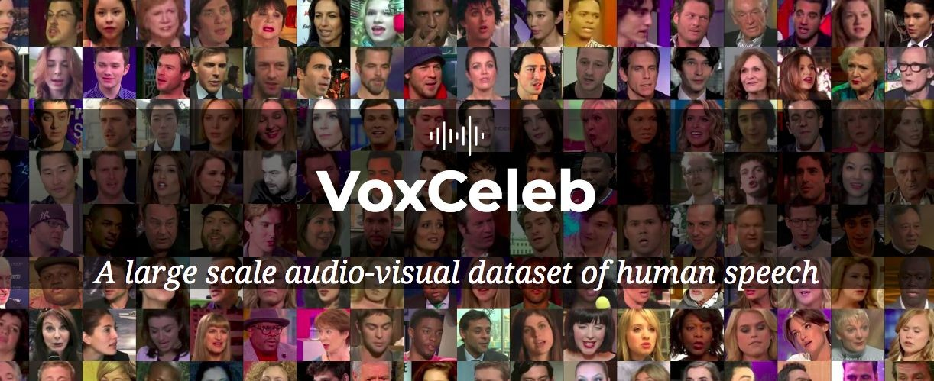
Dataset
Training: 69438 processed audio features with labels.
Testing: 6000 processed audio features without labels.
Label: 600 classes in total, each class represents a speaker.

Slide 7
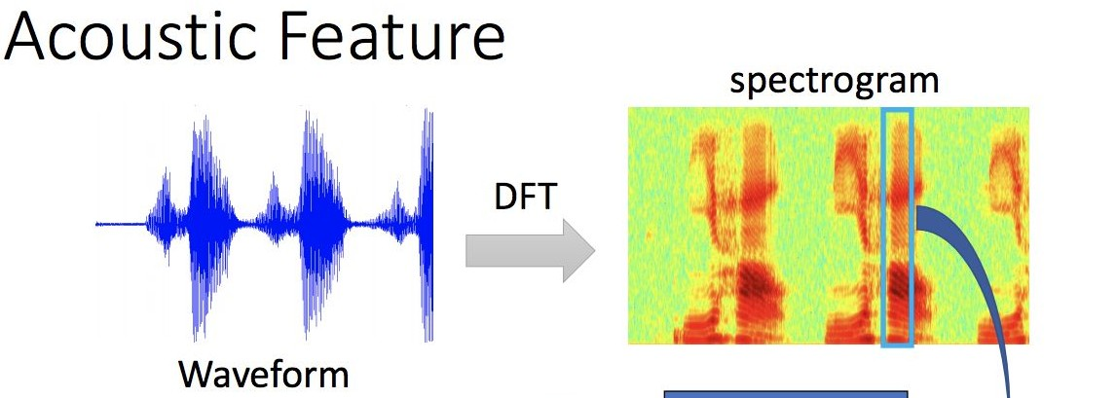
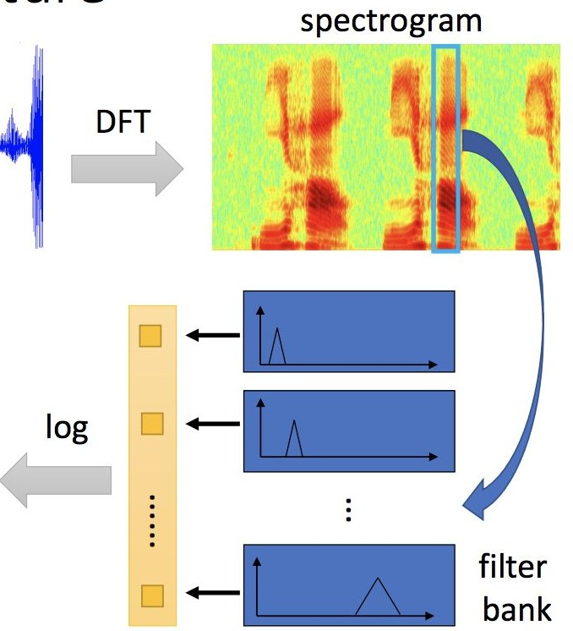
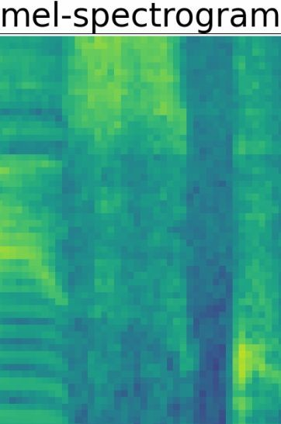
Data Preprocessing
ref.
prof. Hung-Yi Lee [2020Spring DLHLP] Speech Recognition

Slide 8
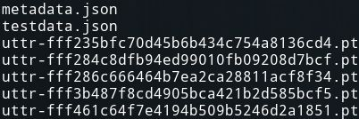
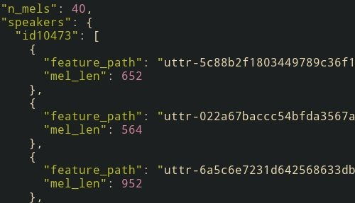
Data formats
Data Directory
metadata.json
testdata.json
mapping.json
uttr-{random string}.pt
The information in metadata
"n_mels": The dimention of mel-spectrogram.
"speakers": A dictionary.
Key: speaker ids.
value: "feature_path" and "mel_len"

Slide 9
Data segmentation during training
Diﬀerent length

Slide 10
Data segmentation during training
Diﬀerent length
Segment during training
Segment = 2

Slide 11
Sample Code
Colab Link: link
Baselines:
Simple: Run sample code and know how to use transformer.
Medium: Know how to adjust parameters of transformer.
Hard: Construct conformer which is a variety of transformer.

Slide 12
Requirements- Simple
Build a self-attention network to classify the speaker with the sample code.
Simple public baseline: 0.82

Slide 13
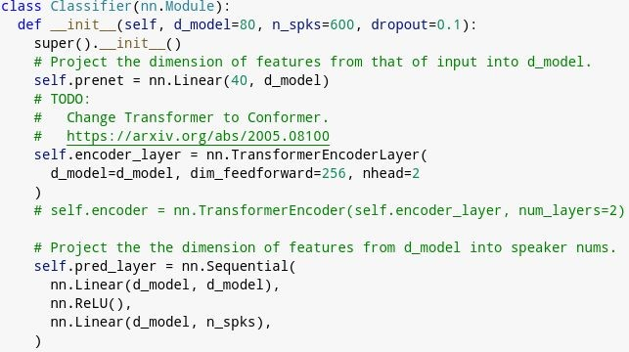
Requirements- Medium
Modify the parameters of the transformer modules in the sample code.
Medium public baseline: 0.88066

Slide 14
Requirements- Hard
Improve the performance by constructing the conformer layer.
Hard public baseline: 0.95166

Slide 15
Grading
Evaluate Metrics = @1 Accuracy。
Simple baseline (public)
Simple baseline (private)
+1 pt (sample code)
+1 pt (sample code)
+1 pt
+1 pt
+1 pt
+1 pt
+4 pts
Medium baseline (public)
Medium baseline (private)
Hard baseline (public)
Hard baseline (private)
Upload code to 數位學院
Total: 10 pts

Slide 16
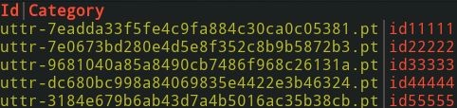
Submission Format
"Id, Category" split by ',' in the ﬁrst row。
Followed by 6000 lines of "ﬁlename, speaker name" split by ','.

Slide 17
Deadlines
Kaggle: 2023/05/9 23:59 (UTC+8)
數位學院: 2023/05/10 23:59 (UTC+8)

Slide 18
Grading - Bonus
If you got 10 points, we make your code public to the whole class.
In this case, if you also submit a PDF report brieﬂy describing your methods (<100 words in English), you get a bonus of 0.5 pt. (your report will also be available to all students)

Slide 19
Code Submission
數位學院 (4pts)
Your submission name should be
<學號>_<科系縮寫>_<任意名稱>
Example:410785007_csie_ta
We can only see your last submission.
Do not submit your model or dataset.
If your code is not reasonable, your semester grade x 0.9.

Slide 20

Code Submission
Your .zip ﬁle should include only
Code: either .py or .ipynb
Report: .pdf (only for those who got 10 points)
Example:

Slide 21
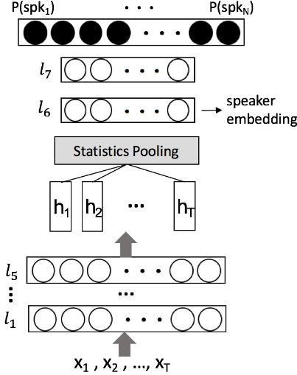
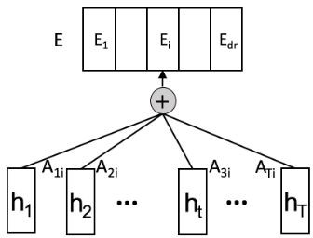
Hints
Self-Attentive Speaker Embeddings: link
replace with
Speaker classiﬁcation system
Self-attention pooling

Slide 22
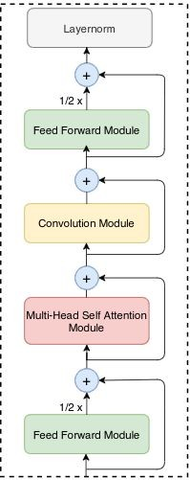
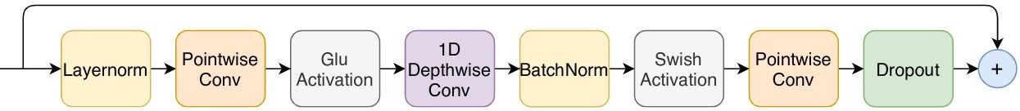
Hints
Conformer: link

Slide 23
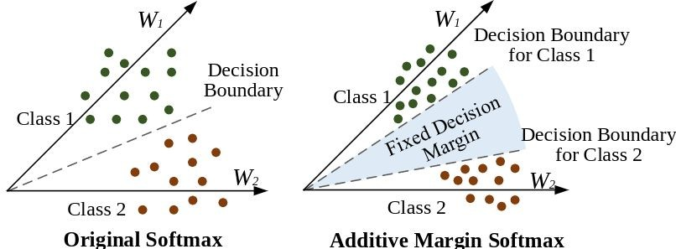
Hints
Additive margin softmax: link

Slide 24
Regulation
You should NOT plagiarize, if you use any other resource, you should cite it in the reference. (＊)
You should NOT modify your prediction ﬁles manually.
Do NOT share codes or prediction ﬁles with any living creatures.
Do NOT use any approaches to submit your results more than 5 times a day.
Do NOT search or use additional data or pre-trained models.
Your ﬁnal grade x 0.9 if you violate any of the above rules.
Prof. Lee & TAs preserve the rights to change the rules & grades.
(＊) Academic Ethics Guidelines for Researchers by the Ministry of Science and Technology

Slide 25
If any questions, you can ask us via...xs
Email
maypp555@gmail.comThe title should begin with “[hw4]”

